Slide 1
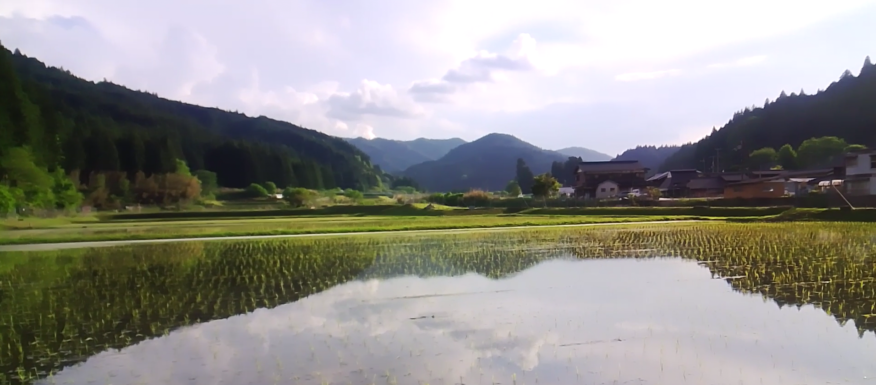
YR-DESIGN · SAFECAST
IMPACT INVESTMENT PROSPECTUS · インパクト投資
NARA, JAPAN · 2026
A 25-YEAR MODEL FOR RURAL REGENERATION
Mitsue Project
御杖プロジェクト
Restored forest, local clean energy, and a community-owned data center — one integrated system, openly documented for any village to follow.
森林再生・地域エネルギー・コミュニティ所有のデータセンター。どの集落も辿れる、公開された統合モデル。
Mitsue Village · 御杖村, Nara
HORIZON · 期間
PHASE · 段階
ADVISORS · 顧問
25 years
0 · Pre-foundation
Ozzie · Dome
Notes:
Good morning, and thank you for being here. What you're looking at is a village in eastern Nara called Mitsue — ninety-three percent forest, fewer than fifteen hundred people, and getting smaller every year. Over the next ten minutes I want to show you why we think this particular village is the right place to prove something much larger: that rural decline can be reversed with a model that pays for itself, and that what works here can be copied anywhere. This is an invitation to invest in that proof.

Slide 2
THE THESIS · 命題 · 02
A replicable model for rural regeneration.
地方再生の、再現可能なモデル。
Forest
Energy
Compute
森林再生
地域エネルギー
演算 — エンジン
Aged cedar restored to native broadleaf — turning a liability into feedstock and habitat.
Biomass heat and existing solar — local power, kept local, with the grid as backup.
A community-owned data center — the revenue engine that finances everything else.
Key idea
The data center is the engine. The forest and the village are the return. データセンターはエンジン、森と集落がリターン。
Notes:
Let me start with the idea itself, because it's simple. Most rural revitalization fails because it depends on subsidy that never ends. Ours is built the other way around: three activities — restoring the forest, generating clean energy, and running a small community-owned data center — wired together so that each one feeds the next, and the whole thing eventually funds itself. And here's the part I most want you to hold onto: the data center is not the point. It is the engine. The forest, the jobs, and the village's future are the return on it.

Slide 3
THE CHALLENGE · 現状の課題 · 03
Four problems — or four raw materials
四つの課題は、見方を変えれば四つの資源。
<1,500
93%
1
~92%
Residents, and falling
Forest, much unmanaged
Closed school
Energy imported
人口減少・高齢化（65歳以上が過半）
森林率93%・放置された人工林
旧御杖小学校 — 維持費のかかる遊休資産
エネルギーの大半を域外に依存
An aging community that needs new work and reasons to stay.
Aged cedar: a pollen, fire and landslide liability — and a fuel.
A maintained building earning nothing — ready to be repurposed.
Money leaves the village every month to buy power and fuel.
Population & forest: Mitsue Village statistics / Census. Energy import share illustrative — Japan Energy Database indicators. 出典：御杖村統計・国勢調査／エネルギーは試算
Notes:
So what are we starting with? Be honest about it. The population is under fifteen hundred and projected to roughly halve again; more than half of who remains will be over sixty-five. The mountains are ninety-three percent forest, but most of it is aging cedar plantation that nobody is managing — a pollen and landslide liability, not an asset. The elementary school closed and now costs the village money to stand empty. And almost every yen of energy is bought from outside and shipped in. Four problems — but notice they are also four raw materials.

Slide 4
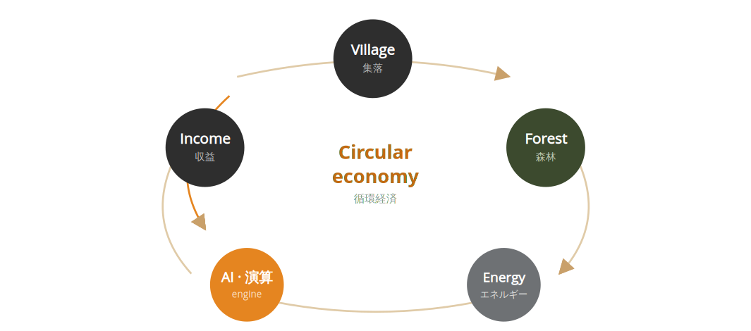
THE CIRCULAR MODEL · 循環モデル · 04
A loop, not a line
Each output is the next input. Revenue returns to the forest and the village.
直線ではなく、循環。各段階が次を支える。
収益は森と集落へ還る。
Notes:
Here is how the four raw materials connect. Start anywhere — say the village. The village manages the forest. The forest yields timber and fuel. That fuel makes heat and power. That energy runs a small data center. The data center earns revenue. And the revenue flows back into the forest, the jobs, and the village. It's a loop, not a line — a circular economy where the output of each step is the input to the next. Subsidy might prime it, but the loop is designed to keep turning on its own.

Slide 5
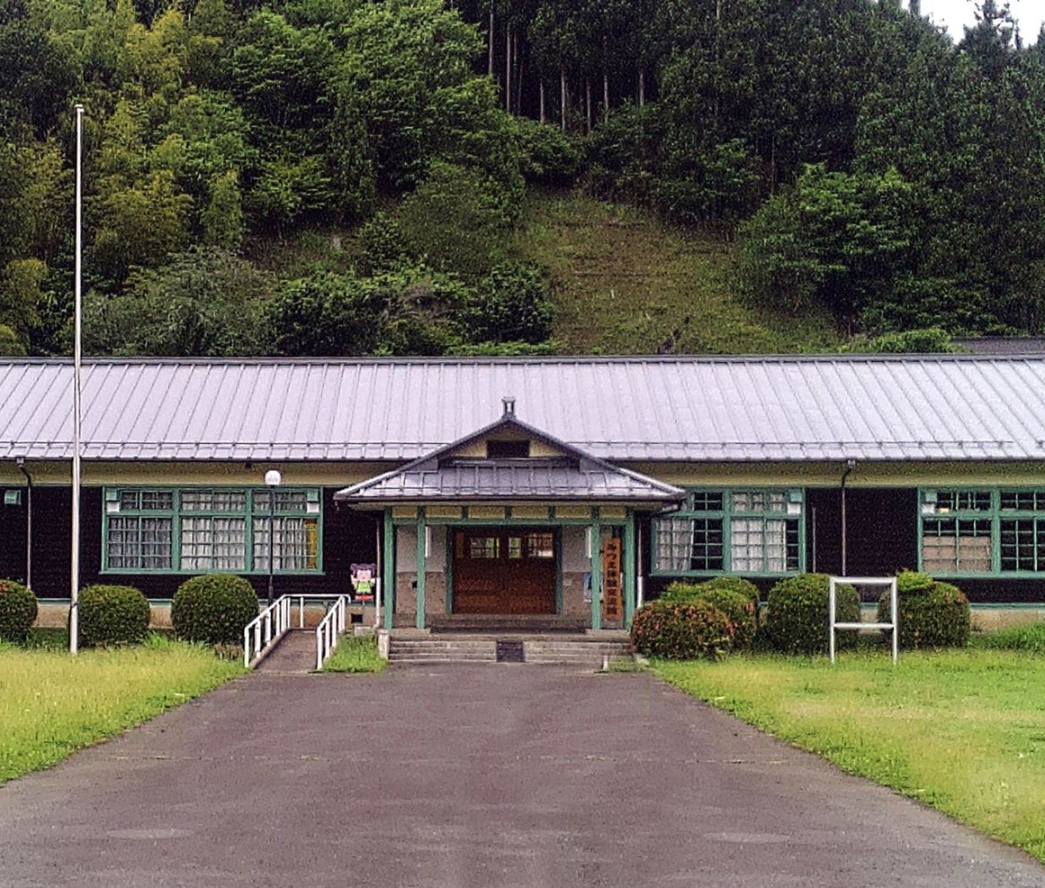
THE ENGINE · エンジン · 05
A community-owned data center
コミュニティ所有の小規模データセンター
The closed Mitsue Elementary School, repurposed as a small, energy-efficient edge & AI compute facility — powered entirely by local renewable energy, owned by the community it serves.
01
Sized for accountability & ownership, not hyperscale economics.
02
Reuses a stranded public asset instead of building new.
03
Generates the recurring revenue that funds the loop.
Former Mitsue Elementary · 旧御杖小学校
Notes:
Let's talk about the engine, because it's the part that makes this an investment and not a donation. We take the closed elementary school and turn it into a small, energy-efficient data center — edge and AI compute, powered by local renewable energy. It is deliberately modest: sized for accountability and community ownership, not hyperscale. But it produces something the forest and the village never could on their own — recurring digital revenue. That revenue is what funds the restoration, the jobs, and the charging network, year after year.

Slide 6
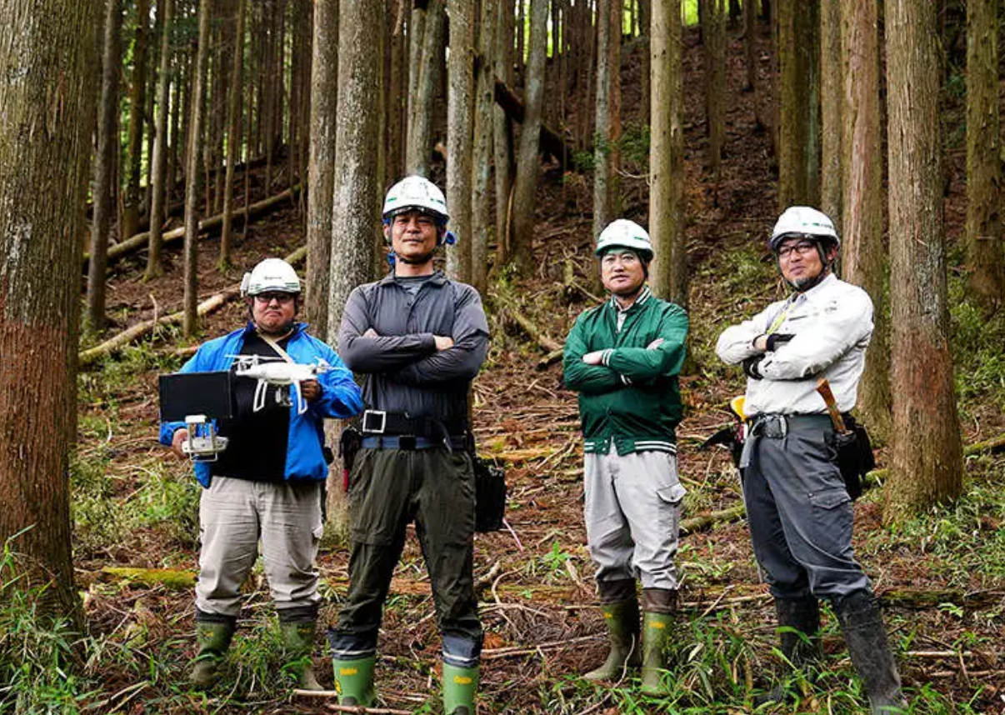
FOREST RESTORATION · 森林再生 · 06
From liability to asset
負債から資産へ — 25年の生態系再生。
Today · 現状
Aged sugi cedar monoculture — pollen, landslide and fire risk, little habitat.
↓ 25-year phased restoration
2050 · 想定
Native broadleaf forest — biodiversity, water retention, timber & biomass.
Thinnings → energy feedstock 間伐材を燃料に
Biodiversity & watershed 生物多様性と水源
J-Credits revenue layer Jクレジット収益
In cooperation with private landowners, the Mitsue Forestry Cooperative, and the Forestry Agency (林野庁).
Notes:
The forest is where the environmental return lives, and it's a twenty-five year job by nature. Post-war Japan planted enormous monocultures of sugi cedar that were never thinned. We replace them, in phases, with native broadleaf species — working alongside the landowners, the village forestry cooperative, and the Forestry Agency. That does three things at once: it pulls the aging plantation down as fuel for the energy system, it brings back biodiversity and water retention, and it earns carbon credits. The liability becomes the feedstock.

Slide 7
ENERGY SYSTEM · エネルギー設計 · 07
Power first — for compute & charging
電力優先 — データセンターとEV充電へ。
1 · Power first
Electricity runs the AI data center and the EV charging network — the demand we are building for. 電力をデータセンターとEV充電へ。
THE REALISTIC MIX · 現実的な電源構成
Biomass
Baseload power · ベースロード電源
Existing solar
Daytime generation · 日中の太陽光
Grid
Backup & peaks · 系統（バックアップ）
2 · Heat, captured second
Not biomass alone, and not a replacement for the village's solar — a resilient blend.
Recovered heat is a by-product we will use as demand emerges — no committed off-taker yet. 排熱は需要が定まり次第活用。
Notes:
Let me be clear about the priority, because it drives everything downstream. Power comes first. The whole point is electricity — to run the AI data center and to build out EV charging for residents and visitors. That is the demand we are designing around. Heat is real and we will capture it, but it comes second: we do not have a committed heat off-taker yet, so we treat recovered heat as an opportunity to develop, not a foundation to depend on. The supply mix is unchanged — biomass for baseload, the village's existing solar by day, the grid for backup — but it is pointed squarely at compute and mobility.

Slide 8
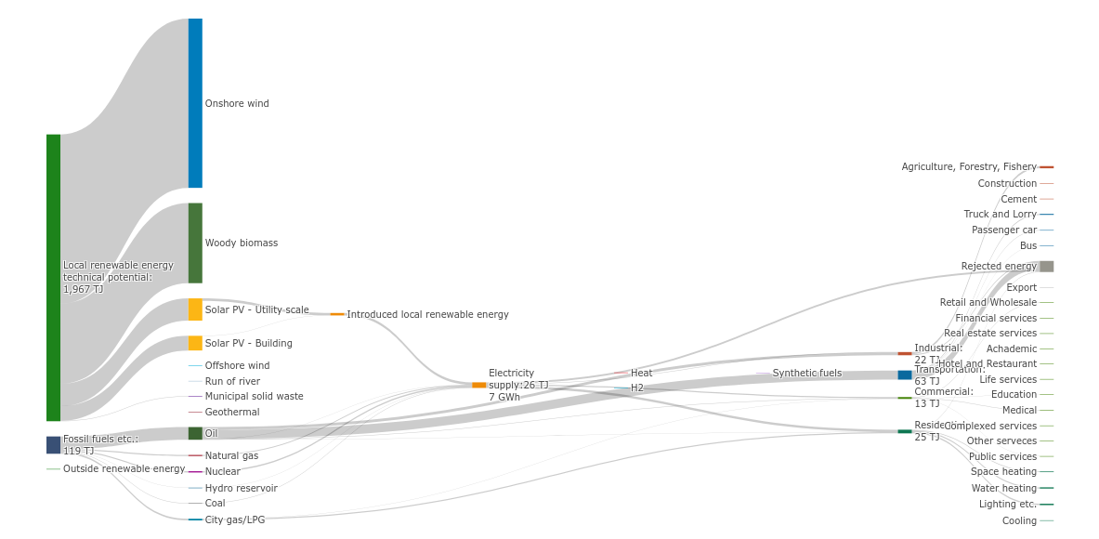
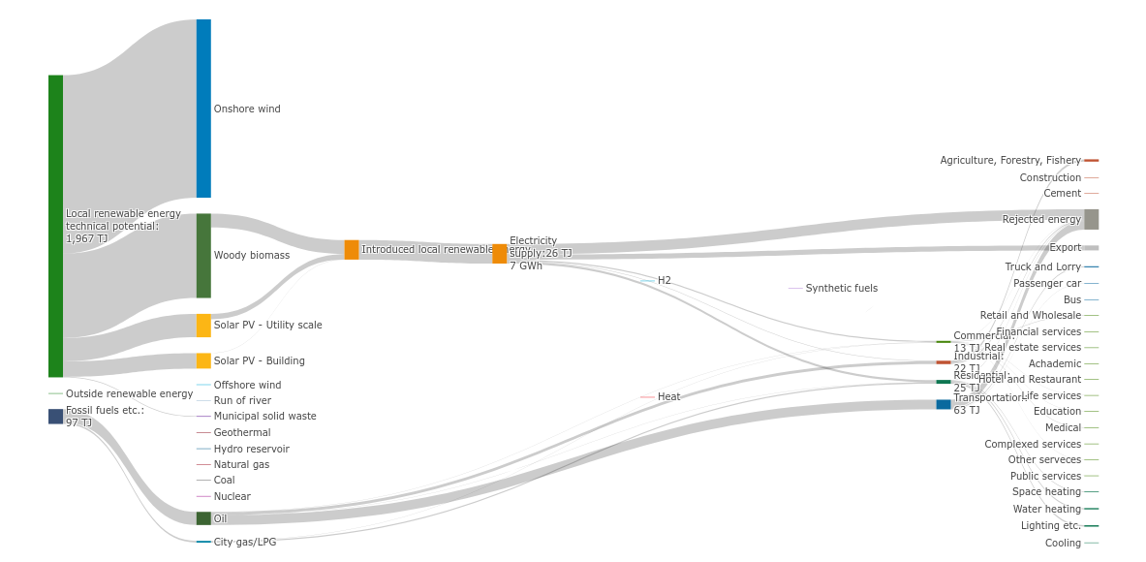
BIOMASS OPPORTUNITY · バイオマスの可能性 · 08
Untapped — but not for long
地域再生可能エネルギーポテンシャル 1,967 TJ — 木質バイオマスが最大の柱
2022 BASELINE · Fossil fuels: 119 TJ · Minimal renewables in use
2032 TARGET · Fossil fuels: 97 TJ · Local renewables introduced
THE BIOMASS CASE
The right bar in both diagrams shows 1,967 TJ of local renewable energy potential — woody biomass (dark green) is the dominant resource by far. Today, almost none is captured. The Mitsue Project changes that: sugi thinnings feed a CHP unit, generating baseload electricity and heat year-round. Every cubic metre of timber harvested for forest restoration becomes fuel — closing the loop between reforestation and energy self-sufficiency.
Indicators: Japan Energy Database (Tohoku University, CC BY-NC). Mitsue values illustrative — confirm via Future Energy Simulator. 出典：地域エネルギー需給データベース／数値は試算

Slide 9
PROFILE IN NUMBERS · 現状と将来 · 08
From dependence to surplus
依存から余剰へ — エネルギー自立への転換
Today · 現状
2050 · 想定
Energy self-sufficiency 自給率
▲ +107pt
Import dependency 域外依存率
▼ −67pt
TODAY
8%
TODAY
92%
2050
115%
2050
25%
Energy trade balance 経済収支
flips +
Energy-related CO₂ CO₂排出量
▼ −73%
TODAY
−¥2.0億
TODAY
11 kt
+¥0.8億
3 kt
2050
2050
Indicators: Japan Energy Database (Tohoku University, CC BY-NC). Mitsue values illustrative — confirm via Future Energy Simulator. 出典：地域エネルギー需給データベース／数値は試算
Notes:
Now the numbers — and these are the indicators a Japanese municipality is actually measured on, from the national Energy Database. Today Mitsue is almost completely energy-dependent: self-sufficiency in single digits, ninety percent of its energy imported, money flowing out, and the emissions that come with all that fossil fuel. The scenario on the right is where the integrated system takes us by twenty-fifty: a net energy exporter, dependency cut to a quarter, the trade balance flipped from negative to positive, and emissions down roughly three-quarters. I want to be straight with you — these are illustrative figures pending the simulator run, but the direction is not in doubt.

Slide 10
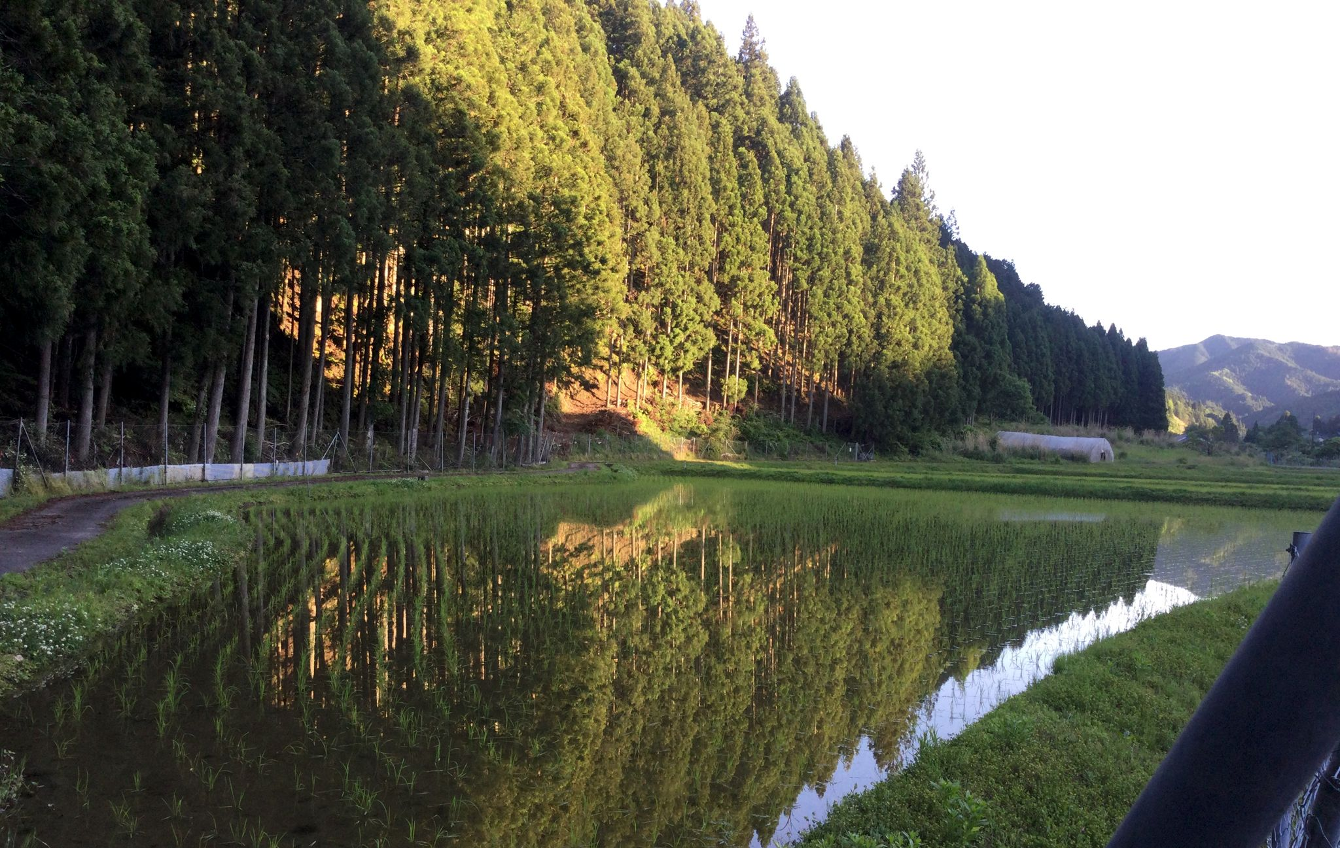
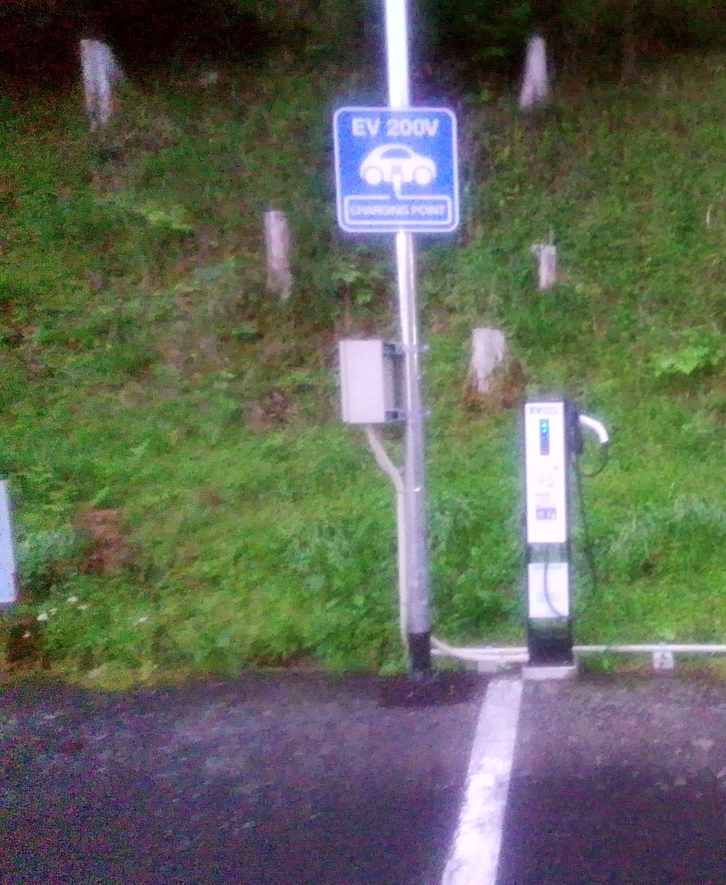
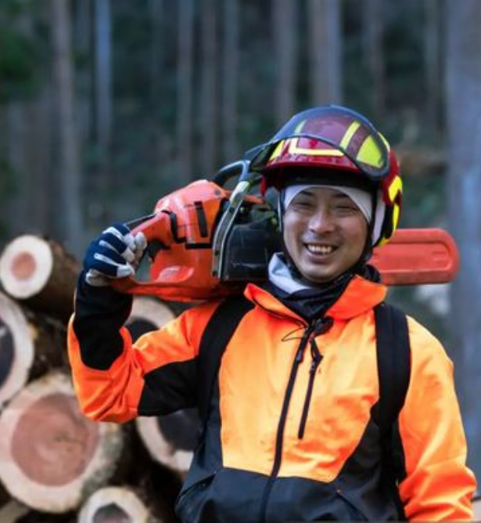
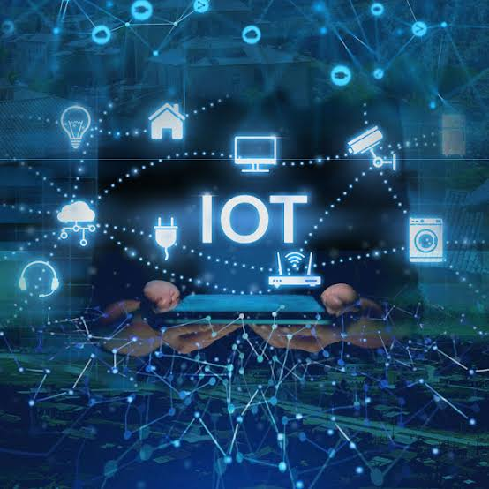

FIVE RETURNS · 五つのリターン · 09
One investment, five returns
一つの投資が、五つのリターンを生む。
Ecological
Energy
Economic
Digital
Knowledge
生態系
エネルギー
経済
デジタル
知識（公開）
Restored watershed, biodiversity, carbon drawdown.
Self-supply and an end to exported cash.
Jobs in forestry, operations and hosting.
Edge compute & connectivity for rural Japan.
Open-licensed — the multiplier other villages copy.
Notes:
So what does an investor actually get back? Not one return — five, and they compound. Ecological: a restored watershed and carbon drawn down. Energy: a village that powers itself and stops exporting cash. Economic: new jobs in forestry, operations and hosting. Digital: edge compute and connectivity that rural Japan badly lacks. And knowledge: because we publish everything under open licences, every lesson here becomes a template other villages can lift. That last one is the multiplier — it's how one village becomes a movement.

Slide 11
PHASED EXECUTION · 段階的実行 · 10
Five phases, gated by funding
資金ゲートで区切られた五段階 — 早すぎる拡大はしない。
Phase 0
Phase 1
Phase 2
Phase 3
Phase 4
Pre-foundation
Foundation
G2
Pilot design
G3
Pilot build
G4
Operate & scale
Months 1–3
G1
Months 4–9
¥30–50M
Months 10–18
¥80–200M
Months 19–30
Months 31+
¥0–0.5M
¥3–8M
¥3–8M
¥15–30M
¥80–200M
Revenue
Variable
Trust, founding team, charter
Legal entity, feasibility, advisors
Engineering, partners, permits
First-stage build, commissioning
Operations, monitoring, replication
◀ YOU ARE HERE
Miss a gate → hold & re-pitch or descope. Never accelerate into an under-resourced phase. ゲート未達なら保留・縮小。
Notes:
This is the part that should make a funder comfortable. We are not asking for one big cheque. The first three years are five phases, and between each phase there is a funding gate. You only unlock the next phase by clearing the last one — and if we fall short at a gate, the plan is explicit: we hold and re-pitch, or we descope. We do not accelerate into an under-resourced phase. Right now we are in Phase Zero, pre-foundation, self-funded, no press, no website — exactly where a careful project should be before it asks for money.

Slide 12
FUNDING STACK · 資金構成 · 11
Five layers, staged over three years
YEAR 1 → YEAR 3
五層の資金 — 単一財源に依存しない。
¥11M → ¥134M
SOURCE · 財源
YEAR 1
YEAR 3
L1
Founder / private capital 自己資金
¥3M
¥1M
L2
Government grants 補助金（NEDO・METI・奈良県・村）
¥5M
¥80M
L3
Foundations 財団（日本財団 ほか）
¥3M
¥20M
L4
Corporate partnerships 企業連携（CSR・蘭日）
—
¥30M
L5
Operating revenue 事業収益（ホスティング・FIT・EV・Jクレジット）
—
¥3M
Illustrative planning targets, not commitments. Actual mix depends on grant outcomes & partnerships in Phases 1–2. 計画上の目標値（確約ではない）。
Notes:
The capital is layered the same way the phases are. Five sources, each unlocked by the deliverables of the one before it, so we are never dependent on a single cheque. Founder capital primes it. Government grants — NEDO, METI, Nara Prefecture, the village itself — do the heavy lifting. Foundations and corporate CSR partners, Dutch and Japanese, add to it. And by year three, operating revenue — hosting, feed-in, EV charging, carbon credits — starts carrying its own weight. We grow from about eleven million yen in year one to roughly one hundred thirty-four million by year three. These are planning targets, not commitments, and we are honest about that.

Slide 13
LONG-TERM RETURN · 長期リターン · 12
An asset, not an expense
一度きりの支出ではなく、25年生み続ける資産。
THE FUNDING MIX INVERTS · 財源は反転する
FOUR RECURRING STREAMS · 収益源
Year 1
Year 3
Year 25
Compute hosting ホスティング
Grants
Energy feed-in (FIT/FIP) 売電
Grants
Self- sustaining
EV charging EV充電
Revenue + partners
Carbon credits (J-Credits) Jクレジット
A 25-year horizon — the bridge to localized small-scale power generation.
~Grant-dependent
Revenue begins to carry it
Operating revenue carries it
Notes:
And this is the case for patience. A conventional grant is spent once and it's gone. What we are building is an asset base that keeps producing — for twenty-five years and beyond. As the phases mature, the funding mix inverts: it starts almost entirely grant-dependent, and it ends carrying itself on four recurring revenue streams — compute hosting, energy feed-in, EV charging, and carbon credits. The twenty-five year horizon is deliberate. It's the bridge between today's rural deficits and the localized, small-scale power generation we expect to arrive within that window. You are not funding an expense. You are seeding an endowment that happens to be made of forest, energy, and compute.

Slide 14
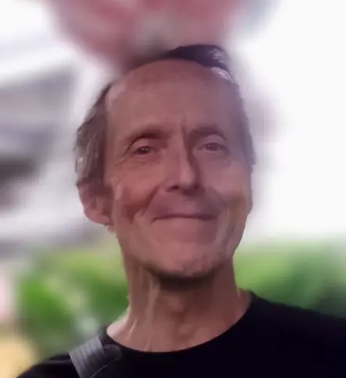
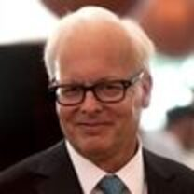
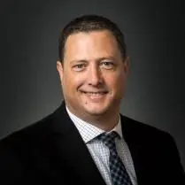
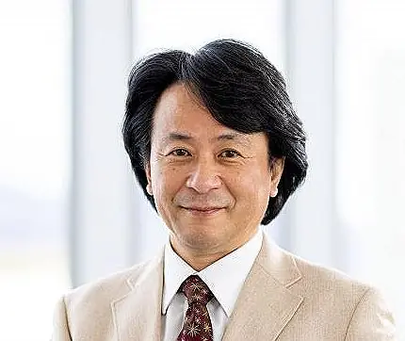
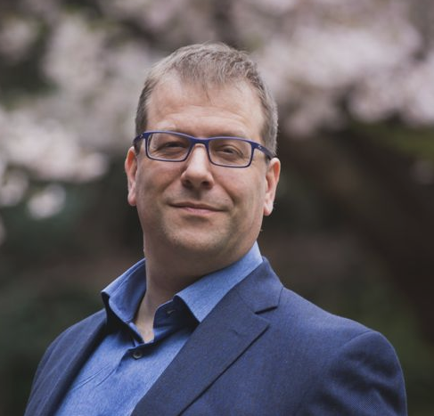
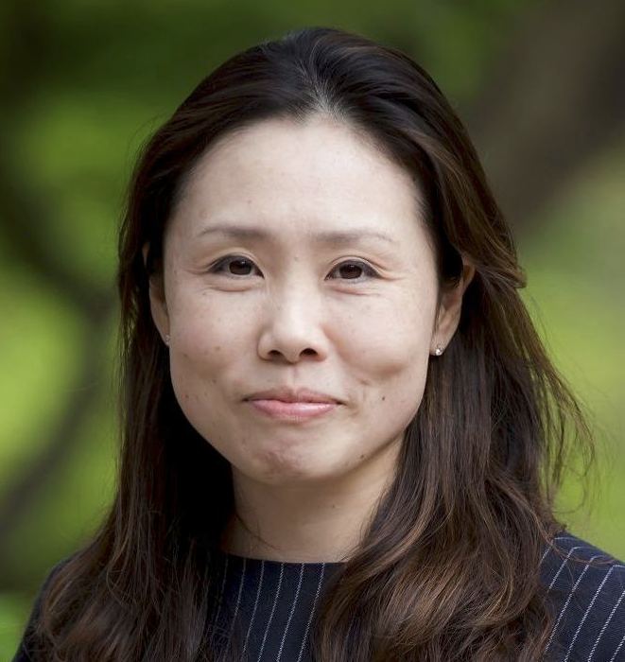
GOVERNANCE & ADVISORS · 体制と顧問 · 13
Small team, serious people, open books
少人数・確かな顔ぶれ・公開された会計。
ADVISORY BOARD · 顧問
Ray Ozzie
San Poisson
Takuo Dome
Evin Zoet
Yoshiko Zoet-Suzuki
Executive Chair, Blues
Project Manager
Prof. Emeritus, Osaka Univ. Director, Inochi Forum
Co-Rep. Director, Transom
Co-Rep. Director, Transom
PROJECT LEAD · 代表
Rob Oudendijk
YR-Design · Safecast
LEGAL PATH · 法人形態
一般社団法人 → NPO → 認定NPO — tax-deductible status.
Notes:
Who is behind this. The project is led by Rob Oudendijk, of YR-Design and Safecast — Safecast being the open environmental-data network that grew out of Fukushima, which tells you something about our commitment to transparency. The legal path runs from a general incorporated association today toward certified non-profit status, so that donations become tax-deductible. And we are advised by people who have built real things: Ray Ozzie, San Poisson, Professor Emeritus Takuo Dome of Osaka University and the Inochi Forum, and Evin Zoet and Yoshiko Zoet-Suzuki of Transom. Small team, serious people, open books.

Slide 15
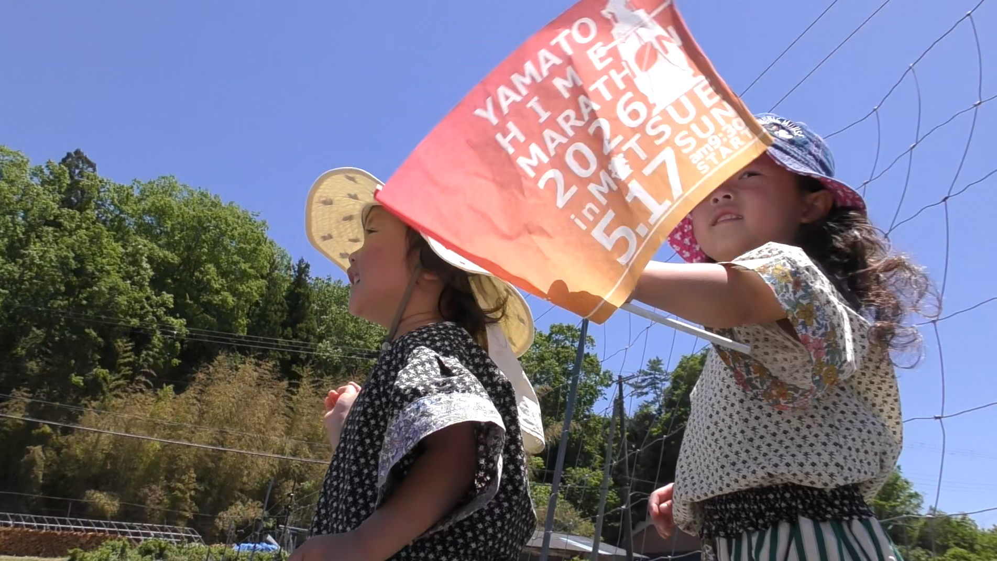
REPLICATION · 横展開 · 14
One village, an open blueprint
御杖は終着点ではなく、原型。公開された設計図。
100s
of depopulating municipalities share the same four raw materials. 同じ条件を持つ自治体は数百。
THE OPEN PLAYBOOK · 公開設計図
Every method, dataset and financial record is released under open licences . The deliverable isn't the data center — it's the repeatable playbook.
01
Restoration & energy methods
02
Financial model & open accounts
03
Governance & legal templates
手法・データ・会計をすべて公開。成果物はデータセンターではなく、再現可能な「型」。
04
Environmental & energy data
Notes:
And here is why this is worth more than one village. Mitsue is not the destination — it's the prototype. There are hundreds of depopulating municipalities across Japan with the same four raw materials: empty forest, a closed school, an energy bill, and a shrinking population. Every method, every financial record, every lesson we learn here is published under open licences. So the real product is not the data center. It's the documented, repeatable playbook — a blueprint another community can pick up and adapt without starting from zero. Fund Mitsue once, and you are funding the template for many.

Slide 16
THE INVITATION · ご提案 · 15
Help write the blueprint, not just fund a village.
一つの村への出資ではなく、地方再生の設計図づくりに参加を。
NOW SEEKING · GATE 1 · 現在募集中
Founding partners welcome — government, foundation, corporate, and impact investors. Open books from day one.
¥3–8M
Phase 1: entity · feasibility · advisors
LEAD
ORG
LOCATION
Rob Oudendijk
YR-Design · Safecast
Mitsue, Nara · 御杖村
Notes:
So here is the invitation. We are in Phase Zero, and we are looking for the partners who clear Gate One — three to eight million yen to stand up the legal entity, the feasibility work, and the professional advisors that the next phase depends on. Come in as a founding partner: government, foundation, corporate, or impact investor. What you get is not a logo on a wall. You get a stake in the first fully-documented model for regenerating rural Japan — and the right to say you helped write the blueprint the others followed. Thank you. Let's talk.

