Slide 1
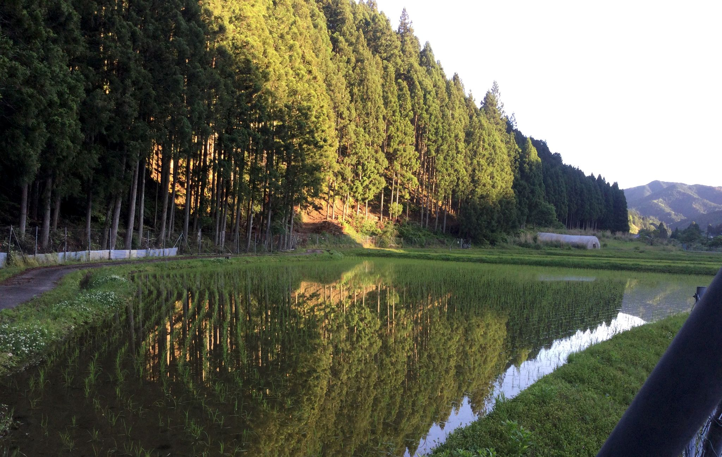
御
Mitsue Project
御杖プロジェクト
NAIST SEMINAR · 13 JANUARY 2027
Planted for a market that no longer exists.
いまは無い市場のために植えられた森
A forest, a village, and a sideways idea: history, today, and what we are still working out.
JAMES HILL · ROB OUDENDIJK
v0.4 DRAFT · 2026-11-09 · WORK IN PROGRESS
01 / 29
Notes:
Working title. Hook: the sugi standing in Mitsue today were planted for a timber and firewood economy that fossil fuels had begun dismantling by 1950. Photo: sugi above rice paddies (from the project funding deck).

Slide 2

NAIST SEMINAR · 13 JAN 2027
WHO IS TALKING
Two people, one forest.
James Hill
FOREST HISTORY · OPENS THE TALK
Takes us from the Tokugawa to 1958: how Japan came to plant this much sugi, and why it made sense at the time.
Rob Oudendijk
MITSUE-IT · THE REST OF THE TALK
Dutch engineer. Built his own house in the Mitsue forest, so the trees are 3 m from the front door. If the talk goes badly, blame the neighbours.
02 / 29
Notes:
Kinjo Rie (Mitsue Kanko) is NOT presenting (decided 2026-11-09). If she attends, thank her from the floor; do not put words in her mouth. Check James's own bio line with him.

Slide 3
PHASE 0 · MITSUE VILLAGE · NARA PREFECTURE
NAIST SEMINAR · 13 JAN 2027 · v0.4 DRAFT · WORK IN PROGRESS
THE PLAN FOR 40 MINUTES
Forty minutes, five stops.
History
The problem
Homework
How Japan came to plant
so much sugi
Three problems with
one shape
What we checked and
what we do not know
JAMES · ~10 MIN
ROB · ~5 MIN
ROB · ~5 MIN + Q&A
1
2
3
4
5
Today
The idea
The village and forest
as they are now
Pull, don't push:
wood, power, replanting
ROB · ~5 MIN
ROB · ~10 MIN
Tone: light, not academic. Big scary problems sometimes have weirdly simple solutions, if you look at them sideways.
御 Mitsue Project
03 / 29
Notes:
Two presenters only (James and Rob). Time boxes: history 10, today 5, problem 5, idea 10, homework 5, Q&A 5. See docs/meetings/naist_2027-01-13_presentation_draft.md.

Slide 4
PHASE 0 · MITSUE VILLAGE · NARA PREFECTURE
NAIST SEMINAR · 13 JAN 2027 · v0.4 DRAFT · WORK IN PROGRESS
HISTORY 01 / 10 · 1603–1958 · THE WHOLE STORY IN ONE STRIP
JAMES · TO EXPAND
Three centuries, one strip.
1951 planting compulsory
1955 the biggest boom
1958 ★ the hinge
1724 Kiso: cut down >60%
1868 Meiji: land ownership
1665 Kiso cuts halved
1849 Yoshino method
1889 Goryōrin founded
TOKUGAWA
MEIJI → WAR
CUTOVER CRISIS 1929–49
1600
1650
1700
1750
1800
1850
1900
1950
The punchline arrives in 1958: the trees we see today were planted just as the demand behind them began to fade.
御 Mitsue Project
04 / 29
Notes:
Overview strip. James: restructure freely. Dates from docs/energy-forest/history/naist_timeline_history_to_1958.md.

Slide 5
PHASE 0 · MITSUE VILLAGE · NARA PREFECTURE
NAIST SEMINAR · 13 JAN 2027 · v0.4 DRAFT · WORK IN PROGRESS
HISTORY 02 / 10 · 1603–1867 · TOKUGAWA TENURE
JAMES · TO EXPAND
Who owns a tree on shared land? The question that made plantations possible.
LORD'S FOREST · guarded
Land is feudal or communal. Private ownership is banned in principle; lords' forests in Kiso are guarded and theft is severely punished.
1665 and 1724. Kiso cuts halved, then cut down by more than 60% and held for 30 years.
Late 1600s: wave 1. Edo and Osaka boom; a 50-year timber investment pays for the first time.
1801. Edo has about 1,000,000 people, bigger than London or Paris. With imports shut out, all demand falls on domestic forests.
Plant a tree on land you do not own: who gets the timber in 50 years?
VILLAGE COMMONS · fuel, fodder
御 Mitsue Project
05 / 29
Notes:
Sources: Iwamoto; Totman, Green Archipelago. The answer worked out in Yoshino and Owase (private ownership of planted trees on communal land) is the same question behind Mitsue's private woodlots today.

Slide 6
PHASE 0 · MITSUE VILLAGE · NARA PREFECTURE
NAIST SEMINAR · 13 JAN 2027 · v0.4 DRAFT · WORK IN PROGRESS
HISTORY 03 / 10 · 1849 · THE YOSHINO METHOD
JAMES · TO EXPAND
Plant dense, thin early, thin again.
›
›
›
PLANT
THIN
RE-THIN
FINAL
at 3 ft spacing
when butt reaches 2–3 in.
5 years later
12 ft spacing, grow on
Okino Takao, Kurobane domain, 1849 a citable Edo-era schedule that still looks familiar.
Also: 1750s Yamaguni guild licence class for plantation growers; 1779 first Kiso forest inventory.
御 Mitsue Project
06 / 29
Notes:
Source: Totman. The thinning rules are old. What is new is that nobody is there to do the thinning. Good hook for 'Today'. Tree drawings are schematic, not to scale.

Slide 7
PHASE 0 · MITSUE VILLAGE · NARA PREFECTURE
NAIST SEMINAR · 13 JAN 2027 · v0.4 DRAFT · WORK IN PROGRESS
HISTORY 04 / 10 · 1868–1889 · KAN / MIN
JAMES · TO EXPAND
Government or private? Six policy reversals in five years.
1880
31%
官有地 kan'yuchi
government. the state wants sanrin: dense conifer
1889
53%
民有地 min'yuchi
private. villagers need gen'ya: scrub for fuel and fodder
共有地 koyuchi
share of Japan's woodland held by the government
shared use. a third category, because the first two did not fit real life
1868 formal ownership introduced; national forests carved from communal and former feudal land. 1871–76 the state tries to sort all woodland into kan or min.
御 Mitsue Project
07 / 29
Notes:
Source: Totman. Worth a joke: six policy reversals in five years is a pace nobody would call planning. Same tension in a Japanese village today: what the state wants from the forest is not what the village needs.

Slide 8
PHASE 0 · MITSUE VILLAGE · NARA PREFECTURE
NAIST SEMINAR · 13 JAN 2027 · v0.4 DRAFT · WORK IN PROGRESS
HISTORY 05 / 10 · 1889–1947 · GORYŌRIN
JAMES · TO EXPAND
For 58 years, forestry was a real business.
1.6 M ha
40 %
31 %
70 %
carved out in 1889–90 as the Imperial Household's own income-producing forest estate
net margin on gross income at the 1936–45 peak, against 23% for the much larger National Forest
of Imperial Household income in 1940 (19% in 1916)
of Household wealth by 1946: ¥2.6 bn of cumulative asset value
Goryōrin
National Forest
1889 founded
1892 turns profitable
1942 Hundred Year Plan suspended,
'special harvesting'
1947 dissolved
御 Mitsue Project
08 / 29
Notes:
Source: Totman, Goryōrin and lumber industry notes. Managed Japanese forestry was, for decades, a real bankable asset and not a subsidised cost. Our slogan 'Grow the Forest. Grow the Village.' comes from a hundred-year plan like this.

Slide 9
PHASE 0 · MITSUE VILLAGE · NARA PREFECTURE
NAIST SEMINAR · 13 JAN 2027 · v0.4 DRAFT · WORK IN PROGRESS
HISTORY 06 / 10 · 1929–1949 · THE CUTOVER CRISIS
JAMES · TO EXPAND
Twenty years in a row, more was cut than planted.
area cut
1.49 M ha
cutover land in 1948, about 6% of Japan's forest area, concentrated near villages
gap peaks in the
mid-1940s
8.6 → 10.97
million koku harvested, 1942 to 1944: paid for by cutting reforestation and aftercare
area planted
1948 forecast: wood exhausted in 15–33 years. Wrong, but it drove everything after.
1929 ········································ 1949 SCHEMATIC, NOT DATA (James to replace)
御 Mitsue Project
09 / 29
Notes:
Source: Matsushita (2015). The curves are a SCHEMATIC of the stated facts (cut area exceeds planted area every year 1929–49, gap peaks mid-1940s); replace with the real Forestry Agency series.

Slide 10
PHASE 0 · MITSUE VILLAGE · NARA PREFECTURE
NAIST SEMINAR · 13 JAN 2027 · v0.4 DRAFT · WORK IN PROGRESS
HISTORY 07 / 10 · 1949–1961 · POSTWAR PLANS
JAMES · TO EXPAND
Three plans in twelve years, and planting becomes the law.
5-Year Plan
1.5 M ha cutover; 60–70% executed
10-Year Plan
self-sufficiency via broadleaf → conifer
6-Year Plan
quality: nursery stock, seed trees
1951 planting compulsory (Art. 14); log import tariffs cut to near zero
1949
1950
1951
1952
1953
1954
1955
1956
1957
1958
1959
1960
1961
A tidy irony: broadleaf-to-conifer conversion is what we now want to undo, where it makes sense.
御 Mitsue Project
10 / 29
Notes:
Source: Matsushita (2015). The irony line is Rob's addition; James to check it holds for the Nara region.

Slide 11
PHASE 0 · MITSUE VILLAGE · NARA PREFECTURE
NAIST SEMINAR · 13 JAN 2027 · v0.4 DRAFT · WORK IN PROGRESS
HISTORY 08 / 10 · 1950–1955 · TWO CURVES CROSS
JAMES · TO EXPAND
Planting peaks. The reason for planting fades.
1950
The demand floor drops out
area planted
firewood and charcoal
demand
Fossil fuels replace firewood and charcoal; chemical fertiliser replaces green fertiliser; machines replace draft animals.
curves cross
≈ 1950s
1954–55
Peak planting
Highest annual area under the 10-Year Plan in 1954. Wave 3, the biggest boom, runs 1955–1970.
1945 ····································· 1970 SCHEMATIC, NOT DATA (James to replace)
御 Mitsue Project
11 / 29
Notes:
Sources: Totman; Iwamoto; Matsushita. The two curves are SCHEMATIC. James: a real chart of Forestry Agency planted-area series vs firewood/charcoal use would be the strongest slide of the history part.

Slide 12
PHASE 0 · MITSUE VILLAGE · NARA PREFECTURE
NAIST SEMINAR · 13 JAN 2027 · v0.4 DRAFT · WORK IN PROGRESS
HISTORY 09 / 10 · 1951–2025 · SEEDS AND THE CRASH
JAMES · TO EXPAND
Planted as a retirement fund, then the market crashed.
¥12,000
1951
Import tariffs to near zero
Sensible at the time; it set up self-sufficiency to fall for decades.
¥4,475
1956
Forest Development Corporation
Long-term debt plants the least attractive land against a harvest 40–50 years out. After 1980 all 47 prefectural corporations fall into debt distress.
1970s–80s
Cheap imports
then
2025
The market crashes before the planted trees are old enough to cash in. Only A-grade sells today.
A-grade sugi per m³ (years and series to be sourced)
御 Mitsue Project
12 / 29
Notes:
The ¥12,000 → ¥4,475/m³ line is in the draft outline (docs/meetings/naist_2027-01-13_presentation_draft.md); James to source the series and years before it goes on a slide. 1956 corporation: Matsushita (2015).

Slide 13

HISTORY 10 / 10 · 1958 · THE HINGE
JAMES · TO EXPAND
1958
The trees are older than the demand that justified planting them.
Deep inside the biggest boom (1955–70), planting compulsory since 1951, self-sufficiency still about 95%. The sugi and hinoki in Mitsue's mountains were planted in exactly this window. Over to Rob: today.
We are all born without clothes. We are all the same. Humans.
ROB, NOVEMBER 1958
13 / 29
Notes:
Hinge line from docs/energy-forest/history/naist_timeline_history_to_1958.md. Rob was born 1958-11-30; inset is his newborn photo (decks/Naist/266980202968.jpg), OK'd by Rob for the public repo. Rob's comment under it: 'We are all born without clothes. We are all the same. Humans.' (human-scale joke after the dry history: say it, smile, move on to today). The Profit-Sharing Forestation Act follows in the same year.

Slide 14
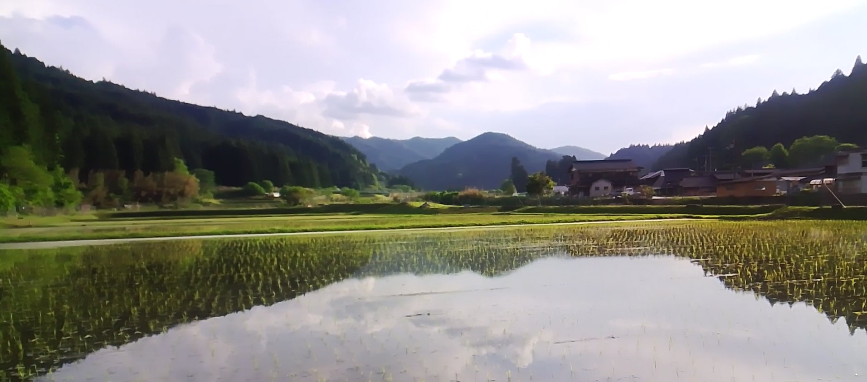
NAIST SEMINAR · 13 JAN 2027 · v0.4 DRAFT
TODAY · THE SETTING
A village of 1,400 people, a forest of 7,000 hectares.
≈ 1,400
≈ 93 %
residents
forest cover
≈ 7,050 ha
50–60 yr
forest, over 90% private
age of the main sugi and hinoki stands
Many owners are elderly or live elsewhere. At today's prices a cut sugi barely pays for the cutting. Still checking: how many owners, how many parcels, who inherits.
14 / 29
Notes:
Figures: residents and cover from the project deck; 7,051 ha and >90% private from the village plan. Photo: Mitsue landscape from the project funding deck. The forest register is with the village hall (asked 6 Nov).

Slide 15
PHASE 0 · MITSUE VILLAGE · NARA PREFECTURE
NAIST SEMINAR · 13 JAN 2027 · v0.4 DRAFT · WORK IN PROGRESS
THE PROBLEM
Three problems with one shape: nobody is paid to fix it.
Not enough hands
A ticking clock
No pull to replant
The cooperative is small and has few young people. Harvest at scale needs machines and trained operators. Thinning is planned, but most of it is cut and left.
A large share of the forest reaches harvest age inside the same ~25-year window in which new small-scale power technology matures. Nice timing, if we use it.
Cutting sugi for cheap lumber does not pay enough to put anything back. Short-term profit, repeat forever. Nobody has a reason to break the cycle.
御 Mitsue Project
15 / 29
Notes:
Structure from docs/meetings/naist_2027-01-13_presentation_draft.md section 4. Council minutes 2020: the Mayor named the worker shortage as the bottleneck.

Slide 16
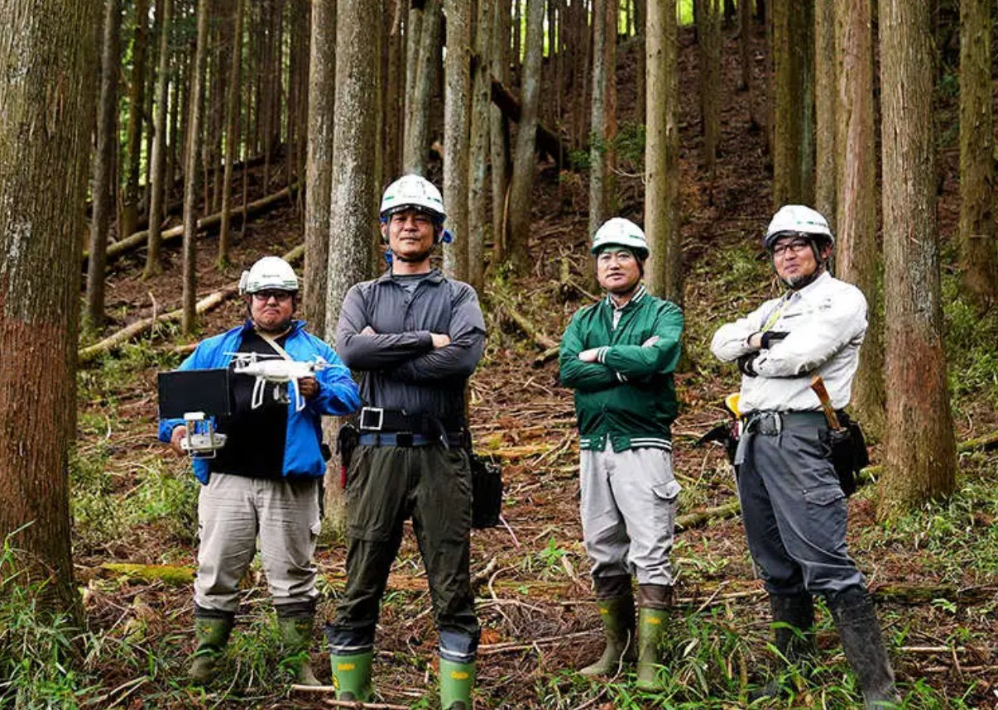
PHASE 0 · MITSUE VILLAGE · NARA PREFECTURE
NAIST SEMINAR · 13 JAN 2027 · v0.4 DRAFT · WORK IN PROGRESS
THE PROBLEM IN NUMBERS
STILL RESEARCHING
Most of the thinning wood stays in the forest.
18,140 m³
cut and left in the forest
PLANNED THINNING FY2024–26 · 113 PARCELS · ≈ 222 ha · 4 DISTRICTS
2,574 m³
taken out
≈ 88 %
That cut-and-left wood is a fuel resource, if it can be collected at a price that makes sense. Steep slopes and missing roads are why it is left.
Still checking: how much is reachable with a winch-assisted machine, and what an earlier '120–300 m³/yr' cooperative figure really measured.
stays in the forest: about 860 m³ a year actually comes out
Sources: Village forestry plan R6–R8 (FY2024–26); village hall (Oba)
御 Mitsue Project
16 / 29
Notes:
18,140 of 20,714 m³ left; 2,574 out over three years (about 860/yr). Verify with the village data sheet (xlsx) before the talk. Photo: forestry team in the forest, from the project funding deck: confirm we may show it and who is in it.

Slide 17
PHASE 0 · MITSUE VILLAGE · NARA PREFECTURE
NAIST SEMINAR · 13 JAN 2027 · v0.4 DRAFT · WORK IN PROGRESS
THE IDEA
Pull, don't push: give the wood a buyer that pays.
1 Thin and clear
2 Sort A / B / C / D
3 Chip and dry
4 Small CHP
Cut-to-length machines on steep sugi
A and B to the sawmill, C and D to chips
Local chipping, drying with CHP heat
Gasification plant: power and heat, 24 h
Why 'pull'. Waiting for a subsidy pushes wood out once, then stops. A buyer that wants fuel 24 hours a day pulls wood out every year, and can pay for the replanting.
Then replant. Cleared stands go back to native broadleaf (oak, chestnut, konara) for wildlife and watershed, with fast-growing kiri on part of the land. Species chosen with the NGO more trees.
御 Mitsue Project
17 / 29
Notes:
Core of the talk (~10 min). Compute (AI data center) is the later anchor customer: present as 'a small compute load next to the CHP', not a done deal.

Slide 18
PHASE 0 · MITSUE VILLAGE · NARA PREFECTURE
NAIST SEMINAR · 13 JAN 2027 · v0.4 DRAFT · WORK IN PROGRESS
THE IDEA · TWO WAYS TO MOVE WOOD
Push stops. Pull keeps going.
PUSH · A ONE-OFF SUBSIDY
PULL · A BUYER FOR FUEL, 24 HOURS A DAY
forest
forest
subsidy
…then nothing
landowners
+ replanting
chips
CHP + compute
Money from the plant flows back to owners and pays for replanting: the loop closes.
御 Mitsue Project
18 / 29
Notes:
'Pull, don't push': an AI data center + biomass CHP creates a buyer for wood that actually pays, pulling sustainable forestry forward instead of waiting for a subsidy.

Slide 19
PHASE 0 · MITSUE VILLAGE · NARA PREFECTURE
NAIST SEMINAR · 13 JAN 2027 · v0.4 DRAFT · WORK IN PROGRESS
THE IDEA · WHAT A TREE IS WORTH
STILL RESEARCHING
Only A-grade wood sells. B, C and D are a problem we can use.
A
B
C
D
Straight, clean, few knots
Slightly bent, some knots
Crooked or small
Branches, tops, bark
Sawlog. The only grade worth cutting for lumber.
Sawlog or laminated. Price depends on the buyer.
Chips, pulp, board. Cheap.
Today: left on the slope.
Sources: Grade descriptions simplified; model v1.2 (61% A national average, 22% A thinning-type stands)
御 Mitsue Project
19 / 29
Notes:
Grade definitions are simplified: check against the Japanese log-grading rules before presenting to forestry specialists. Idea: CHP fuel plus a data-center customer means C and D wood suddenly has a buyer too; the sawlogs still fund most of the work.

Slide 20
PHASE 0 · MITSUE VILLAGE · NARA PREFECTURE
NAIST SEMINAR · 13 JAN 2027 · v0.4 DRAFT · WORK IN PROGRESS
THE IDEA · THEN REPLANT
From one crop of cedar to a forest that feeds the bears.
BEFORE · MONOCULTURE
AFTER · NATIVE BROADLEAF + KIRI
pollen, landslide risk, nothing to eat
oak, chestnut, konara: acorns for wildlife
Species are chosen with the NGO more trees. The village's default is native broadleaf, not another monoculture.
Kiri (paulownia) is a fast fuel crop on part of the land: Tokushima growth data 8.6 t dry/ha/yr; Mitsue growth data requested from SANSEI. Still checking.
御 Mitsue Project
20 / 29
Notes:
Reforestation principle: native broadleaf for wildlife forage; NGO picks species. Kiri figures from model v1.2; do not cite IGES/Miyawaki figures (Morales 2025 review: evidence weak). Drawings are schematic.

Slide 21
PHASE 0 · MITSUE VILLAGE · NARA PREFECTURE
NAIST SEMINAR · 13 JAN 2027 · v0.4 DRAFT · WORK IN PROGRESS
THE FIRST NUMBERS
PLACEHOLDER PRICES
Our first model says plus, then shows how fragile that is.
STEADY-STATE SYSTEM NET, ¥M PER YEAR
Base case
+45
Not a forecast.
Owners get 0 %
+79
50 ha/yr clear-cut at 600 m³/ha, sawlogs sold, C+D chipped, half the land replanted to kiri, landowners paid 30% of sawlog net.
At the village's actual standing volume (277–317 m³/ha) the base case falls to about break-even.
Left out: carbon credits, data-center income, machine purchase, wages.
Owners get 50 %
+22
No residue collected
+32
Replant kiri every cut
+26
Thinning-type grade split
+4
317 m³/ha, 95 ha/yr
+1
Low price, high cost
−10
Sources: kiri_sugi_integrated_system_model_2026-11-03.xlsx v1.2. All prices and costs are placeholders, not quotes.
御 Mitsue Project
21 / 29
Notes:
Steady-state system net, ¥M/yr, from model v1.2. Say clearly: feasibility sizing, not a forecast. Do NOT state +45 as an expected result.

Slide 22
PHASE 0 · MITSUE VILLAGE · NARA PREFECTURE
NAIST SEMINAR · 13 JAN 2027 · v0.4 DRAFT · WORK IN PROGRESS
WHAT DECIDES IT
STILL RESEARCHING
Four unknowns decide the answer, not the technology.
Wood per hectare
village plan
Model assumes 600; village plan shows 277–317.
M³/HA
model
A-grade share
thinning-type
Sawlog sales fund everything.
% OF VOLUME
national avg
Landowner share
Each 10 points costs about ¥11M a year.
% OF SAWLOG NET
our choice
Residue price
placeholder
Doubling adds only about ¥1.6M a year: minor.
¥ PER TONNE
if doubled
Sources: kiri_sugi_system_summary_2026-11-03.md, 'What drives the result'
御 Mitsue Project
22 / 29
Notes:
Clay = what the village data suggests; green = what the first model assumed. The gap between them is why we say 'fragile'. Landowner share: base 30%; residue: ¥4,000/t placeholder.

Slide 23
PHASE 0 · MITSUE VILLAGE · NARA PREFECTURE
NAIST SEMINAR · 13 JAN 2027 · v0.4 DRAFT · WORK IN PROGRESS
THE ENERGY SIDE
STILL RESEARCHING
Start small to learn. Size the real plant to the wood we can get.
≈ 0.5–0.6 MWe
1.2 MWe
needs ≈ 24,000 m³ of fuel a year. Not until the harvest is proven. At ≥ 1,000 kW the tariff is FIP-only, and splitting is not allowed.
50 kWe
Prototype in a 20 ft container. ≈ 450–600 t dry wood a year. A learning step: efficiency only ~12–20% at this size.
First commercial size. 23–28% efficiency for gasifier plus engine at this scale. Fuel mostly C+D wood and residue.
NOT TO SCALE
Also: Japanese maker only; gasification + engine beats steam below ~1 MWe; grid at 6.6 kV has about 3 MW locally, none upstream; fuel may be bought from neighbouring villages.
Sources: Energy, finance and resources overview v1.1 (2026-11-03)
御 Mitsue Project
23 / 29
Notes:
'Fuel from neighbours' is not yet in the model (needs delivered ¥/t and haul distance). Do not name a CHP maker in public: shortlist and quotes are in flux.

Slide 24
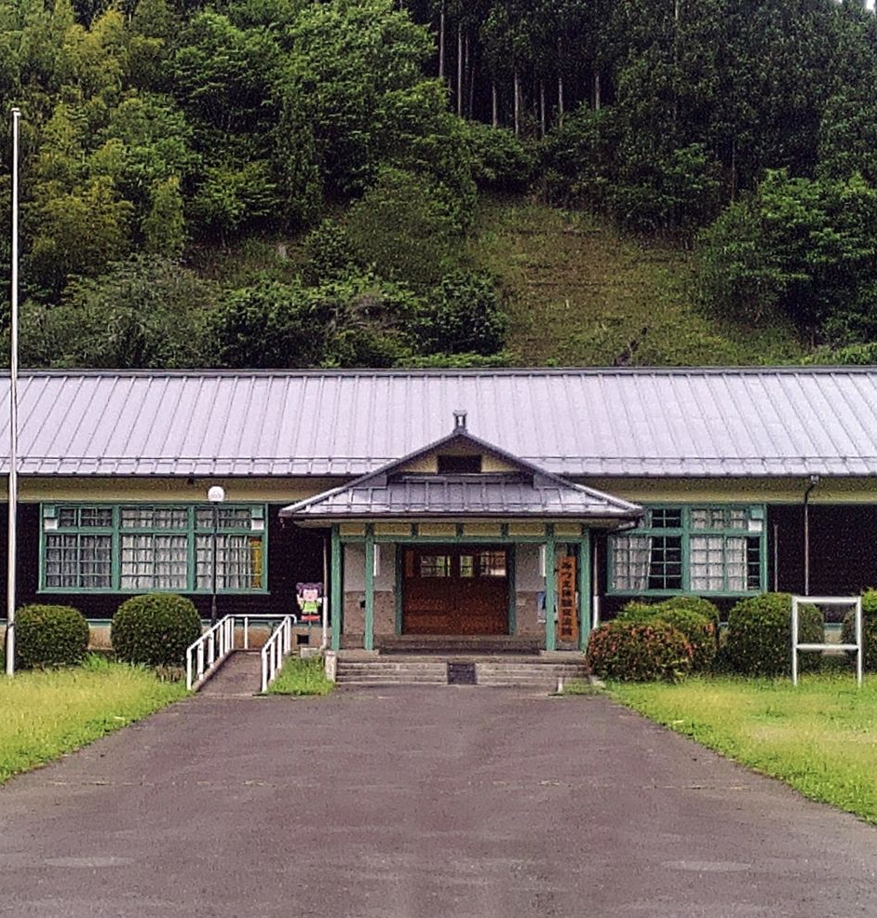
PHASE 0 · MITSUE VILLAGE · NARA PREFECTURE
NAIST SEMINAR · 13 JAN 2027 · v0.4 DRAFT · WORK IN PROGRESS
STILL RESEARCHING
NOT JUST US DREAMING
Pieces of this already exist, in Japan and abroad.
Tenkawa, next door
A biomass council since 2016; a wood boiler heats the Dorogawa hot spring baths. We visited on 25 Aug 2026.
Aizu, 2011
A closed school (Akazawa Elementary) turned into a data center. A precedent for an empty school building like ours.
Wood power plus compute
Tried before: Buena Vista (US), Deutsche Telekom with Bankhaus Metzler (Germany), IIJ Matsue (Japan).
Still checking what each one really is and what transfers. Leads, not proof.
The closed Mitsue school building.
Sources: Tenkawa Forest Power Council; Aizu (2011) Safecast blog; Buena Vista, DT/Metzler, IIJ Matsue
御 Mitsue Project
24 / 29
Notes:
Each precedent needs one verified sentence. Photo: the closed Mitsue elementary school (from the project funding deck). Do not claim these are identical to our plan. Tenkawa photos from the 2026-08-25 meeting can be added.

Slide 25
PHASE 0 · MITSUE VILLAGE · NARA PREFECTURE
NAIST SEMINAR · 13 JAN 2027 · v0.4 DRAFT · WORK IN PROGRESS
WHAT WE DID
The homework so far: we read, we asked, we counted.
45
113
2
village, prefectural and national acts on forestry, biomass, 協力隊 and siting, collected and summarised
parcels in the village thinning plan, read parcel by parcel
rounds of questions to Komatsu on steep-slope harvesting; gasification CHP makers compared
1.2
5+
100%
version of the spreadsheet model linking clear-cut, sawlogs, chips, kiri, CHP and landowner payments
site and office visits: forest, village hall, Uda City cooperative, Tenkawa
of it open, in a public repository, so anyone including NAIST students can check or challenge it
Forest work in Mitsue (confirm who and where).
Sources: repository docs/, research/, docs/reference/
御 Mitsue Project
25 / 29
Notes:
Numbers: 45 acts (village regulations folder), 113 parcels (thinning plan). Edit to match what James has also done. Public repository: https://codeberg.org/YR-Design/mitsue-ai-data-center (mirror on GitHub). Photo needs a caption/consent check.

Slide 26
PHASE 0 · MITSUE VILLAGE · NARA PREFECTURE
NAIST SEMINAR · 13 JAN 2027 · v0.4 DRAFT · WORK IN PROGRESS
WHAT WE DO NOT KNOW YET
STILL RESEARCHING
An honest list of open questions, and who is answering them.
OPEN QUESTION
WHO
STATUS
Stand volume, stumpage, who gets the sale income
Village hall (Oba)
asked 6 Nov
Slope limits with and without winch, road width, yearly output
Komatsu
follow-up sent
Real CHP efficiency and cost at 0.6–0.8 MWe
Maker quotes
to request
Kiri growth on Mitsue slopes
SANSEI planting data
asked 2 Nov
Grid connection at 6.6 kV
Kansai T&D
consultation drafted
Fuel bought in from neighbouring villages
Uda City, others
to approach
What students and researchers would measure
NAIST (you)
to discuss
Sources: docs/strategy/mitsue_energy_finance_resources_overview_2026-11-03.md section 5
御 Mitsue Project
26 / 29
Notes:
Refresh right before the talk: statuses change weekly. The last row is the real ask to NAIST.

Slide 27
PHASE 0 · MITSUE VILLAGE · NARA PREFECTURE
NAIST SEMINAR · 13 JAN 2027 · v0.4 DRAFT · WORK IN PROGRESS
WHERE WE STAND
Early planning. No money raised, no contracts, no machines bought.
NOW
DEC 2026
2027
2028 →
LATER
Phase 0
Phase 0 ends
Prototype
Machines
Full scale
Trust, sites, fuel talks, homework
Decision on first site and partners
50 kWe CHP and fuel trial, if site and partners settle
A CTL trial if a fit is shown and financing is in place
≈ 0.5–1.2 MWe and a larger compute load; no fixed date
¥0 committed. Dates are targets, not promises. The grant tracks we know of (METI GX regional, MoE zero-emission data center) are being studied, not applied for.
御 Mitsue Project
27 / 29
Notes:
Align the dates with the current phase plan (Phase 0 extended to Dec 2026, later phases shifted three months). Never imply contracts exist.

Slide 28
THE LONG VIEW
75 years to grow the forest.
25 years to grow the village.
A hundred-year plan in the old Goryōrin spirit: planting for the people who will be here when the trees are ready.
28 / 29
Notes:
Closing image. Link back to the Goryōrin slide (history 5): the last time anyone planned forestry on this horizon.

Slide 29
PHASE 0 · MITSUE VILLAGE · NARA PREFECTURE
NAIST SEMINAR · 13 JAN 2027 · v0.4 DRAFT · WORK IN PROGRESS
Q&A
Tell us where we are wrong.
Honest critique is more useful to us than polite interest.
What would you measure? What would you doubt? Who else should we ask?
Rob Oudendijk · Mitsue-it · rob@mitsue.it
All documents open: https://codeberg.org/YR-Design/mitsue-ai-data-center
Website: mitsue.it
御 Mitsue Project
29 / 29
Notes:
Q&A ~5 min. Check the signature block against docs/outreach/email_signature_standard.md. Add James's contact line only if he agrees.

