Slide 1
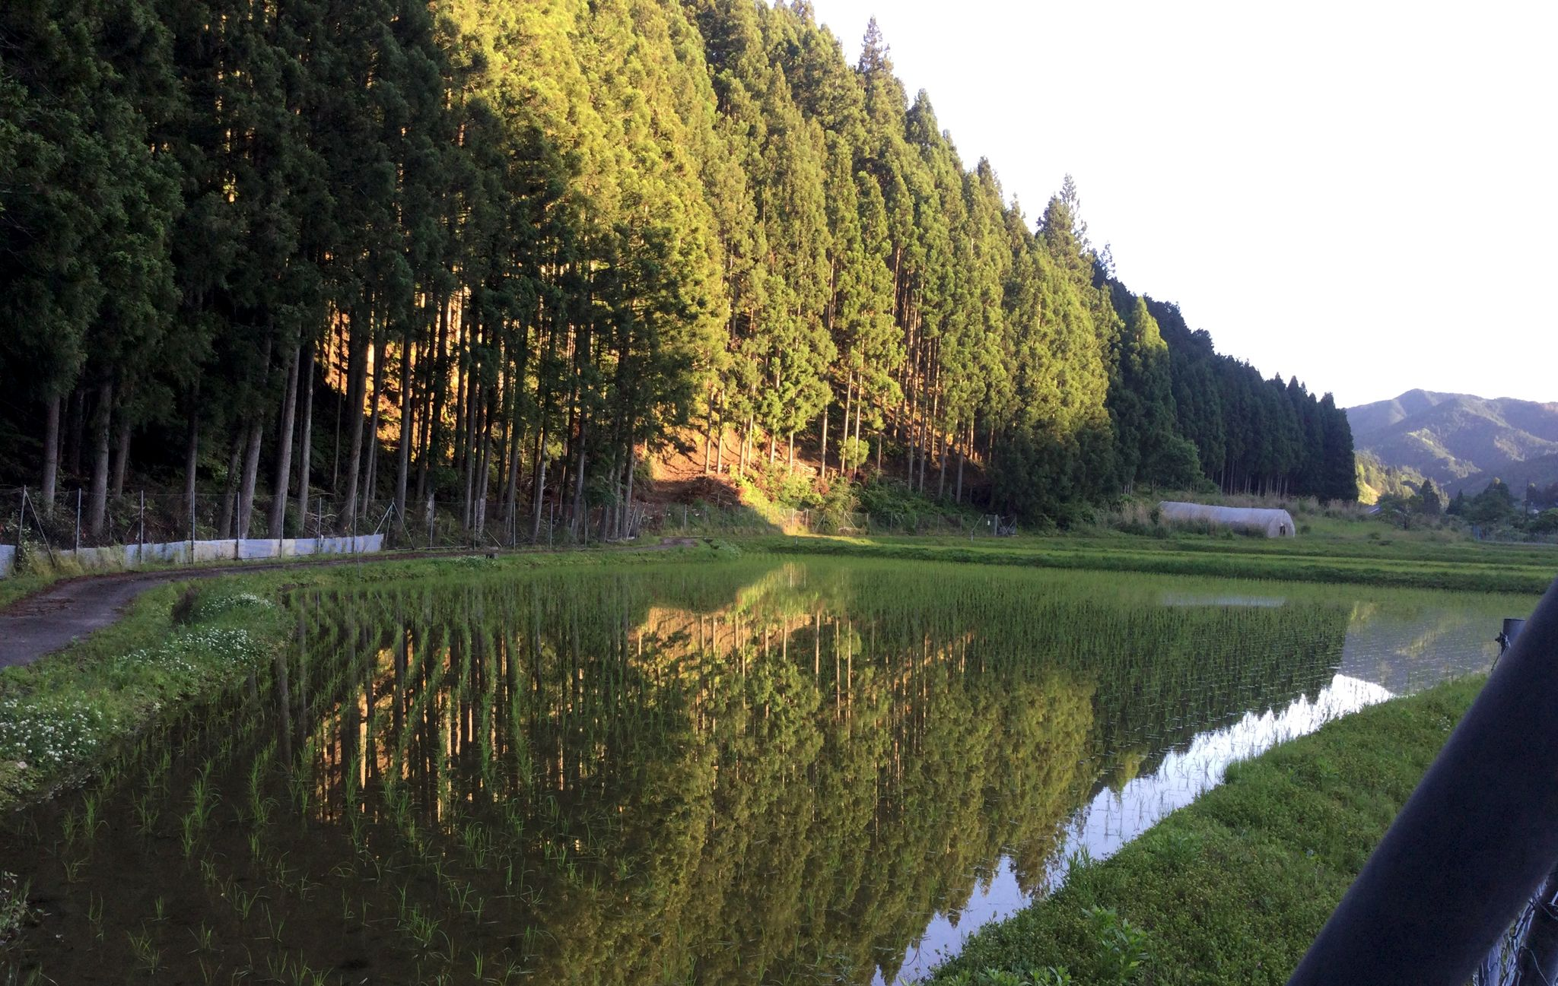
御
Mitsue Project
御杖プロジェクト
NAIST SEMINAR · 13 JANUARY 2027
Planted for a market that no longer exists.
いまは無い市場のために植えられた森
A forest, a village, and a sideways idea: history, today, and what we are still working out.
01–10 JAMES · HOW WE GOT HERE
11–20 ROB · WHERE WE ARE, WHAT WE TRY
JAMES HILL OPENS · ROB OUDENDIJK CONTINUES
v0.6 DRAFT · 2026-11-09 · WORK IN PROGRESS
01 / 20
Notes:
Working title. Hook: the sugi standing in Mitsue today were planted for a timber and firewood economy that fossil fuels had begun dismantling by 1950. Photo: sugi above rice paddies (from the project funding deck).
TWO PRESENTERS, ONE CONVERSATION. James (slides 1-10): Japanese forestry from the Tokugawa to 1958. Rob (11-20): the forest and village now, and what we try. We refer to each other's slides (tags like '→ ROB · 12' and '← JAMES · 9') and ask each other a few questions on stage. Kinjo Rie is not presenting.
James bio: forest-history researcher (confirm wording with James). Rob: Dutch engineer, built his own house in the Mitsue forest, trees 3 m from the front door; if the talk goes badly, blame the neighbours.

Slide 2
PHASE 0 · MITSUE VILLAGE · NARA PREFECTURE
NAIST SEMINAR · 13 JAN 2027 · v0.6 DRAFT · WORK IN PROGRESS
HISTORY 02 / 10 · 1603–1958 · THE WHOLE STORY IN ONE STRIP
JAMES · TO EXPAND
Three centuries, one strip.
1951 planting compulsory
1955 the biggest boom
1958 ★ the hinge
1724 Kiso: cut down >60%
1868 Meiji: land ownership
1665 Kiso cuts halved
1849 Yoshino method
1889 Goryōrin founded
TOKUGAWA
MEIJI → WAR
CUTOVER CRISIS 1929–49
1600
1650
1700
1750
1800
1850
1900
1950
The punchline arrives in 1958: the trees we see today were planted just as the demand behind them began to fade.
→ ROB · 11
The same trees, today: what it looks like on the ground.
御 Mitsue Project
02 / 20
Notes:
JAMES opens: 'Where does all this sugi come from? Three centuries in one slide, then we slow down.' Hand-off at slide 10.
Overview strip. James: restructure freely. Dates from docs/energy-forest/history/naist_timeline_history_to_1958.md.

Slide 3
PHASE 0 · MITSUE VILLAGE · NARA PREFECTURE
NAIST SEMINAR · 13 JAN 2027 · v0.6 DRAFT · WORK IN PROGRESS
HISTORY 03 / 10 · 1603–1849 · TENURE AND THE YOSHINO METHOD
JAMES · TO EXPAND
Who owns a tree on shared land? And how do you grow one?
TENURE
WAVE 1 · LATE 1600s
CUTS AND COUNTS
Land is feudal or communal; private ownership is banned in principle. Lords' forests in Kiso are guarded and theft is severely punished.
Edo and Osaka boom: a 50-year timber investment pays for the first time. Custom starts to recognise private ownership of planted trees on communal land (Yoshino, Owase).
Kiso cuts halved in 1665, down by more than 60% in 1724 and held for 30 years. First forest inventory 1779. Edo reaches 1,000,000 people in 1801.
›
›
›
PLANT
at 3 ft spacing
THIN
when butt reaches 2–3 in.
RE-THIN
5 years later
FINAL
12 ft spacing, grow on
Okino Takao, Kurobane domain, 1849: a citable Edo-era schedule that still looks familiar. Also: 1750s Yamaguni guild licence class for plantation growers.
→ ROB · 13
Thin early, thin again. Who does the thinning today?
御 Mitsue Project
03 / 20
Notes:
Sources: Totman; Iwamoto. Merged from two earlier slides (tenure, Yoshino). The answer worked out in Yoshino and Owase (private ownership of planted trees on communal land) is the same question behind Mitsue's private woodlots today. Tree drawings schematic, not to scale. JAMES: 'The rules for thinning are 170 years old. Rob, who does the thinning in Mitsue today?' (Rob answers on slide 13.)

Slide 4
PHASE 0 · MITSUE VILLAGE · NARA PREFECTURE
NAIST SEMINAR · 13 JAN 2027 · v0.6 DRAFT · WORK IN PROGRESS
HISTORY 04 / 10 · 1868–1889 · KAN / MIN
JAMES · TO EXPAND
Government or private? Six policy reversals in five years.
1880
31%
官有地 kan'yuchi
government. the state wants sanrin: dense conifer
1889
53%
民有地 min'yuchi
private. villagers need gen'ya: scrub for fuel and fodder
共有地 koyuchi
share of Japan's woodland held by the government
shared use. a third category, because the first two did not fit real life
1868 formal ownership introduced; national forests carved from communal and former feudal land. 1871–76 the state tries to sort all woodland into kan or min.
→ ROB · 11
Over 90% of Mitsue's forest is private: the village is the 'min' side of this story.
御 Mitsue Project
04 / 20
Notes:
JAMES: 'Government or private? The same tension shows up in a Japanese village today. Rob will show you.'
Source: Totman. Worth a joke: six policy reversals in five years is a pace nobody would call planning. Same tension in a Japanese village today: what the state wants from the forest is not what the village needs.

Slide 5
PHASE 0 · MITSUE VILLAGE · NARA PREFECTURE
NAIST SEMINAR · 13 JAN 2027 · v0.6 DRAFT · WORK IN PROGRESS
HISTORY 05 / 10 · 1889–1947 · GORYŌRIN
JAMES · TO EXPAND
For 58 years, forestry was a real business.
1.6 M ha
40 %
31 %
70 %
carved out in 1889–90 as the Imperial Household's own income-producing forest estate
net margin on gross income at the 1936–45 peak, against 23% for the much larger National Forest
of Imperial Household income in 1940 (19% in 1916)
of Household wealth by 1946: ¥2.6 bn of cumulative asset value
Goryōrin
National Forest
1889 founded
1892 turns profitable
1942 Hundred Year Plan suspended,
'special harvesting'
1947 dissolved
→ ROB · 14
A buyer that pays: the idea we are trying to rebuild with a power plant.
御 Mitsue Project
05 / 20
Notes:
JAMES: 'Goryōrin worked because someone needed the wood and paid for it for 58 years. Rob will tell you why that matters now.'
Source: Totman, Goryōrin and lumber industry notes. Managed Japanese forestry was, for decades, a real bankable asset and not a subsidised cost. Our slogan 'Grow the Forest. Grow the Village.' comes from a hundred-year plan like this.

Slide 6
PHASE 0 · MITSUE VILLAGE · NARA PREFECTURE
NAIST SEMINAR · 13 JAN 2027 · v0.6 DRAFT · WORK IN PROGRESS
HISTORY 06 / 10 · 1929–1949 · THE CUTOVER CRISIS
JAMES · TO EXPAND
Twenty years in a row, more was cut than planted.
area cut
1.49 M ha
cutover land in 1948, about 6% of Japan's forest area, concentrated near villages
gap peaks in the
mid-1940s
8.6 → 10.97
million koku harvested, 1942 to 1944: paid for by cutting reforestation and aftercare
area planted
1948 forecast: wood exhausted in 15–33 years. Wrong, but it drove everything after.
1929 ········································ 1949 SCHEMATIC, NOT DATA (James to replace)
→ ROB · 12
Cut > planted: when short-term demand beats the plan. We call it 'no pull to replant'.
御 Mitsue Project
06 / 20
Notes:
JAMES: 'Twenty years of overcutting, then a planting rush. Rob: do you recognise this pattern?'
Source: Matsushita (2015). The curves are a SCHEMATIC of the stated facts (cut area exceeds planted area every year 1929–49, gap peaks mid-1940s); replace with the real Forestry Agency series.

Slide 7
PHASE 0 · MITSUE VILLAGE · NARA PREFECTURE
NAIST SEMINAR · 13 JAN 2027 · v0.6 DRAFT · WORK IN PROGRESS
HISTORY 07 / 10 · 1949–1961 · POSTWAR PLANS
JAMES · TO EXPAND
Three plans in twelve years, and planting becomes the law.
5-Year Plan
1.5 M ha cutover; 60–70% executed
10-Year Plan
self-sufficiency via broadleaf → conifer
6-Year Plan
quality: nursery stock, seed trees
1951 planting compulsory (Art. 14); log import tariffs cut to near zero
1949
1950
1951
1952
1953
1954
1955
1956
1957
1958
1959
1960
1961
→ ROB · 15
Broadleaf was turned into conifer. We now want to put broadleaf back, where it makes sense.
御 Mitsue Project
07 / 20
Notes:
JAMES: 'Convert broadleaf to conifer, 1952. Rob has a plan that goes the other way.'
Source: Matsushita (2015). The irony line is Rob's addition; James to check it holds for the Nara region.

Slide 8
PHASE 0 · MITSUE VILLAGE · NARA PREFECTURE
NAIST SEMINAR · 13 JAN 2027 · v0.6 DRAFT · WORK IN PROGRESS
HISTORY 08 / 10 · 1950–1955 · TWO CURVES CROSS
JAMES · TO EXPAND
Planting peaks. The reason for planting fades.
1950
The demand floor drops out
area planted
firewood and charcoal
demand
Fossil fuels replace firewood and charcoal; chemical fertiliser replaces green fertiliser; machines replace draft animals.
curves cross
≈ 1950s
1954–55
Peak planting
Highest annual area under the 10-Year Plan in 1954. Wave 3, the biggest boom, runs 1955–1970.
1945 ····································· 1970 SCHEMATIC, NOT DATA (James to replace)
→ ROB · 14
Demand for the trees fell away. Can a small power plant bring some of it back?
御 Mitsue Project
08 / 20
Notes:
JAMES: 'Planting peaks, the reason for planting fades. Rob: can the demand be rebuilt?' (Rob picks up on slide 14.)
Sources: Totman; Iwamoto; Matsushita. The two curves are SCHEMATIC. James: a real chart of Forestry Agency planted-area series vs firewood/charcoal use would be the strongest slide of the history part.

Slide 9
PHASE 0 · MITSUE VILLAGE · NARA PREFECTURE
NAIST SEMINAR · 13 JAN 2027 · v0.6 DRAFT · WORK IN PROGRESS
HISTORY 09 / 10 · 1951–2025 · SEEDS AND THE CRASH
JAMES · TO EXPAND
Planted as a retirement fund, then the market crashed.
¥12,000
1951
Import tariffs to near zero
Sensible at the time; it set up self-sufficiency to fall for decades.
¥4,475
1956
Forest Development Corporation
Long-term debt plants the least attractive land against a harvest 40–50 years out. After 1980 all 47 prefectural corporations fall into debt distress.
1970s–80s
Cheap imports
then
2025
The market crashes before the planted trees are old enough to cash in. Only A-grade sells today.
A-grade sugi per m³ (years and series to be sourced)
→ ROB · 15
Only A-grade sells today. What do we do with B, C and D?
御 Mitsue Project
09 / 20
Notes:
JAMES: 'So the retirement fund crashed. Only the straightest logs sell. Rob, what do we do with the rest?'
The ¥12,000 → ¥4,475/m³ line is in the draft outline (docs/meetings/naist_2027-01-13_presentation_draft.md); James to source the series and years before it goes on a slide. 1956 corporation: Matsushita (2015).

Slide 10
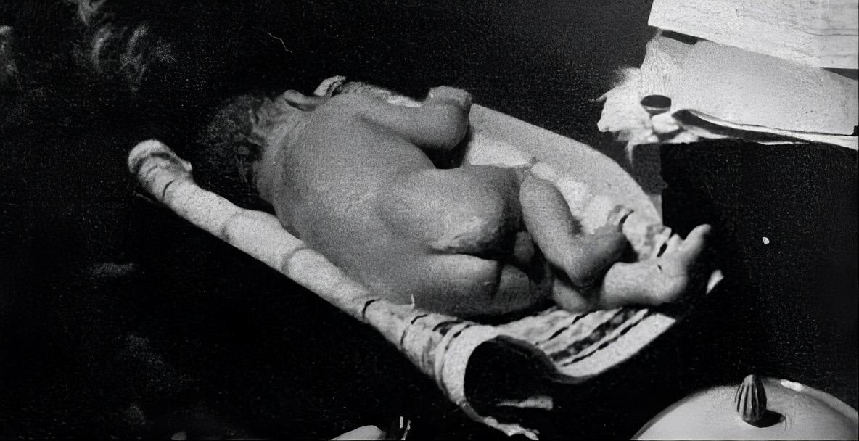
HISTORY 10 / 10 · 1958 · THE HINGE
JAMES · TO EXPAND
1958
The trees are older than the demand that justified planting them.
Deep inside the biggest boom (1955–70), planting compulsory since 1951, self-sufficiency still about 95%. The sugi and hinoki in Mitsue's mountains were planted in exactly this window. Over to Rob: today.
We are all born without clothes. We are all the same. Humans.
ROB, NOVEMBER 1958
→ ROB · 11
James hands over: what is standing on those slopes now?
10 / 20
Notes:
JAMES: 'Over to Rob.' ROB opens with: 'James just showed you how the trees got there. This is what they look like today.'
Hinge line from docs/energy-forest/history/naist_timeline_history_to_1958.md. Rob was born 1958-11-30; inset is his newborn photo (decks/Naist/266980202968.jpg), OK'd by Rob for the public repo. Rob's comment under it: 'We are all born without clothes. We are all the same. Humans.' (human-scale joke after the dry history: say it, smile, move on to today). The Profit-Sharing Forestation Act follows in the same year.

Slide 11
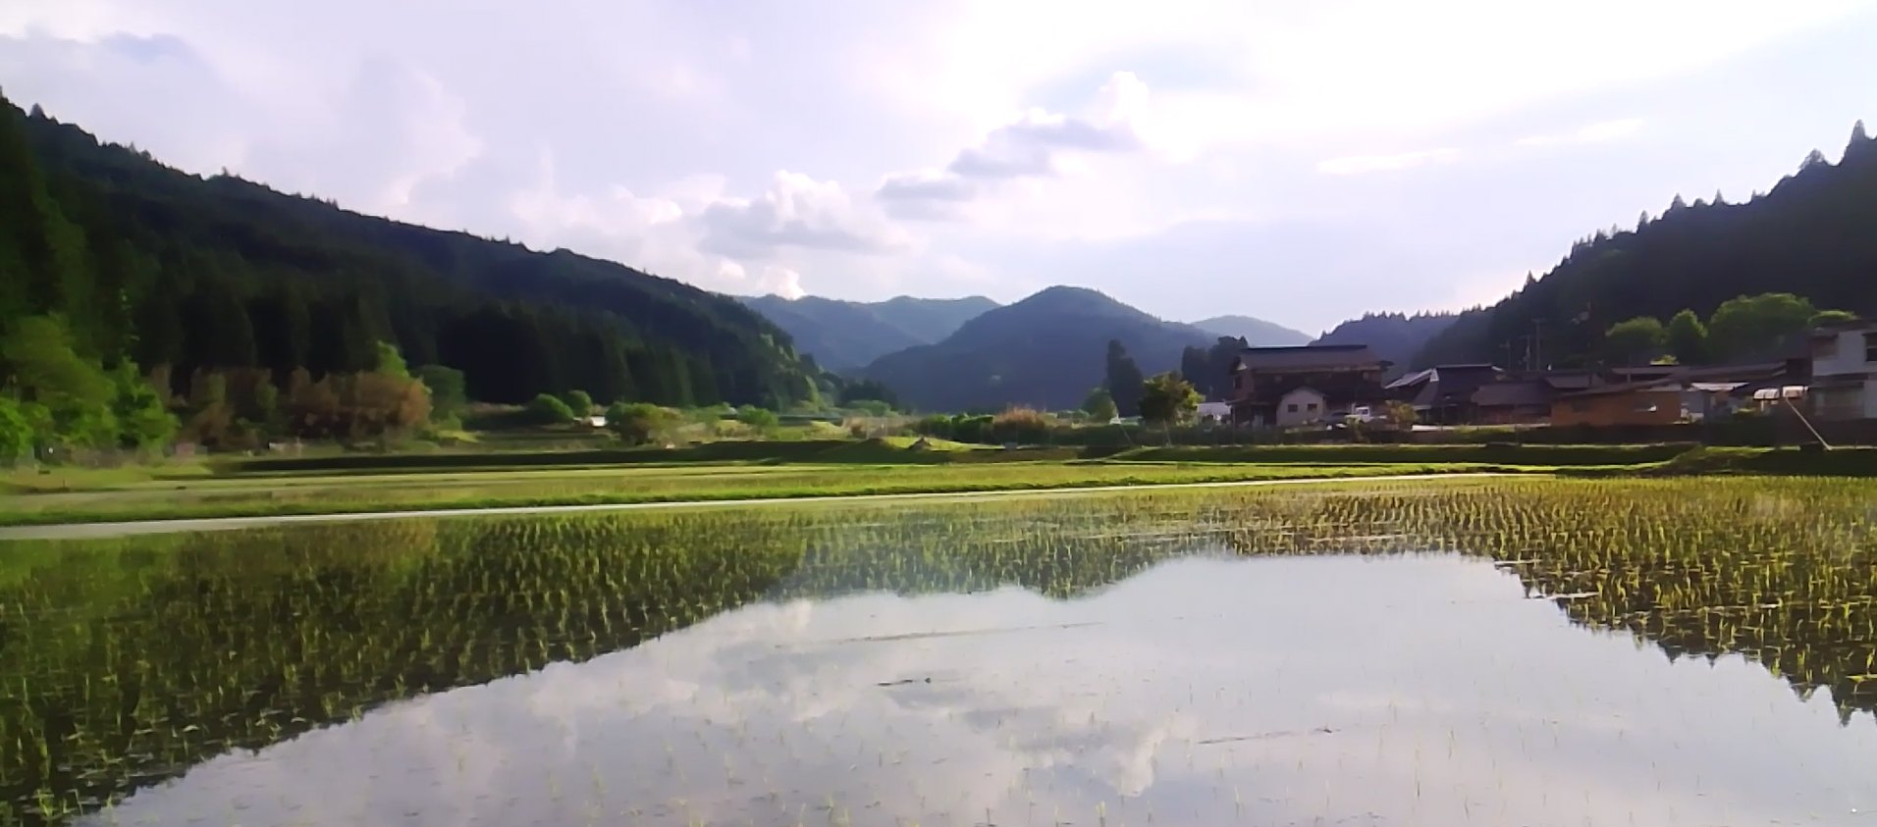
NAIST SEMINAR · 13 JAN 2027 · v0.6 DRAFT
ROB 01 / 10 · TODAY · THE SETTING
A village of 1,400 people, a forest of 7,000 hectares.
≈ 1,400
≈ 93 %
residents
forest cover
≈ 7,050 ha
50–60 yr
forest, over 90% private
age of the main sugi and hinoki stands
Many owners are elderly or live elsewhere. At today's prices a cut sugi barely pays for the cutting. Still checking: how many owners, how many parcels, who inherits.
← JAMES · 10
The sugi and hinoki planted in exactly that window.
11 / 20
Notes:
Figures: residents and cover from the project deck; 7,051 ha and >90% private from the village plan. Photo: Mitsue landscape from the project funding deck. The forest register is with the village hall (asked 6 Nov).

Slide 12
PHASE 0 · MITSUE VILLAGE · NARA PREFECTURE
NAIST SEMINAR · 13 JAN 2027 · v0.6 DRAFT · WORK IN PROGRESS
ROB 02 / 10 · THE PROBLEM
Three problems with one shape: nobody is paid to fix it.
Not enough hands
A ticking clock
No pull to replant
The cooperative is small and has few young people. Harvest at scale needs machines and trained operators. Thinning is planned, but most of it is cut and left.
A large share of the forest reaches harvest age inside the same ~25-year window in which new small-scale power technology matures. Nice timing, if we use it.
Cutting sugi for cheap lumber does not pay enough to put anything back. Short-term profit, repeat forever. Nobody has a reason to break the cycle.
← JAMES · 7
A ticking clock: the 1950s planting wave all reaches harvest age together.
← JAMES · 9
No pull to replant: the market crashed before the trees grew up.
御 Mitsue Project
12 / 20
Notes:
ROB: 'James showed you the history. Here is the same story as three problems.' Ask James: 'Was there a time when the forest paid for its own replanting?' (James: Goryōrin, slide 5.)
Structure from docs/meetings/naist_2027-01-13_presentation_draft.md section 4. Council minutes 2020: the Mayor named the worker shortage as the bottleneck.

Slide 13
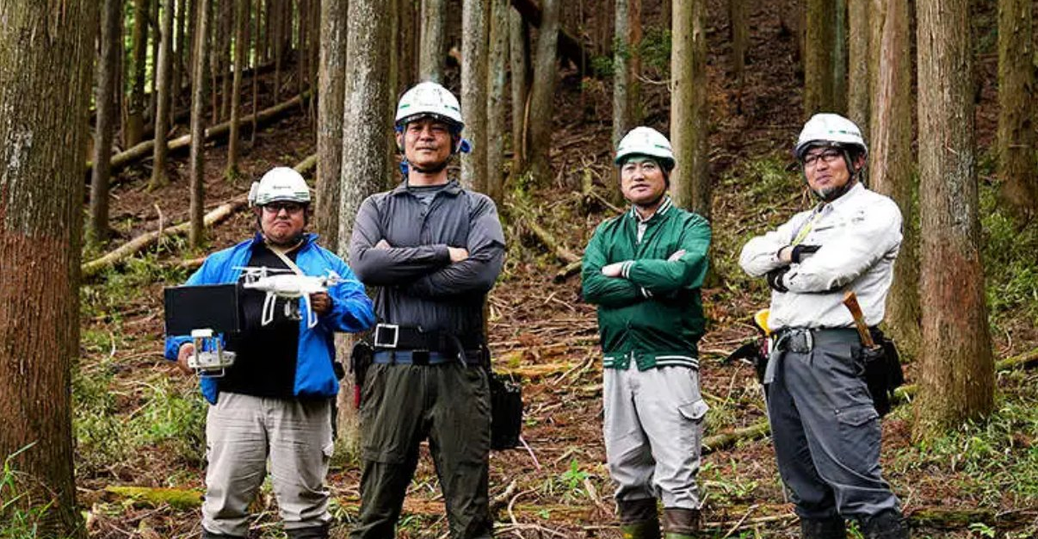
PHASE 0 · MITSUE VILLAGE · NARA PREFECTURE
NAIST SEMINAR · 13 JAN 2027 · v0.6 DRAFT · WORK IN PROGRESS
ROB 03 / 10 · THE PROBLEM IN NUMBERS
STILL RESEARCHING
Most of the thinning wood stays in the forest.
18,140 m³
cut and left in the forest
PLANNED THINNING FY2024–26 · 113 PARCELS · ≈ 222 ha · 4 DISTRICTS
2,574 m³
taken out
≈ 88 %
That cut-and-left wood is a fuel resource, if it can be collected at a price that makes sense. Steep slopes and missing roads are why it is left.
Still checking: how much is reachable with a winch-assisted machine, and what an earlier '120–300 m³/yr' cooperative figure really measured.
stays in the forest: about 860 m³ a year actually comes out
← JAMES · 3
Thin early, thin again: the rule is 170 years old. Here nobody is there to do it.
Sources: Village forestry plan R6–R8 (FY2024–26); village hall (Oba)
御 Mitsue Project
13 / 20
Notes:
18,140 of 20,714 m³ left; 2,574 out over three years (about 860/yr). Verify with the village data sheet (xlsx) before the talk. Photo: forestry team in the forest, from the project funding deck: confirm we may show it and who is in it.

Slide 14
PHASE 0 · MITSUE VILLAGE · NARA PREFECTURE
NAIST SEMINAR · 13 JAN 2027 · v0.6 DRAFT · WORK IN PROGRESS
ROB 04 / 10 · THE IDEA
Pull, don't push: give the wood a buyer that pays.
1 Thin and clear
2 Sort A / B / C / D
3 Chip and dry
4 Small CHP
Cut-to-length machines on steep sugi
A and B to the sawmill, C and D to chips
Local chipping, drying with CHP heat
Gasification plant: power and heat, 24 h
Why 'pull'. Waiting for a subsidy pushes wood out once, then stops. A buyer that wants fuel 24 hours a day pulls wood out every year, and can pay for the replanting.
Then replant. Cleared stands go back to native broadleaf (oak, chestnut, konara) for wildlife and watershed, with fast-growing kiri on part of the land. Species chosen with the NGO more trees.
← JAMES · 5
Goryōrin: the last time forestry was a business. Someone needed the wood and paid for it.
御 Mitsue Project
14 / 20
Notes:
Precedents (kept out of the slides, mention if asked): Tenkawa next door has had a biomass council since 2016 and a wood boiler heating the Dorogawa baths (visited 25 Aug 2026); Aizu 2011 turned a closed school (Akazawa Elementary) into a data center; wood power plus compute has been tried at Buena Vista (US), Deutsche Telekom/Bankhaus Metzler (DE), IIJ Matsue (JP). Leads, not proof.
Core of the talk (~10 min). Compute (AI data center) is the later anchor customer: present as 'a small compute load next to the CHP', not a done deal.

Slide 15
PHASE 0 · MITSUE VILLAGE · NARA PREFECTURE
NAIST SEMINAR · 13 JAN 2027 · v0.6 DRAFT · WORK IN PROGRESS
ROB 05 / 10 · WHAT A TREE IS WORTH, AND WHAT COMES NEXT
STILL RESEARCHING
Sell the straight logs, burn the rest, replant the hill.
WHAT A TREE IS WORTH
THEN REPLANT
A
B
C
D
Straight, clean:
sawlog
Some knots:
sawlog
Crooked, small:
chips
Tops, bark:
stays on slope
pollen, landslide risk
acorns for wildlife
Only A-grade sells today. With a CHP plant as buyer, C and D wood suddenly has a customer too.
Native broadleaf (oak, chestnut, konara), chosen with the NGO more trees, plus kiri (paulownia) as a fast fuel crop on part of the land. Mitsue growth data requested from SANSEI. Still checking.
← JAMES · 9
Only A-grade sells: the crash.
← JAMES · 7
The 1952 plan turned broadleaf into conifer. We go the other way.
Sources: Grade descriptions simplified; model v1.2 (61% A national average, 22% A in thinning-type stands)
御 Mitsue Project
15 / 20
Notes:
Grade definitions simplified: check against the Japanese log-grading rules before presenting to specialists. Reforestation principle: native broadleaf for wildlife forage; NGO picks species. Do not cite IGES/Miyawaki figures (Morales 2025 review: evidence weak). Drawings schematic. ROB to James: 'You said the 1950s plan turned broadleaf into conifer. Was it wrong, or right for its time?'

Slide 16
PHASE 0 · MITSUE VILLAGE · NARA PREFECTURE
NAIST SEMINAR · 13 JAN 2027 · v0.6 DRAFT · WORK IN PROGRESS
ROB 06 / 10 · THE FIRST NUMBERS
PLACEHOLDER PRICES
Our first model says plus, then shows how fragile that is.
STEADY-STATE SYSTEM NET, ¥M PER YEAR
Base case
+45
Not a forecast.
Owners get 0 %
+79
Base: 50 ha/yr clear-cut at 600 m³/ha, sawlogs sold, C+D chipped, half replanted to kiri, owners paid 30%.
Four unknowns decide it: wood per hectare (600 assumed, village plan 277–317), A-grade share (61% national, 22% thinning-type), landowner share (30%), residue price (¥4,000/t placeholder).
Left out: carbon credits, data-center income, machines, wages.
Owners get 50 %
+22
No residue collected
+32
Replant kiri every cut
+26
Thinning-type grade split
+4
317 m³/ha, 95 ha/yr
+1
Low price, high cost
−10
← JAMES · 6
Wartime override: what happens when short-term demand beats the plan. Our model has the same weak spot.
Sources: kiri_sugi_integrated_system_model_2026-11-03.xlsx v1.2. All prices and costs are placeholders, not quotes.
御 Mitsue Project
16 / 20
Notes:
Steady-state system net, ¥M/yr, from model v1.2. Say clearly: feasibility sizing, not a forecast. Do NOT state +45 as an expected result.

Slide 17
PHASE 0 · MITSUE VILLAGE · NARA PREFECTURE
NAIST SEMINAR · 13 JAN 2027 · v0.6 DRAFT · WORK IN PROGRESS
ROB 07 / 10 · THE ENERGY SIDE
STILL RESEARCHING
Start small to learn. Size the real plant to the wood we can get.
≈ 0.5–0.6 MWe
1.2 MWe
needs ≈ 24,000 m³ of fuel a year. Not until the harvest is proven. At ≥ 1,000 kW the tariff is FIP-only, and splitting is not allowed.
50 kWe
Prototype in a 20 ft container. ≈ 450–600 t dry wood a year. A learning step: efficiency only ~12–20% at this size.
First commercial size. 23–28% efficiency for gasifier plus engine at this scale. Fuel mostly C+D wood and residue.
NOT TO SCALE
Also: Japanese maker only; gasification + engine beats steam below ~1 MWe; grid at 6.6 kV has about 3 MW locally, none upstream; fuel may be bought from neighbouring villages.
Sources: Energy, finance and resources overview v1.1 (2026-11-03)
御 Mitsue Project
17 / 20
Notes:
'Fuel from neighbours' is not yet in the model (needs delivered ¥/t and haul distance). Do not name a CHP maker in public: shortlist and quotes are in flux.

Slide 18
PHASE 0 · MITSUE VILLAGE · NARA PREFECTURE
NAIST SEMINAR · 13 JAN 2027 · v0.6 DRAFT · WORK IN PROGRESS
ROB 08 / 10 · THE HOMEWORK, AND WHAT WE STILL DO NOT KNOW
STILL RESEARCHING
We read, we asked, we counted. Then we listed what we do not know.
45
113
2
v1.2
5+
100%
acts on forestry, biomass, 協力隊, siting read and summarised
thinning parcels read one by one
rounds of questions to Komatsu on steep-slope harvesting
of the spreadsheet model: clear-cut, logs, chips, kiri, CHP, owners
forest, village hall, Uda City and Tenkawa visits
open in a public repository, to check or challenge
OPEN QUESTION
WHO
STATUS
Stand volume, stumpage, who gets the sale income
Village hall (Oba)
asked 6 Nov
Slope limits with and without winch, road width, yearly output
Komatsu
follow-up sent
Real CHP efficiency and cost at 0.6–0.8 MWe
Maker quotes
to request
Kiri growth on Mitsue slopes
SANSEI planting data
asked 2 Nov
Grid connection at 6.6 kV
Kansai T&D
consultation drafted
Fuel bought in from neighbouring villages
Uda City, others
to approach
What students and researchers would measure
NAIST (you)
to discuss
ASK JAMES
What do we still not know about how the history actually went?
御 Mitsue Project
18 / 20
Notes:
Sources: repository docs/, research/; docs/strategy/mitsue_energy_finance_resources_overview_2026-11-03.md section 5. Numbers: 45 acts (village regulations folder), 113 parcels (thinning plan). Refresh the status column right before the talk. The last row is the real ask to NAIST. ROB to James: 'You have read far more of the old sources than we have. What would you check first?'

Slide 19
PHASE 0 · MITSUE VILLAGE · NARA PREFECTURE
NAIST SEMINAR · 13 JAN 2027 · v0.6 DRAFT · WORK IN PROGRESS
ROB 09 / 10 · WHERE WE STAND
Early planning. No money raised, no contracts, no machines bought.
NOW
DEC 2026
2027
2028 →
LATER
Phase 0
Phase 0 ends
Prototype
Machines
Full scale
Trust, sites, fuel talks, homework
Decision on first site and partners
50 kWe CHP and fuel trial, if site and partners settle
A CTL trial if a fit is shown and financing is in place
≈ 0.5–1.2 MWe and a larger compute load; no fixed date
¥0 committed. Dates are targets, not promises. The grant tracks we know of (METI GX regional, MoE zero-emission data center) are being studied, not applied for.
← JAMES · 5
Goryōrin ran a hundred-year plan for 58 years. We are at year zero.
御 Mitsue Project
19 / 20
Notes:
Align the dates with the current phase plan (Phase 0 extended to Dec 2026, later phases shifted three months). Never imply contracts exist.

Slide 20
ROB 10 / 10 · THE LONG VIEW · Q&A
75 years to grow the forest.
25 years to grow the village.
Tell us where we are wrong.
Honest critique is more useful to us than polite interest. What would you measure? What would you doubt? Who else should we ask?
Rob Oudendijk · Mitsue-it · rob@mitsue.it · mitsue.it
All documents open: https://codeberg.org/YR-Design/mitsue-ai-data-center
← JAMES · 5
The last time anyone planned forestry on this horizon.
20 / 20
Notes:
Closing image, then Q&A (~5 min). Both presenters take questions; send history questions to James. Check the signature block against docs/outreach/email_signature_standard.md. Add James's contact line only if he agrees.

