Slide 1
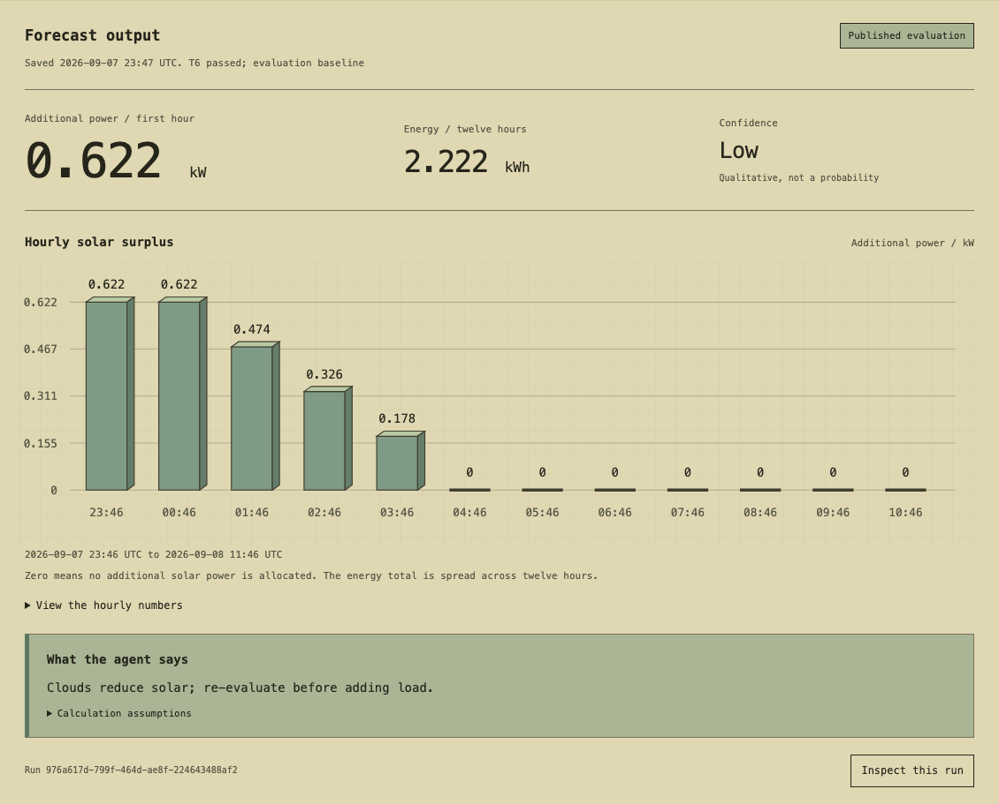
DragonWings PAP / output walkthrough
The output an operator sees
0.622 kW
Additional power in the first hour
2.222 kWh
Energy across twelve hours
Low confidence
What it does
Why it matters
Turns source readings into an hourly power profile.
Makes the result easy to review.
1 / 3
Notes:
Show the completed Forecast page. The first interval allocates 0.622 kW beyond existing load. Across twelve one-hour intervals the model allocates 2.222 kWh. Confidence is low. These are saved evaluation results, not hardware commands. The separate Inspector opens the same episode.
Evidence: submission/examples/output/output-example.json. Episode 976a617d-799f-464d-ae8f-224643488af2. Captured 2026-09-07T23:49:25.054648+00:00. Source scrape 2026-09-07T23:46:08.528303Z. Real MySolArk telemetry with synthetic weather. UI screenshot from the same episode. Repository: https://github.com/roboyak/PAP-Agent (owner controls visibility).

Slide 2
DragonWings PAP / output walkthrough
How to read the twelve-hour profile
Additional power (kW)
2026-09-07 23:46 to 2026-09-08 11:46 UTC
2.222 kWh in total
Zero means no additional solar allocation.
The total is spread across the forecast.
2 / 3
Notes:
The bars are the exact published available_kw values. Each covers one hour. The kWh total is the sum of energy_kwh from those intervals. Zero means no extra solar allocation. The total does not describe a continuous load or energy available all at once. This is a synthetic-weather persistence baseline; the taper is not a validated overnight solar forecast.
Evidence: submission/examples/output/output-example.json. Episode 976a617d-799f-464d-ae8f-224643488af2. Captured 2026-09-07T23:49:25.054648+00:00. Source scrape 2026-09-07T23:46:08.528303Z. Real MySolArk telemetry with synthetic weather. UI screenshot from the same episode. Repository: https://github.com/roboyak/PAP-Agent (owner controls visibility).

Slide 3
DragonWings PAP / output walkthrough
Guidance, evidence and human review
Recorded model guidance
Clouds reduce solar; re-evaluate before adding load.
What supports the result
What still needs judgment
1.48 kW measured solar
0.858 kW measured load
392.9 V battery / 305.2 V floor
Synthetic weather and constant demand
No battery discharge or equipment commands
Forecast accuracy remains unproven
Inspect this run
Saved details share one episode. Health checks the current service.
3 / 3
Notes:
Read the model guidance verbatim. The publication's status means deterministic checks passed. Confidence is qualitative. Real solar and load readings are used with synthetic weather, constant demand and zero battery discharge. Inspect this run opens the matching episode. Trace gives workflow order; Context, Memory, Tools, Subagent and Health explain its evidence, model activity and current dependencies. The operator retains control.
Evidence: submission/examples/output/output-example.json. Episode 976a617d-799f-464d-ae8f-224643488af2. Captured 2026-09-07T23:49:25.054648+00:00. Source scrape 2026-09-07T23:46:08.528303Z. Real MySolArk telemetry with synthetic weather. UI screenshot from the same episode. Repository: https://github.com/roboyak/PAP-Agent (owner controls visibility).

