Slide 1
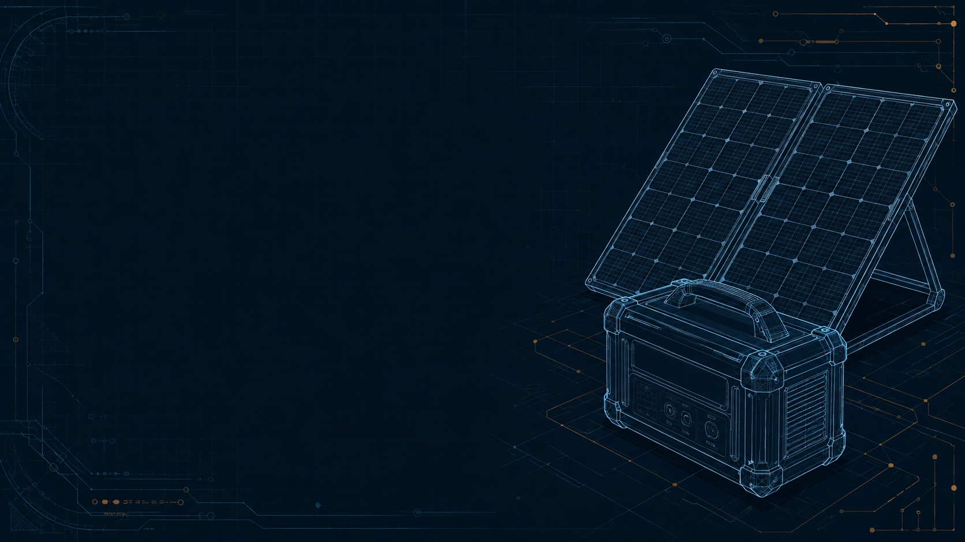
DragonWings PAP Optional 90-second pitch
Planning extra load
needs more than
a live reading
A power forecast with evidence an operator can inspect
Shawn Cunningham
1 / 3
Notes:
Planned duration: 25 seconds
An operator of a portable solar and battery system needs more than a current power reading. They need to understand how much additional load might be reasonable later, and why. My capstone, the DragonWings Power Availability Profile Forecaster, turns real local telemetry into a twelve-hour estimate of additional solar power.
Evidence
R1: https://github.com/roboyak/PAP-Agent/blob/aa61ba7f1e5fe87c90b7182ea8ba82e1cdc94ca5/README.md
Design reference: user-supplied DragonWings_Bounded_Power_Architecture.pdf and DragonWings_Bounded_Power_Forecasting.pptx. Cover illustration: generated conceptual solar and battery blueprint. Console screenshot: actual local Playwright run, September 7, 2026.

Slide 2
How it works
An agent with clear limits
Read fresh
telemetry
Calculate
solar surplus
Interpret
with evidence
Publish
or withhold
Code owns the numbers. Models explain uncertain cases.
Read-only guidance. Every equipment action stays with the operator.
2 / 3
Notes:
Planned duration: 35 seconds
It uses a durable workflow, searchable memory, and bounded language-model roles to explain uncertain cases. Ordinary code owns the calculations and validation. The models cannot change the battery voltage floor or command equipment. Six inspection views show the evidence, tool calls, memory, model outputs, and stopping decisions. That makes a published result, or a decision to withhold it, something an engineer can inspect and debug.
Evidence
R1: https://github.com/roboyak/PAP-Agent/blob/aa61ba7f1e5fe87c90b7182ea8ba82e1cdc94ca5/README.md
R2: https://github.com/roboyak/PAP-Agent/blob/aa61ba7f1e5fe87c90b7182ea8ba82e1cdc94ca5/docs/architecture/FINAL_MVP.md
Design reference: user-supplied DragonWings_Bounded_Power_Architecture.pdf and DragonWings_Bounded_Power_Forecasting.pptx. Cover illustration: generated conceptual solar and battery blueprint. Console screenshot: actual local Playwright run, September 7, 2026.

Slide 3
What the MVP demonstrates
A working foundation
for measured improvement
44 unit and integration tests
13 Chromium browser checks
Bounded model roles with visible evidence
Forecast quality still needs broader evaluation
https://github.com/roboyak/PAP-Agent
3 / 3
Notes:
Planned duration: 30 seconds
The local gate passed forty-four unit and integration tests plus thirteen browser checks. One live comparison kept the same power calculation while the third agent added latency without a demonstrated quality benefit. The forecast still uses synthetic weather factors and needs broader evaluation. My takeaway is that useful agent autonomy needs clear authority and visible evidence. DragonWings PAP makes that boundary concrete in a working local system.
Evidence
R5: https://github.com/roboyak/PAP-Agent/blob/aa61ba7f1e5fe87c90b7182ea8ba82e1cdc94ca5/docs/pr/PR-11.md
R8: https://github.com/roboyak/PAP-Agent/blob/aa61ba7f1e5fe87c90b7182ea8ba82e1cdc94ca5/docs/pr/PR-15.md
Design reference: user-supplied DragonWings_Bounded_Power_Architecture.pdf and DragonWings_Bounded_Power_Forecasting.pptx. Cover illustration: generated conceptual solar and battery blueprint. Console screenshot: actual local Playwright run, September 7, 2026.

