Slide 1
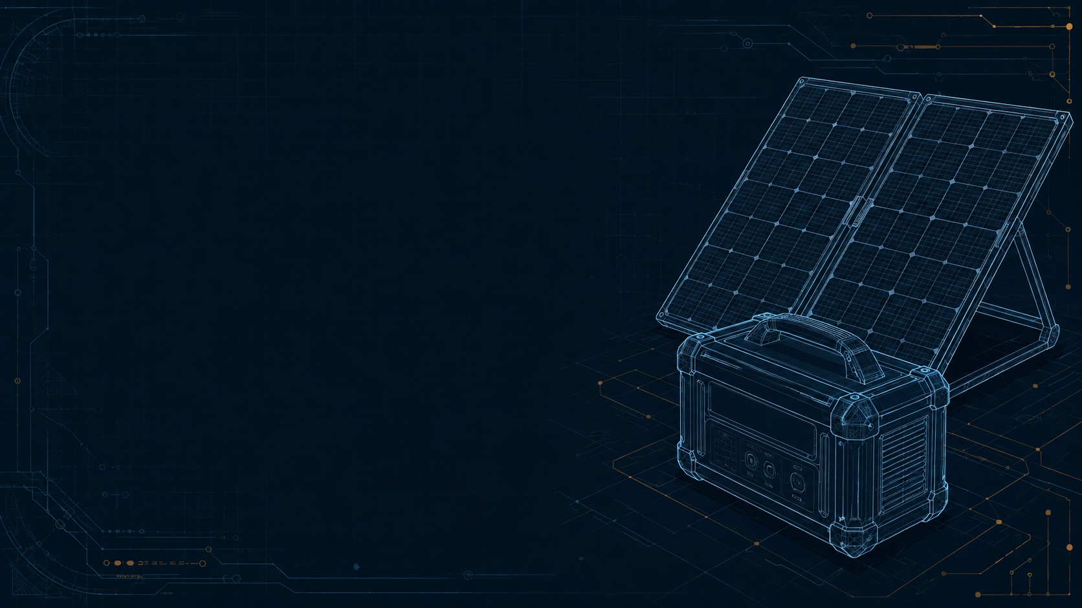
Final capstone submission
DragonWings
Power Availability
Profile Forecaster
A bounded agent for additional solar power estimates
Working MVP with inspectable evidence and human oversight
Shawn Cunningham
September 7, 2026
1 / 10
Notes:
Planned duration: 40 seconds
Hello, I am Shawn Cunningham. My capstone is the DragonWings Power Availability Profile Forecaster, or PAP. It helps an operator review how much additional solar power may be available over the next twelve hours. This is a working local agent service with real telemetry, searchable memory, and bounded model roles. The central design decision is to give numerical calculations and validation to ordinary code, while models interpret evidence. I will walk through the six checkpoints, show how they became one application, and distinguish the implementation results from the forecast quality that still needs broader evaluation.
Evidence
R1: https://github.com/roboyak/PAP-Agent/blob/74cc759/README.md
R2: https://github.com/roboyak/PAP-Agent/blob/74cc759/docs/architecture/FINAL_MVP.md
Design reference: user-supplied DragonWings_Bounded_Power_Architecture.pdf and DragonWings_Bounded_Power_Forecasting.pptx. Cover illustration: generated conceptual solar and battery blueprint. Console screenshot: actual local Playwright run, September 7, 2026.

Slide 2
Checkpoint 1 Problem and scope
The operator's planning question
How much extra load might the next 12 hours support?
Solar production
12-hour
solar-surplus profile
Operator
reviews the evidence
Existing demand
Battery voltage
What it does
Why it matters
Estimates additional power and energy by interval.
A reading taken now does not establish future availability.
MVP scope: synthetic weather factors, constant demand, zero battery discharge
2 / 10
Notes:
Planned duration: 50 seconds
The first checkpoint started with an operating question, rather than a choice of framework. An operator can see solar production, load, and battery voltage, but those readings alone do not tell them what optional load might be reasonable later. PAP combines those inputs into a twelve-hour profile. Kilowatts describe power during an interval. Kilowatt-hours describe energy over time. For this MVP, I intentionally limited the calculation to additional solar surplus. It uses synthetic hourly solar factors, keeps measured demand constant, and allocates no battery discharge. These choices make the smallest complete workflow testable, but they also mean the output is evaluation guidance. The operator still makes every equipment decision.
Evidence
R1: https://github.com/roboyak/PAP-Agent/blob/74cc759/README.md
R2: https://github.com/roboyak/PAP-Agent/blob/74cc759/docs/architecture/FINAL_MVP.md
C1: https://github.com/roboyak/PAP-Agent/blob/74cc759/20260907_151637_UTC_Final_Capstone_Report_DragonWings_PAP_Section_B.pdf
Design reference: user-supplied DragonWings_Bounded_Power_Architecture.pdf and DragonWings_Bounded_Power_Forecasting.pptx. Cover illustration: generated conceptual solar and battery blueprint. Console screenshot: actual local Playwright run, September 7, 2026.

Slide 3
Checkpoint 2 Tools and persistent state
One workflow connects the components
Read inputs
T1 / T2 MCP
Validate evidence
T3 Units and freshness
Calculate profile
T4 / T5 / T6 Python
Publish or withhold
T7 Final recheck
Qualified memory + bounded model roles
Only when the route needs interpretation
PostgreSQL stores evidence and results. LangGraph checkpoints store workflow progress.
What it does
Why it matters
Runs the evidence-to-decision sequence automatically after a request.
Every result can be traced to inputs, calculations, and a stopping decision.
3 / 10
Notes:
Planned duration: 65 seconds
Checkpoint two introduced the tool and feedback cycle. In the implemented system, LangGraph owns the workflow. The first two tools are read-only MCP adapters. One reads the persisted MySolArk scrape and one supplies the current synthetic weather scenario. T3 checks their structure, units, timestamps, and freshness. Python then forecasts, calculates solar surplus, and applies constraints. Only after those calculations does the graph assess whether interpretation is needed. Qualified memory and bounded model roles can supply advice, but they cannot rewrite the calculated power. T7 performs another freshness and constraint check before the result is published or withheld. PostgreSQL stores the actual evidence and results. The graph checkpointer stores progress and record references, which allows a run to resume without creating a competing copy of the facts.
Evidence
R2: https://github.com/roboyak/PAP-Agent/blob/74cc759/docs/architecture/FINAL_MVP.md
Design reference: user-supplied DragonWings_Bounded_Power_Architecture.pdf and DragonWings_Bounded_Power_Forecasting.pptx. Cover illustration: generated conceptual solar and battery blueprint. Console screenshot: actual local Playwright run, September 7, 2026.

Slide 4
Checkpoint 3 Retrieval and grounding
Memory adds relevant experience
Compare outcomes
Forecast vs newer sample
Admit memory
Qualified records only
Retrieve 5
Local vector search
Keep at most 3
Filter and deduplicate
Outcomes become evidence for a later run
Cited context for model guidance
What it does
Why it matters
Finds relevant past outcomes and operating guidance.
The agent can explain caution using evidence from an earlier run.
Current measurements and numerical constraints stay authoritative
4 / 10
Notes:
Planned duration: 55 seconds
Checkpoint three added searchable external memory. The operator can compare a forecast with a newer reading, then explicitly index qualified outcome records and short guidance documents. The system creates local embeddings and stores them in pgvector alongside the relational data. A query considers five candidates, checks source, version, expiry, relevance, and duplicates, and passes at most three into model context. Think of this as finding a relevant note from a previous job. It is useful context, but it cannot change the current instrument reading. One actual semantic query about protecting the battery ranked reserve guidance first. That demonstrates the mechanism. It is not an estimate of retrieval accuracy, and the cosine score is not a probability.
Evidence
R2: https://github.com/roboyak/PAP-Agent/blob/74cc759/docs/architecture/FINAL_MVP.md
R4: https://github.com/roboyak/PAP-Agent/blob/74cc759/docs/pr/PR-08.md
Design reference: user-supplied DragonWings_Bounded_Power_Architecture.pdf and DragonWings_Bounded_Power_Forecasting.pptx. Cover illustration: generated conceptual solar and battery blueprint. Console screenshot: actual local Playwright run, September 7, 2026.

Slide 5
Checkpoint 4 Selective Tree of Thoughts
Extra reasoning has a fixed budget
Routine evidence
Final publication check
Direct path without model generation
Recorded ambiguity
Generate 3
alternatives
Prune invalid
candidates
Critique
survivors
Keep 2
best branches
One refinement. Depth-three submission. Eight shared model attempts maximum.
What it does
Why it matters
Compares a few explanations when recorded evidence justifies it.
Simple cases stay quick, and difficult cases still terminate.
5 / 10
Notes:
Planned duration: 60 seconds
Checkpoint four introduced selective Tree of Thoughts. Routine evidence takes the direct path to the final publication check and needs no model generation. In the current demonstration, recorded mean solar overestimation above zero point two five kilowatts triggers ambiguity. The generator proposes up to three alternatives. Python removes invalid candidates before the critic evaluates the survivors. The controller retains a beam of two and permits only one refinement before final submission. All roles share a maximum of eight model attempts. Every call also has a time and output limit. These limits bound the search and make termination visible. The alternatives concern interpretation, refreshing evidence, or withholding. They do not propose new battery limits or alter the power formula.
Evidence
R1: https://github.com/roboyak/PAP-Agent/blob/74cc759/README.md
R2: https://github.com/roboyak/PAP-Agent/blob/74cc759/docs/architecture/FINAL_MVP.md
Design reference: user-supplied DragonWings_Bounded_Power_Architecture.pdf and DragonWings_Bounded_Power_Forecasting.pptx. Cover illustration: generated conceptual solar and battery blueprint. Console screenshot: actual local Playwright run, September 7, 2026.

Slide 6
Checkpoint 5 Agent coordination
The third role added cost in one trial
Optional interpreter adds context
Generator proposes
Critic evaluates
Same evidence snapshot | Model calls | Elapsed | Result
Two roles | 4 | 53.035 s | Valid
Three roles | 6 | 70.223 s | Withheld
Calculated kW and kWh stayed identical
What it does
Why it matters
An environment flag enables an additional interpretation role.
Its contribution can be compared before accepting added complexity.
One sequential pair. No demonstrated quality improvement. Third role defaults off.
6 / 10
Notes:
Planned duration: 65 seconds
Checkpoint five separated the generator and critic so that proposing and evaluating guidance have distinct roles. The MVP also has an optional third role that interprets the evidence before search. An environment variable controls that role, and the browser comparison uses the same telemetry and weather snapshot for both modes. In one actual MySolArk and Ollama pair, two roles used four calls and about fifty-three seconds, producing a valid publication. Three roles used six calls and about seventy seconds, producing a withheld result. The calculated power and energy were identical. This is an informative latency observation, but only one sequential pair. Warm-up and model variability could affect the comparison. I have not established that the third role improves quality, so it remains disabled by default.
Evidence
R5: https://github.com/roboyak/PAP-Agent/blob/74cc759/docs/pr/PR-11.md
Design reference: user-supplied DragonWings_Bounded_Power_Architecture.pdf and DragonWings_Bounded_Power_Forecasting.pptx. Cover illustration: generated conceptual solar and battery blueprint. Console screenshot: actual local Playwright run, September 7, 2026.

Slide 7
Checkpoint 6 Safety and human oversight
Validation controls publication
Fresh inputs
Valid arithmetic
Voltage above floor
Supported guidance
305.2 V
Pass: publish read-only profile
Fixed observed voltage floor
Fail: withhold with a reason
What it does
Why it matters
Stops publication when required evidence or checks fail.
A convincing explanation must not bypass an operating constraint.
No equipment commands. No prediction or guarantee of future battery voltage.
7 / 10
Notes:
Planned duration: 55 seconds
Checkpoint six made the safety and oversight boundaries explicit. Input checks, numerical checks, bounded model execution, and the final publication gate each have a visible purpose. A scan of six thousand five hundred twenty-seven MySolArk records found a minimum of three hundred five point two volts. I use that fixed floor under the user's operating policy, which associates it with roughly thirty percent reserve. PAP does not measure SOC or derive a voltage-to-SOC curve. It withholds at or below the configured reading and never reduces the floor automatically. It also does not predict future battery voltage. The operator can inspect a withholding reason, resolve the evidence or configuration, and request another validated run. There are no hardware-control tools.
Evidence
R1: https://github.com/roboyak/PAP-Agent/blob/74cc759/README.md
R2: https://github.com/roboyak/PAP-Agent/blob/74cc759/docs/architecture/FINAL_MVP.md
Design reference: user-supplied DragonWings_Bounded_Power_Architecture.pdf and DragonWings_Bounded_Power_Forecasting.pptx. Cover illustration: generated conceptual solar and battery blueprint. Console screenshot: actual local Playwright run, September 7, 2026.

Slide 8
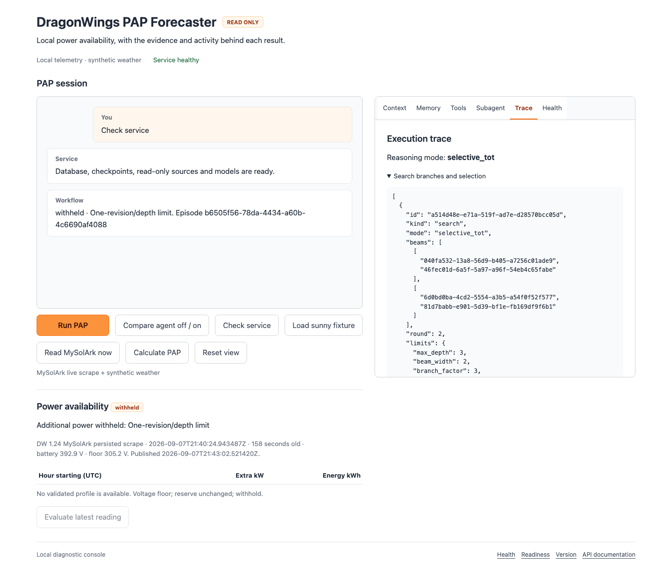
Integrated MVP Monitoring and debugging
Six views explain each decision
Context
Inputs and calculated facts
Memory
Retrieved records and feedback
Tools
Schemas, calls, and results
Subagent
Role inputs and validated outputs
Trace
Branches, scores, and stop reasons
Health
Source and dependency readiness
What it does
Why it matters
Makes the working agent inspectable from one local console.
A result is easier to debug when its evidence and decisions are visible.
8 / 10
Notes:
Planned duration: 50 seconds
The integrated console brings these checkpoints together. Context shows the actual inputs and calculated facts. Memory shows retrieved records and evaluated outcomes. Tools shows the read-only interfaces, call arguments, results, and elapsed time. Subagent shows role inputs, schemas, validated outputs, and usage. Trace shows graph progress, branch pruning, scores, and stopping reasons. Health checks the source, database, vector store, checkpointer, and local models. The screenshot is an actual browser run that withheld publication. That is useful to inspect because the application should explain why it stopped, rather than leave an unexplained empty result. These views expose evidence and structured decisions, not private model chain-of-thought.
Evidence
R1: https://github.com/roboyak/PAP-Agent/blob/74cc759/README.md
R6: https://github.com/roboyak/PAP-Agent/blob/74cc759/docs/pr/PR-12.md
Design reference: user-supplied DragonWings_Bounded_Power_Architecture.pdf and DragonWings_Bounded_Power_Forecasting.pptx. Cover illustration: generated conceptual solar and battery blueprint. Console screenshot: actual local Playwright run, September 7, 2026.

Slide 9
Final evaluation Implemented behavior and limits
Evidence supports the integrated workflow
40
10
One newer real telemetry sample
Point-power metric | Error
Solar overestimation | 0.410 kW
Availability error | 0.076 kW
Unit and integration tests
Chromium Playwright checks
Reproducible local gate
What it does
Why it matters
Tests arithmetic, boundaries, persistence, retrieval, and the browser flow.
Separates software correctness from forecast and advice quality.
Required tests use model doubles. Live checks are small demonstrations, not accuracy rates.
9 / 10
Notes:
Planned duration: 65 seconds
Evaluation uses two complementary methods. The required local gate passed forty unit and integration tests plus ten Chromium Playwright checks. The tests cover numerical behavior, invalid inputs, voltage policy, model boundaries, search budgets, durable execution, retrieval, and the console. They use deterministic model doubles so results can be repeated. Separately, live browser checks used the real local telemetry database and actual Ollama models. One newer sample measured zero point four one zero kilowatts of solar overestimation and zero point zero seven six kilowatts of availability error. These are point-power comparisons, not measured hourly energy. The final live run completed within its model budget and exposed a withheld outcome. The evidence supports integration and tested boundaries. It does not establish forecast accuracy, calibrated confidence, or an agent quality success rate.
Evidence
R3: https://github.com/roboyak/PAP-Agent/blob/74cc759/docs/pr/PR-07.md
R6: https://github.com/roboyak/PAP-Agent/blob/74cc759/docs/pr/PR-12.md
Design reference: user-supplied DragonWings_Bounded_Power_Architecture.pdf and DragonWings_Bounded_Power_Forecasting.pptx. Cover illustration: generated conceptual solar and battery blueprint. Console screenshot: actual local Playwright run, September 7, 2026.

Slide 10
Capstone review and continuation
Repository and next steps
https://github.com/roboyak/PAP-Agent
README.md
Next improvements
Setup and usage
src/pap_agent/
Validated weather and equipment limits
Workflow, tools, models, and UI
tests/ and docs/pr/
Verification and teaching evidence
Held-out forecast outcomes
submission/
Editable content and artifact builders
Repeated agent comparisons and operator review
make bootstrap
PAP_PROFILE=macmini-replay make run
make verify
What it does
Why it matters
A reproducible local MVP with bounded, observable model roles.
The next improvements can be measured against an inspectable baseline.
10 / 10
Notes:
Planned duration: 55 seconds
The repository is at github dot com slash roboyak slash PAP dash Agent. Its README explains the native prerequisites, architecture, setup, and usage. Reviewers can use the synthetic replay profile without the private telemetry database. The code, tests, and PR evidence show each teaching increment. The submission folder contains the editable content and scripts that regenerate this presentation and report. The main strength is the integrated boundary between evidence, deterministic calculation, and model advice, with enough visibility to inspect a run. The next work is to validate real weather and equipment capability, evaluate held-out forecast outcomes, and repeat the agent comparison with order balanced across trials. The result is a working foundation for evaluation, with the limits of its current claims stated explicitly.
Evidence
R1: https://github.com/roboyak/PAP-Agent/blob/74cc759/README.md
R2: https://github.com/roboyak/PAP-Agent/blob/74cc759/docs/architecture/FINAL_MVP.md
Design reference: user-supplied DragonWings_Bounded_Power_Architecture.pdf and DragonWings_Bounded_Power_Forecasting.pptx. Cover illustration: generated conceptual solar and battery blueprint. Console screenshot: actual local Playwright run, September 7, 2026.

