Slide 1
Airline Crew Scheduling
Robert Pacuła

Slide 2
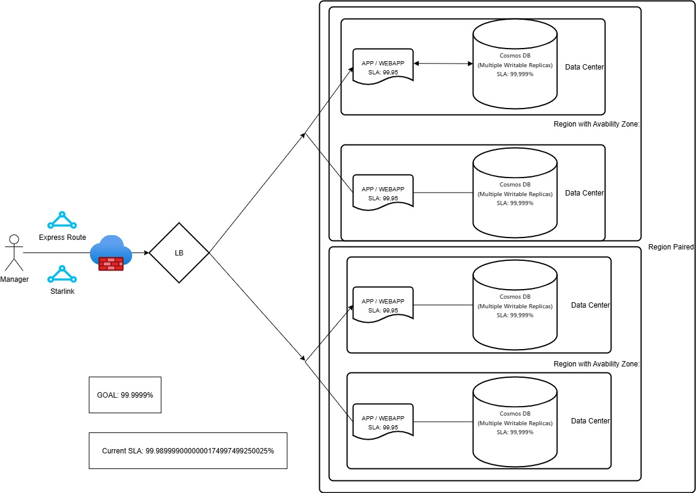
Slow Internet Connetsion / SLA:

Slide 3
DataBase Diagram:

Slide 4
RLS plan with separate schema as a upper layer:
[ap].[vGetFlyingCrew],
[ap].[vGetUserNotFollowingRules],
[ap].[vGetUserFlownHoursPerMonth],
[ap].[vGetFlightDetails],
[ap].[vGetUserDetails]
For Whom ? Airport Managers could see only data related to theirs airport.

Slide 5
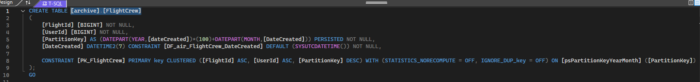
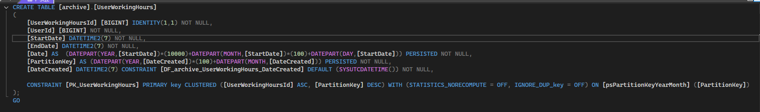
Archiving / HouseKeeping data:
[archive].[CrewHoursFlown],
[archive].[Flight],
[archive].[FlightCrew],
[archive].[UserWorkingHours]
Switch partition is much faster than copying data.

Slide 6
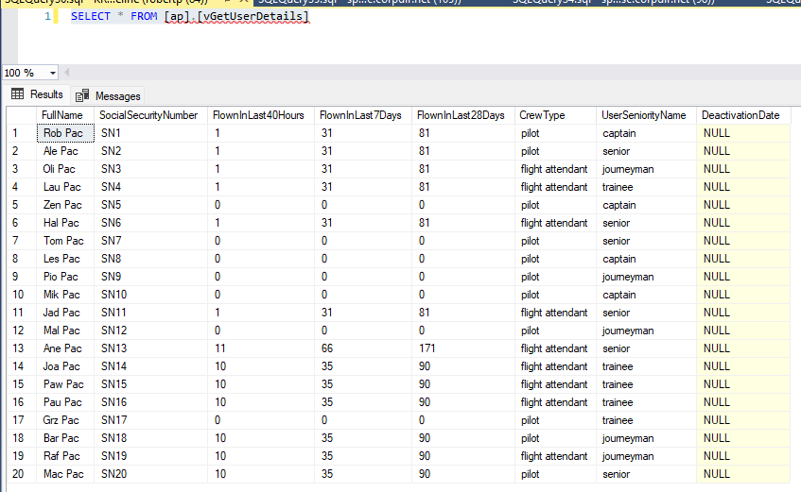
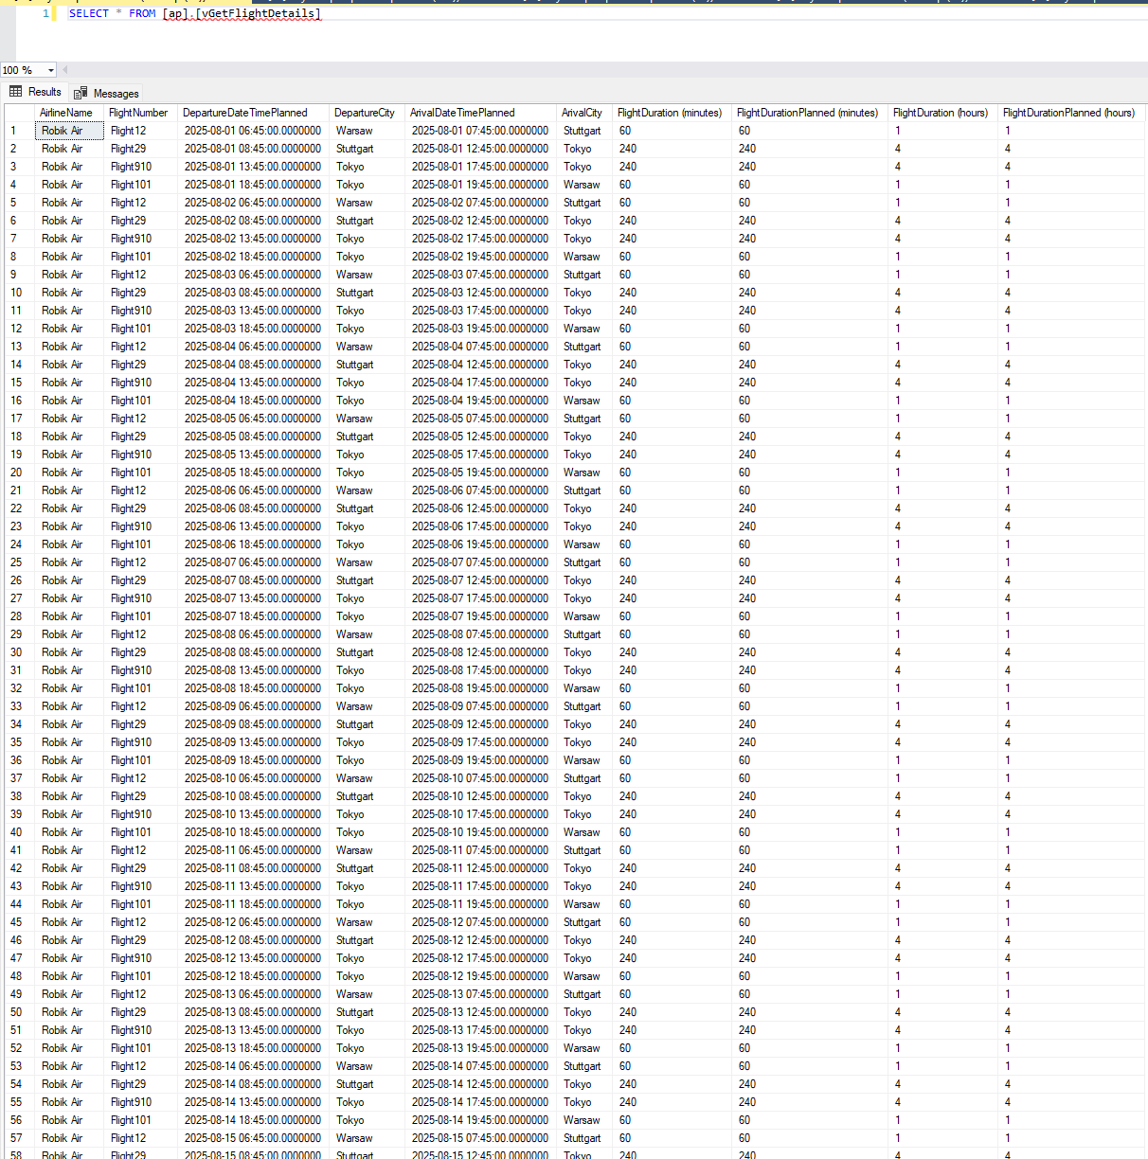
View with Users:
View with Flights:

Slide 7
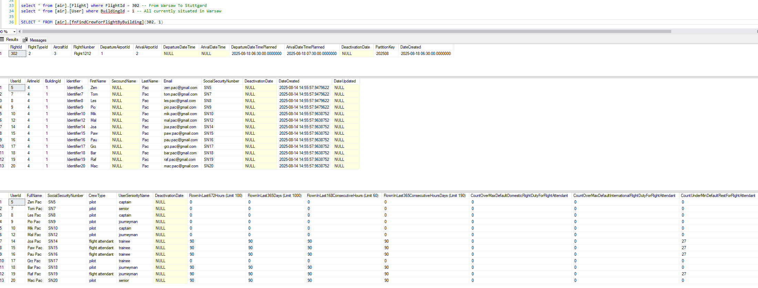
Report 2: Looking for a cew for by a location:

Slide 8
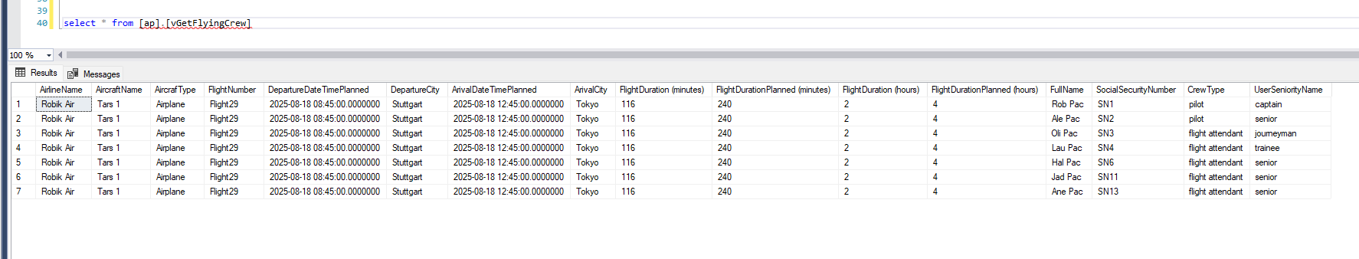
Report 3: All crew members currently in flight:

Slide 9
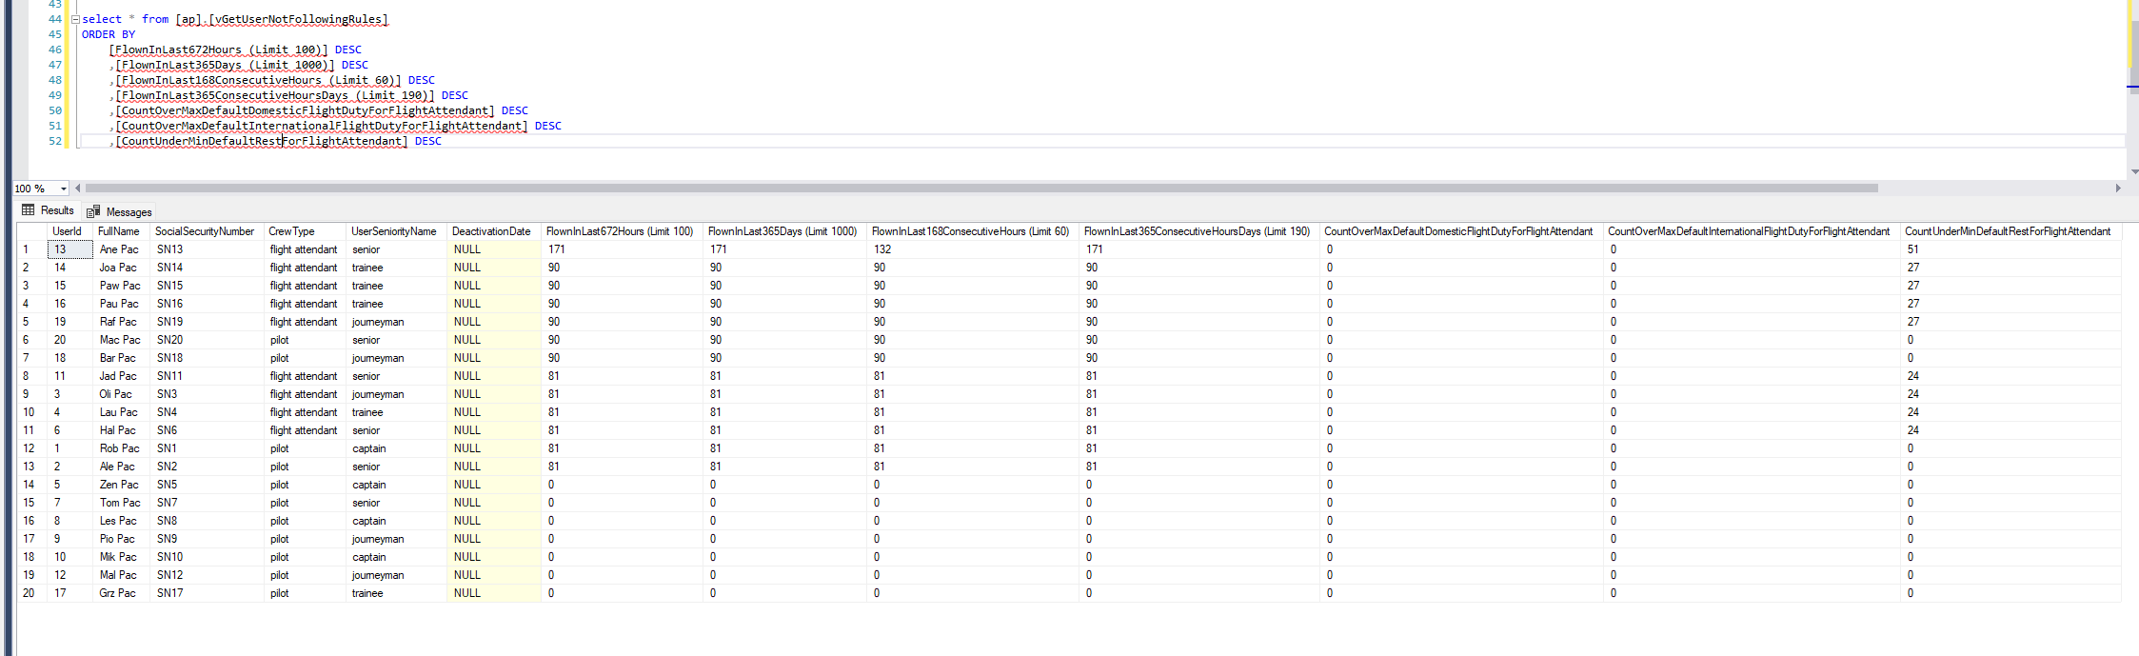
Report 4: All crew members with hour limitations:

Slide 10
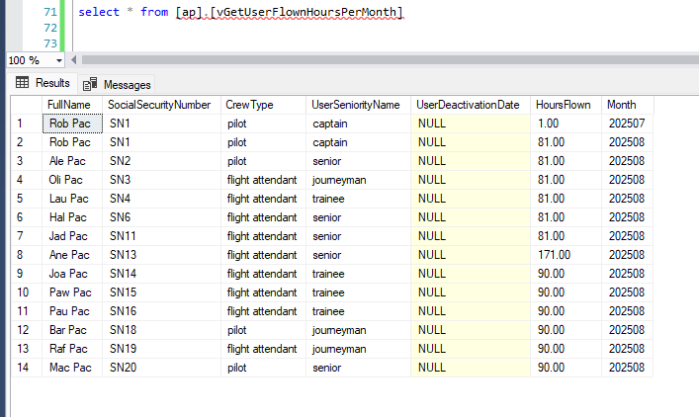
Report 5: All Users with hours worked per month :

Slide 11
T-SQL Queries:
Thank you!
https://github.com/robpacpriv/airline

