Slide 1
CSc 631 Network Issues for MultiPlayer Game Design

Slide 2
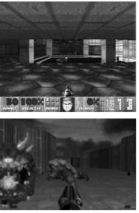
Networked Games: Doom
id Software, 1993
First-person shooter (FPS) for PCs
Part of the game was released as shareware in 1993
extremely popular
created a gamut of variants
Flooded LANs with packets at frame rate

Slide 3
Networked Games: ‘First Generation’
Peer-to-peer architectures
  each participating computer is an equal to every other
  inputs and outputs are synchronized
  each computer executes the same code on the same set of data
Advantages:
  determinism ensures that each player has the same virtual environment
  relatively simple to implement
Problems:
  persistency: players cannot join and leave the game at will
  scalability: network traffic explodes with more players
  reliability: coping with communication failures

Slide 4
Networked Games: ‘Second Generation’
Client-server architectures
  one computer (a server) keeps the game state and makes decisions on updates
  clients convey players’ input and display the appropriate output but do not inlude (much) game logic
Advantages:
  generates less network traffic
  supports more players
  allows persistent virtual worlds
Problems:
  responsiveness: what if the connection to the server is slow or the server gets overburdened?

Slide 5
Networked Games: ‘Third Generation’
Client-server architecture with prediction algorithms
  clients use dead reckoning
Advantages:
  reduces the network traffic further
  copes with higher latencies and packet delivery failures
Problems:
  consistency: if there is no unequivocal game state, how to solve conflicts as they arise?

Slide 6
Networked Games: ‘Fourth Generation’
Generalized client-server architecture
  the game state is stored in a server
  clients maintain a subset of the game state locally to reduce communication
Advantages:
  traffic between the server and the clients is reduced
  clients can response more promptly
Problems:
  boundaries: what data is kept locally in the client?
  updating: does the subset of game state change over time?
  consistency: how to solve conflicts as they occur?

Slide 7
Networking
Data transfer
  latency
  bandwidth
  reliability
  protocol
Internet protocols
  TCP, UDP
  unicast, broadcast, multicast
Communication architectures
  peer-to-peer
  client-server

Slide 8




Server and Client
host:port
host:port
host:port
Server listens
on a port #
host:port
Clients make “calls”
to that port #

Slide 9
Server and client can be the same machine!
Client Process
Server Process

Slide 10
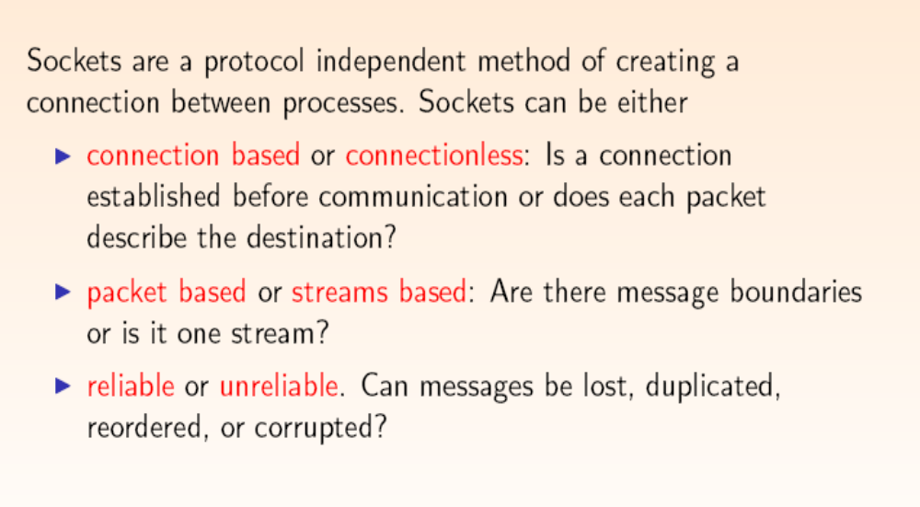
Socket Programming

Slide 11
TCP
Connection-Oriented
  Port on “client” connects to port on “server”
Reliable
  3-way handshake
Byte-Stream
  To application, looks like stream of bytes flowing between two hosts
Flow Control
  Prevents overrunning receiver / network capacity
Notes:
First, it is connection-oriented, unlike IP.
IP, where each packet is conceptually separate... TCP packets are part of one connection
In Addition, the connection is two-way. Software can write bytes to the connection, and it shows up other side.
Second, it’s End-to-End Reliable
The destination will reassemble and error check packets
Lost, Corrupted packets will be resent by the sender
Third, TCP provides illusion of continuous, byte stream from sender to recipient.
Bytes written 1234 by the sender... will show up 1234 at the receiver
Finally, TCP has Flow Control which means that
Sender wills slow down to a packet rate that the receiver and network can cope with. The way it does this is with ACK packets. Helps to share network capacity between users...

Slide 12
User Datagram Protocol (UDP)
Characteristics
  Connectionless, Datagram, Unreliable
Good for Streaming Media, Real-time Multiplayer Networked Games, VoIP
Notes:
No connection establishment.... packets can show up at any time.... the App has to handle whether you are prepared for the incoming data or not...
Datagram.... means UDP packets are self contained no sequencing like in TCP
Unreliable like IP, no ACKs... no flow control, no automatic retransmission...
Adds checksumming the headers.... to prevent errors... Adds application multiplexing, to send the UDP packet to the correct service. Both TCP and UDP perform this demultiplexing, and they use port numbers to do it....

Slide 13
Web Server example I
A server class starts max number threads of request_handler that extends Thread class.
hconfig = new httpd_config("httpd.conf");
if(!hconfig.isValid()){
System.out.println("Configuration file not correct");
return;}
mime = new mime_config(hconfig.getValue("TypesConfig"));
mime.setDefault(hconfig.getValue("DefaultType"));
s = new server(hconfig,mime);
if(s.isReady()){
s.run();
}
Server.run
for(i=0; i<maxthreads;i++){
request_handler server_thread = new request_handler(ss,i,hc,mc,l);
server_thread.start();
}

Slide 14
Web Server example II
A main server class waits for connections and creates new thread when a new request arrives.
The ServerHandler extends thread class.
while( true )
{
Socket socket = sSocket.accept();
new ServerHandler( socket, numThreadsCreated,
srmProp ).start();
}
ServerHandler.run
BufferedReader in = new BufferedReader(
new InputStreamReader(
socket.getInputStream()));
request.readRequest(in);
response = new HResponse(request,socket.getOutputStream());
socket.close();

Slide 15
Socket Example in C
struct sockaddr_in peer;
peer.sin_addr.s_addr = inet_addr(”127.0.0.1”);
peer.sin_port = htons(7500);
peer.sin_family = AF_INET;
s = socket(AF_INET, SOCK_STREAM,0);
connect(s, (struct sockaddr *)&peer, sizeof(peer));
send(s, “Hi There!”, 9, 0);

Slide 16
Client Side –
Establishing a Connection
Establish Socket Connection
Send & Receive Data
Close Socket Connection
Demo of Winsock programming

Slide 17
Design of a Game Room
Server/Client
Server listens
Clients call

Slide 18
Game Server Design 1
Server State
  Updated whenever a client connects
  Who is connected
  Send out accumulated updates from each client to every connecting client
Server Abilities
  Accept a New Connection
  Close a Connection
  Receive an action from a client
  Send the actions to all connected clients

Slide 19
Game Server Design 1
Client State
  Updated asynchronously when a client connects to server
  Who is connected
  Send out accumulated updates from each client to every connecting client
Client Abilities
  Receive a list of actions of other players from a server
  Update the player’s states in their own client copy

Slide 20
JAVA Example for Server
JAVA SERVER - singlethreaded
ServerSocket ding = null;
Socket dong = null;
try {
// ServerSocket, Socket are availalbe Java classes.
ding = new ServerSocket(hcf.getListenPort());
System.out.println("Opened socket " + hcf.getListenPort());
while (true) { // keeps listening for new clients, one at a time
try {
dong = ding.accept(); // waits for client here
}
catch (IOException e) {
System.out.println("Error opening socket");
System.exit(1);
}
try {
// Connection is built, so read stream from the socket
// and parse request
ReadHMsg(dong);
} catch (Exception e){
System.out.println("Error writing output"); }

Slide 21
Web Server - multithreaded
A server class starts max number threads of request_handler that extends Thread class.
hconfig = new httpd_config("httpd.conf");
if(!hconfig.isValid()){
System.out.println("Configuration file not correct");
return;}
mime = new mime_config(hconfig.getValue("TypesConfig"));
mime.setDefault(hconfig.getValue("DefaultType"));
s = new server(hconfig,mime);
if(s.isReady()){
s.run();
}
Server.run
for(i=0; i<maxthreads;i++){
request_handler server_thread = new request_handler(ss,i,hc,mc,l);
server_thread.start();
}

Slide 22
Request_handler.run
Request_handler.reset
public void run(){
while(true){
reset();
s = get_socket();
if(s==null){
// got an error,
// return and kill thread
return;
}
set_streams();
get_request();
process_request();
send_reply();
close_socket();
}
}
private void reset(){
env.reset();
r_method = null;
r_page = null;
r_http_version = null;
r_address = "";
r_agent = "-";
r_accept = null;
r_referer = "-";
r_ctype = null;
r_clength = "0";
r_command = "";
error_code = 0;
script = false;
filename = null;
scriptname = null;
filelength = 0;
filestream = null;
}

Slide 23
Request_handler.get_socket
private synchronized Socket get_socket(){
try{
Socket incoming = ss.accept();
return(incoming);
}
catch(IOException e){
System.out.println(e);
}
return(null);
}

Slide 24
Web Server – multithread example II
A main server class waits for connections and creates new thread when a new request arrives.
The ServerHandler extends thread class.
while( true )
{
Socket socket = sSocket.accept();
new ServerHandler( socket, numThreadsCreated,
srmProp ).start();
}
ServerHandler.run
BufferedReader in = new BufferedReader(
new InputStreamReader(
socket.getInputStream()));
request.readRequest(in);
response = new HResponse(request,socket.getOutputStream());
socket.close();

Slide 25
Request_handler.get_socket
private synchronized Socket get_socket(){
try{
Socket incoming = ss.accept();
return(incoming);
}
catch(IOException e){
System.out.println(e);
}
return(null);
}

Slide 26
Extend web server to game server
A main server class waits for connections and creates new thread when a new request arrives.
The server maintains connections from clients and maintain status of all the connected clients.
Each client updates server about 10 times per sec.
Server updates the status and returns the status of connected clients who are in the same room.
Clients updates status of other connected players on their side.

Slide 27
Our Game Protocol
“Endianness”
In computing, endianness is the byte (and sometimes bit) ordering used to represent some kind of data. Typical cases are the order in which integer values are stored as bytes in computer memory (relative to a given memory addressing scheme) and the transmission order over a network or other medium. When specifically talking about bytes, endianness is also referred to simply as byte order. ^{[1]} The usual contrast is between most significant byte (or bit) first, called big-endian, and least significant byte (or bit) first, called little-endian.
Game client: Panda3D – Little-endian
Game server: Java – Big-endian
Encoding
All data packages sending between client and server are in the format of “pydatagram” which is heavily used in the client-side programming. The protocol between client and server should strictly follow this format when sending data packages on the wire.
Generic Package Format:
[Total length of package] [Data1 encoded] [Data2 encoded]…
----->2 bytes Short<------
(fixed)
Nurse Game C/S Generic Package Format:
[Total length of package] [Request or response ID] [Data1 encoded] [Data2 encoded]…
----->2 bytes Short<------ ----->2 bytes Short<------
(fixed) (fixed)

Slide 28
Requests (client to server in Pydatagram format)
# Some changes made to conform to the Python and Java communication
Implemented – Necessary functions
To be implemented – Need less client side support, doable
Type and usage | Format
RequestLogin Client requests to login with a username and password. The server validates this and responds with ResponseAuth | Short Constants.CMSG_AUTH String Username String Password
RequestHeartbeat Client's state has not changed, but enough time has passed that the client would like an update from the server. Each client now is a thread and associated with a specific username, when request comes, server knows which client is sending the heartbeat, so no user id is required. The server will be able to check the client’s queued response and send all of them out to the client socket. | Short Constants.REQ_HEARTBEAT String Greeting
RequestLogout Client wishes to log out from the game. No more requests are to be sent after this. The server will respond with ResponseDisconnected, and server will update other users with ResponseRemoveUser. | Short Constants.CMSG_DISCONNECT_REQ String message
RequestMove Client issues a change to their location, and isMoving flag. This is used when a client wishes to move or stop moving. It is followed by creating a number of ResponseMove and Server will update other users with these ResponseMove | Short Constants.CMSG_MOVE Float x //location vector Float y Float z Float h //facing direction boolean isMoving
RequestChatPrivate Client sends chat message to a single player. Message type can be used with a buddy list. The private chat message will be delivered only if the “to” user is online at the time the update reaches them. | Short Constants.CMSG_PRIVATE_CHAT String receiverName String message
RequestChatGlobal Client sends chat message to everyone currently online. | Short Constants.REQ_CHAT_GLOBAL String message
RequestChatTeam Client sends chat message to every member of their team currently online. | int Constants.REQ_CHAT_TEAM long userId String message

Slide 29
Responses (server to client in Pydatagram format)
# Some changes made to conform to the Python and Java communication
Implemented – Necessary functions
To be implemented – Need less client side support, doable
Type and usage | Format
ResponseAuth Affirmative response to RequestLogin. It is followed by creating a number of ResponseCreate. All ResponseCreate will be queued up into all OTHER users’ update queue. | Short Constants.SMSG_AUTH_RESPONSE Int flag (1 valid 2 invalid) String greeting
ResponseCreate Create one character in client game world represent one existing user who already logs in. The new character in the world will be associated with username. | Short Constants.SMSG_CREATE String createCharacterName String greeting
ResponseLogout Client sends out request to disconnect. Server replies and removes user from current list also inform other clients to remove the user. Followed by creating a number of ResponseRemoveUser. All ResponseRemoveUser will be queued up into all OTHER users’ update queue. | Short Constants.SMSG_DISCONNECT_ACK
ResponseRemoveUser One client disconnects. Server informs other clients to remove the user in their game worlds. | Short Constants.SMSG_REMOVE_USER String removeCharacterName String message

Slide 30

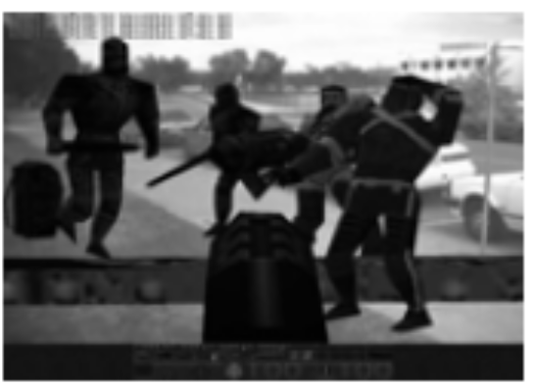
BTW….Old Networked Game Idea: ARQuake
School of Computer and Information Science, University of South Australia
  augmented reality version of
  Quake: walk around in the real world and play Quake against virtual monsters
Components
  head mounted display
  mobile computer
  head tracker
  GPS system

