Slide 1

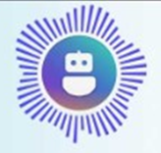



Agent Rob Architecture
1
2
3
MS Foundry
User
AI Agent
Voice Live API
4
GPT-4.1
→ User talks to the Agent
→ Agent streams to Voice Live API
→ Voice Live API hands off to Microsoft Foundry
→ Microsoft Foundry uses GPT‑4.1 model
→ response streams back to the user.

