Slide 1

TFE4141: MICROARCHITECTURE and
PERFORMANCE ESTIMATION
Roberto Scardia
Wassim Fathallah
Eduardo Vàsquez

Slide 2
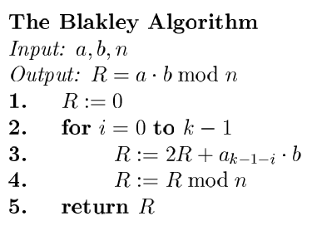
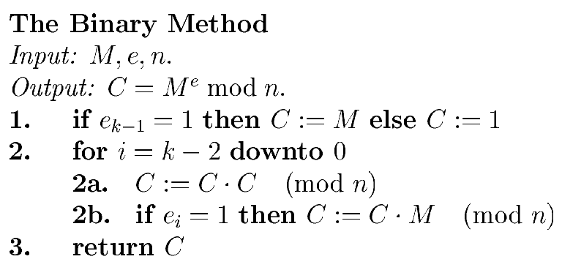
ALGORITHM
Blakley Method for modulus multiplication + Binary Method for modulus exponentiation
Simple algorithms that are known to perform well (see Hall of Fame)
Easy to understand and optimize space or time wise (depending on our needs)

Slide 3
MICROARCHITECTURE: M-EXP

Slide 4
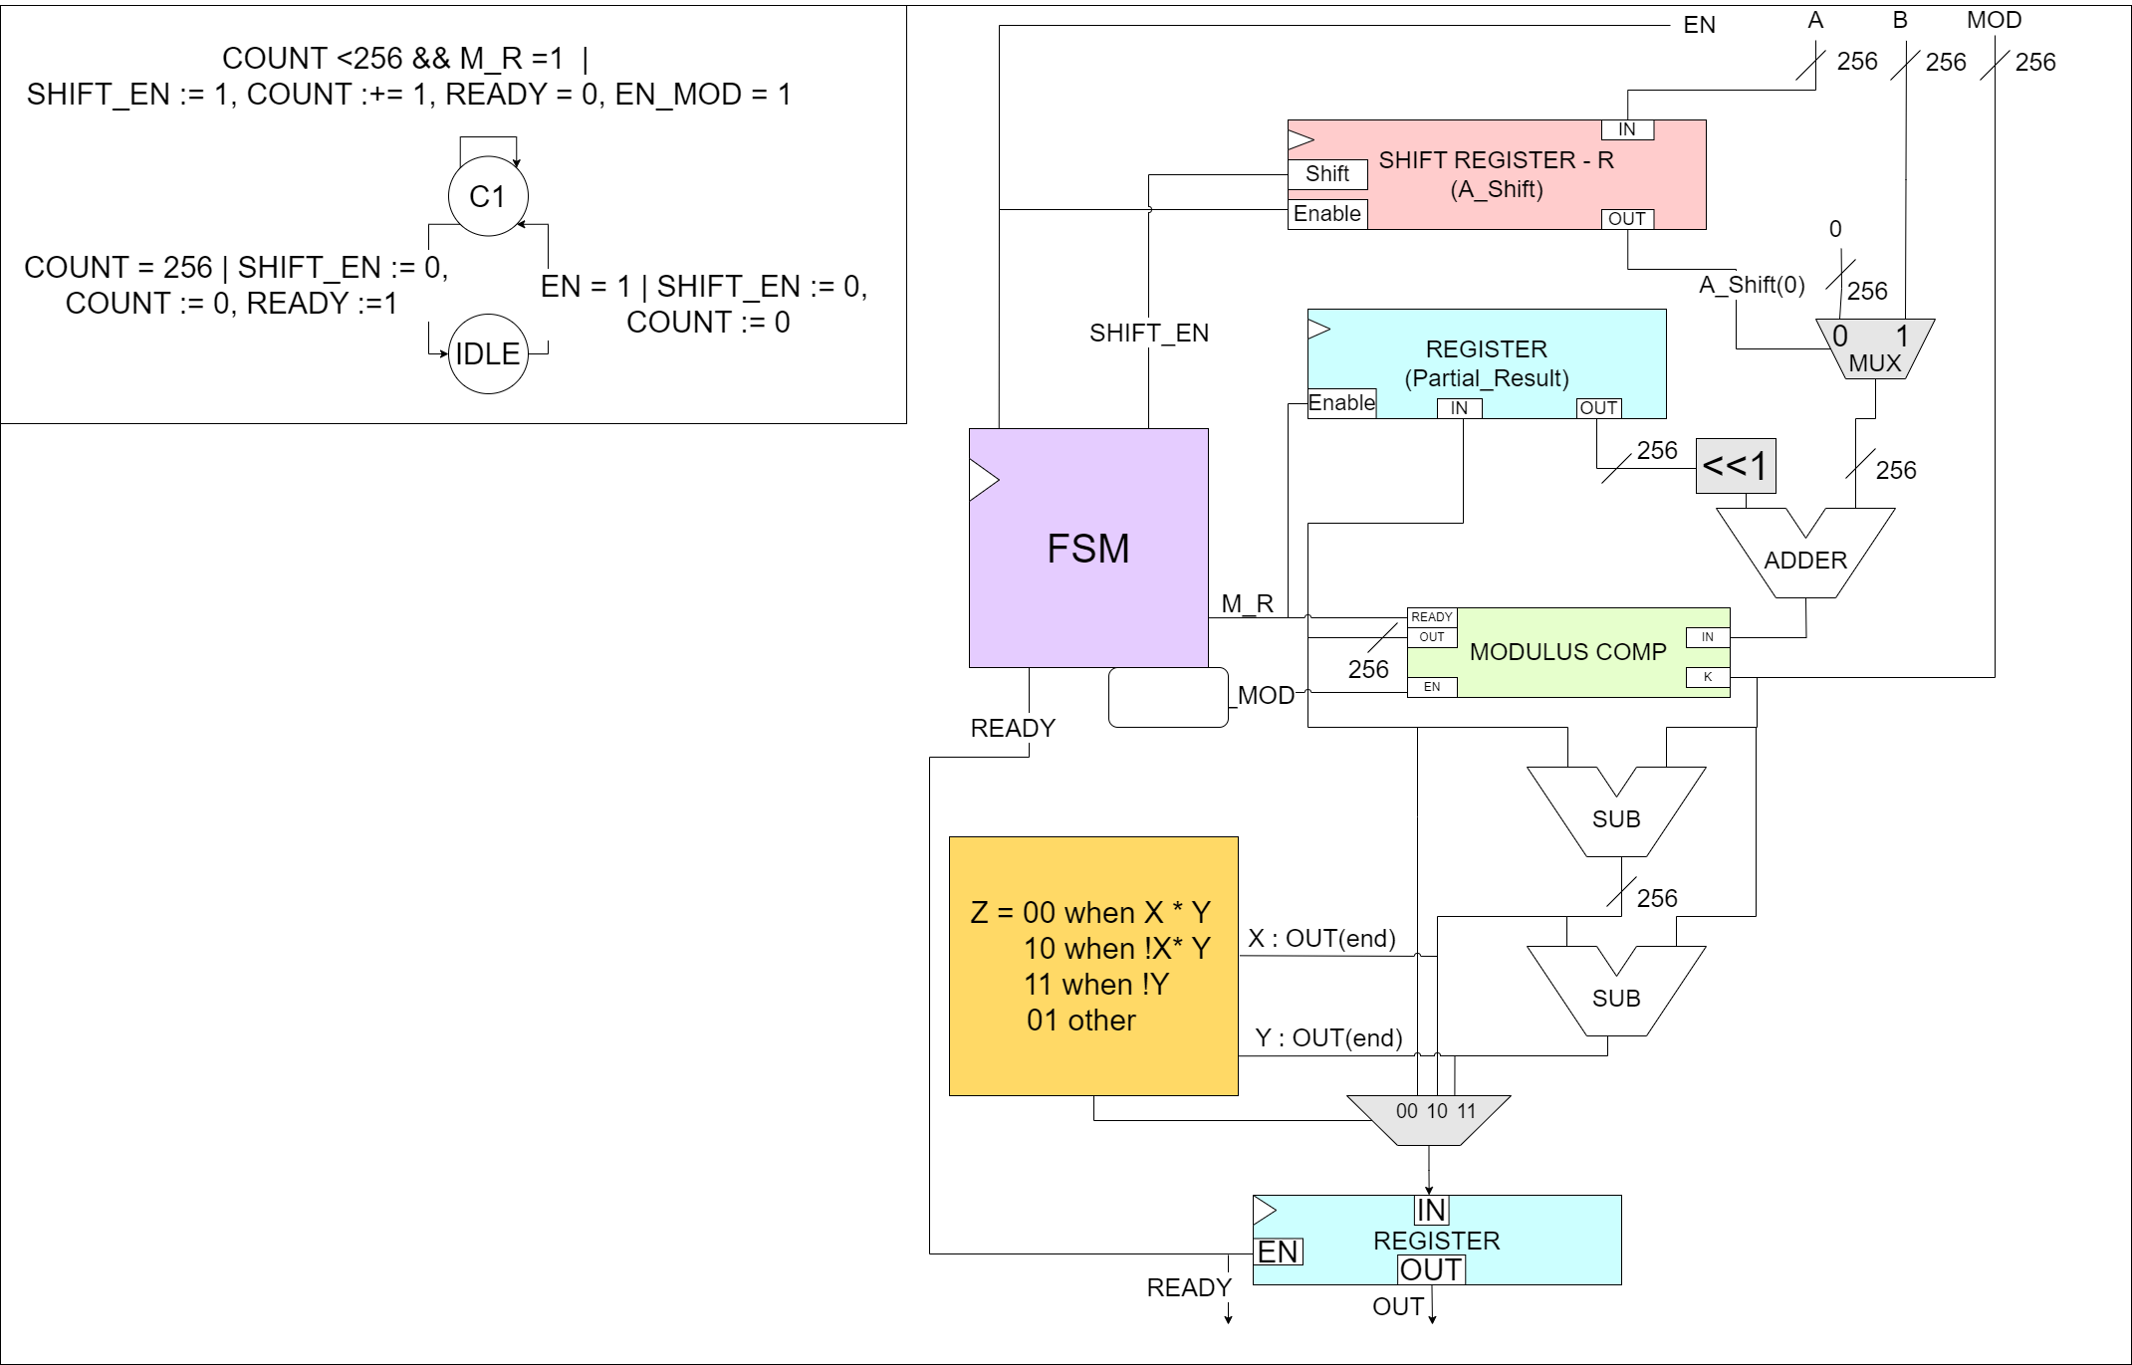
MICROARCHITECTURE: M-MOLT
Serial
Implementation of the Blakley Method:

Slide 5
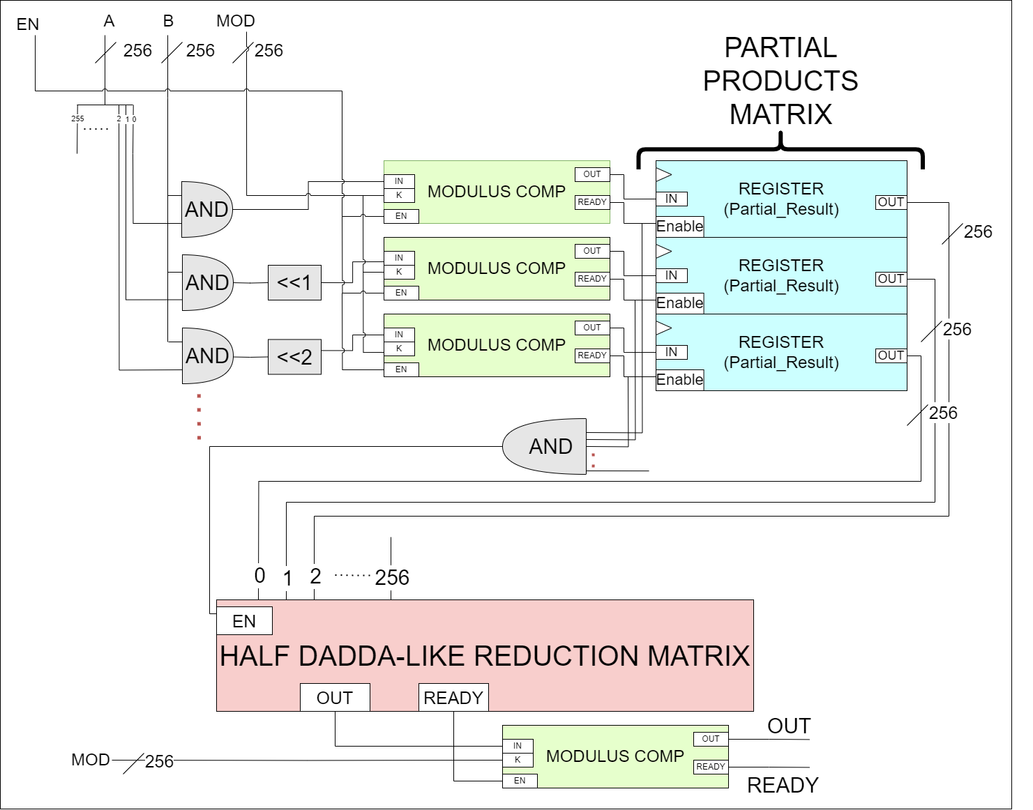
MICROARCHICTURE: M-MOLT
Parallel
Implementation of the Blakley Method:

Slide 6
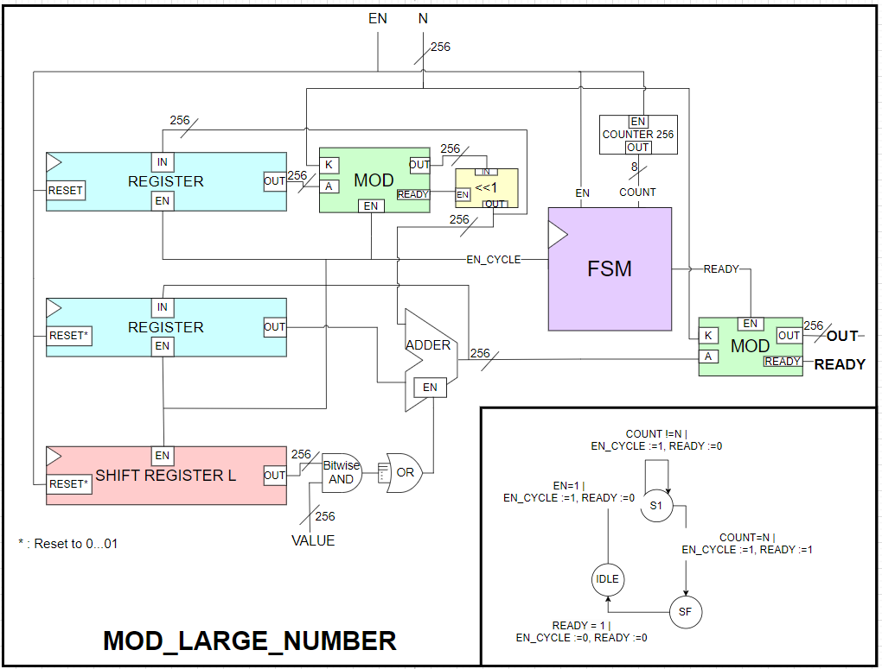
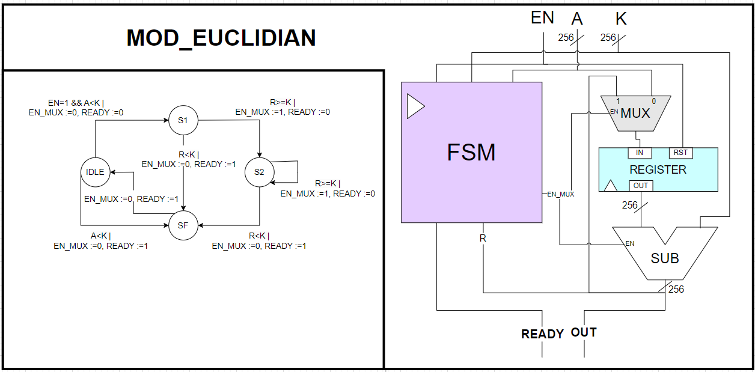
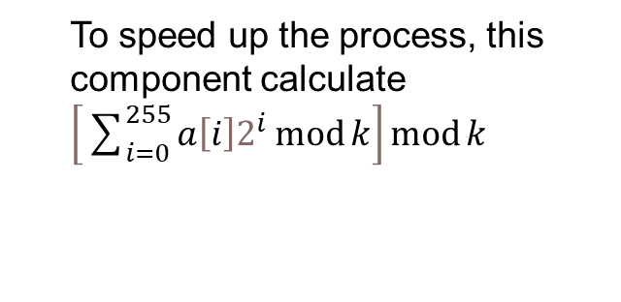
MICROARCHITECTURE: MODULUS
To speed up the process, this component calculate $\left[\sum_{i=0}^{255}{a\left[i\right]2^{i}\operatorname{mod}{k}}\right]\operatorname{mod}{k}$

Slide 7
PERFORMANCE ESTIMATION
If we consider the serial implementations of each component, we find that to elaborate a message block of 256 bits one core takes approx. 256^3 ~ 1.67*10^7 cycles. With a 100MHz clock cycle this means that it will take ~167 ms to process one block.
If we use the parallel implementation for the modulus multiplier, the estimated amount of cycles needed is 256^2*10 ~ 6.55*10^5 (6.55 ms @100MHz).
The design can be further improved by using the board’s CPU and RAM to precalculate and store the 2^i mod k values needed for the modulus component.

