Slide 1
Knuckle Input
Robin Schweigert, Simon Hagenmayer, Jan Leusmann
Fachpraktikum Interaktive Systeme: Machine Learning and Computer Vision for HCI | Stuttgart | 11.12.2018

Slide 2

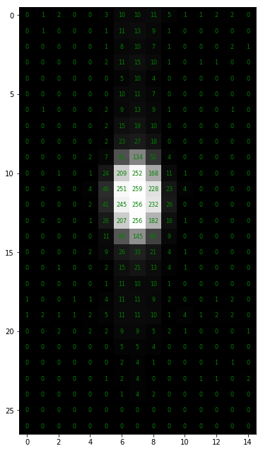
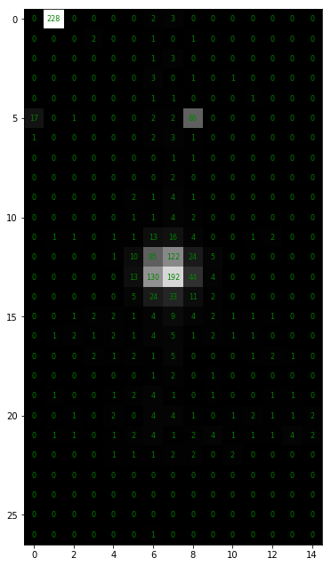
Step 1 - Data Collection
Data is stored
24.7 to 24.8 samples/second
Some data is lost
< 1%
DataStream is missing some characters
Blob Detection in progress
So far 10 participants
Finger
Knuckle

Slide 3
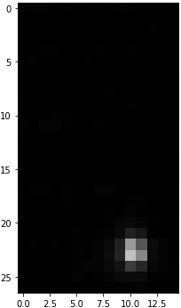
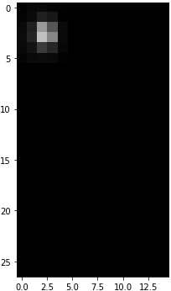
Step 2 – Finger/Knuckle Recognition
Split Data in Training and Test
7 participants for training
3 participants for testing
Run blob detection
Move blob to left upper corner
Raw Image
Blob Image

Slide 4
Step 2 – Finger/Knuckle Recognition
CNN to decide between Finger and Knuckle
2 Layer:
2 x Convolution
MaxPooling
Dropout
2 x Dense
2 Conv2D
MaxPool
Dropout
2 Conv2D
MaxPool
Dropout
Finger
Dense
Dense
Knuckle
Notes:
Flatten between second batch and dense

Slide 5
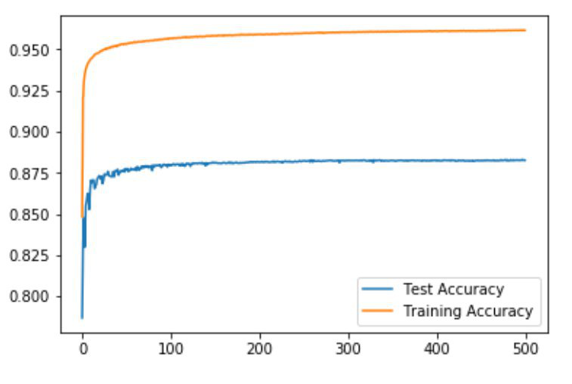
Step 2 – Finger/Knuckle Recognition

Slide 6
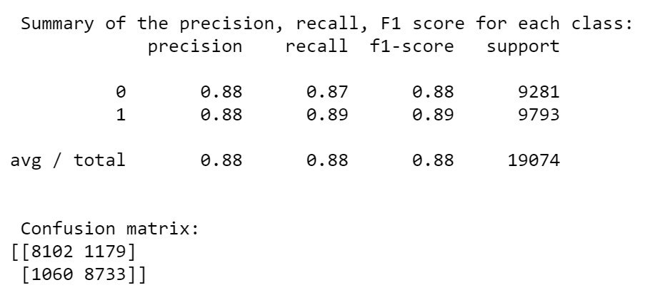
Step 2 – Finger/Knuckle Recognition

Slide 7
Step 3 - Gesture recognition – First Approach
Use same blob detection
Add up all blobs
Then use CNN for classification

Slide 8
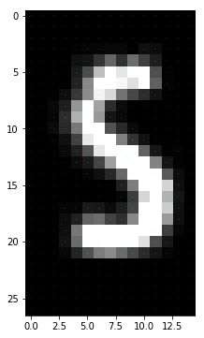
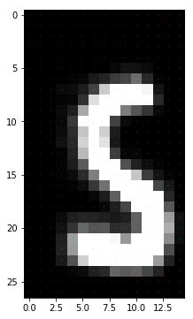
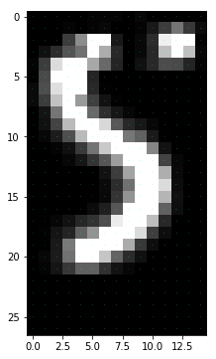
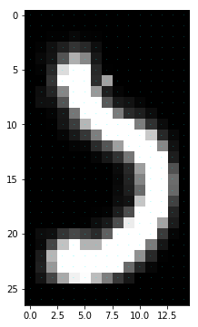
Step 3- Gesture recognition – First Approach

Slide 9
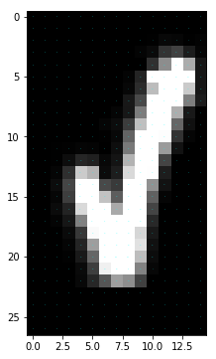
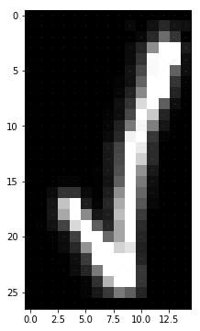
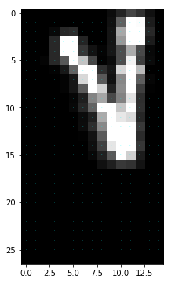
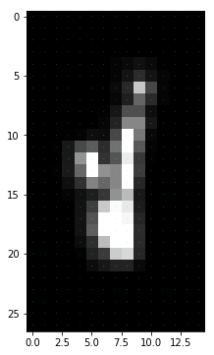
Step 3 - Gesture recognition – First Approach

Slide 10
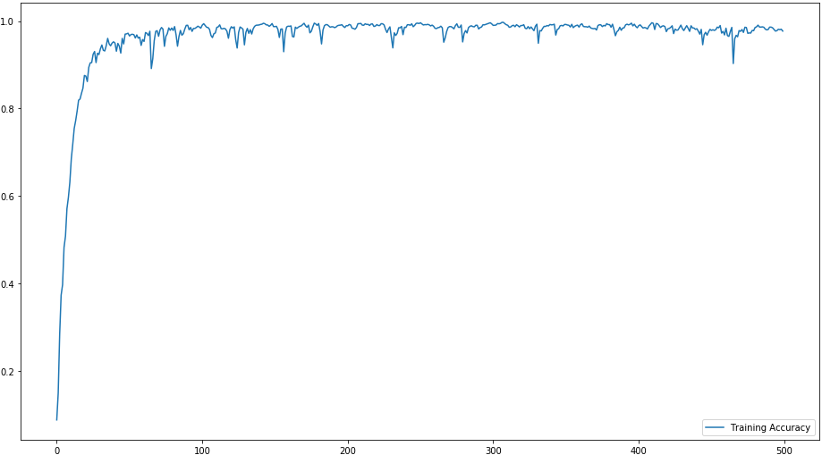
Step 3 - Gesture Recognition - CNN

Slide 11
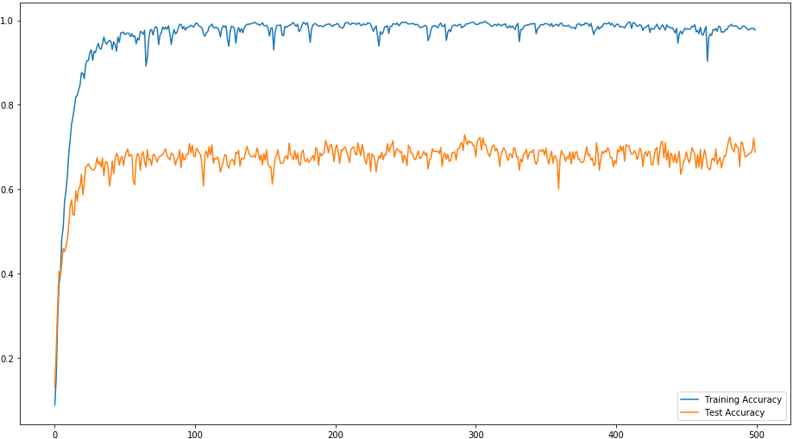
Step 3 - Gesture Recognition - CNN

Slide 12
Step 4 - Gesture Recognition - Solution
LSTM to the rescue
Hopefully better test results
Hopefully less overfitting
Currently work in progress

Slide 13
Todo
?
Questions
?

