Slide 1
Knuckle Input
Simon Hagenmayer, Robin Schweigert, Jan Leusmann

Slide 2
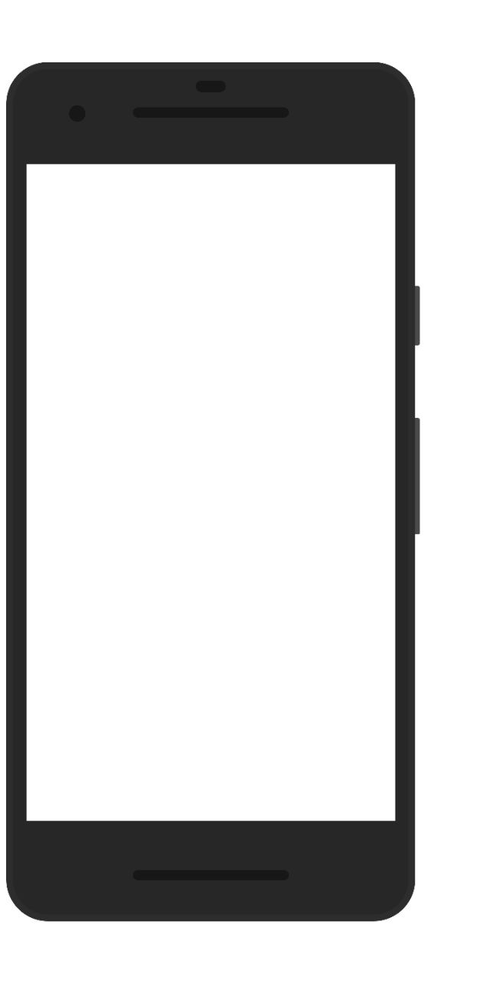
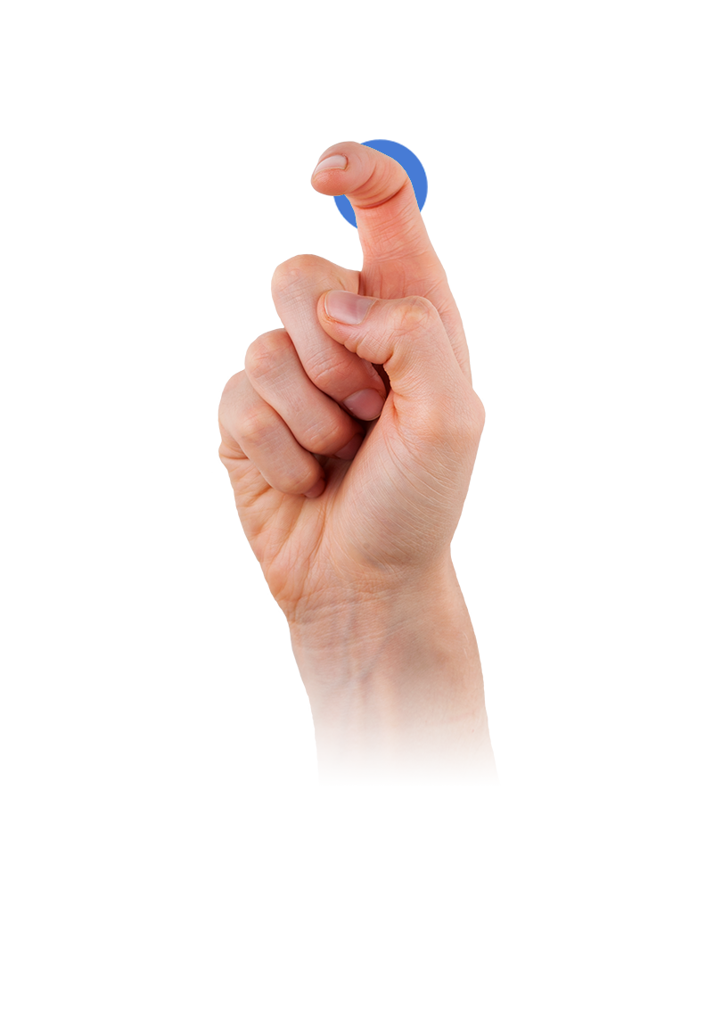
Motivation
Extend current options for input on a touchscreen
Recognize if touch input is finger or knuckle
Differentiate between 17 different gestures
source: qeexo.com/fingersense/

Slide 3
Related Work
TapSense
Sound-based
Differentiate between four different finger inputs
SVM: 86% accuracy
Nail+
3x3 grid of strain sensors, worn on the fingernail
Different levels of applied finger-force can be detected
85% accuracy
Qeexo FingerSense
Implemented in Huawei Smartphones

Slide 4
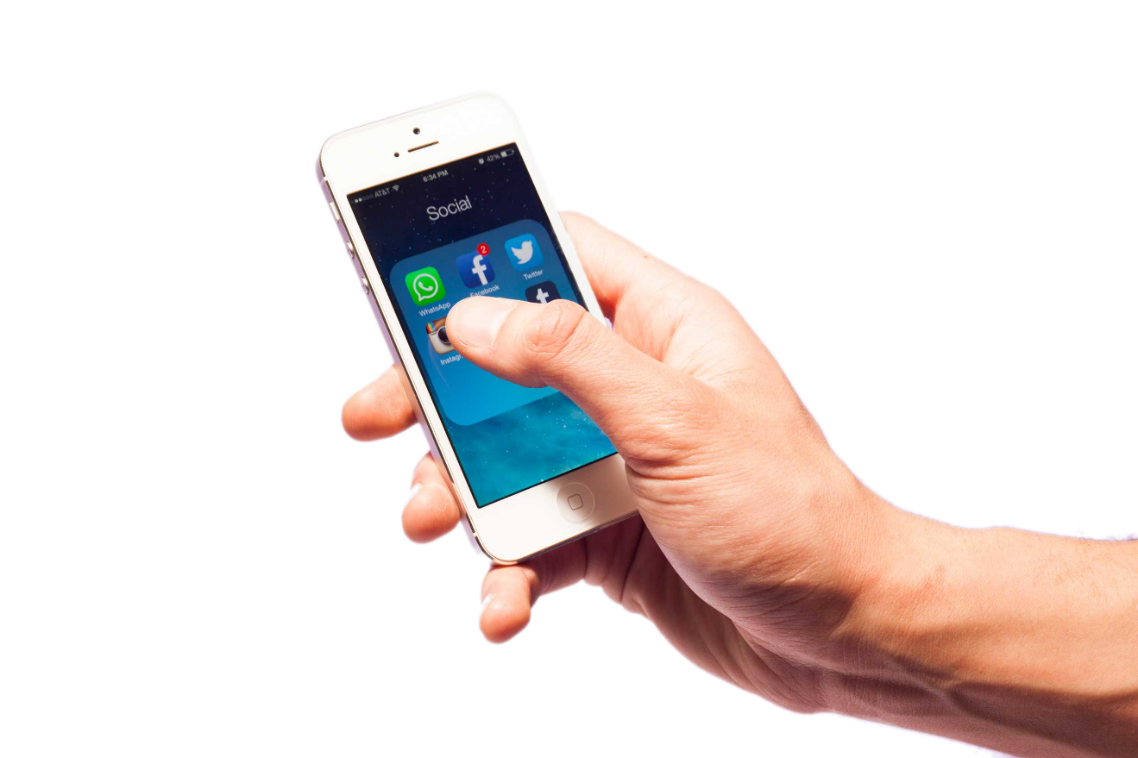
Study
Only right-handed, no movement impaired
Two-handed interaction only
17 Gestures
20 repetitions per gesture
Both knuckle and finger
Within-Subject design
17 participants
Study-length: 60 minutes
source: time.com

Slide 5
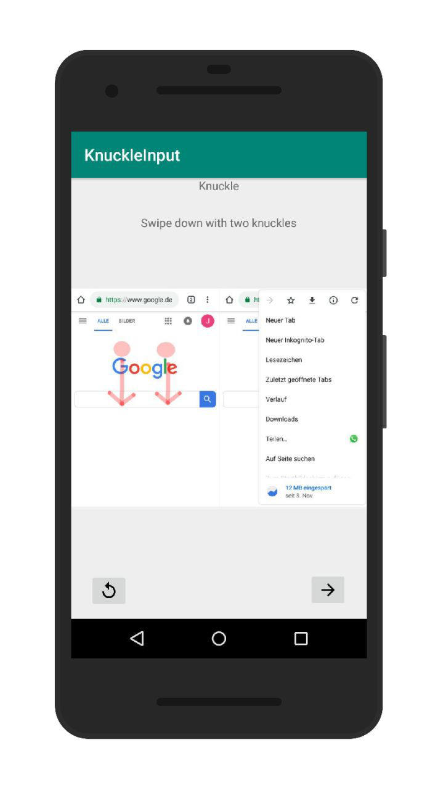
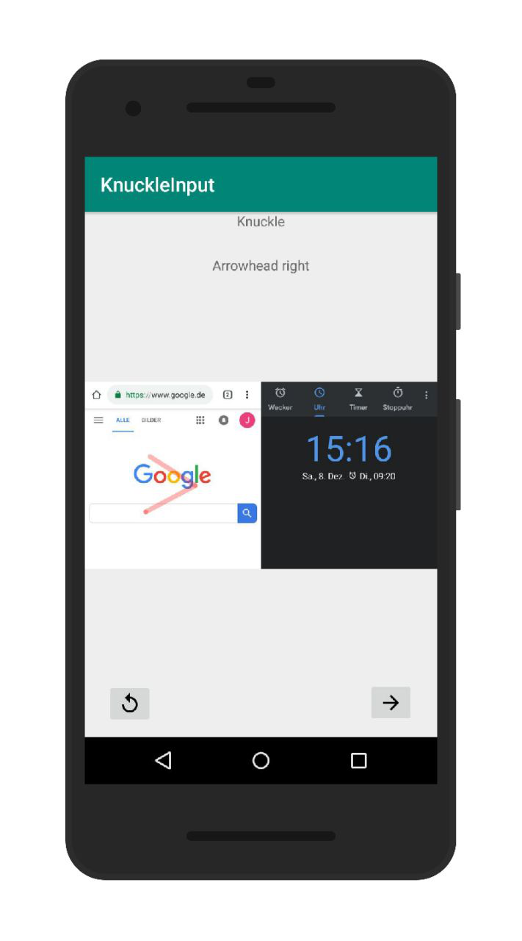
Study App

Slide 6
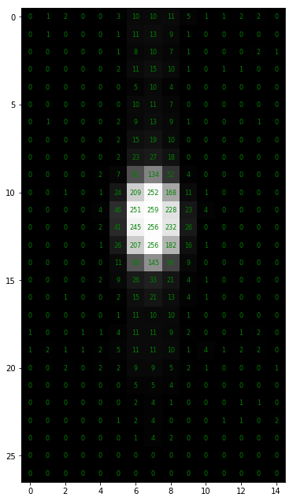
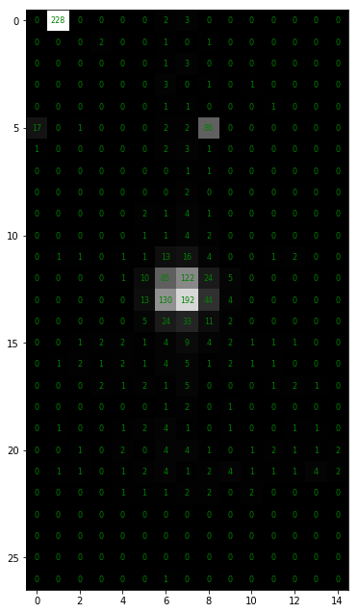
Data Collection: Data
956426 Images in total
27 * 15 pixels each
806891 actual gesture images

Slide 7
Preprocessing: First Filters
Use highest repetition only
Blob detection on images
Get rid of images without blobs
Remaining: 155439

Slide 8
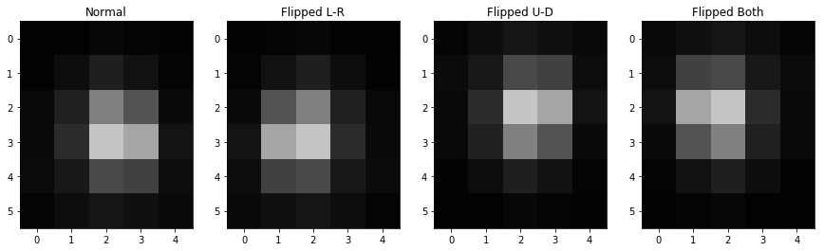
Preprocessing: Data Augmentation
Mirroring on both x and y-Axis
New total images: 621756

Slide 9
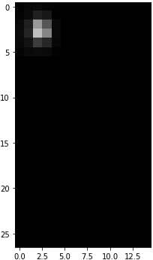
CNN: Structure
DENSE
DENSE
DENSE
Conv2D
Conv2D
BatchNorm
MaxPool2D
Dropout
Conv2D
Conv2D
BatchNorm
MaxPool2D
Dropout
Finger
Knuckle

Slide 10
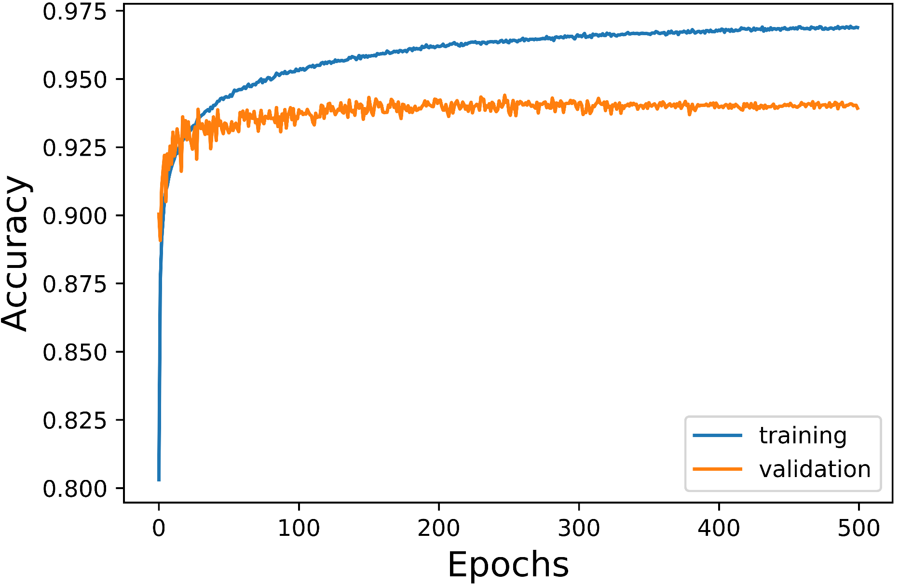
CNN: Results

Slide 11

CNN: Cross-Validation
TestID | ValAcc | Acc
1 | 0.9466 | 0.9596
2 | 0.9672 | 0.9577
3 | 0.9602 | 0.9533
4 | 0.9454 | 0.9612
5 | 0.9872 | 0.9571
6 | 0.9699 | 0.9562
7 | 0.9061 | 0.9625
8 | 0.9909 | 0.9560
9 | 0.8627 | 0.9613
10 | 0.8349 | 0.9636
11 | 0.8984 | 0.9586
12 | 0.9438 | 0.9596
13 | 0.9922 | 0.9589
14 | 0.9738 | 0.9568
15 | 0.9676 | 0.9569
16 | 0.9929 | 0.9543
17 | 0.9598 | 0.9545
Mean | 0.9470 | 0.9581
Leave one out
Trained for 500 epochs
Mean values are very similiar to a general trained model

Slide 12
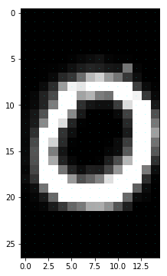
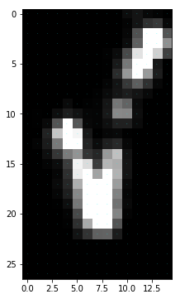
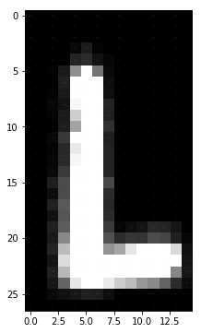
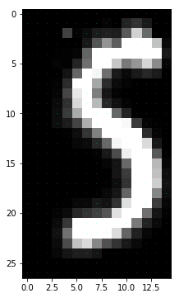
Gestures
First idea: CNN for gestures with combined images
Val. Accuracy ~ 40%
LSTM
Fixed window size (30/50)

Slide 13
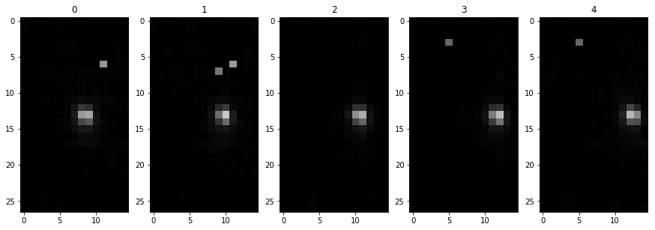
Preprocessing: LSTM
Take images between first and last blob
Reset gesture index
Remaining: 8088 gestures

Slide 14
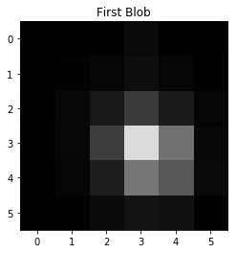
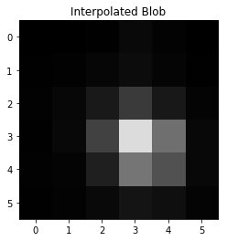

Preprocessing: Interpolation
Filter on gestures on length
Fixed window size, some Gestures are longer, some shorter → Interpolation
Detect Blobs, Interpolate Blobs, Interpolate Positions

Slide 15
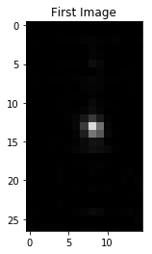
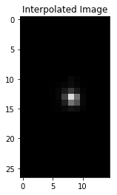
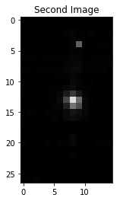
Preprocessing: Interpolation

Slide 16
LSTM: Structure
Tap
Two Tap
LSTM
DENSE
DENSE
Conv2D
Conv2D
MaxPool2D
Dropout
LSTM
Checkmark
Rotate

Slide 17
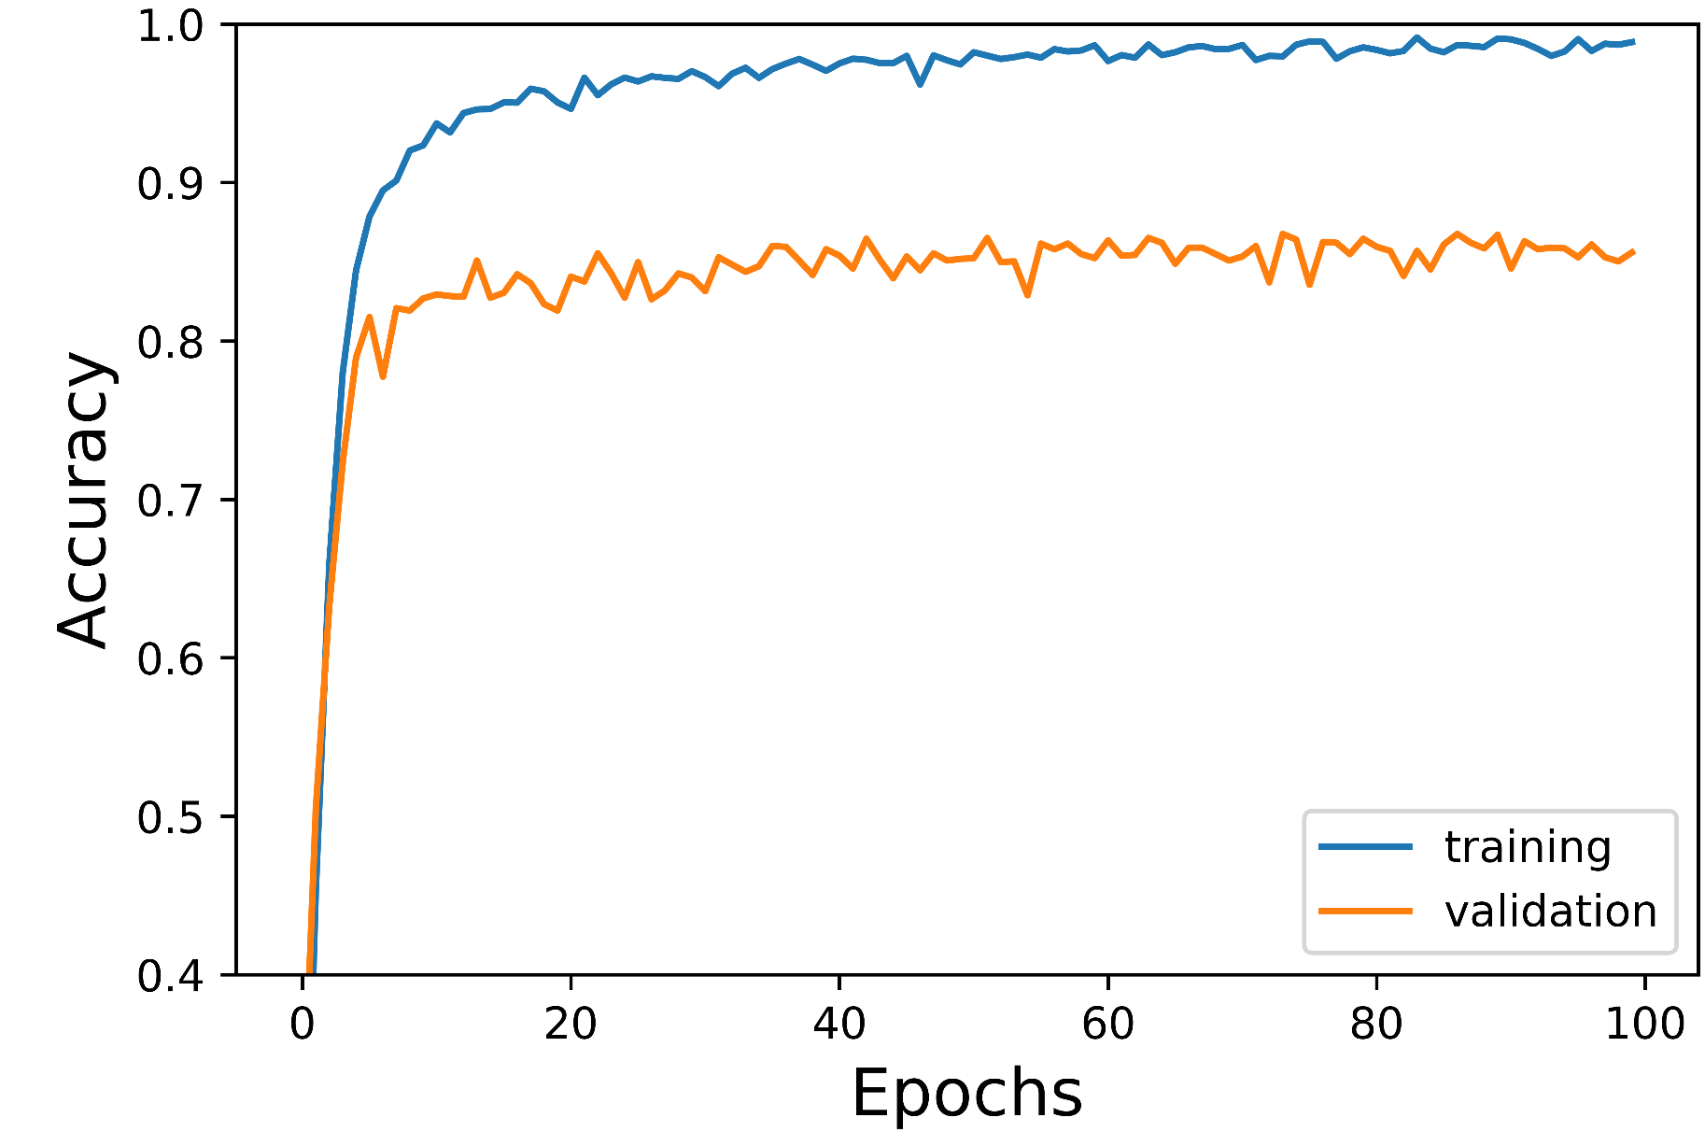
LSTM: Results

Slide 18
Combination
LSTM
Rotate | Rotate
CNN
FLATTEN
DENSE
Tap | Tap
Two Tap | Two Tap
Swipe Left | Swipe Left
CNN
CNN
Finger | Knuckle

Slide 19
Todos
Optimize Models
Way more epochs
App compatabilty with combination model
Look further into interpolation for LSTM
Future Work
Different touch angles
Combined gestures

Slide 20
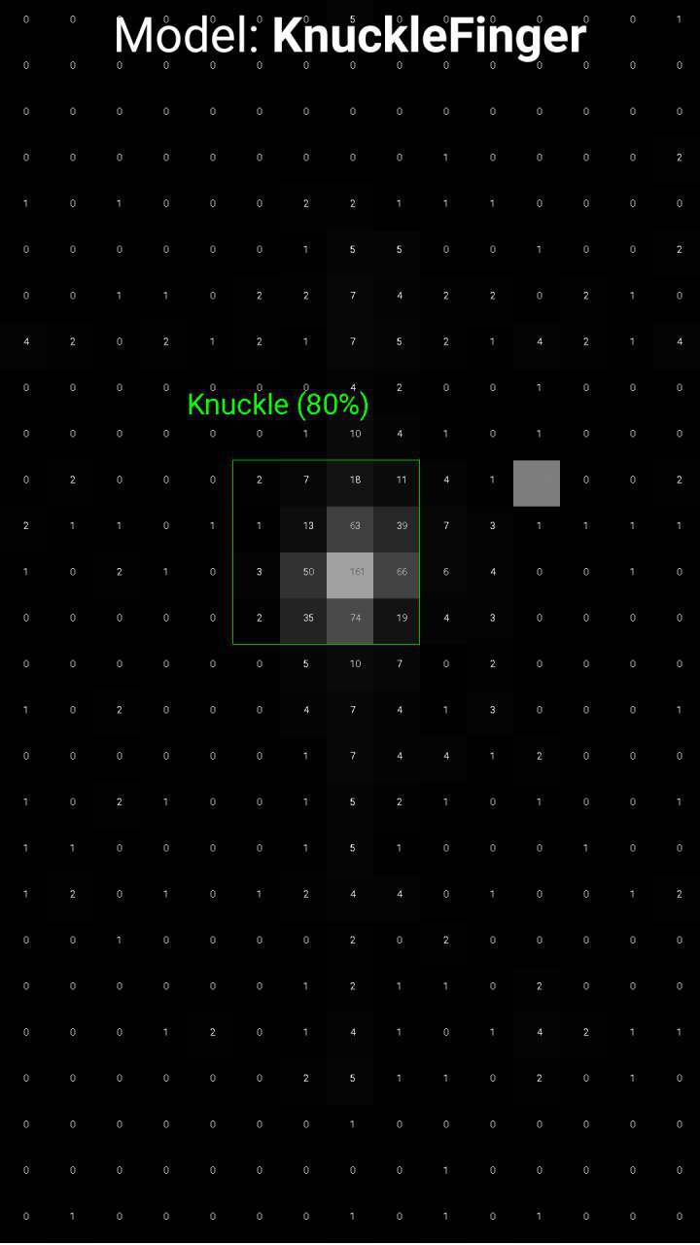
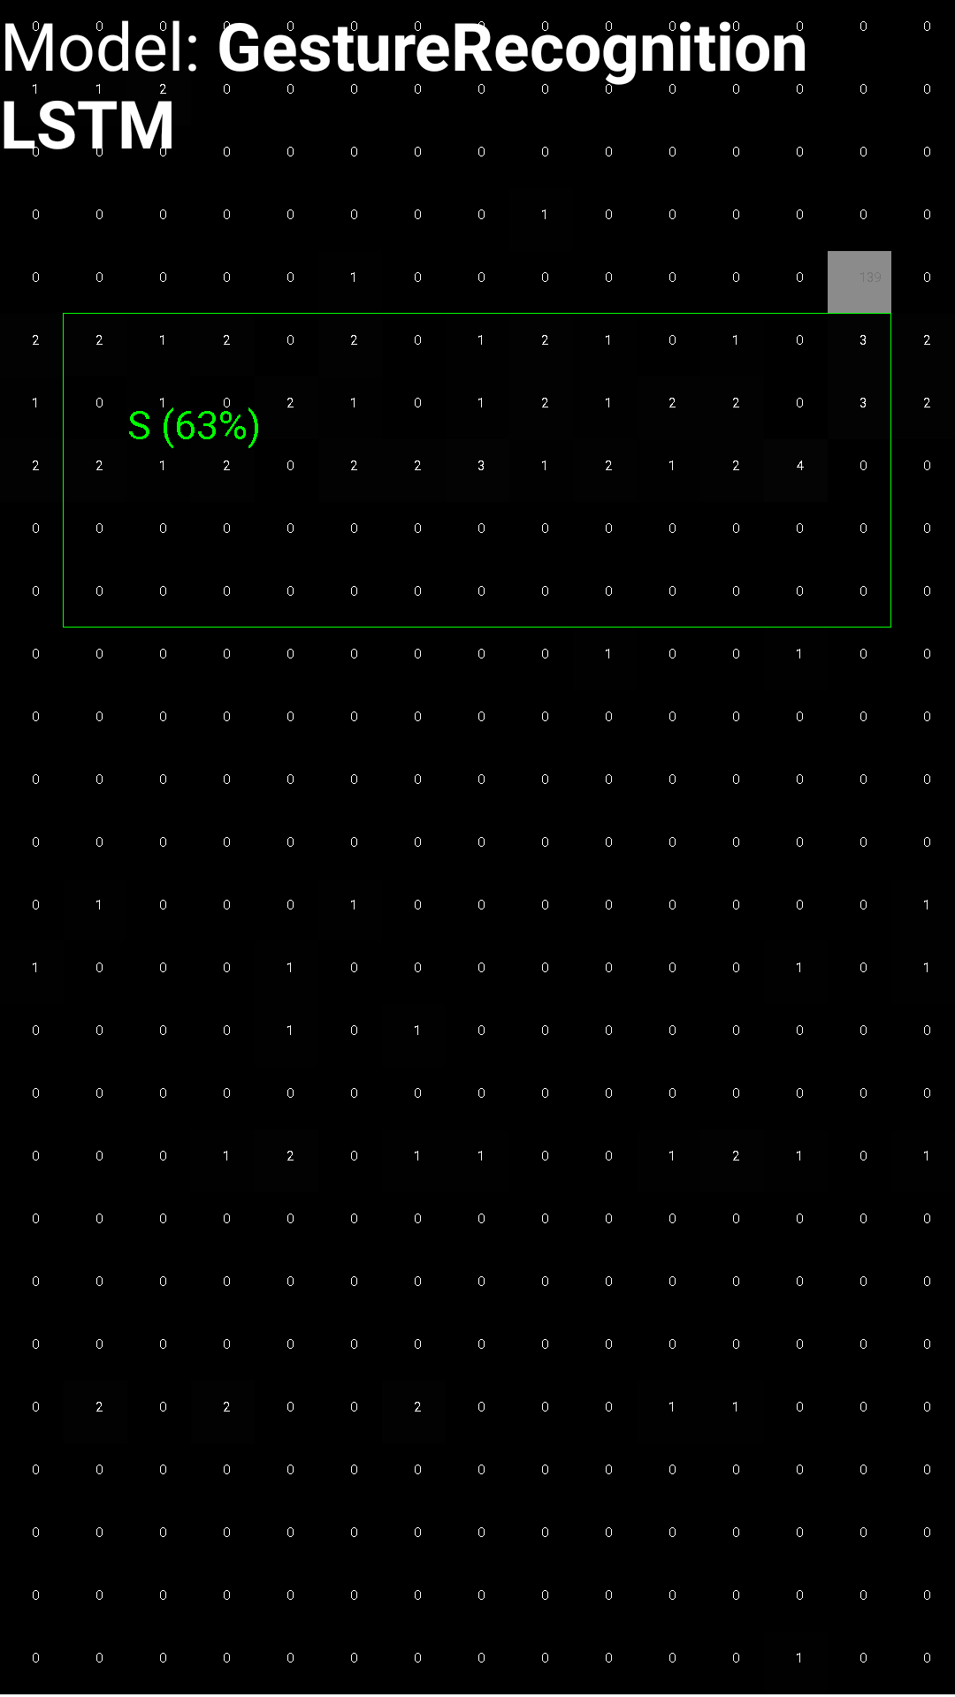
Demo App
CNN
LSTM
Visualisation:
Capacitive Image
Blob Bounding Box
Accuracy
Models used:
CNN (Knuckle/Finger)
LSTM (Gesture)

