Slide 1
Knuckle Input
Robin Schweigert, Simon Hagenmayer, Jan Leusmann
Fachpraktikum Interaktive Systeme: Machine Learning and Computer Vision for HCI| Stuttgart | 07.11.2018

Slide 2
Introduction
Use Knuckle as another input method for smartphones
Having a second input method is great e.g. can be used as “right-click”
Until now mircophones have been used to differentiate

Slide 3
Related Work:Robin
http://delivery.acm.org/10.1145/2080000/2076364/p53-lopes.pdf?ip=141.58.63.6&id=2076364&acc=ACTIVE%20SERVICE&key=2BA2C432AB83DA15%2EB24C68F3238D7605%2E4D4702B0C3E38B35%2E4D4702B0C3E38B35&__acm__=1541164148_f9593dc613ea1758d788650897573c8a
Notes:
Robin: https://dl.acm.org/citation.cfm?id=2047279
http://doi.acm.org/10.1145/2076354.2076364
http://doi.acm.org/10.1145/2935334.2935362

Slide 4
Related Work: Simon
http://delivery.acm.org/10.1145/2050000/2047279/p627-harrison.pdf?ip=141.58.63.6&id=2047279&acc=ACTIVE%20SERVICE&key=2BA2C432AB83DA15%2EB24C68F3238D7605%2E4D4702B0C3E38B35%2E4D4702B0C3E38B35&__acm__=1541164156_6cba7c46e5f7a071776e4ccf3cb5b031
Notes:
Robin: https://dl.acm.org/citation.cfm?id=2047279
http://doi.acm.org/10.1145/2076354.2076364
http://doi.acm.org/10.1145/2935334.2935362

Slide 5
Related Work: Jan
http://delivery.acm.org/10.1145/2940000/2935362/p1-hsiu.pdf?ip=141.58.63.6&id=2935362&acc=ACTIVE%20SERVICE&key=2BA2C432AB83DA15%2EB24C68F3238D7605%2E4D4702B0C3E38B35%2E4D4702B0C3E38B35&__acm__=1541163329_28e1688c9cf93543549cc748ab20a051
Notes:
Robin: https://dl.acm.org/citation.cfm?id=2047279
http://doi.acm.org/10.1145/2076354.2076364
http://doi.acm.org/10.1145/2935334.2935362

Slide 6
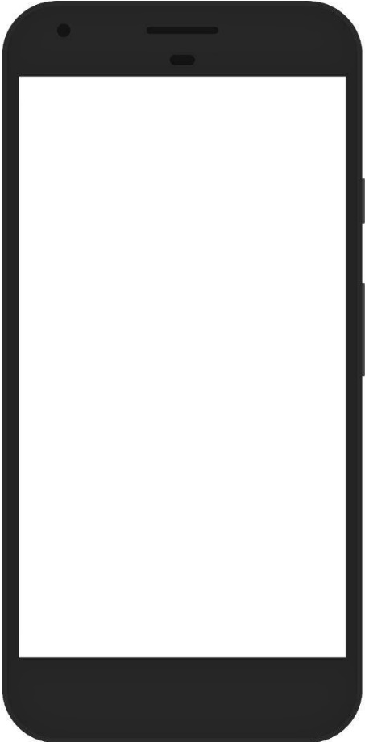
Project planning: Android-App
Input method
Finger
Knuckle
Tap Type
Tap
Double-Tap
Long-Press
Randomized Targets
Collected data
UserID
Timestamp
TargetID
Condition
Position
Capacitive image
Input method
Tap type
Notes:
Randomized targets
50 % Finger, 50 % Knuckle
3 different input-methods:
Tap
Double-Tap
Long-Press
Collected data: Capacitive image, UserID, Condition, UNIX-Timestamp, TargetID, Position

Slide 7
Project planning: Study
Only Right-handed, not movement impaired
Two-handed interaction only
100 target selection per condition (6 conditions)
Within-Subject design
~16 participants
Study-length: 15 minutes

Slide 8
Project planning: Model training
1 CNN for all data

Slide 9
Agenda
App until 9.12
Study done until 21.12
Results until end of january
Camera ready paper until mid february

Slide 10
Questions
Completely randomized order or conditions & Latin-squared
One-handed interaction (thump-knuckle)
Index or Middlefinger?

