Slide 1
Knuckle Input
Robin Schweigert, Simon Hagenmayer, Jan Leusmann
Fachpraktikum Interaktive Systeme: Machine Learning and Computer Vision for HCI | Stuttgart | 22.01.2019

Slide 2
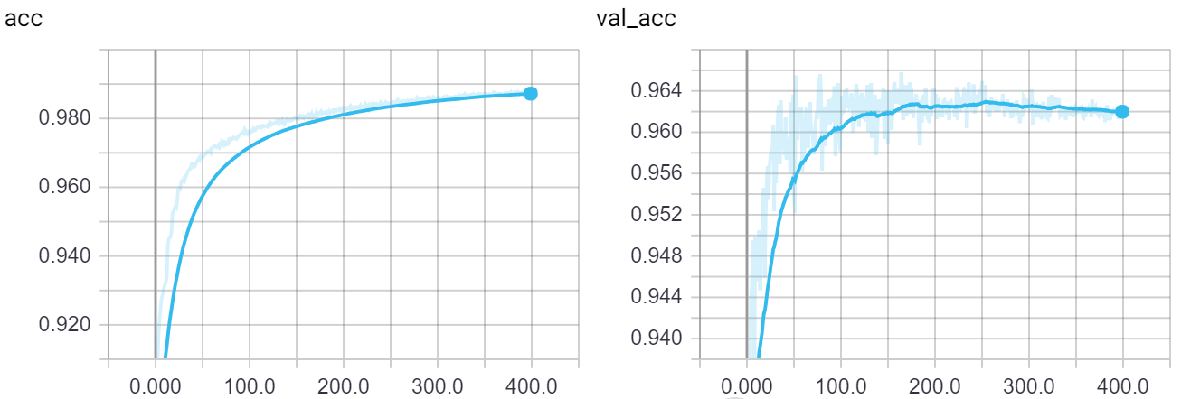
Current Status: CNN
Currently best model
Cross Validation: 94 val acc, 97 acc
Trying to find wrongly labeled images with model.predict to improve our blob detection

Slide 3
Current Status: LSTM
Basic structure is working
Input: Every blob between the first and last blob detected for one gesture
Currently trying to work with fixed window size (50)
Might want to try with non-fixed window size

Slide 4
Current Status: Data
Augmented the data by flipping the images (4 times the data for CNN only)
Validation only with non-augmented data
Removed some gestures, because of model.predict results
Can improve blob detection
Sometimes when 2 blobs where very close to each other, it would be detected as one blob
Sometimes very small blobs

Slide 5
Current Status: Evaluation App
App to live test our model(s)
Model is imported in the app
Have to write the same blob detection in java, which we used for preprocessing the data for model training

