Slide 1
Knuckle Input
Robin Schweigert, Simon Hagenmayer, Jan Leusmann
Fachpraktikum Interaktive Systeme: Machine Learning and Computer Vision for HCI | Stuttgart | 22.01.2019

Slide 2
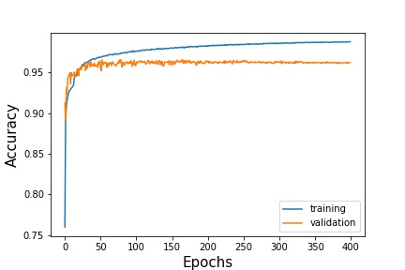
Current Status: CNN
Current best model
Cross Validation:
Acc: 0.9593
Val. Acc: 0.9189
Trying to find wrongly labeled images with model.predict to improve our blob detection

Slide 3
Current Status: LSTM
Basic structure is working
Input: Every blob between the first and last blob detected for one gesture
Currently trying to work with fixed window size (50)
Might want to try with non-fixed window size

Slide 4
Current Status: Data
Augmented the data by flipping the images (4 times the data for CNN only)
Validation only with non-augmented data
Removed some gestures, because of model.predict results
Can improve blob detection
Sometimes when 2 blobs where very close to each other, it would be detected as one blob
Sometimes very small blobs

Slide 5
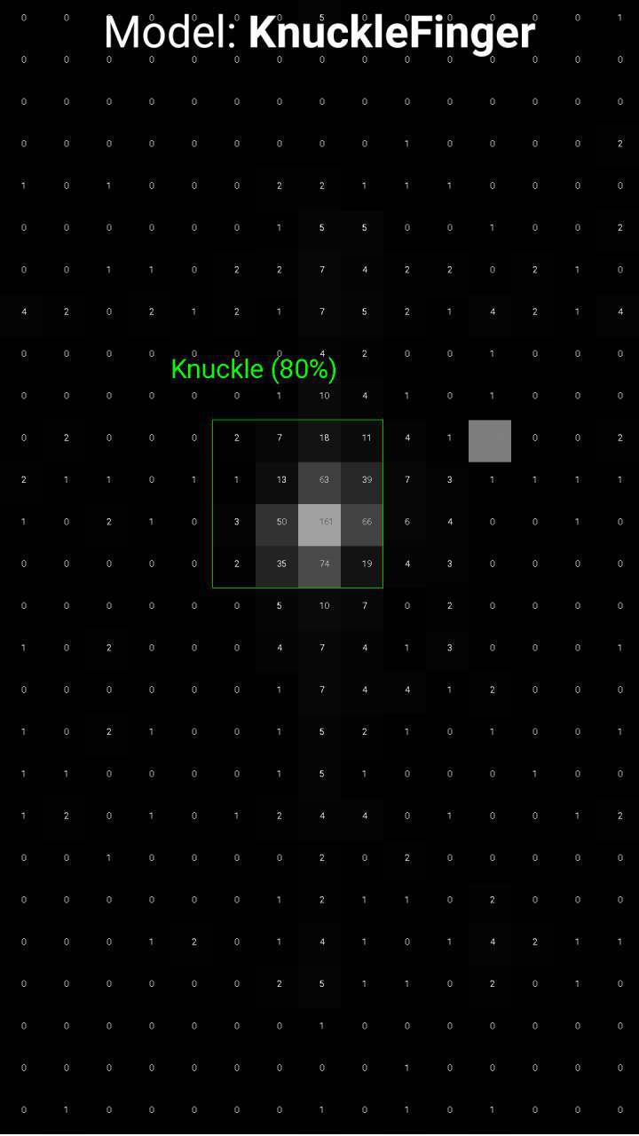
Current Status: Evaluation App
App to live test our model(s)
Model is imported in the app
Blob detection in progress:
Have to write the same blob detection in java, which we used for preprocessing the data for model training
Blob extraction working

