Slide 1
Knuckle Input
Simon Hagenmayer, Robin Schweigert, Jan Leusmann

Slide 2
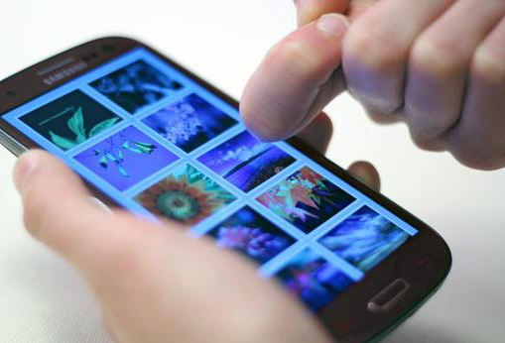
Motivation
Extend current options for input on a touchscreen

Slide 3
Related Work
TapSense
Sound-based
Differentiate between four different finger inputs
SVM
86% accuracy
Nail+
3x3 grid of strain sensors, worn on the fingernail
Different levels of applied finger-force can be detected
85% accuracy
Huawei

Slide 4
Study

Slide 5
Preprocessing

Slide 6
CNN

Slide 7
Gesture

Slide 8
Combination

Slide 9
Future Work

Slide 10
Demo

