Slide 1
Knuckle Input
Robin Schweigert, Simon Hagenmayer, Jan Leusmann
Fachpraktikum Interaktive Systeme: Machine Learning and Computer Vision for HCI | Stuttgart | 11.12.2018

Slide 2
Current Status
Created example images for each gesture
Study procedure implemented in app
Odd UserIDs start with finger, even UserIDs with knuckle
Gestures in random order
Datawriter ist implemented

Slide 3
Gestures
Press
Two knuckel press
Swipe left/right/up/down
Two knuckle swipe up/down
Arrowhead left/right
Checkmark
L, mirrored L and Γ
S
Press and rotate
Right-click
Open multitasking view
Rotate 3D object
Open settings / app settings
Switch between apps
Confirm input
Custom apps, flashlight
Screenshot
Change volume

Slide 4
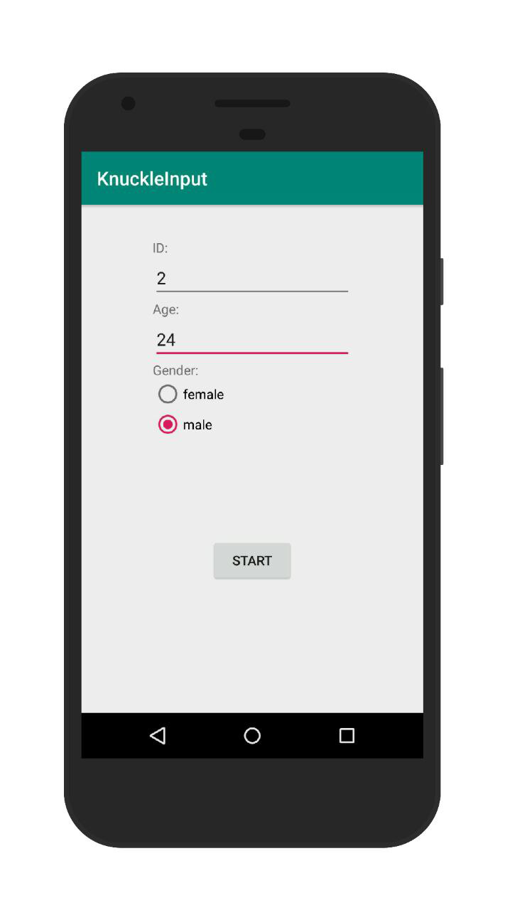
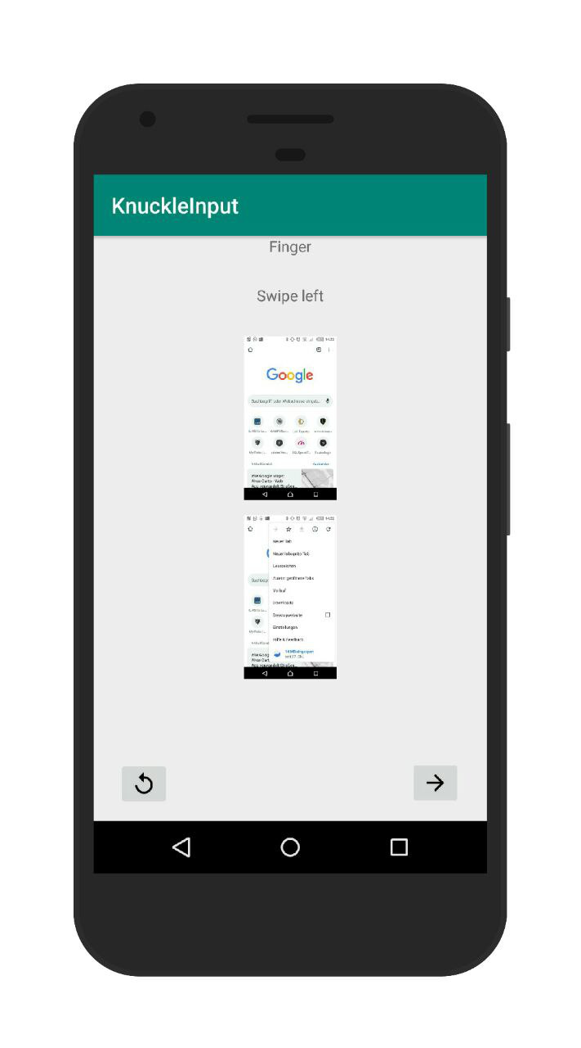
App Structure

Slide 5
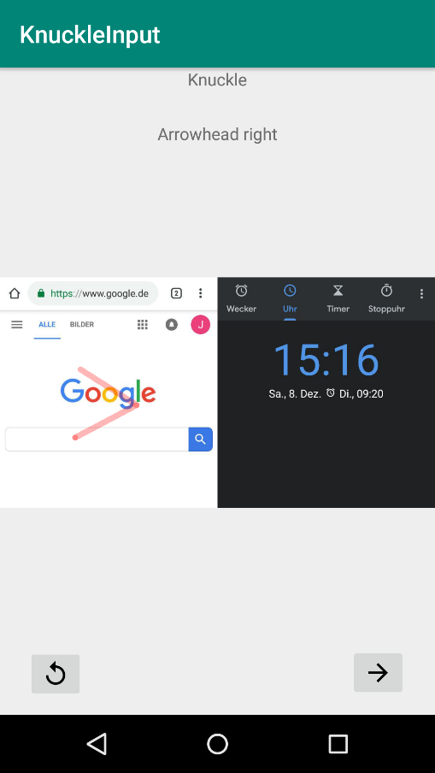
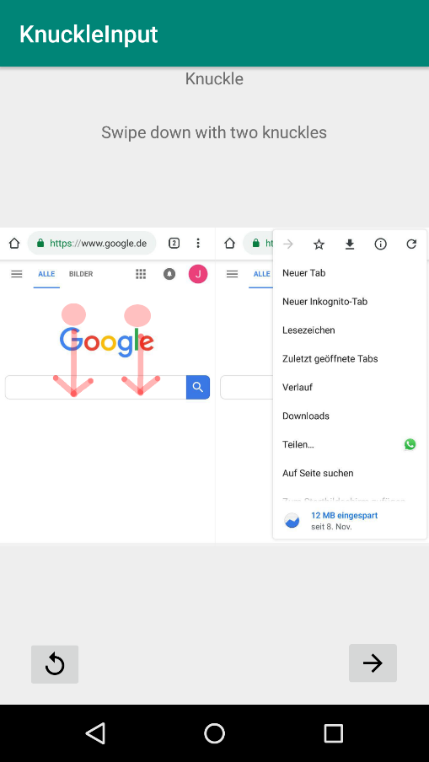
App Structure

Slide 6
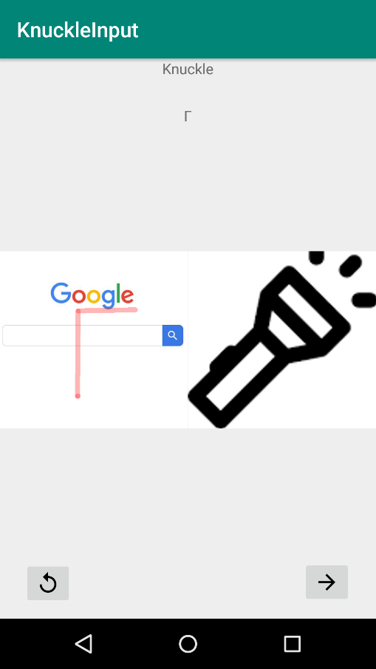
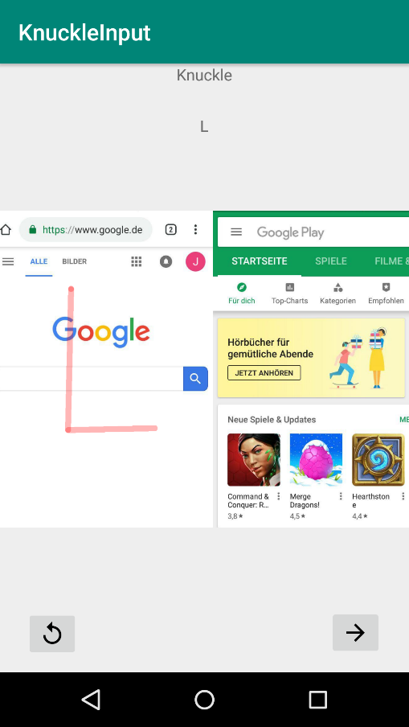
App Structure

Slide 7
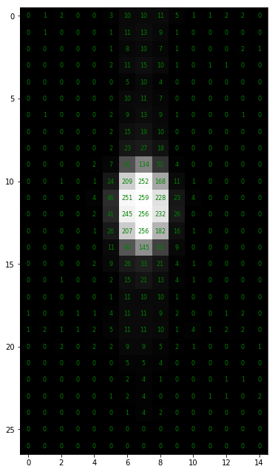
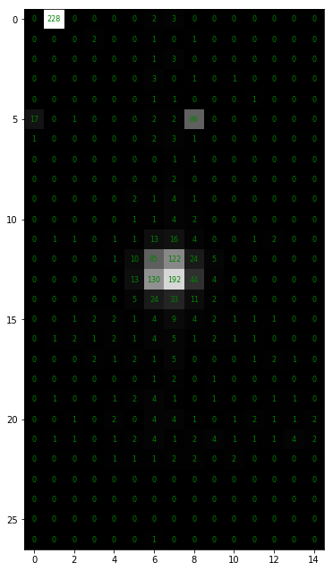
Data Collection
Data is stored
24.7 to 24.8 samples/second
Some data is lost
< 1%
DataStream is missing some characters
Blob Detection in progress
Finger
Knuckle

Slide 8
Todo
New blob detection, because the kernel with highest output slows down input
Pilot study
Questions
?

