Slide 1
Knuckle Input
Robin Schweigert, Simon Hagenmayer, Jan Leusmann
Fachpraktikum Interaktive Systeme: Machine Learning and Computer Vision for HCI | Stuttgart | 27.11.2018

Slide 2
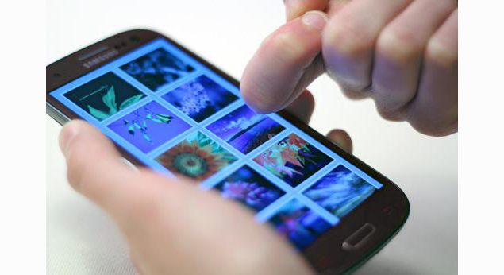
Motivation
Discriminate between Finger and Knuckle
Discriminate between 10 Gestures

Slide 3
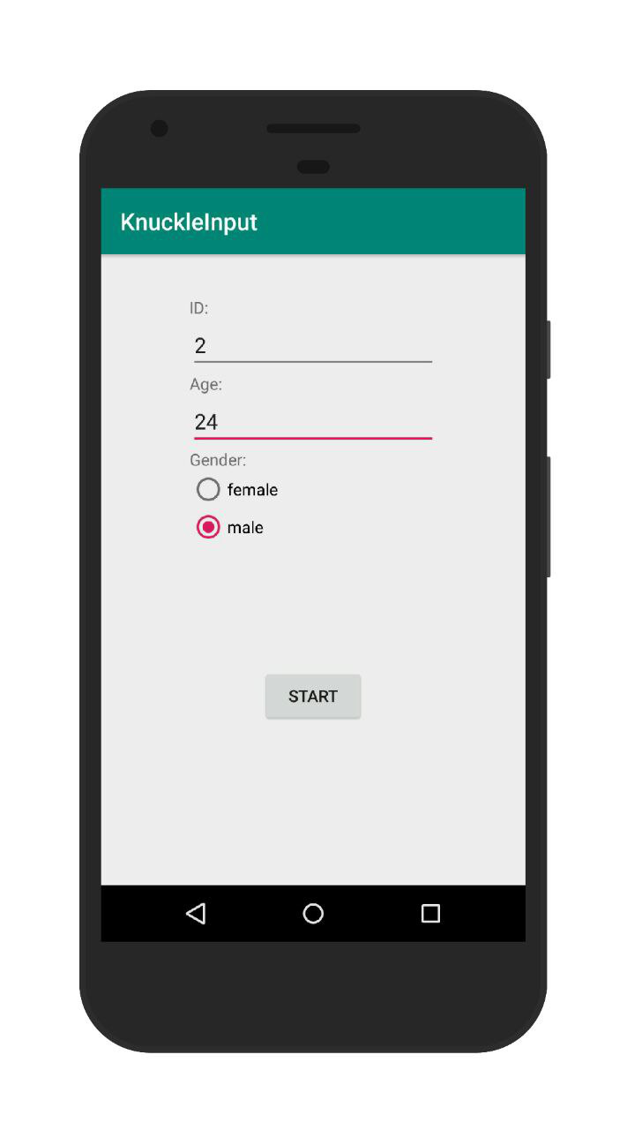
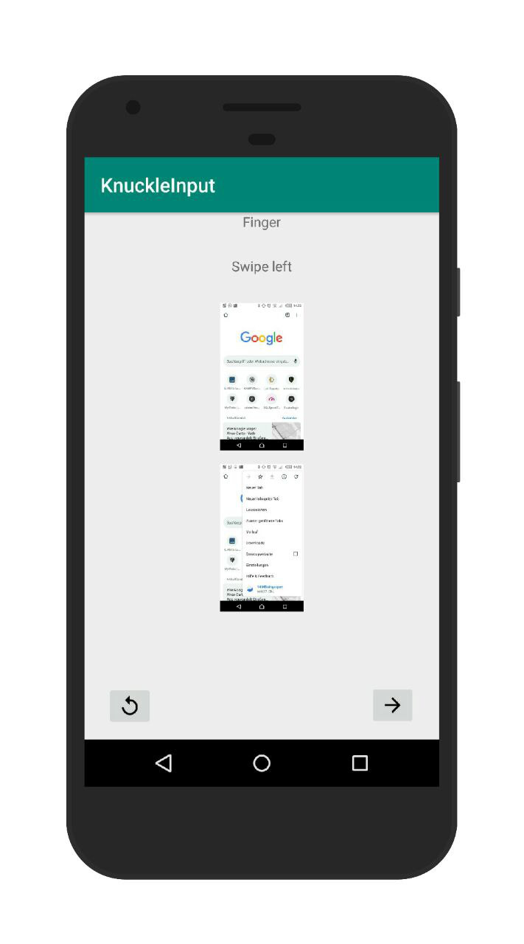
App structure

Slide 4
Data
userID
timestamp
touch (bool)
gestureID
versionID
inputMethod (finger/knuckle)
actualData (bool)
capacitiveImage (Matrix)

Slide 5
Gestures
1. Press (1s)
2-5. swipe all directions
6-7. 2 Finger swipe
8. Circle
9-10. Arrowhead left right
11-12: “L” and mirrored
13. Check mark
14. „S“
15. Press and rotate
“Right-click”
Turn 3D object
Next browser tab
Open camera (or other app)
Switch between apps
Open flashlight
Confirm input
Screenshot
Volume

Slide 6
Todo
Until Friday: Survey about gestures
Until 9.12: Complete App
Until Christmas: Conduct study
Questions
Data acquisition to slow
Hide images when user starts gesture?

