Slide 1
Knuckle Input
Robin Schweigert, Simon Hagenmayer, Jan Leusmann
Fachpraktikum Interaktive Systeme: Machine Learning and Computer Vision for HCI| Stuttgart | 07.11.2018

Slide 2
Introduction
Use Knuckle as another input method for smartphones
Having a second input method is great e.g. can be used as “right-click”
Until now mircophones have been used to differentiate

Slide 3
Related Work:Robin
http://delivery.acm.org/10.1145/2080000/2076364/p53-lopes.pdf?ip=141.58.63.6&id=2076364&acc=ACTIVE%20SERVICE&key=2BA2C432AB83DA15%2EB24C68F3238D7605%2E4D4702B0C3E38B35%2E4D4702B0C3E38B35&__acm__=1541164148_f9593dc613ea1758d788650897573c8a
Notes:
Robin: https://dl.acm.org/citation.cfm?id=2047279
http://doi.acm.org/10.1145/2076354.2076364
http://doi.acm.org/10.1145/2935334.2935362

Slide 4
Related Work: Simon
http://delivery.acm.org/10.1145/2050000/2047279/p627-harrison.pdf?ip=141.58.63.6&id=2047279&acc=ACTIVE%20SERVICE&key=2BA2C432AB83DA15%2EB24C68F3238D7605%2E4D4702B0C3E38B35%2E4D4702B0C3E38B35&__acm__=1541164156_6cba7c46e5f7a071776e4ccf3cb5b031
Notes:
Robin: https://dl.acm.org/citation.cfm?id=2047279
http://doi.acm.org/10.1145/2076354.2076364
http://doi.acm.org/10.1145/2935334.2935362

Slide 5
Related Work: Jan
http://delivery.acm.org/10.1145/2940000/2935362/p1-hsiu.pdf?ip=141.58.63.6&id=2935362&acc=ACTIVE%20SERVICE&key=2BA2C432AB83DA15%2EB24C68F3238D7605%2E4D4702B0C3E38B35%2E4D4702B0C3E38B35&__acm__=1541163329_28e1688c9cf93543549cc748ab20a051
Notes:
Robin: https://dl.acm.org/citation.cfm?id=2047279
http://doi.acm.org/10.1145/2076354.2076364
http://doi.acm.org/10.1145/2935334.2935362

Slide 6
Project planning: Android-App
Randomized targets
50 % Finger, 50 % Knuckle
3 different input-methods:
Tap
Double-Tap
Long-Press
Collected data: Capacitive image, UserID, Condition, UNIX-Timestamp, TargetID, Position

Slide 7
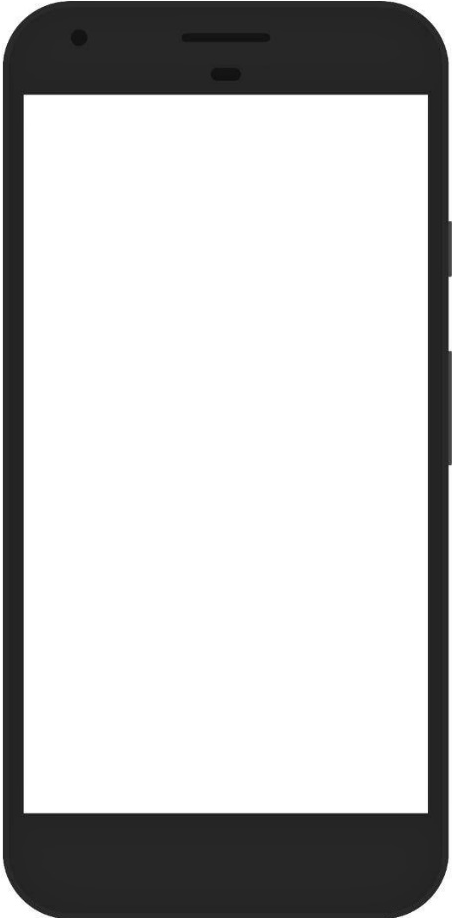
Project planning: Android-App
Collected data
UserID
Timestamp
TargetID
Condition
Position
Capacitive image
Input method
Finger
Knuckle
Tap Type
Tap
Double-Tap
Long-Press
Randomized Targets
Input method
Tap type

Slide 8
Project planning: Android-App
Input method
Finger
Knuckle
Tap Type
Tap
Double-Tap
Long-Press
Randomized Targets
Collected data
UserID
Timestamp
TargetID
Condition
Position
Capacitive image
Input method
Tap type

Slide 9
Project planning: Study
Only Right-handed, not movement impaired
Two-handed interaction only
100 target selection per condition (6 conditions)
Within-Subject design
~16 participants
Study-length: 15 minutes

Slide 10
Project planning: Model training
1 CNN for all data

Slide 11
Agenda
App until 9.12
Study done until 21.12
Results until end of january
Camera ready paper until mid february

Slide 12
Questions
Completely randomized order or conditions & Latin-squared
One-handed interaction (thump-knuckle)
Index or Middlefinger?

