Slide 1
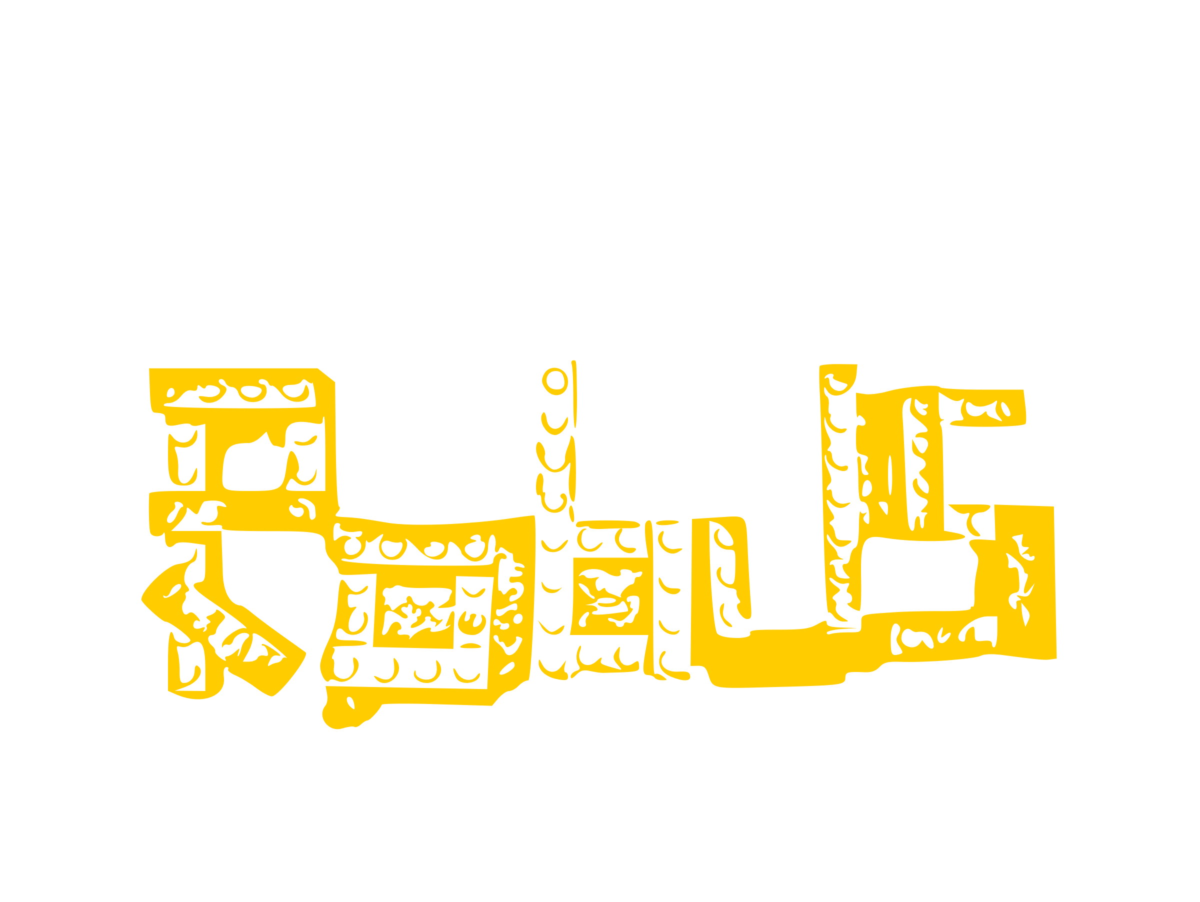
The Minimalists JavaScript Framework
Font heißt Consolas

Slide 2
The Minimalists JavaScript Framework

Slide 3


