Slide 1

GraphQL

Slide 2
Overview
Topics:
Introduction
GraphQL is the better REST
Schema and SDL
GraphQL in React
GraphQL on a server
Going forward

Slide 3
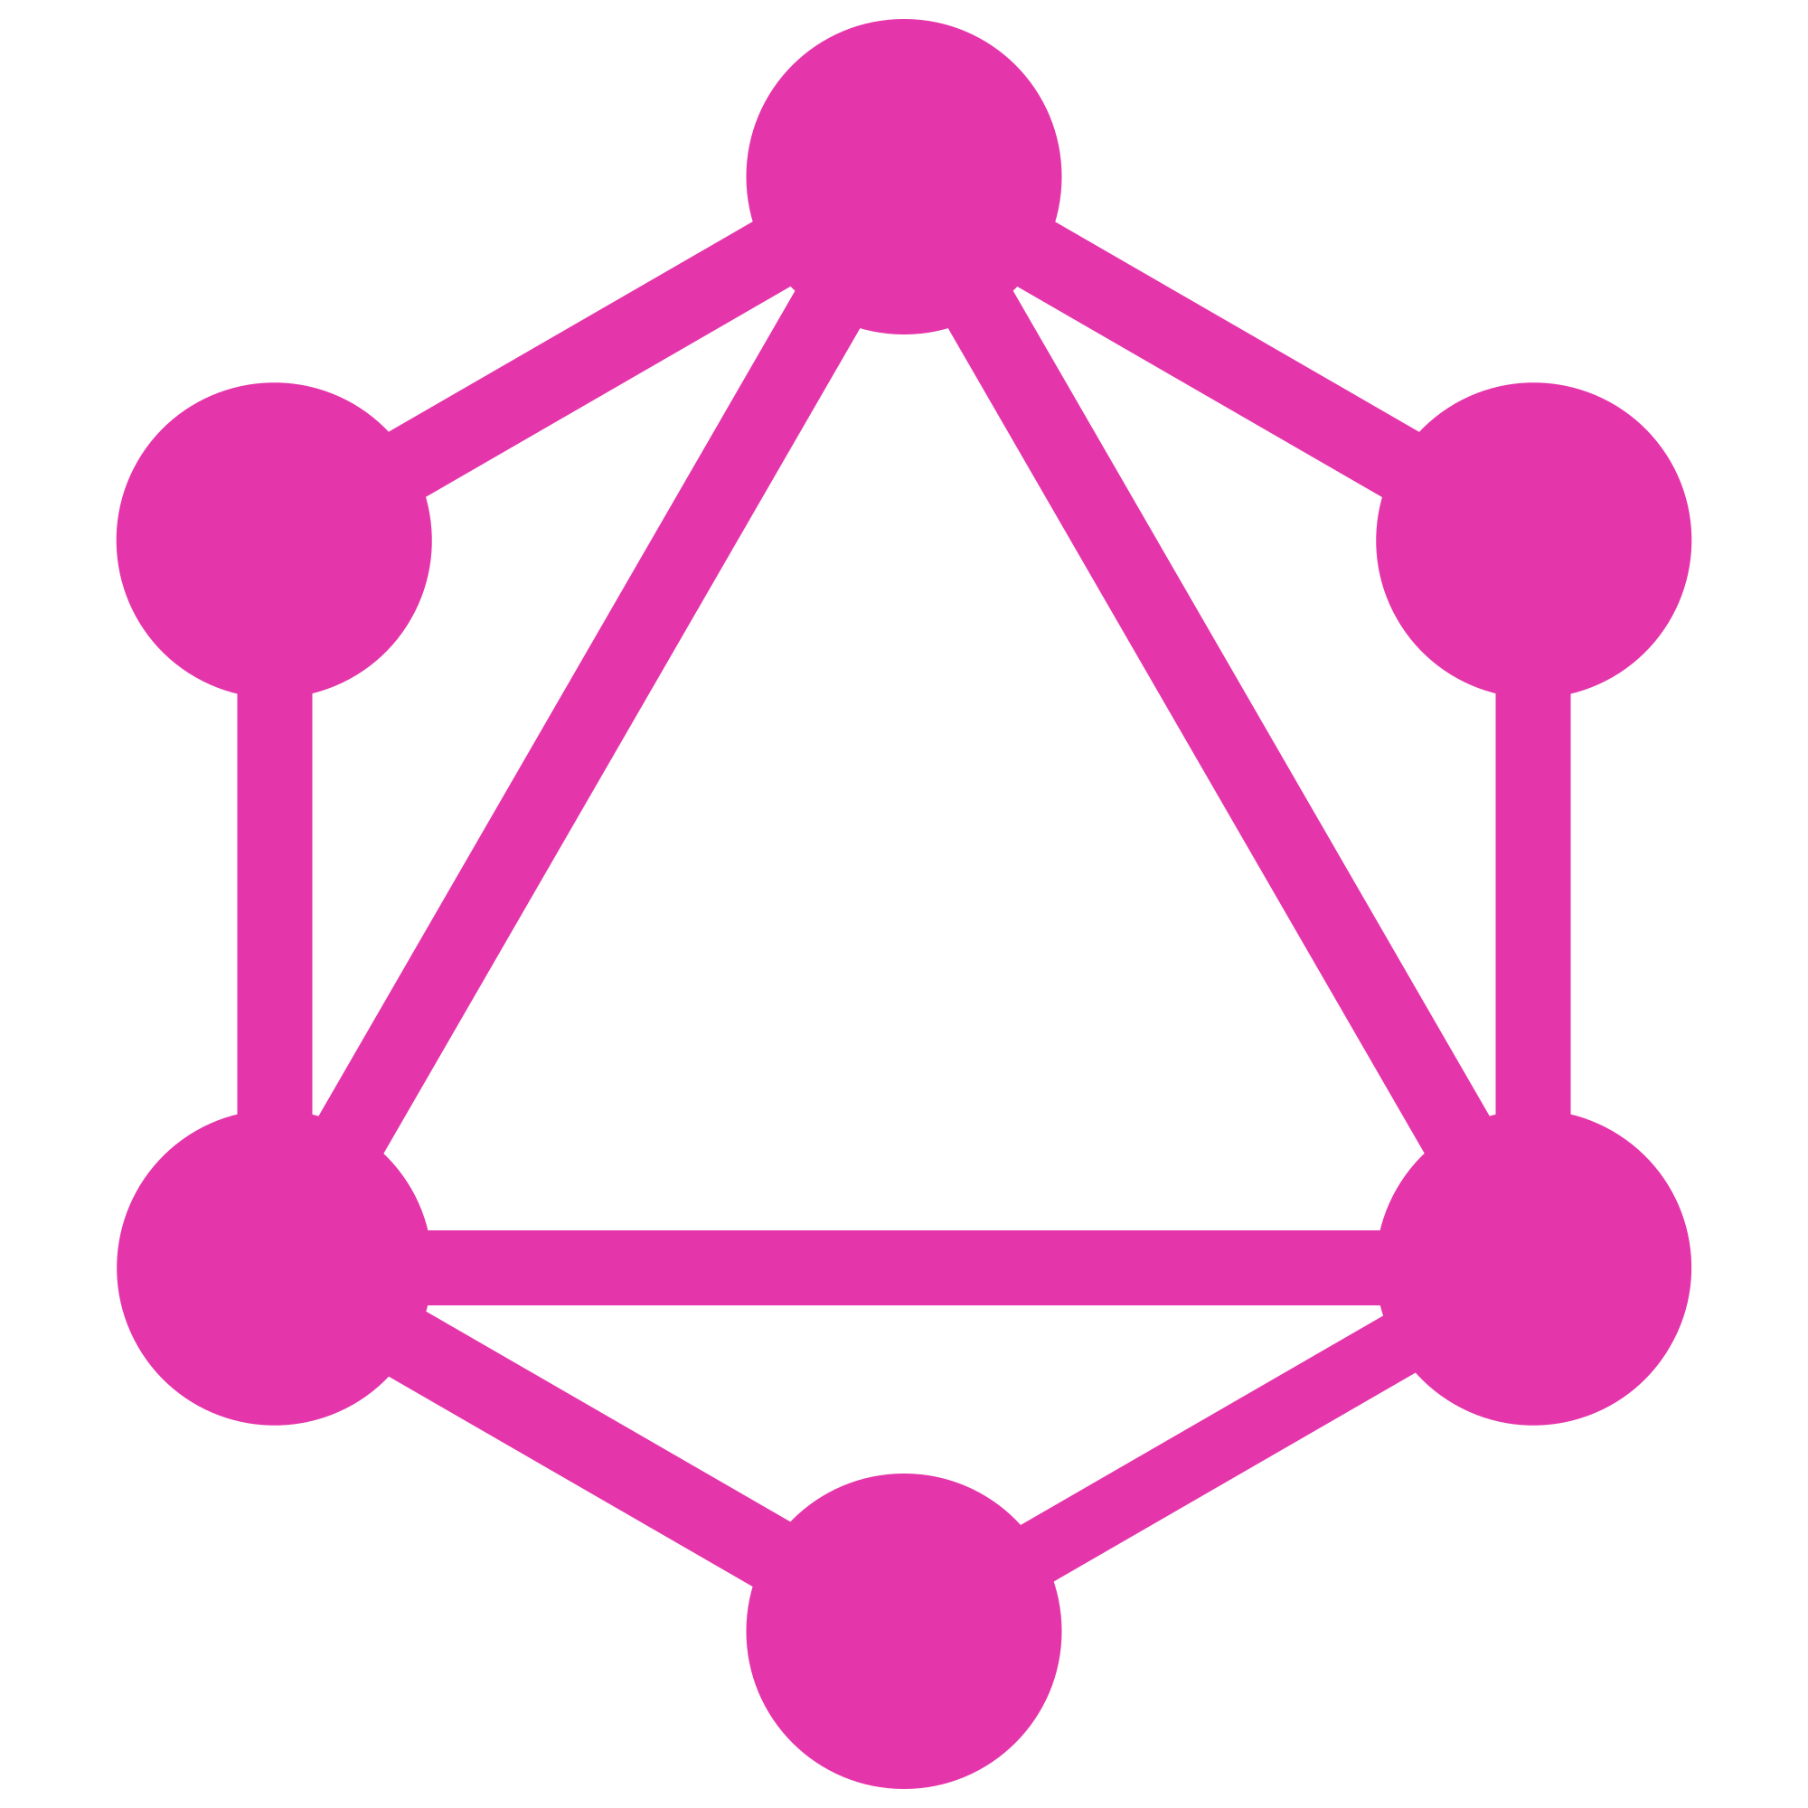
Introduction

Slide 4


What is it?
A revolutionary new way to think about APIs
  - fetching / mutating data between a client and a server
Multiple ‘dumb’ server-defined endpoints (e.g. REST)?
→ Send specific queries to a single ‘smart’ endpoint
3 main characteristics:
  Lets the client specify exactly what data it needs
  Makes it easier to aggregate data from multiple sources
  Uses a type system to describe data as a schema

Slide 5
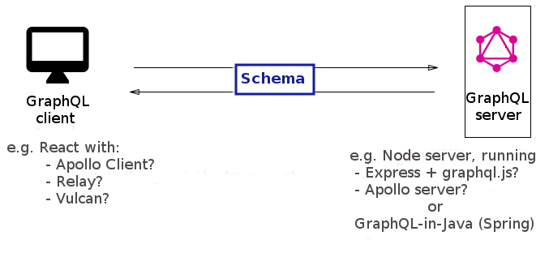
Client and server
GraphQL is a query language for APIs and a runtime for fulfilling those queries with your existing data.
Create/ send query string
Receive/ handle response
Receive query
Generate JSON response from
data source(s)

Slide 6
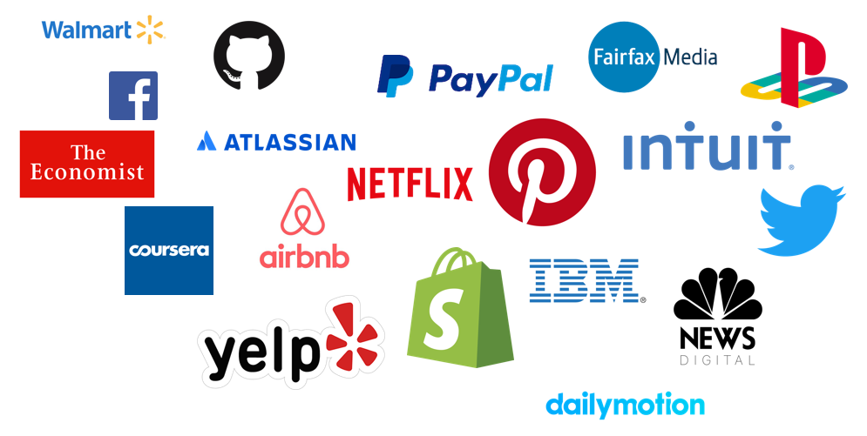
History, context & adoption
Facebook started using GraphQL in 2012 in their native mobile apps, now used mainly in their web apps.
Presented to the public at React.js Conf 2015 and shortly after they announced their plans to open source it.
GraphQL was not designed only for React. It is a technology that can be used everywhere a client communicates with an API.
Adoption has become widespread:

Slide 7
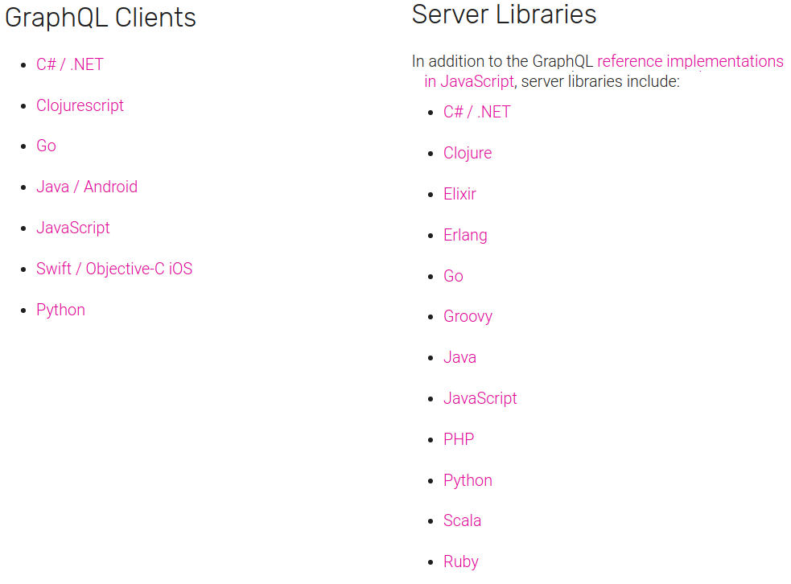
Language support

Slide 8
Benefits
No more over- and under-fetching
Defined schema & type system Rapid product iterations, as clean decoupling of API
Insightful analytics on the backend: tools for performance monitoring

Slide 9
GraphQL is the better REST

Slide 10
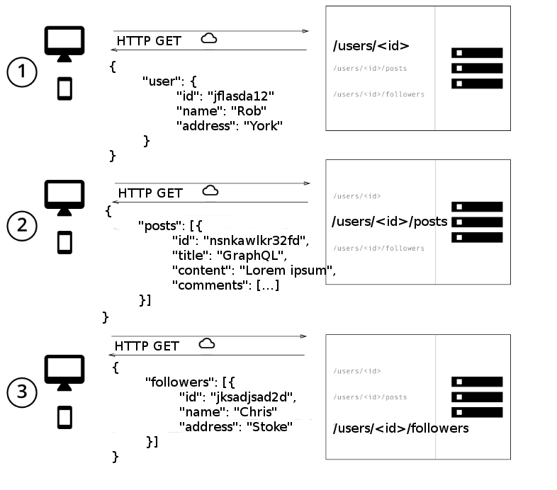
REST under-fetch example
Social media app
id

Slide 11
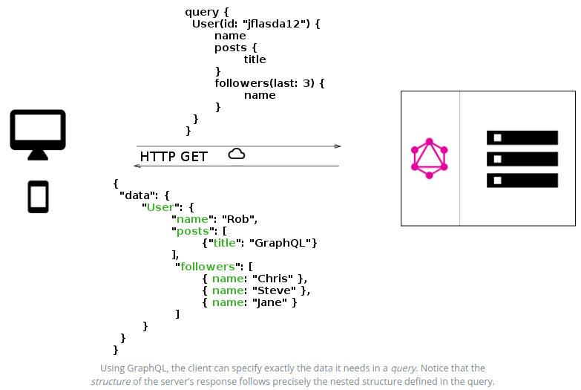
GraphQL example

Slide 12
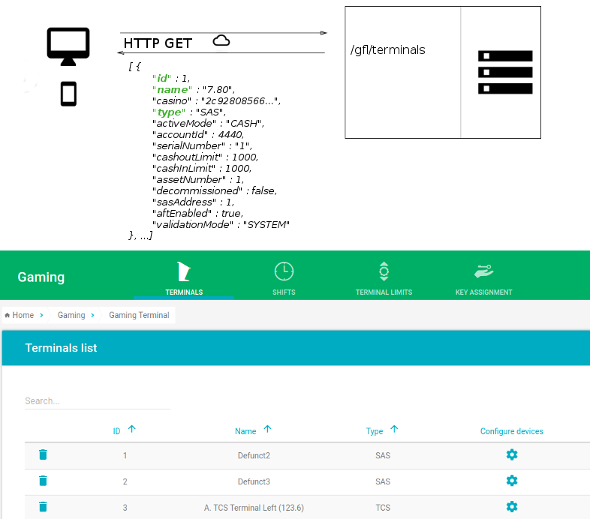
REST over-fetch example

Slide 13
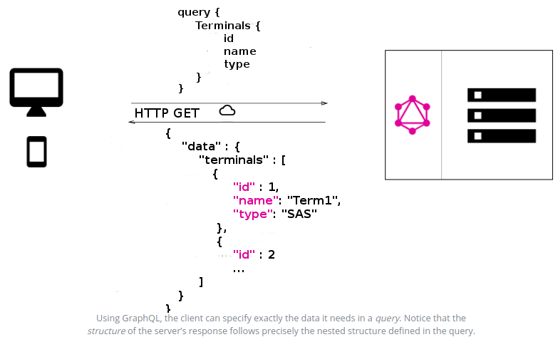
GraphQL example

Slide 14
Schema and
Schema Definition Language (SDL)

Slide 15
Schema-first development
GraphQL uses a strong type system to define the capabilities of an API
All the types that are exposed in an API are written down in a schema using the GraphQL Schema Definition Language (SDL)
This schema serves as the contract between the client and the server to define how a client can access the data
Once the schema is defined, the teams working on frontend and backend can do their work without further communication, since they both are aware of the definite structure of the data that’s sent over the network

Slide 16
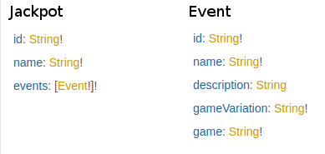
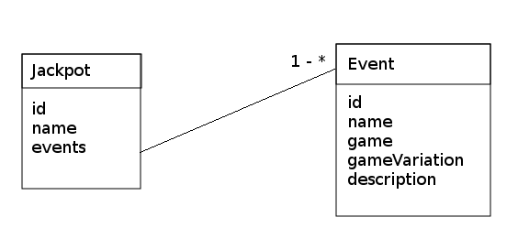
Exercise: queries & mutations
https://github.com/robsdev/GraphQL-Intro
UML
Schema Definition Language

Slide 17
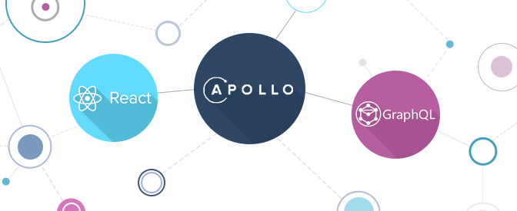
GraphQL in React

Slide 18

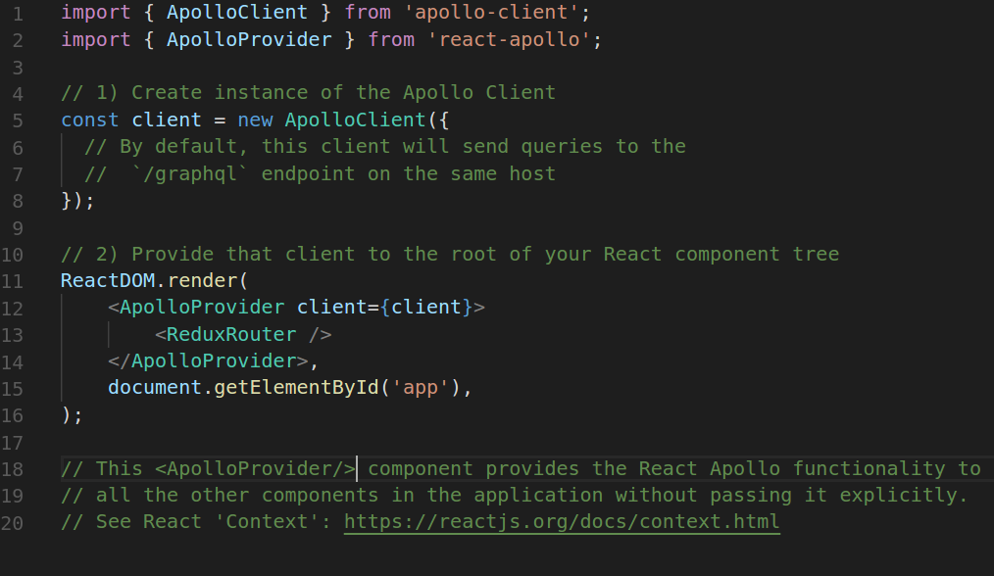
Apollo client

Slide 19
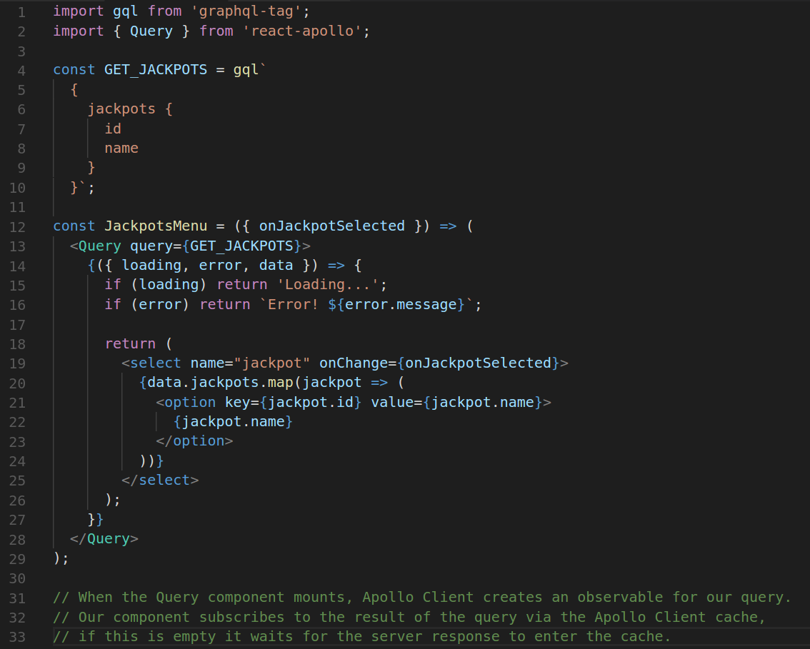
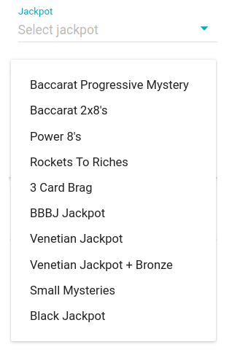
Graphql-tag
Queries (and Mutations)

Slide 20
GraphQL on server

Slide 21

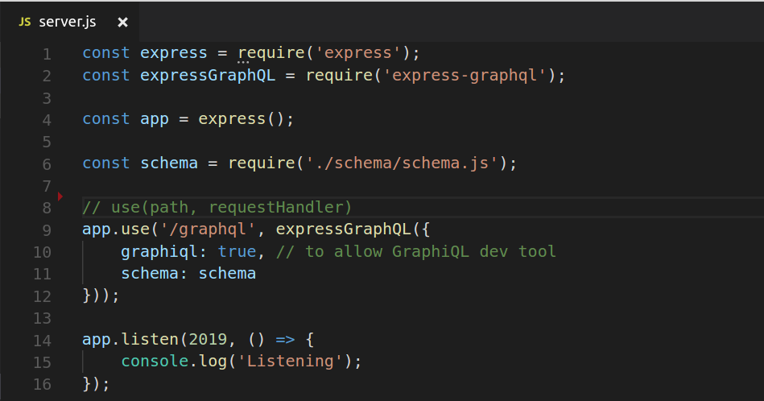
Express + GraphQL server (Node)

Slide 22
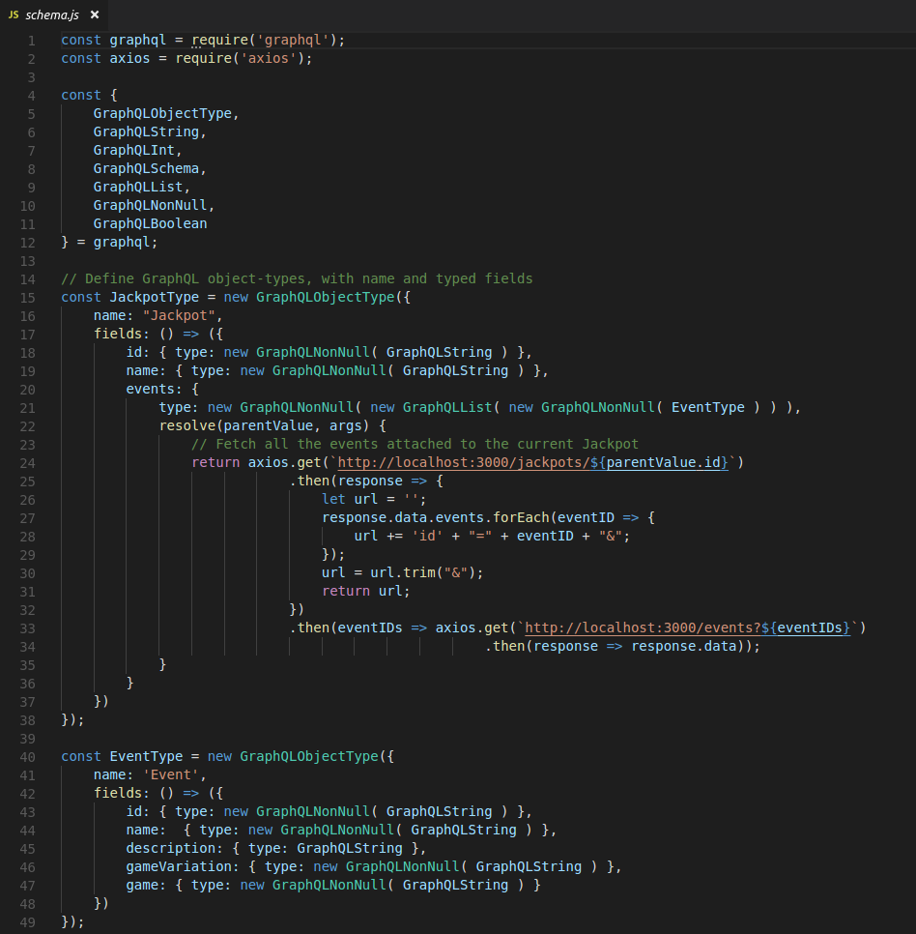
GraphQL Schema

Slide 23
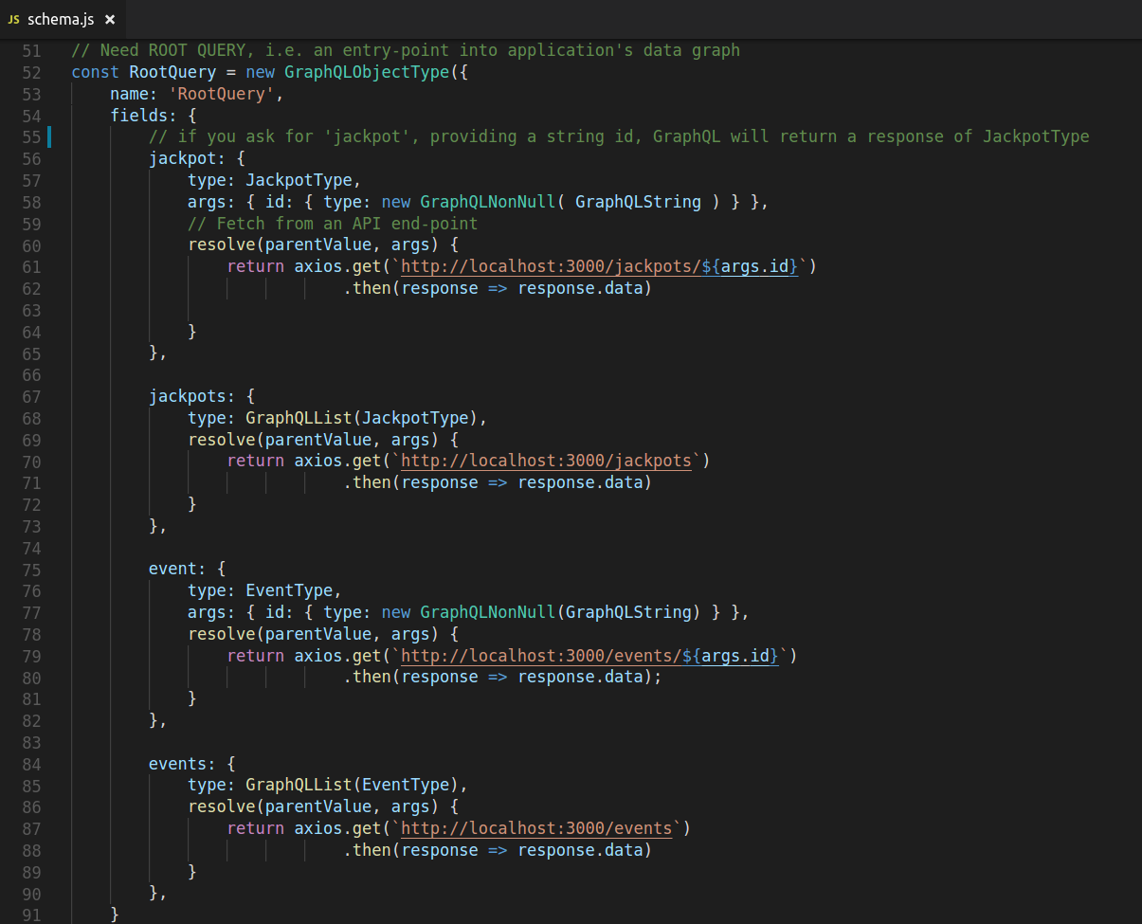
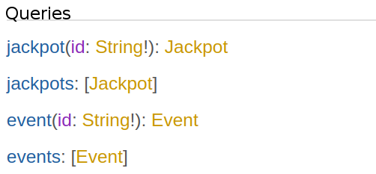
Root query

Slide 24
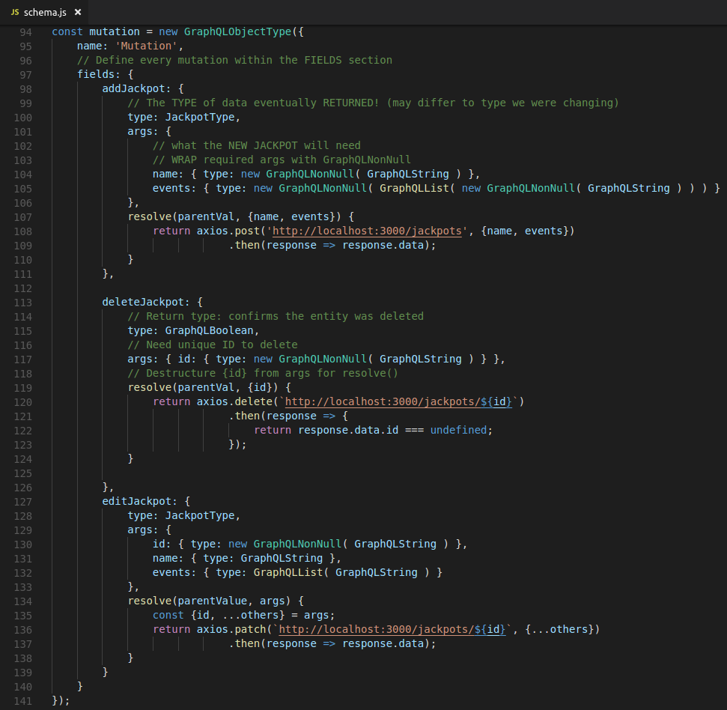
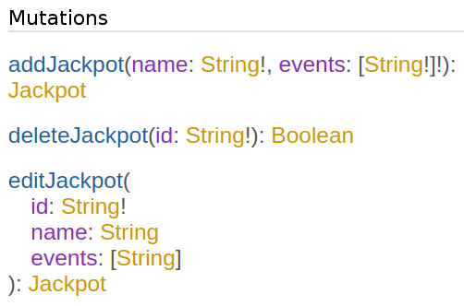
Root mutation

Slide 25
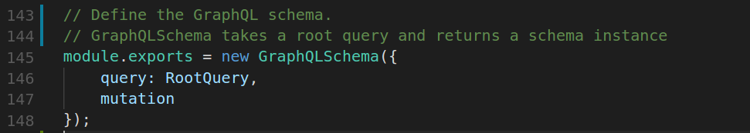
GraphQLSchema object

Slide 26
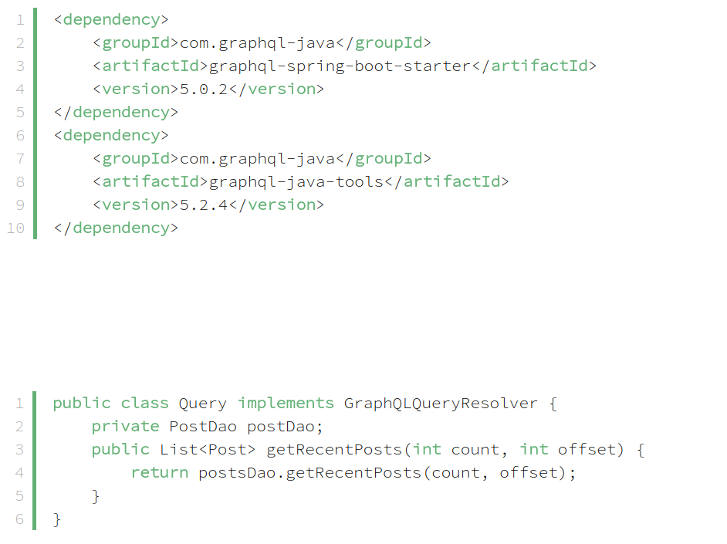
Us: GraphQL in Spring-Boot?

Slide 27
Going forward

Slide 28
GFL-B decisions
Design the full schema, so that client and server can be implemented simultaneously
Decide on the best architecture

Slide 29
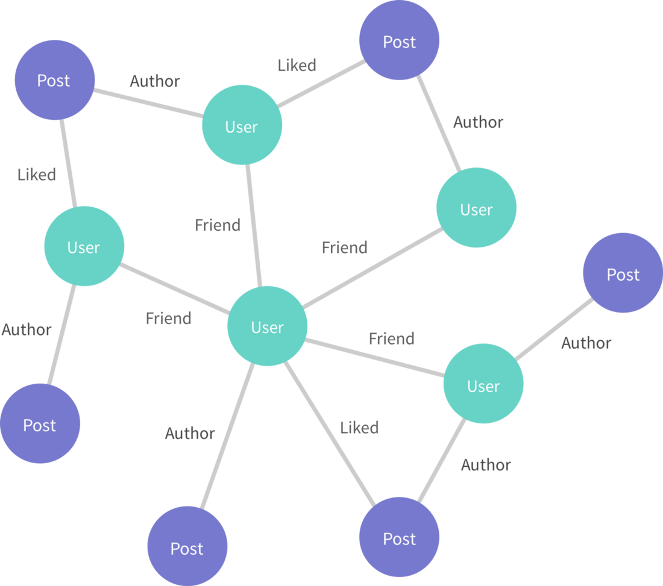
Graph: nodes/ edges
type UserFriendsEdge {
cursor: String!
node: User
friendedAt: DateTime
}

Slide 30
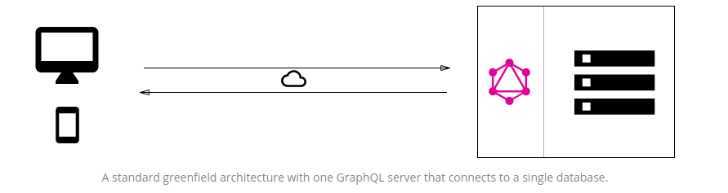
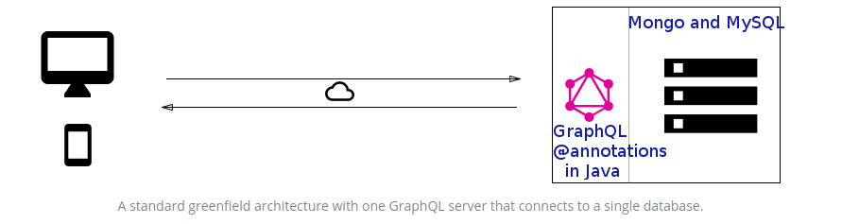
Single connection

Slide 31
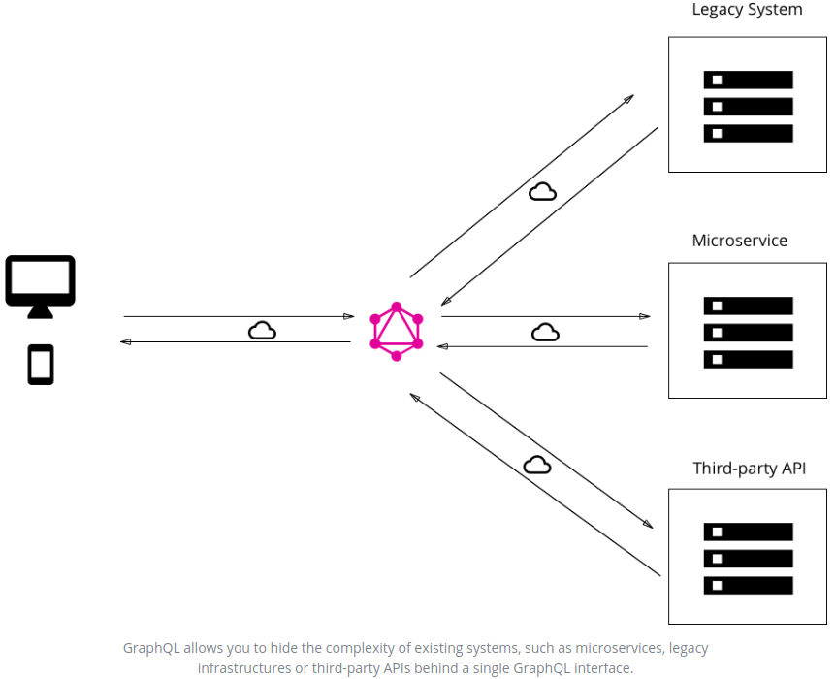
Distributed

Slide 32
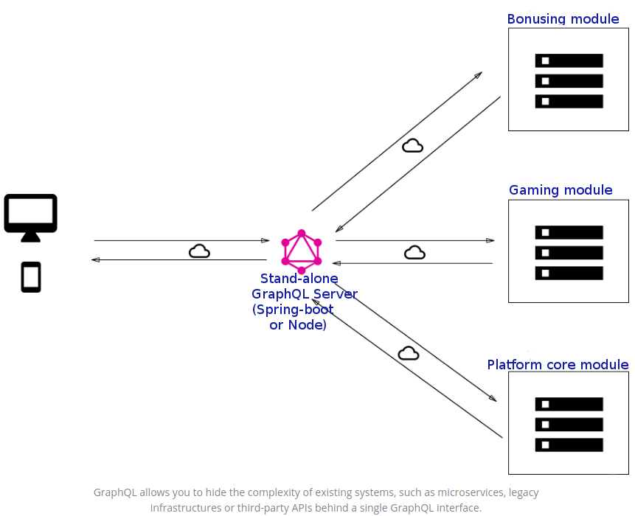

Slide 33
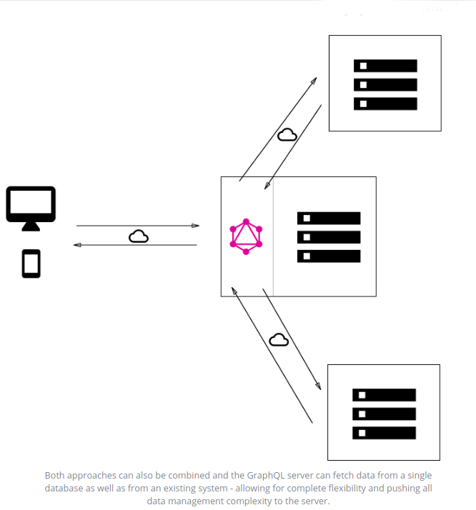
Hybrid
Core

Slide 34
The end

