Slide 1
Seedstars
Data Scientist Intern Case Study

Slide 2
Insights and findings
The data available for the case study was a little bit dirty and some datapoints were missing.
After the extraction, a little bit of transformation was necessary.
We took the average of data and amount to replace missing points.
Loan_ident, Campaign and user_id columns were not required to perform a good prediction, so they were removed.
Gender and Reason were transformed into categorical variables.

Slide 3
Insights and findings
Once we are aiming to predict in which category (label 0 or 1) the customers belong, the best way to do it is using a Logistic Regression.
Python’s SKLearn Lib was the main tool to perform this analysis.
Full code is on GitHub: colocar o link

Slide 4
Results – Accuracy
Splitting the data into 66.6% for trainning purposes and 33.3% for test purposes, we got a R-squared of 81% using Logistic Regression.
The R-squared can be read as ”Explained Variation/Total Variation” its highest value is 100% and lowest 0%

Slide 5
Results – Confusion Matrix
We got the following Confusion Matrix:
True Positive (tp): 154; True Negative (tn): 85
False Positive (fp): 21; False Negative (fn): 35
The Confusion Matrix is used to amplify the understandment of the model’s accuracy pointing where it is getting right and where it is getting wrong. tn, fp, fn, tp = confusion_matrix([0, 1, 0, 1], [1, 1, 1, 0]).ravel()

Slide 6
Results – Classification Report
For the classification report we got:
The precision is the ratio tp / (tp + fp). The precision is intuitively the ability of the classifier to not label a sample as positive if it is negative.

Slide 7
Results – Classification Report
The recall is the ratio tp / (tp + fn). The recall is intuitively the ability of the classifier to find all the positive samples.
The F-beta score can be interpreted as a weighted harmonic mean of the precision and recall, where an F-beta score reaches its best value at 1 and worst score at 0.

Slide 8
Results - ROC
The Receiver Operating Characteristic curve is another common tool used with binary classifiers. The dotted line represents the ROC curve of a purely random classifier; a good classifier stays as far away from that line as possible (toward the top-left corner).

Slide 9
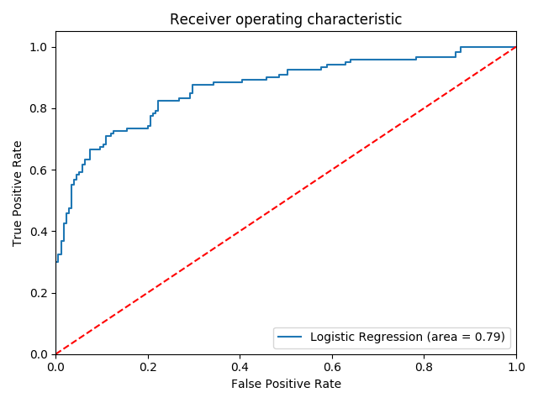
Results - ROC

