Slide 1
Final Project Presentation
2.S998
May 17, 2012
Issac Evans and Robert Truax

Slide 2
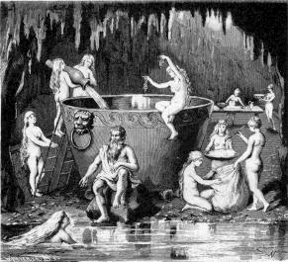
Aegir – God of the Ocean
Old Norse for ”Sea”
Giant
Father of 9 billow madiens
Known hosting elaborate parties for the other gods

Slide 3
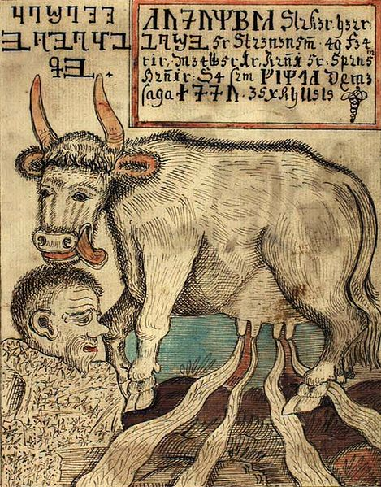
Buri – First God
Ancestor of all other Norse gods
Father of Borr and grandfather of Odin, Vili, and Ve
Formed by the cow Auðumbla licking the salty ice of Ginnungagap

Slide 4
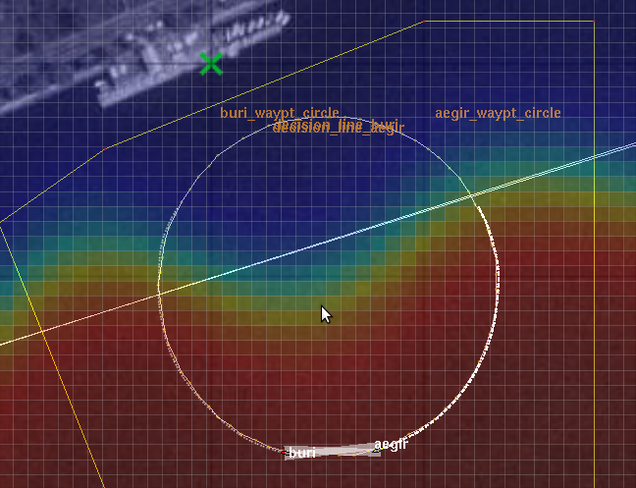
Search Phase
Split circle search path between two vehicles
Collect statistics on temperature to estimate wavefront
Exchange information at end of path

Slide 5
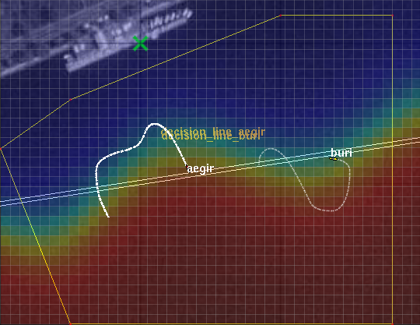
Front Following Phase
Both vehicles use identical strategies
Move back and forth across wavefront
Combination of 3 behaviors (plus collision avoidance)
Timed return at 1000 seconds

Slide 6
Behaviors During Following
BHV_GoSideways
  Desired heading along decision line along whichever direction is closer
BHV_WaveFollow
  Constant desired speed (1.5)
  Heading toward hot or cold with small offset
  Bang-bang setpoint controller to crisscross wave front
BHV_RubberBand
  Holds vehicles inside area

Slide 7
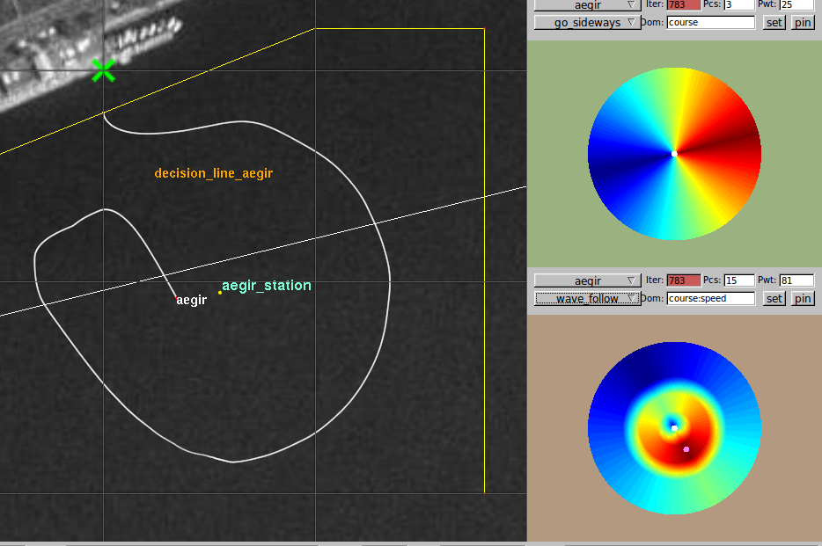
Behaviors IVP Functions

Slide 8
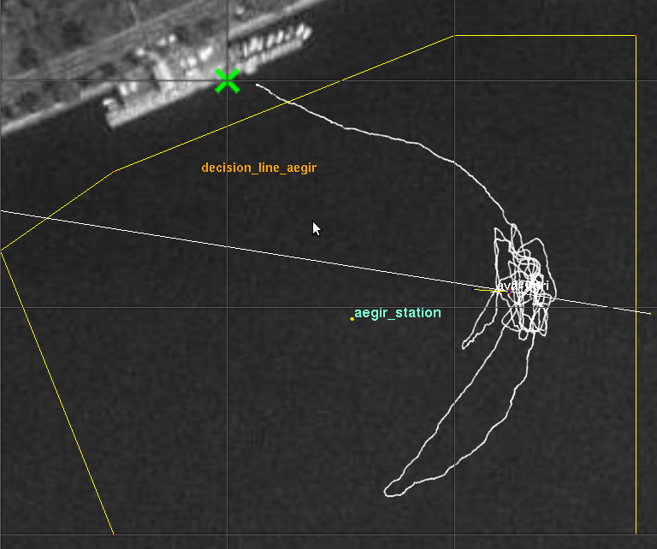
Effect of Noise On Water

