Slide 1
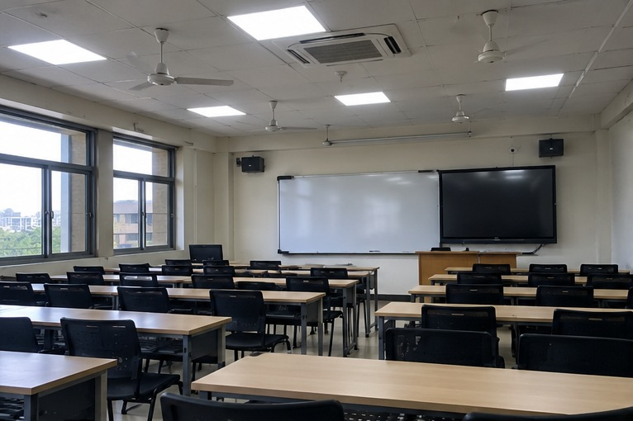
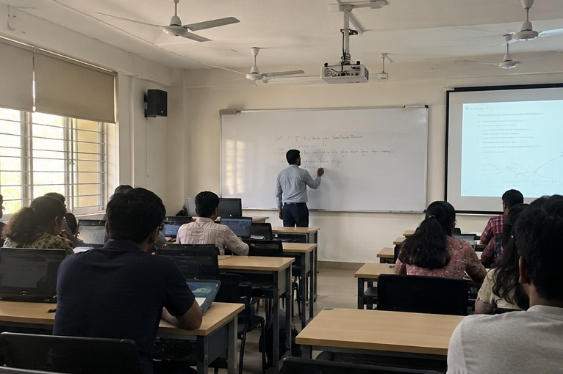
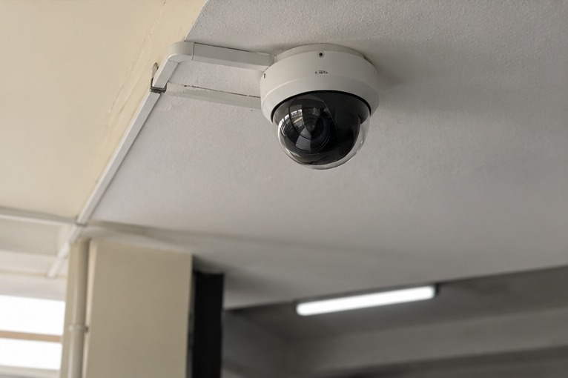
PHANTOM CLASSROOMS
Camera-assisted energy intelligence
Find empty rooms where lights or AC may still be running.
A practical campus tool that helps staff spot waste and decide what to do next.
SYNESIS 2026 | Team: DATA DYNAMOS
DATA DYNAMOS • PHANTOM CLASSROOMS
Notes:
We flag likely energy waste, rather than blindly switching equipment off.

Slide 2
The problem: empty rooms can still use power
02
Timetables show planned use—not what is happening in the room.
A class may finish early or be cancelled.
Lights, projectors or air-conditioning may stay on.
Staff cannot manually check every room all day.
Energy bills show usage, but not always where waste happened.
DATA DYNAMOS • PHANTOM CLASSROOMS
Notes:
The gap is between a room's scheduled use and its actual use.

Slide 3
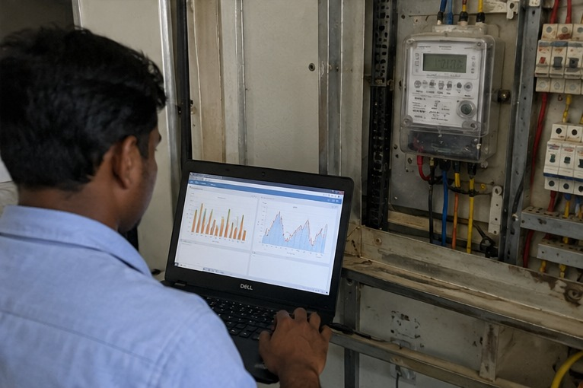
Our solution in one sentence
03
Use camera-based occupancy estimates and room energy status to flag possible waste.
1. Observe
2. Compare
3. Flag
Estimate whether the room is occupied.
Check timetable and equipment status.
Show rooms that may be wasting energy.
DATA DYNAMOS • PHANTOM CLASSROOMS
Notes:
Staff review the recommendation; the system does not assume every empty-looking room is safe to switch off.

Slide 4
How the system decides
04
It checks more than one signal before raising an alert.
Camera estimate
Timetable
Equipment / meter
Does the room appear occupied?
Should a class be happening now?
Are lights or AC still drawing power?
People-count / occupancy estimate
Scheduled start and end times
On/off status or energy readings
Example alert
“Room 101 may be empty, but the lights appear to be on. Please verify.”
DATA DYNAMOS • PHANTOM CLASSROOMS
Notes:
If the signals disagree, the system asks for a check instead of making a confident claim.

Slide 5
What the staff dashboard shows
05
A short list of rooms to check first—without complicated charts.
Example room status
Room 101
Possible waste
Empty estimate + lights on
Lab 204
Verify
Low-confidence occupancy signal
Seminar Hall 3
In use
People detected
Illustrative interface—not live campus data.
DATA DYNAMOS • PHANTOM CLASSROOMS
Notes:
The dashboard prioritizes which room staff should check and explains why.

Slide 6
Example: spotting waste in Room 101
06
One clear example makes the idea easy to understand.
What the system sees
The timetable says the class has ended.
The camera estimate finds no occupants.
The energy reading suggests the lights are still on.
Recommendation: ask staff to verify, then switch off if safe.
DATA DYNAMOS • PHANTOM CLASSROOMS
Notes:
This is an example scenario; a real pilot needs reliable energy data and testing.

Slide 7
Estimate savings with simple maths
07
Show assumptions clearly instead of promising unverified savings.
Energy saved = equipment power × avoidable hours × verified days
2 kW
1.5 hours/day
20 days/month
Assumed equipment power
Avoidable run time
Days the pattern repeats
2 × 1.5 × 20 = 60 kWh/month (illustrative only)
Estimated cost avoided = kWh saved × your electricity tariff.
DATA DYNAMOS • PHANTOM CLASSROOMS
Notes:
We can replace these example numbers with measured readings during a pilot.

Slide 8
Safe, explainable, and practical
08
The system helps people make better decisions; it does not replace them.
No automatic shutdown based on one uncertain signal.
Respect comfort, accessibility, safety and staff override.
Show the reason behind every alert.
Start with a small pilot and measure actual results.
Phantom Classrooms
Find waste. Verify it. Save energy.
TEAM DATA DYNAMOS • THANK YOU
DATA DYNAMOS • PHANTOM CLASSROOMS
Notes:
Our goal is to give campus staff clear evidence and a safe next step.

