Slide 1

Much Gracias: Semi-supervised Code-switch Detection for Spanish-English: How far can we get?
Dana-Maria Iliescu (dail@itu.dk)
Sara Qirko (saqi@itu.dk)
Rasmus Grand (gran@itu.dk)
Rob van der Goot (robv@itu.dk)

Slide 2


Code-Switch Detection
El | online | exercise | de | hoy | :
es | en | en | es | es | other

Slide 3
Code-Switch Detection
El | online | exercise | de | hoy | :
es | en | en | es | es | other
Previous work: train sequence labeler (supervised):
Require annotated training data for each language pair
We exploit mono-lingual data instead (semi-supervised)
Enables CS-detection for many more language pairs!

Slide 4
RQ1: How do semi-supervised models compare and perform in the task of language identification in English-Spanish code-switched data?
RQ2: How does the best semi-supervised model compare to a supervised model known to give almost state-of-the-art results?

Slide 5
Related Work
LinCE: A Centralized Benchmark for Linguistic Code-switching Evaluation
GLUECoS: An Evaluation Benchmark for Code-Switched NLP
Detecting Code-Switching Between Turkish-English Language Pair
ML-BERT: 98.53% accuracy
ELMo: 98.12% accuracy
-> pre-trained on large multilingual annotated datasets
-> pre-trained on large annotated datasets and fine-tuned with generated and real code-switched data
Modified ML-BERT: 96.24% F1 score
Unsupervised MUSE: 92.42% F1 score
-> trained on monolingual word embeddings
Character n-grams: 92.9% micro-average F1 score
Conditional Random Fields: 95.6% micro-average F1 score
-> trained on big English and Turkish monolingual data, used small annotated Twitter data for validation

Slide 6
Datasets
Twitter data introduced by LinCE
Default train, validation and test sets
* When validating and testing, words from some categories were skipped (e.g. “ne” for named entities)
Wikipedia data
Monolingual data (English: 41M words, Spanish: 60M words)
“Annotation” is noisy and there are no code-switches
Pre-processing
Rule-based tokenization using spacy
Emoticons, punctuations, numbers categorised as other

Slide 7

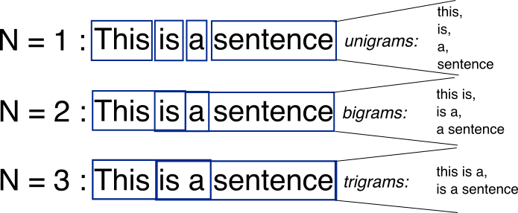
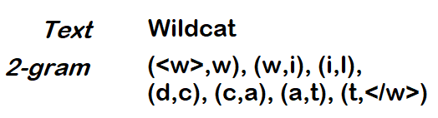
Methods
Word uni-grams
Word n-grams
Character n-grams
Choosing the language where the word appears with higher probability
Choosing the language where the joint probability of the character sequence has the highest probability
Choosing the language where the joint probability of the word sequence has the highest probability
Disclaimer: Images used in this slide are not owned by us and they do not depict the exact method implementation
Notes:
Naive Word Prob
Wikipedia data, Frequency Dicts
Character n-grams
Split words into n-grams (1-6)

Slide 8
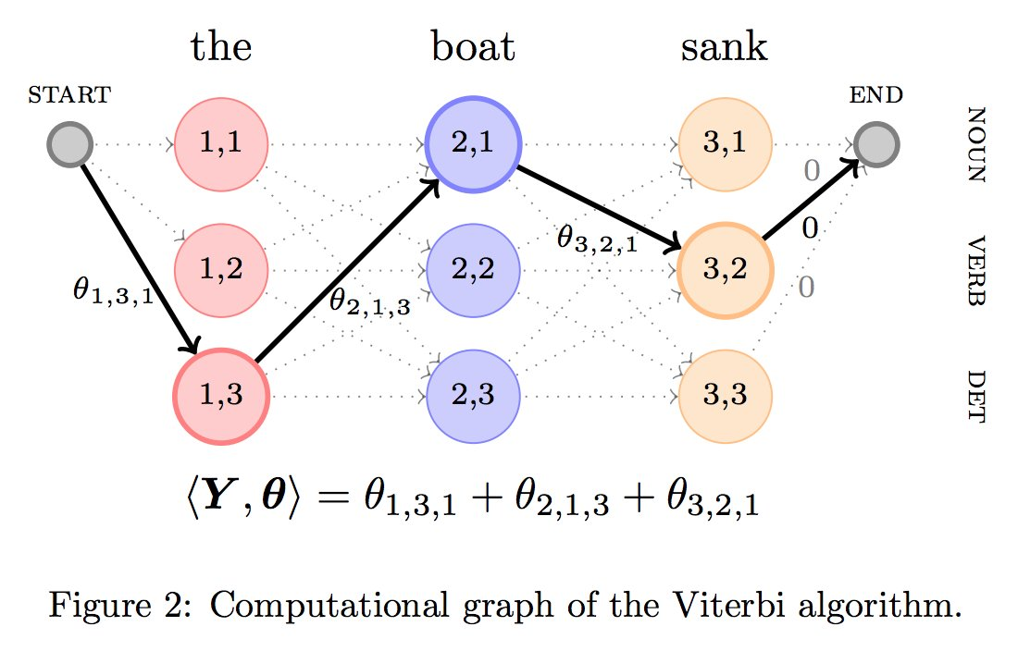
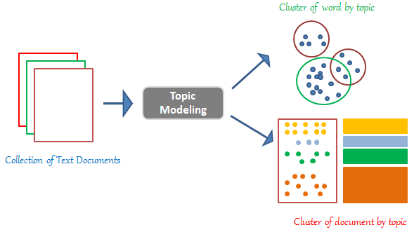


Methods
Viterbi Decoding
Latent Dirichlet Allocation
Support Vector Machine
Logistic Regression
Finding the most probable sequence of languages given observed twitter data
Find the language a word belongs to based on the features of the word
Creating a decision boundary hyperplane between the two languages
Creating a decision boundary based on a regression using a logistic function
Disclaimer: Images used in this slide are not owned by us and they do not depict the exact method implementation
Notes:
Viterbi
HMM
Sentences can be represented as markov chain with hidden states that are the two languages
Parameters found empirically
LDA
Topics a document belongs to based on collection of words in the document
Topics = lang1, lang2, Document = Word, Word=character n-grams
Word unigrams probability is used to label the clusters
Support Vector Machine
Supervised
Logistic Regression
Supervised

Slide 9
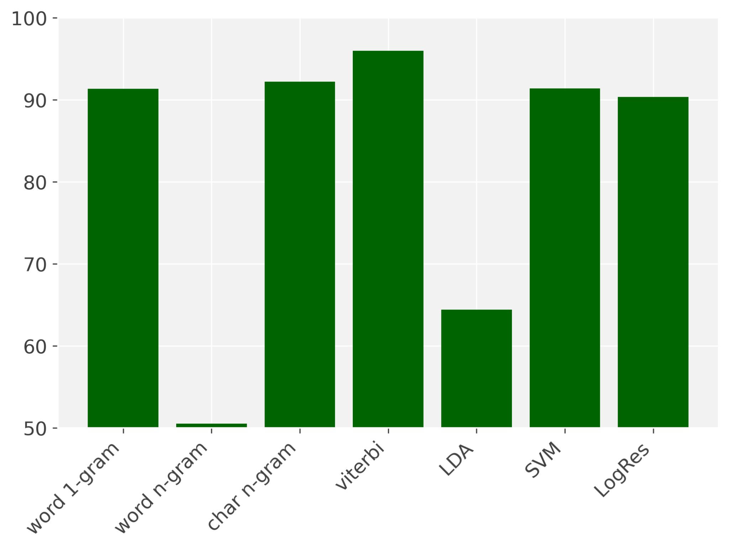
Results

Slide 10
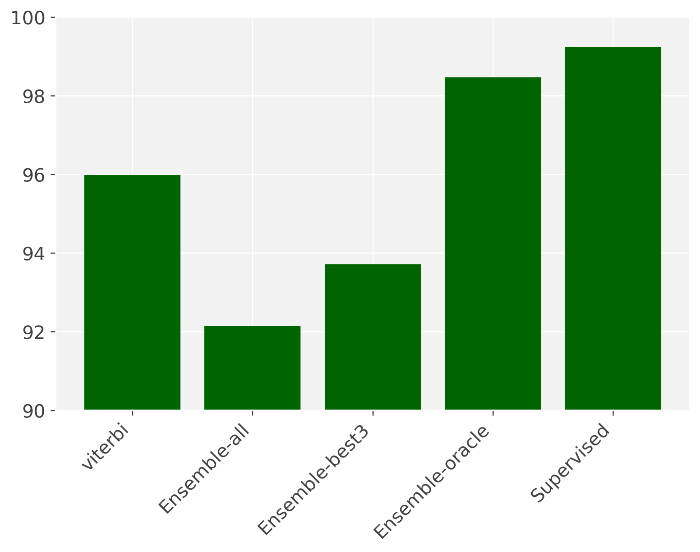
Results

Slide 11
Analysis
English vs. Spanish performance
LDA: inappropriate model for the task
Varying hyperparameters

Slide 12
Conclusions
We found that most of the models achieved promising results, however, the Viterbi model performed the best with a weighted F1 score of 95.99% on validation data and 92.23% on test data (RQ1).
Even though the results were good, our models still underperformed compared to the supervised MaChAmp model, that scored 99.24% on validation data and 98.43% on test data (RQ2).
Ensembling has potential.

Slide 13
Thank you!
https://github.com/RalleGr/msc-code-switching

Slide 14


Slide 15
Much Gracias: Semi-supervised Code-switch Detection for Spanish-English: How far can we get?
Dana-Maria Iliescu (dail@itu.dk)
Sara Qirko (saqi@itu.dk)
Rasmus Grand (gran@itu.dk)
Rob van der Goot (robv@itu.dk)

Slide 16
Code-switch Detection
Previous work: train sequence labeler (supervised):
Require annotated training data for each language pair
We exploit mono-lingual data instead (semi-supervised)
Enables CS-detection for many more language pairs!

Slide 17
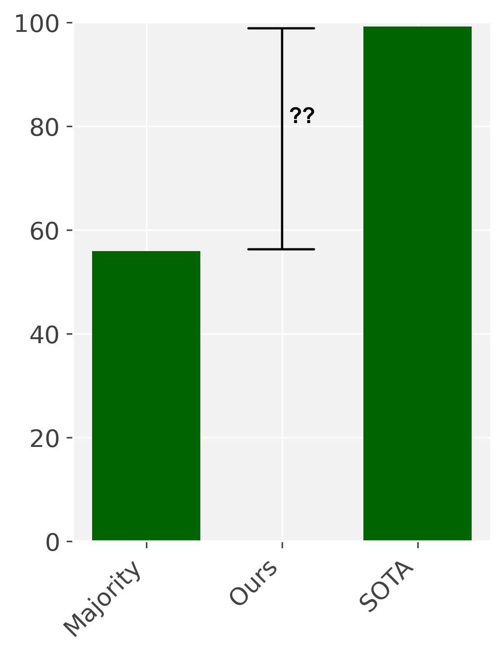
Semi-supervised Code-switch Detection
We propose 7 models based on mono-lingual data:
Which models are the most promising for CS-detection?
How does our best model compare to SOTA supervised models?

