Slide 1
Lets agree to disagree about syntactic annotations
Rob van der Goot
40 years GroNLP
21 oktober 2026

Slide 2
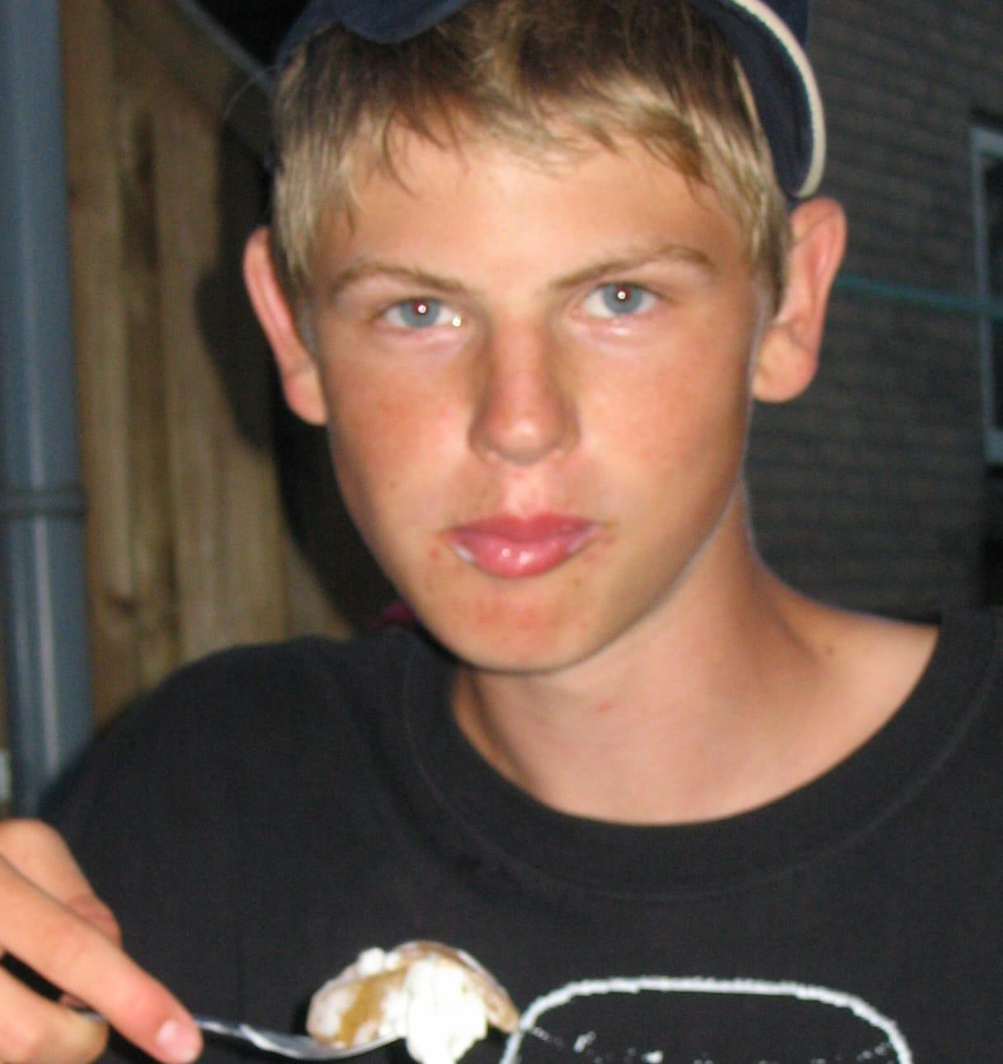
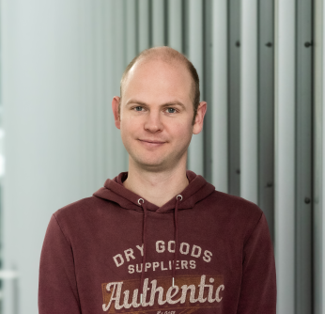
Background
I'm Rob
Studied Informatiekunde from 2009-2014 in Groningen
PhD on "Normalization and Parsing for Uncertain Input"
Supervised by Gertjan

Slide 3
Background
I'm Rob
Studied Informatiekunde from 2009-2014 in Groningen
PhD on "Normalization and Parsing for Uncertain Input"
Supervised by Gertjan
Since then: IT University of Copenhagen

Slide 4
Story
Present my slowest, most interesting (?!) project
Not published
Based on actual events

Slide 5

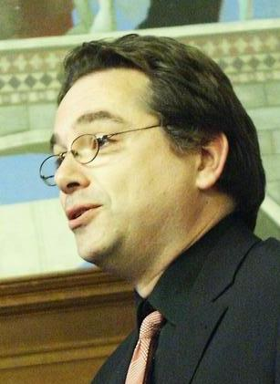
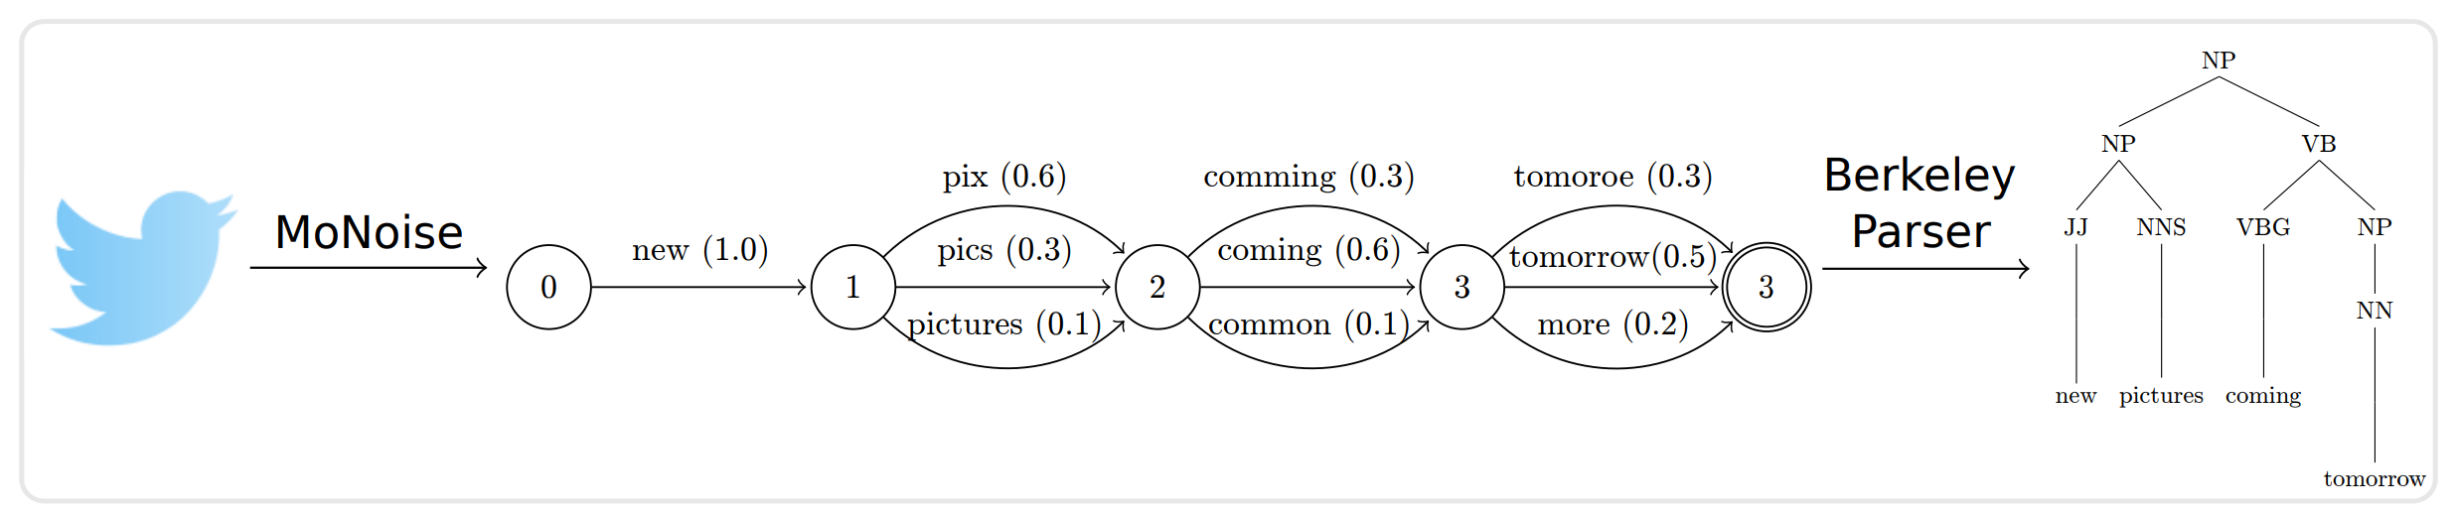
Story
Parsing Uncertain Input
2018:
  SOTA normalization
  Top-n consituency parser

Slide 6
Story
Parsing Uncertain Input
2018:
  SOTA normalization
  Top-n consituency parser
  Dependency Parsing became more popular

Slide 7
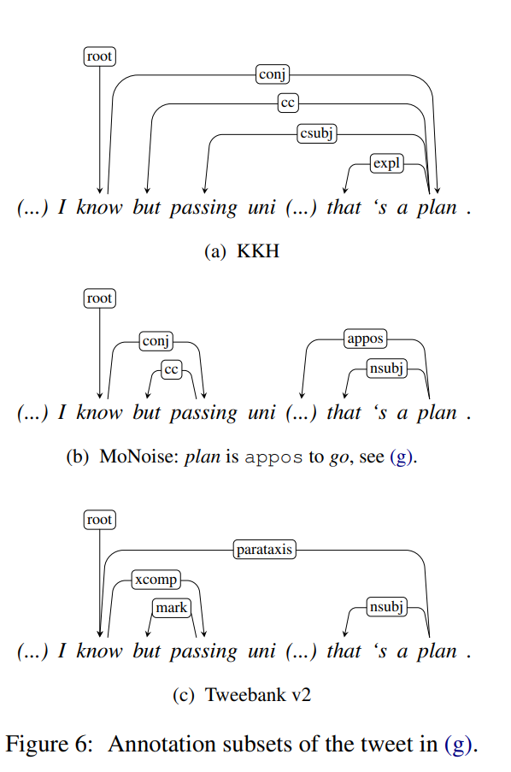
So: "Modeling Input Uncertainty in Neural Network Dependency Parsing"
Created a small UD treebank based on social media data. (and build a parser)
Annotated by me

Slide 8
Submitted to EMNLP 2018.
Scores: 2.5 3 3 (out of 5)

Slide 9
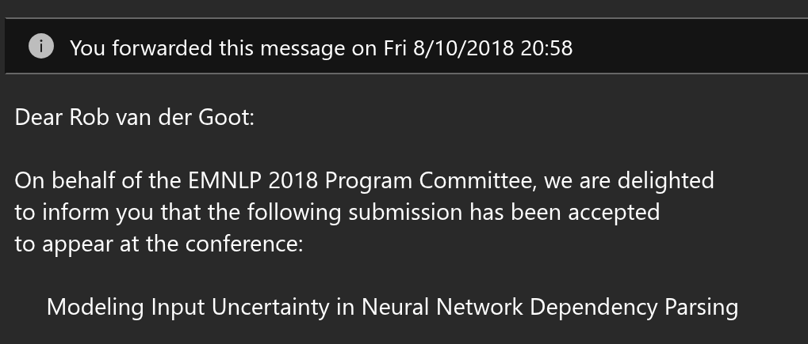

Slide 10
E-mail
Wow, really! Congratulations!
So… not getting married after all?
GJ

Slide 11
E-mail
Wow, really! Congratulations!
So… not getting married after all?
GJ
Yes, I can go. Then I’ll actually be doing something for my co‑authorship for once…
GJ

Slide 12
One year later
Tweebank 2.0 was released
UD annotations for social media data
  Both contain data from Owoputi et al. (2013)!
  First totally independent annotations for syntax (?)

Slide 13
One year later
Tweebank 2.0 was released
UD annotations for social media data
  Both contain data from Owoputi et al. (2013)!
  First totally independent annotations for syntax (?)
Gertjan recommended me to move to another university "preferably in another country"

Slide 14
One year later
Tweebank 2.0 was released
UD annotations for social media data
  Both contain data from Owoputi et al. (2013)!
  First totally independent annotations for syntax (?)
Gertjan recommended me to move to another university "preferably in another country"
Moved to Denmark to work with Barbara

Slide 15
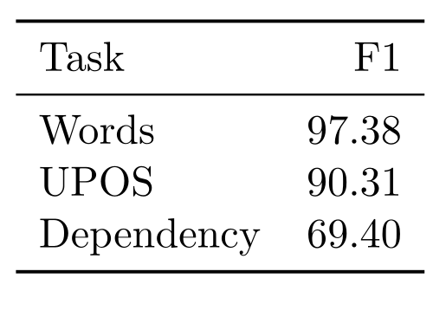
Cross-annotator F1 score

Slide 16
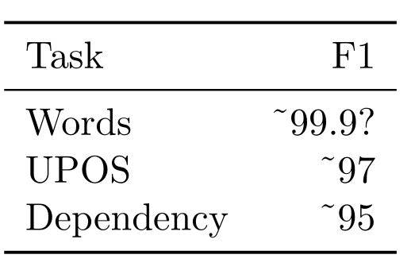
Cross-annotator F1 score
SOTA (news data)

Slide 17
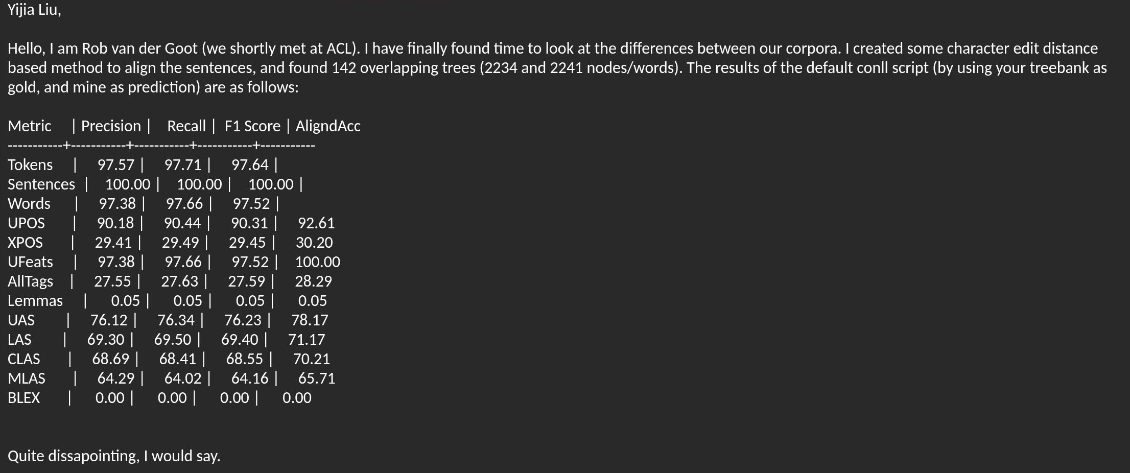

Slide 18
Reply:
Hi Rob,
Thanks for the experiments. The number seemed OK to me

Slide 19
Reply:
Hi Rob,
Thanks for the experiments. The number seemed OK to me
Lets agree to disagree

Slide 20
Interesting!, but what to do?
Not sure... was also moving

Slide 21
Interesting!, but what to do?
Not sure...
Until I met an excellent master student in Copenhagen (2023).
We published some papers, and she wanted a challenging, linguistically focused project for thesis.

Slide 22
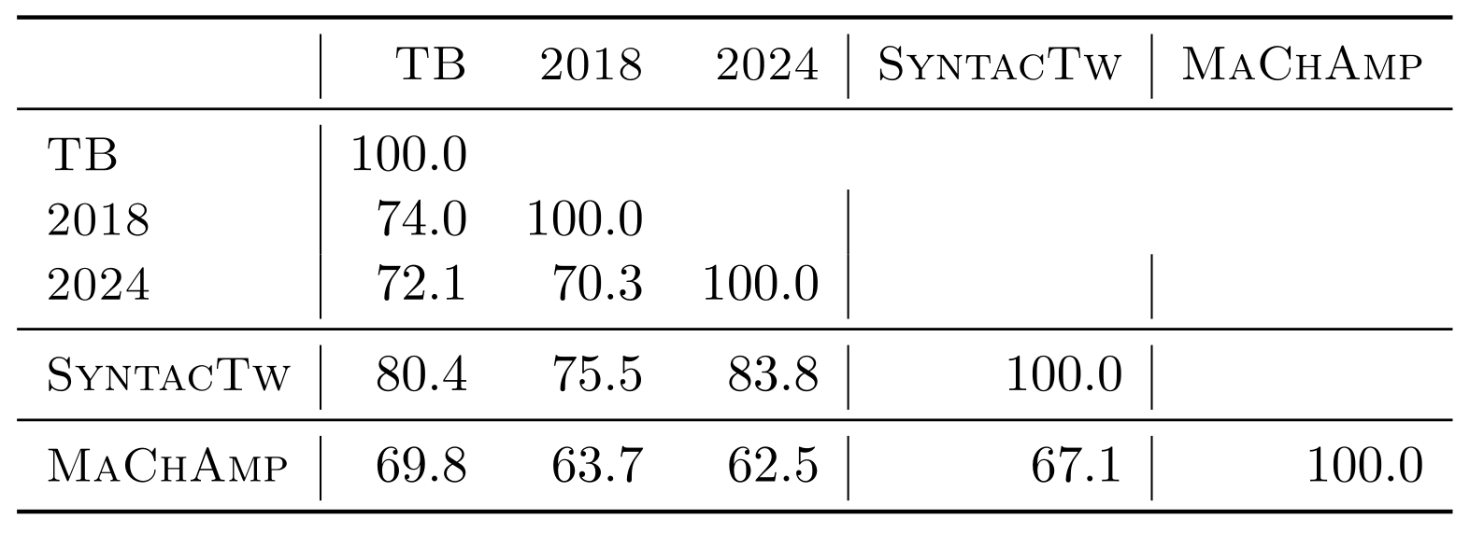
Comparing different annotations (LAS)

Slide 23
Comparing different annotations (LAS)

Slide 24
Example

Slide 25
Compare to standard
Experienced linguist converges the different annotations to a gold standard (SyntacTw)
Addendum to UD guidelines

Slide 26
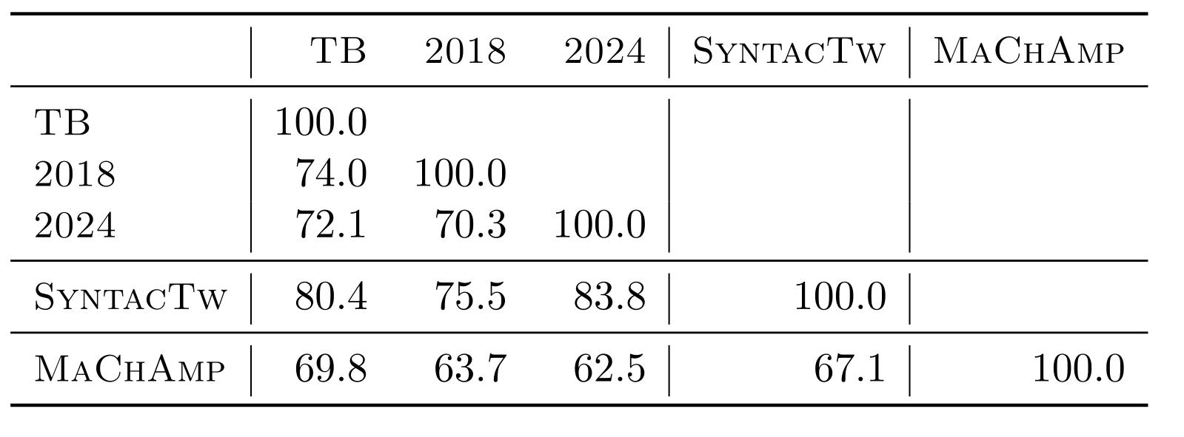
Comparing different annotations (LAS)

Slide 27
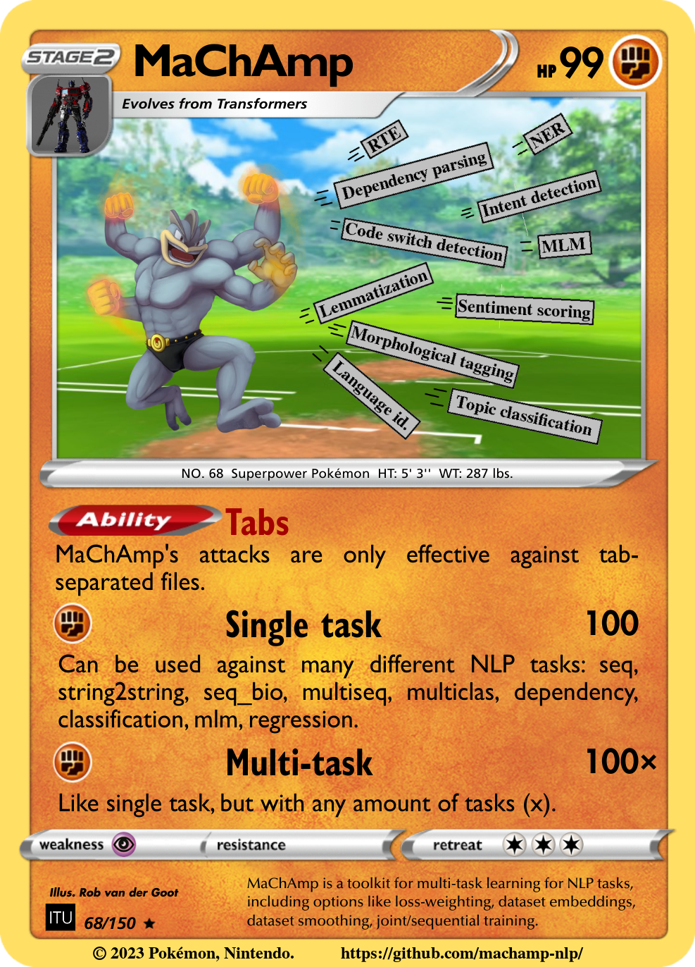
What about automated parsers?
Train MaChAmp toolkit (deep-biaffine parser)
RoBERTa-base
TweeBank 2

Slide 28
Comparing different annotations (LAS)

Slide 29
Overall scores (internal agreement/parser) are lower compared to previous studies
Non-standardness of data
We do annotations from scratch, avoiding anchoring (Berzak et al. 2016)
Others had clearer guidelines from the beginning

Slide 30
Are we close to a performance ceiling for parsing social media data?

Slide 31
Lets ask another experienced linguistic annotator
Annotator selects preferred structure across two annotations
Blind, order=mixed

Slide 32
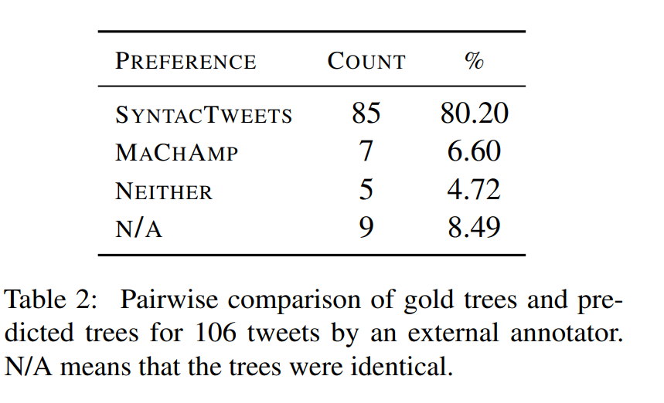
Lets ask another experienced linguistic annotator

Slide 33
Lets ask another experienced linguistic annotator
Humanly annotated structures are better

Slide 34
What about alligning parsers?
Evaluation
Parser implementation

Slide 35
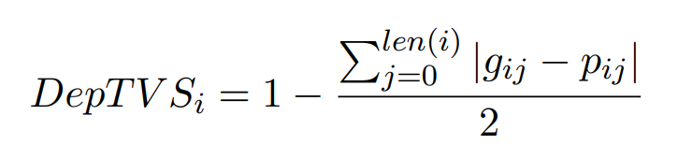
Use distribution for evaluation: Dependency Total Variation Similarity
Loop over all words (i)
  Loop over each label (j)
  Sum absolute differences

Slide 36
Use distribution for evaluation: Dependency Total Variation Similarity
Loop over all words (i)
  Loop over each label (j)
  Sum absolute differences
Divide by 2 to make range 0-1
Add 1- to make higher = better

Slide 37
Use distribution for evaluation: Dependency Total Variation Similarity
Loop over all words (i)
  Loop over each label (j)
  Sum absolute differences
Divide by 2 to make range 0-1
Add 1- to make higher = better

Slide 38
Building a parser
Deep-biaffine parser
Predictions every word to every word
Chu-Liu algorithm

Slide 39
Building a parser
Deep-biaffine parser
Predictions every word to every word
Chu-Liu algorithm

Slide 40
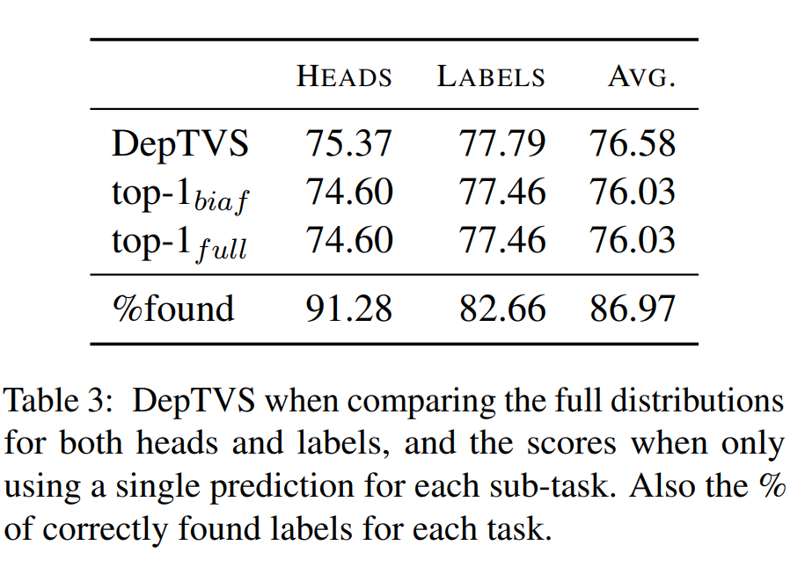
Use distribution for evaluation: Dependency Total Variation Similarity

Slide 41
Conclusions
I learned some things from Gertjan
People disagree
Parsing is not solved
We can evaluate against a distribution of annotators
Distribution of deep biaffine parser has some relevant signal encoded

Slide 42
Many thanks!
Gertjan
Barbara
Kia
Sonnik
Gosse

Slide 43





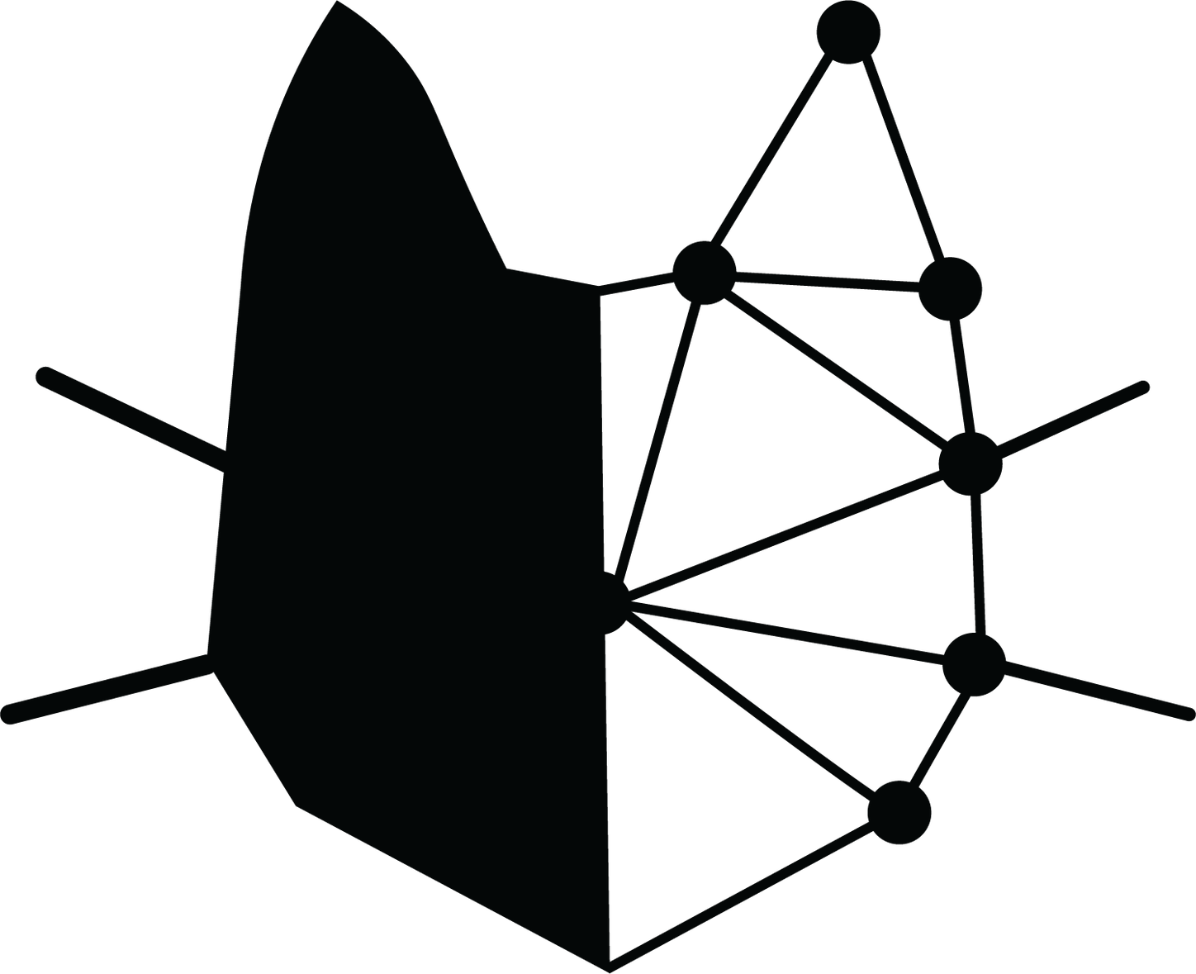
Thanks!

Slide 44
