Slide 1
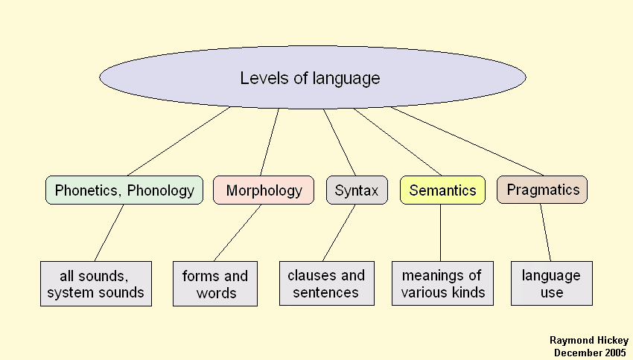

Slide 2
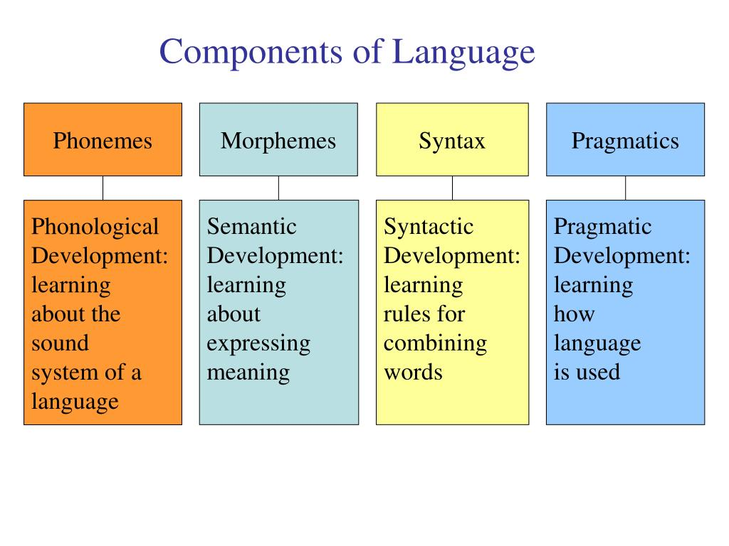

Slide 3
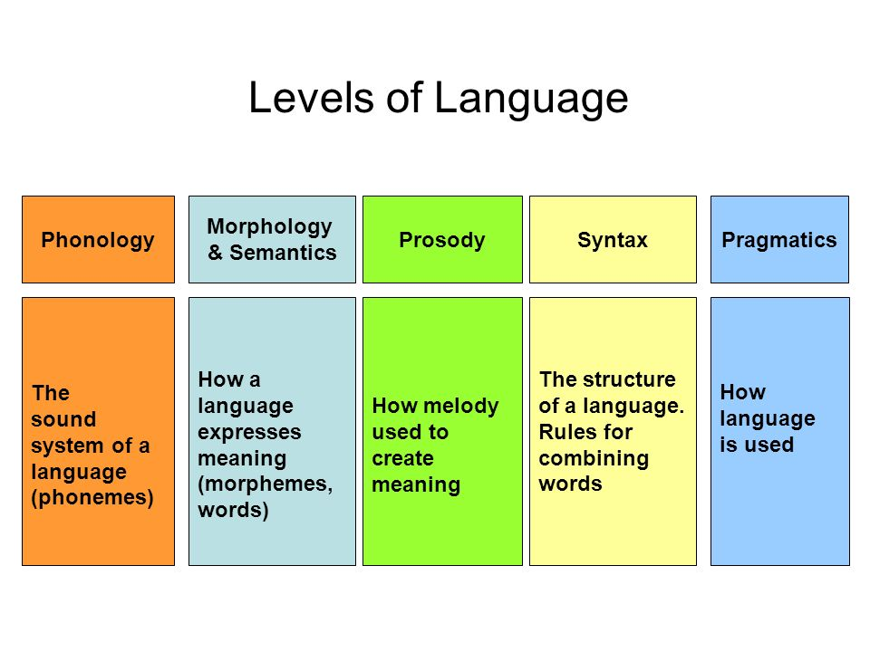

Slide 4
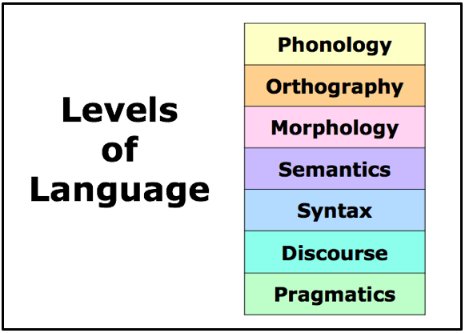

Slide 5
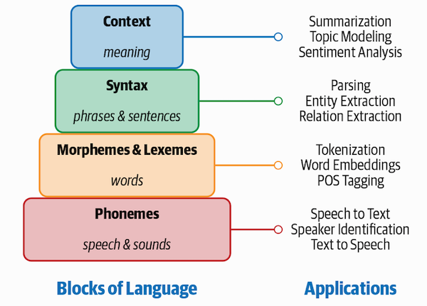

Slide 6
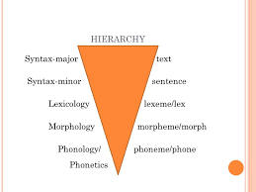

Slide 7
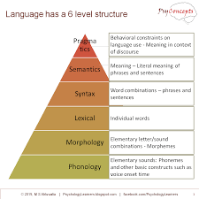

Slide 8
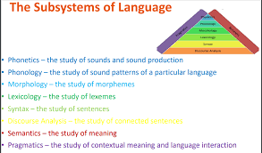

Slide 9
The language hierarchy
The language hierarchy comprises of 6 levels as shown in the diagram below. Brief descriptions follow:
The Hierarchy of Language Posted by Psychology Learners on Saturday, 27 June 2015
1. Phonology: Elementary sounds
Phonemes are the smallest units in a language that are experienced as different sounds by its native speakers. Ex: 'bat' and 'pat' differ by just one phoneme. They are composed of different combinations of discernibly-different features that form the level below Phonemes. Ex: voice onset time. Anything with voice-onset time < 20 ms. is 'b'; and voice onset time > 40 ms. is 'p'. People can't distinguish between differences within the range. English has 46 separate phonemes: vowels, a, e, i, o, and u; consonants, such as p, m, k, and d; and blends of the two. Different languages often employ different groups of phonemes – sounds used in one language may be absent in another, although learning the phonological structure of one language may increase one’s chances of proficiency in a second language (Holm & Dodd, 1996).
2. Morphology: Elementary letter/sound combinations
Morpheme is the smallest meaningful unit of a language. Ex: “disliked” has three morphemes: “dis,” “lik,” and “ed.” In English, Morphemes are usually whole words or meaningful parts of words, such as prefixes, suffixes, and word stems. Some languages also allow infix attachment - morpheme is attached inside another morpheme. Many words are made up of more than one morpheme, because they can take other morphemes as suffixes. In some languages all words are made up of multiple morphemes, because they can be combined in richer ways than they can in English, often playing the role that is played by word order (at the syntactical level) in English. English has about 100,000 morphemes. Some of these are words; others, such as the plural s or prefixes such as un or sub, are not.
3. Lexical: Individual words
Word is a unit of language that native speakers can identify. They can be single or multi-morphemic. Ex: ‘a’ and ‘I’ are single morphemic words, and, ‘disliked’ and ‘unknown’ are multi-morphemic.
Much of what we think of as word meaning is contained in the relation between words. Although your knowledge of, say, dogs is not entirely linguistic because you have encountered real dogs- it is likely that your knowledge of justice or Plato or East Timor probably is, because you probably know about all these things only from words.
The number of English words is considered to be around 500,000.
https://psylearners.psychotechservices.com/2015/07/solved-ignou-assignment-mpc001-q3.html

Slide 10
4. Syntax: Word combinations
Syntax is the process by which words are combined together to form phrases and sentences. Ex: an article such as “the” must come before a noun, not after: “Read the book,” not “Read book the.”
Importance: Having a pronouncing dictionary of a foreign language (complete access to phonology and morphological knowledge), gives almost no useful information about how to say anything. Most information is contained in the word order, especially, in languages that do not use morphology to tag information about what role a word plays.
Syntax is aligned to the level of surface structure proposed by Chomsky: a superficial appearance, literal ordering of words.
Number of possible combinations of words, is for all practical purposes infinite.
5. Semantics: Meaning
Semantics refers to the rules used to communicate meaning using the lower level elements of language.
It is aligned to the level of deep structure proposed by Chomsky: Underlying representation of meaning. Producing sentences requires transformation of the deep structure into a surface structure.
6. Pragmatics: Behavioral constraints on language use
There are additional higher-level constraints on what we can say, ones operating at the level of pragmatics – the practical use of language. It determines our word choice and our interpretation of language in different settings. Factors such as relevance and politeness play their role.
Ex: If someone asks "Do you want potato chips?” due to rules of pragmatics we consider the next thing said by you to be relevant to the question. The reply "I'm getting too fat”, therefore, is not considered to be a new topic, but a negative answer.
Discourse: The next level
Most linguistic interchanges consist of more than one sentence. When we string multiple sentences together, there are rules about how they should relate to each other. This is called discourse. It is composed of sentences (L4 of hierarchy) composed of constituents composed of words (L3) composed of morphemes (L2) composed of phonemes (L1).
The structure of language is hierarchical comprising of six levels – Phonology, Morphology, Lexical, Syntax, Semantics and Pragmatics. Phonology refers to the elementary sounds. Morphology refers to elementary combinations of letters and sounds. Lexical level refers to individual words formed of Morphemes. Syntax refers to combination of words. Semantics refers to the rules used to convey meaning using the lower levels. Pragmatics refers to behavioral constraints on the use of language. Discourse can be considered to be the next level, as most linguistic interchanges comprise of more than one sentence.
https://psylearners.psychotechservices.com/2015/07/solved-ignou-assignment-mpc001-q3.html

Slide 11
