Slide 1

Spectra

Slide 2
Problem

Slide 3


I became a teacher for the kids. After 4 years of teaching, I didn’t have any close relationships with students.
~ middle school teacher
Notes:
This teacher spent so much time preparing curriculum, grading tests, and delivering content. Relationships became deprioritized as compared to the deliverables that were needed for a class to function. Yet, teacher-student relationships quality and student achievement are correlated. Not only are teachers and students happier if TSRQ is high, student achievement goes up as well.

Slide 4

Relationships improve teacher satisfaction and student outcomes.
Notes:
We decided to improve teacher student relationships in classrooms in order improve teacher satisfaction and student outcomes.

Slide 5
Solution
Notes:
How do we do that? We focused on efficiency, usability, and easily implementable.

Slide 6
Student
Notes:
UI 1: Student Tasks
· Tell your teacher how you are feeling today and why.
· Change your mood to a different mood.

Slide 7
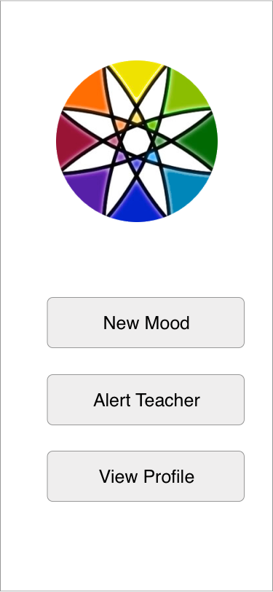

Slide 8
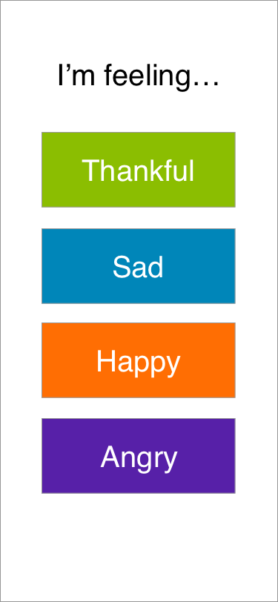

Slide 9
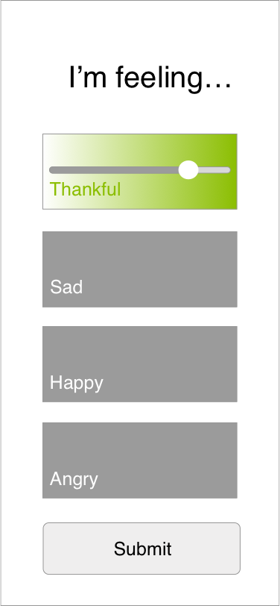

Slide 10
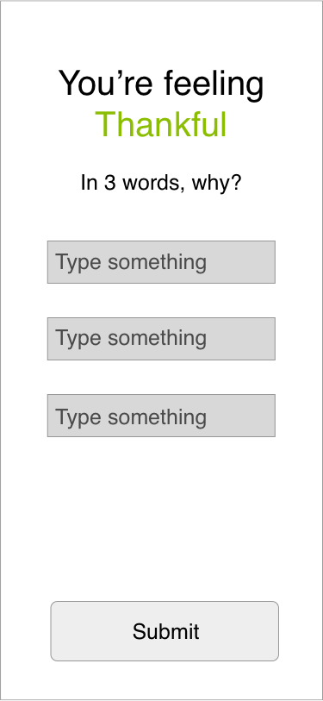

Slide 11
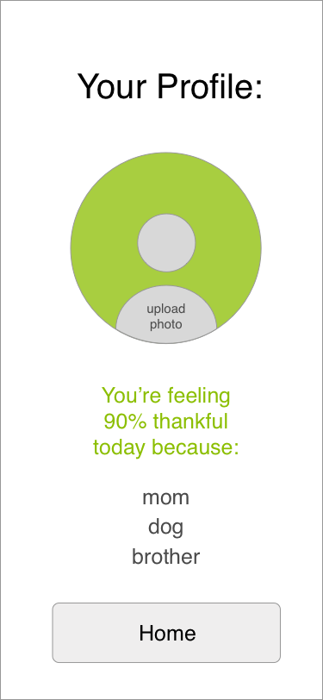

Slide 13
Teacher
Notes:
UI 1: Teacher Tasks
· Contact Jacky Smith’s Parents
· Find out how Jacky Smith was feeling on Friday

Slide 14
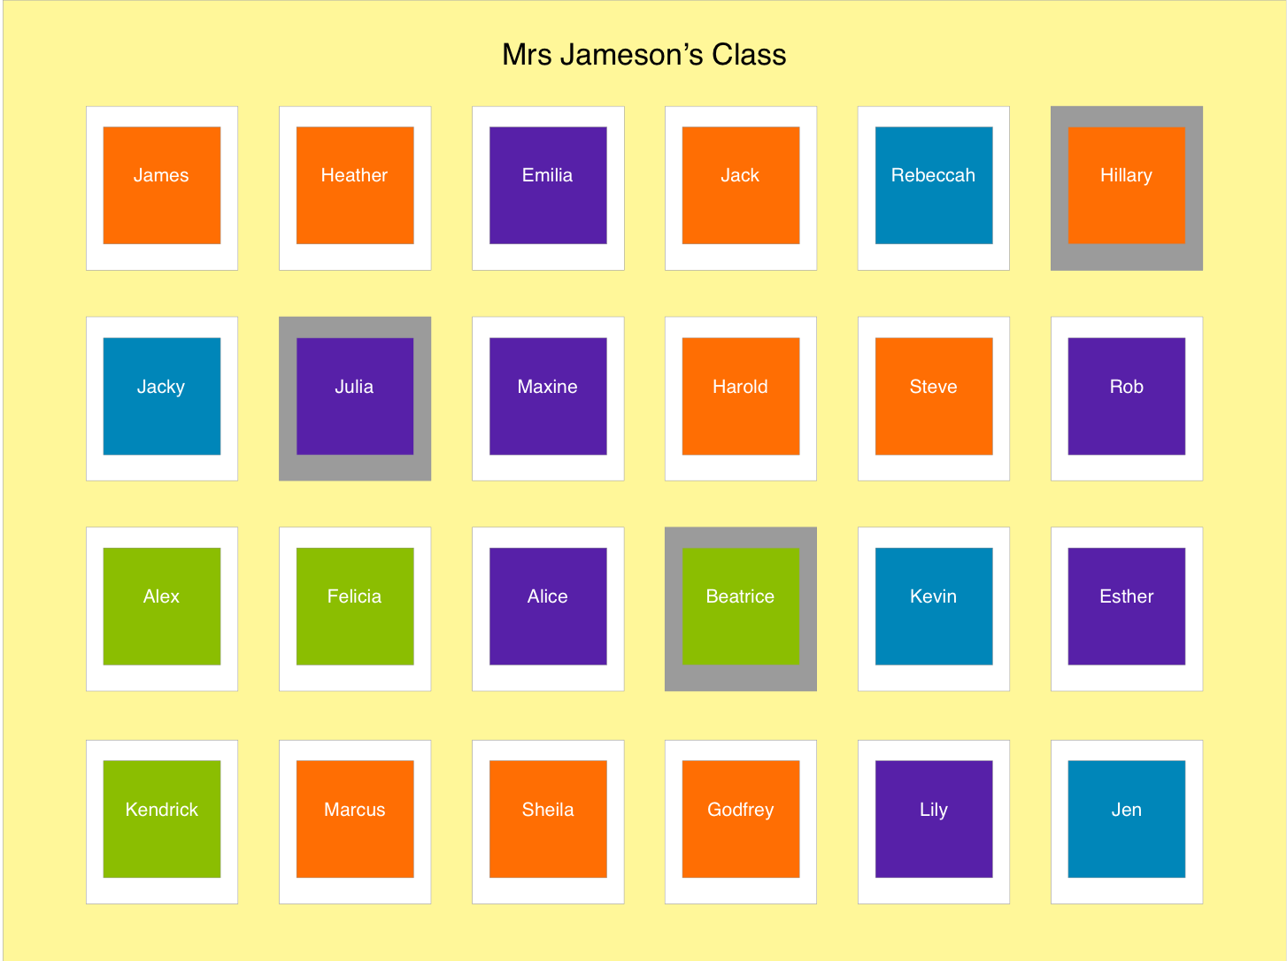

Slide 15
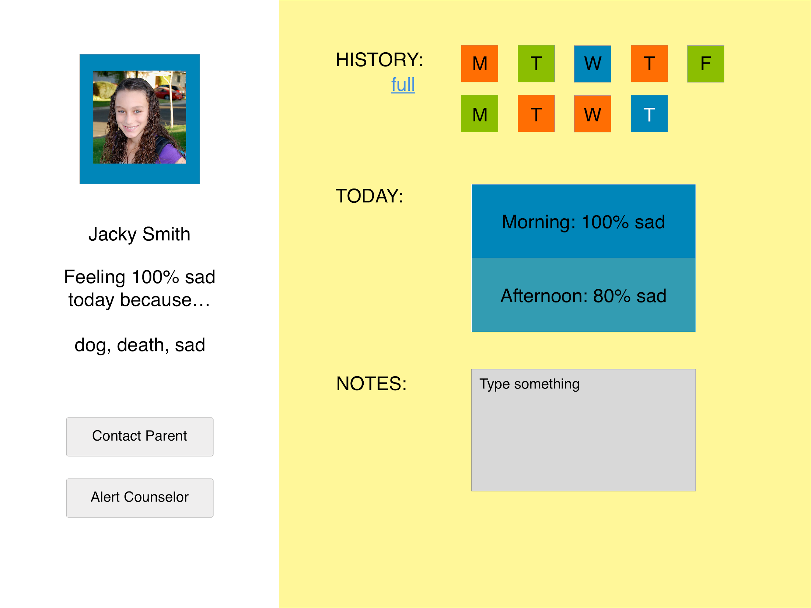

Slide 16
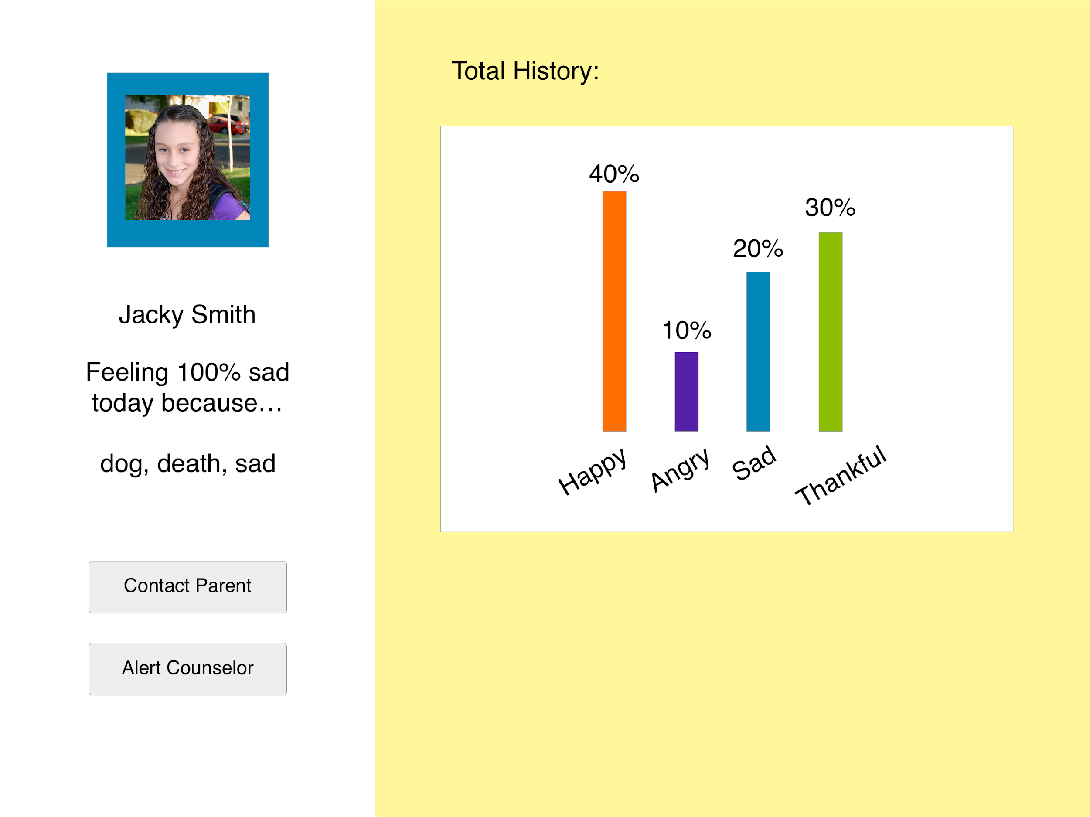

Slide 17
User Feedback

Slide 18
“The confidentiality part of this platform would be helpful. Instead of calling students in the hallway or in class, messaging students through the app would be more discrete.”
Bobak, high school computer science teacher
“I love this because it’s super quick for students to use, super fast for me to interpret the data, and I would definitely use this to develop community in my classroom.”
Nicki, 8th grade teacher
“Middle school students need to develop skills to describe their emotional well-being. The open-response option would be an opportunity for students to practice describing their emotions.”
Amy, 4th grade teacher
Notes:
Positive teacher feedback

Slide 19
“My favorite teachers are the funny ones who make fun of my classmates. That way I don’t have to.”
Victoria, 8th grader
“Some kids would troll this and say whatever, not real feelings.”
Tracy, 8th grader
“I’d use it if I had to but I’m not sure if I would want to.”
Antoinette, 7th grader
Notes:
Student feedback - mainly bad...

Slide 20
Next Steps

Slide 21
“My students would want to request meetings with me all the time even if they didn’t have anything going on. Maybe there could be a limit on the ‘Alert Teacher’ feature.”
Amy, 4th grade teacher
“If there were some kind of database to store “resolved” issues, it would help me remember monitor certain students better”
Bobak, high school computer science teacher
“I would want to decide which teachers could see my responses. I like some of my teachers, but not all of them.”
Alex, 7th grader
Notes:
Feedback requests

Slide 22
What will motivate students to use this app?
How do we discourage students from trolling their responses?
How can we make student data easy for teachers to process?
Notes:
How can we make this more appealing to students?

Slide 23
Questions?

