Slide 1
SeqSQLi
Sequential SQL Injection WAF Bypass via Deep Reinforcement Learning
Roby Firnando Yusuf | Advisor: Prof. Duksan Ryu
Final Seminar | June 2026
Notes:
OPENING (~30 sec)
Good morning. I am Roby Firnando Yusuf.
Today I present SeqSQLi, a Deep RL framework for automated WAF bypass.
Let us get started.

Slide 2
Agenda
1. Background & Motivation
2. SeqSQLi Framework
3. Experimental Setup
4. Results & Analysis
5. Conclusion & Future Work
Notes:
AGENDA (~15 sec)
Five parts: background, framework, setup, results, conclusion.

Slide 3
Background
SQL Injection remains a persistent web security threat
- SQL Injection listed in OWASP Top 10 2025 — Injection category (A05)
- Attackers embed SQL commands into user-controlled inputs (e.g. login forms)
- Impact: unauthorized access, full database exfiltration
- Web Application Firewalls (WAFs) are the primary defense layer
- WAFs block requests by matching text against known malicious patterns
- Core weakness: WAFs check syntax, not semantics
Same SQL meaning + different surface form = WAF evasion
Notes:
BACKGROUND (~1 min)
SQL Injection: attacker inserts SQL into inputs. WAFs scan text patterns.
Weakness: change the form, keep the meaning. Example: SELECT -> SeLeCt.
Same database execution, WAF pattern misses.

Slide 4
Problem & Motivation
Why reinforcement learning?
Prior Approaches
SeqSQLi (Our Approach)
- Random mutation — inefficient
- RL agent learns from live WAF responses
- Manual trial-and-error — slow
- Discovers optimal mutation sequences
- Grammar-based — no live WAF feedback
- Trained online against a real WAF
- No study of mutation ordering
- Formally measures mutation ordering effect
Notes:
MOTIVATION (~1 min)
Prior work: random/grammar-based, no ordering study.
SeqSQLi: RL agent gets direct WAF feedback, learns optimal sequences.
First work to formally study whether mutation order is a learnable signal.

Slide 5
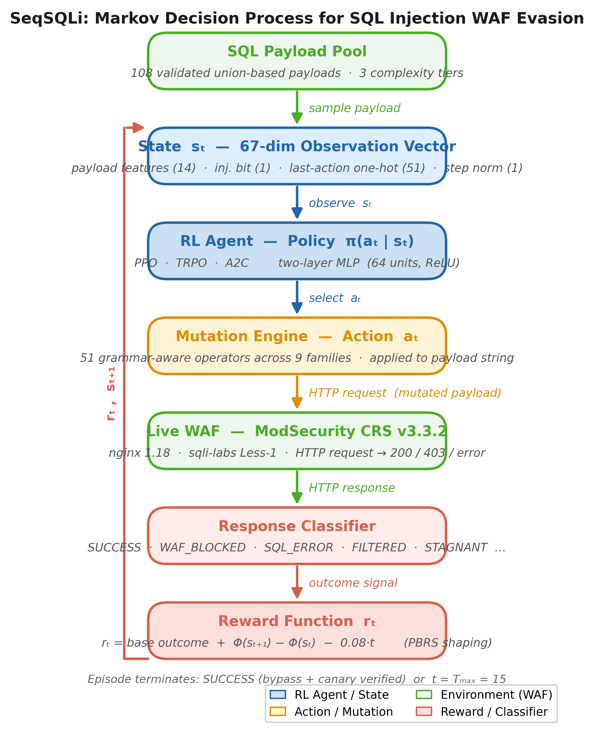
SeqSQLi Framework
Modeled as a Markov Decision Process (MDP)
MDP Components:
State (s)
67-dim observation vector
Action (a)
51 mutation operators
Reward (r)
WAF response -> score
Environment
Live ModSecurity WAF
Episode
Max 15 mutation steps
Notes:
FRAMEWORK (~1.5 min)
MDP: observe 67-dim state -> select mutation -> HTTP request to WAF -> response -> reward -> update policy.
Episode: one payload, max 15 steps, ends on SUCCESS or truncation.

Slide 6
State Representation
Agent observes the payload as a 67-dimensional vector
1. Payload Features (14 dim)
2. Injection Type Bit (1 dim)
Binary flags: which mutation families have already been applied
0 = union-based, 1 = error-based Prevents policy collapse across tasks
3. Last-Action One-Hot (51 dim)
4. Step Counter (1 dim)
Which mutation was applied at t-1 Enables learning of ordering dependencies
Current step normalized by Tmax Implicit remaining-budget signal
Total: 14 + 1 + 51 + 1 = 67 dimensions
Notes:
STATE (~1 min)
14: checklist of applied mutation families.
1: task type bit prevents policy collapse.
51: last-action one-hot — key for ordering learning.
1: step fraction — encourages efficiency.

Slide 7
Action Space
51 grammar-aware mutation operators across 9 families — semantics preserved
Case Mixing
Whitespace Variants
Comment Insertion
SeLeCt, UnIoN
tab, newline, %0a
/**/, /*!50000*/
Hex / Encoding
Identifier Tricks
Aggregate Swap
0x3a, URL-encode
`users`, double-write
JSON_ARRAYAGG(CONCAT(.))
Null Byte
Paren / Space
Semantic Substitution
%00, \x00
func( ), dot prefix
AND->&&, OR->||
Notes:
ACTIONS (~1 min)
51 operators, 9 families. All preserve SQL semantics.
Key: aggregate swap (GROUP_CONCAT -> JSON_ARRAYAGG) unlocked complex tier bypass.

Slide 8
Reward Function
Feedback signal guiding the agent's learning
SUCCESS
+10.0
WAF bypassed — canary markers appear in response body
SQL_ERROR
+0.5
Payload reached DB but caused a SQL syntax error
FILTERED
-1.0
WAF blocked with a specific rule match
UNKNOWN
-0.5
Unrecognized response pattern
SERVER_ERROR
-1.5
HTTP 500 — server error
WAF_BLOCKED
-2.0
WAF hard-blocked the request (HTTP 403)
STAGNANT
-3.0
Mutation produced no change to the payload
+ PBRS Shaping: bonus per WAF trigger removed — policy-invariant dense guidance (Ng et al. 1999)
Notes:
REWARD (~45 sec)
Seven outcomes +10 to -3. STAGNANT lowest to prevent no-op policy.
PBRS: bonus per WAF trigger removed, dense guidance, does not change optimal policy.

Slide 9
Three RL Algorithms Compared
All on-policy, trained under identical conditions
PPO
TRPO
A2C
Proximal Policy Optimization
Trust Region Policy Optimization
Advantage Actor-Critic
Clips the policy update ratio to prevent excessively large steps. Soft brake on policy change.
Enforces a hard KL-divergence constraint on each update. Guarantees monotonic improvement.
No update constraint — gradients applied in a single direct pass. Simplest but most noise-sensitive.
Shared: two-layer MLP (64 units, ReLU) | 150,000 timesteps | GAE (lam=0.95) | gamma=0.99
Notes:
ALGORITHMS (~1.5 min)
PPO: clipped ratio, soft constraint.
TRPO: hard KL bound, monotonic improvement guarantee — suits sparse/long-horizon.
A2C: no constraint, fast but unstable.
Same network, budget, environment — difference = update mechanism only.

Slide 10
Experimental Setup
Identical conditions for all three algorithms
WAF Target
ModSecurity CRS v3.3.2 nginx 1.18 | sqli-labs Less-1
Payload Corpus
108 validated union-based payloads 3 complexity tiers (36 each)
URL
http://localhost:8080/Less-1/
Tiers
Trivial: case + whitespace Medium: + aggregate rule Complex: + hex + FROM users
Hardware
Ubuntu 24.04 (ARM64) 121 GiB RAM | NVIDIA GB10 GPU
Training
150,000 timesteps | max 15 steps/ep
Inference
CPU-only (lightweight MLP)
Evaluation
Stochastic mode | all 108 payloads Metrics: IFNR and SPBARC
Notes:
SETUP (~45 sec)
All algorithms: same environment, corpus, budget, eval protocol.
Tier = number of WAF rule families to defeat simultaneously.
All 108 payloads semantically validated against raw backend before training.

Slide 11
RQ1 — Overall WAF Bypass Performance
TRPO achieves the best results across all metrics
Algorithm
IFNR (higher)
SPBARC (lower)
Trivial
Medium
Complex
TRPO
99.1%
6.07
100%
100%
97.2%
PPO
88.9%
6.89
100%
100%
66.7%
A2C
76.9%
10.08
100%
97.2%
33.3%
IFNR = % of blocked payloads ultimately bypassed | SPBARC = avg. HTTP requests per bypass
All algorithms substantially outperform the random baseline (IFNR 3.7%, SPBARC 216)
Notes:
RESULTS TABLE (~1.5 min)
TRPO: 99.1% IFNR, SPBARC 6.07 — 107/108 payloads bypassed.
PPO 88.9%, A2C 76.9%. All vastly outperform random (3.7%).
Key story: trivial/medium saturated, complex tier is the divergence point.

Slide 12
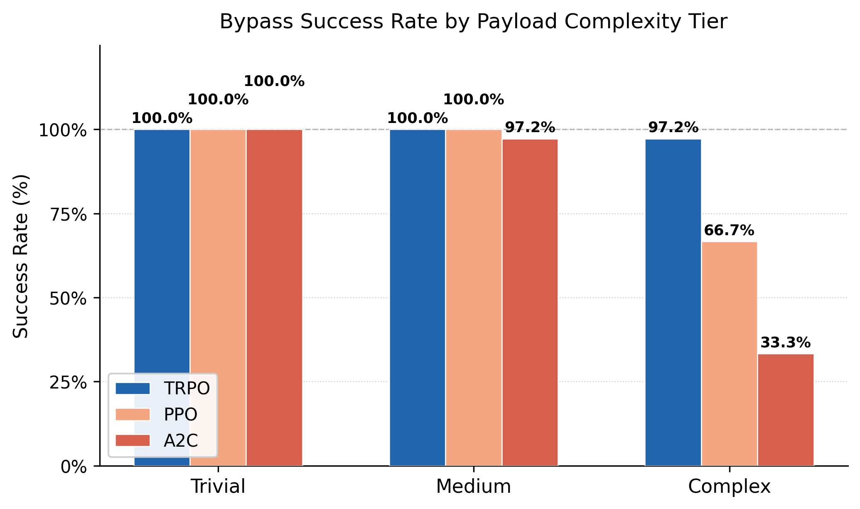
Tier-Level Analysis
Complex tier is the key discriminator — longer mutation chains required
Why does Complex tier matter?
- Trivial: case + whitespace only
- Medium: +1 rule (aggregate functions)
- Complex: +2 more rules (hex + FROM users)
-> Requires 3+ ordered mutations to defeat all rules simultaneously
-> TRPO KL bound provides stability for long mutation chains
Notes:
TIER (~1 min)
Trivial/medium near 100% for all — easy.
Complex: TRPO 97.2%, PPO 66.7%, A2C 33.3% — dramatic divergence.
Complex requires 3+ mutations in correct order against different WAF rule families.

Slide 13
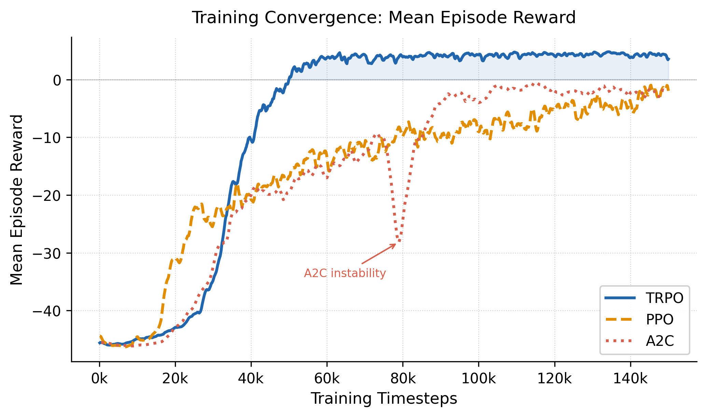
Training Convergence
TRPO most stable; A2C suffers policy collapse at ~80k timesteps
TRPO: Converges to highest reward; most stable trajectory
PPO: Faster initial rise; plateaus below TRPO
A2C: Policy collapse at ~80k (unconstrained update)
Notes:
CURVES (~45 sec)
TRPO: converges highest, most stable.
PPO: rises fast, plateaus below TRPO.
A2C: policy collapse at 80k — unconstrained update destroys learned policy.

Slide 14
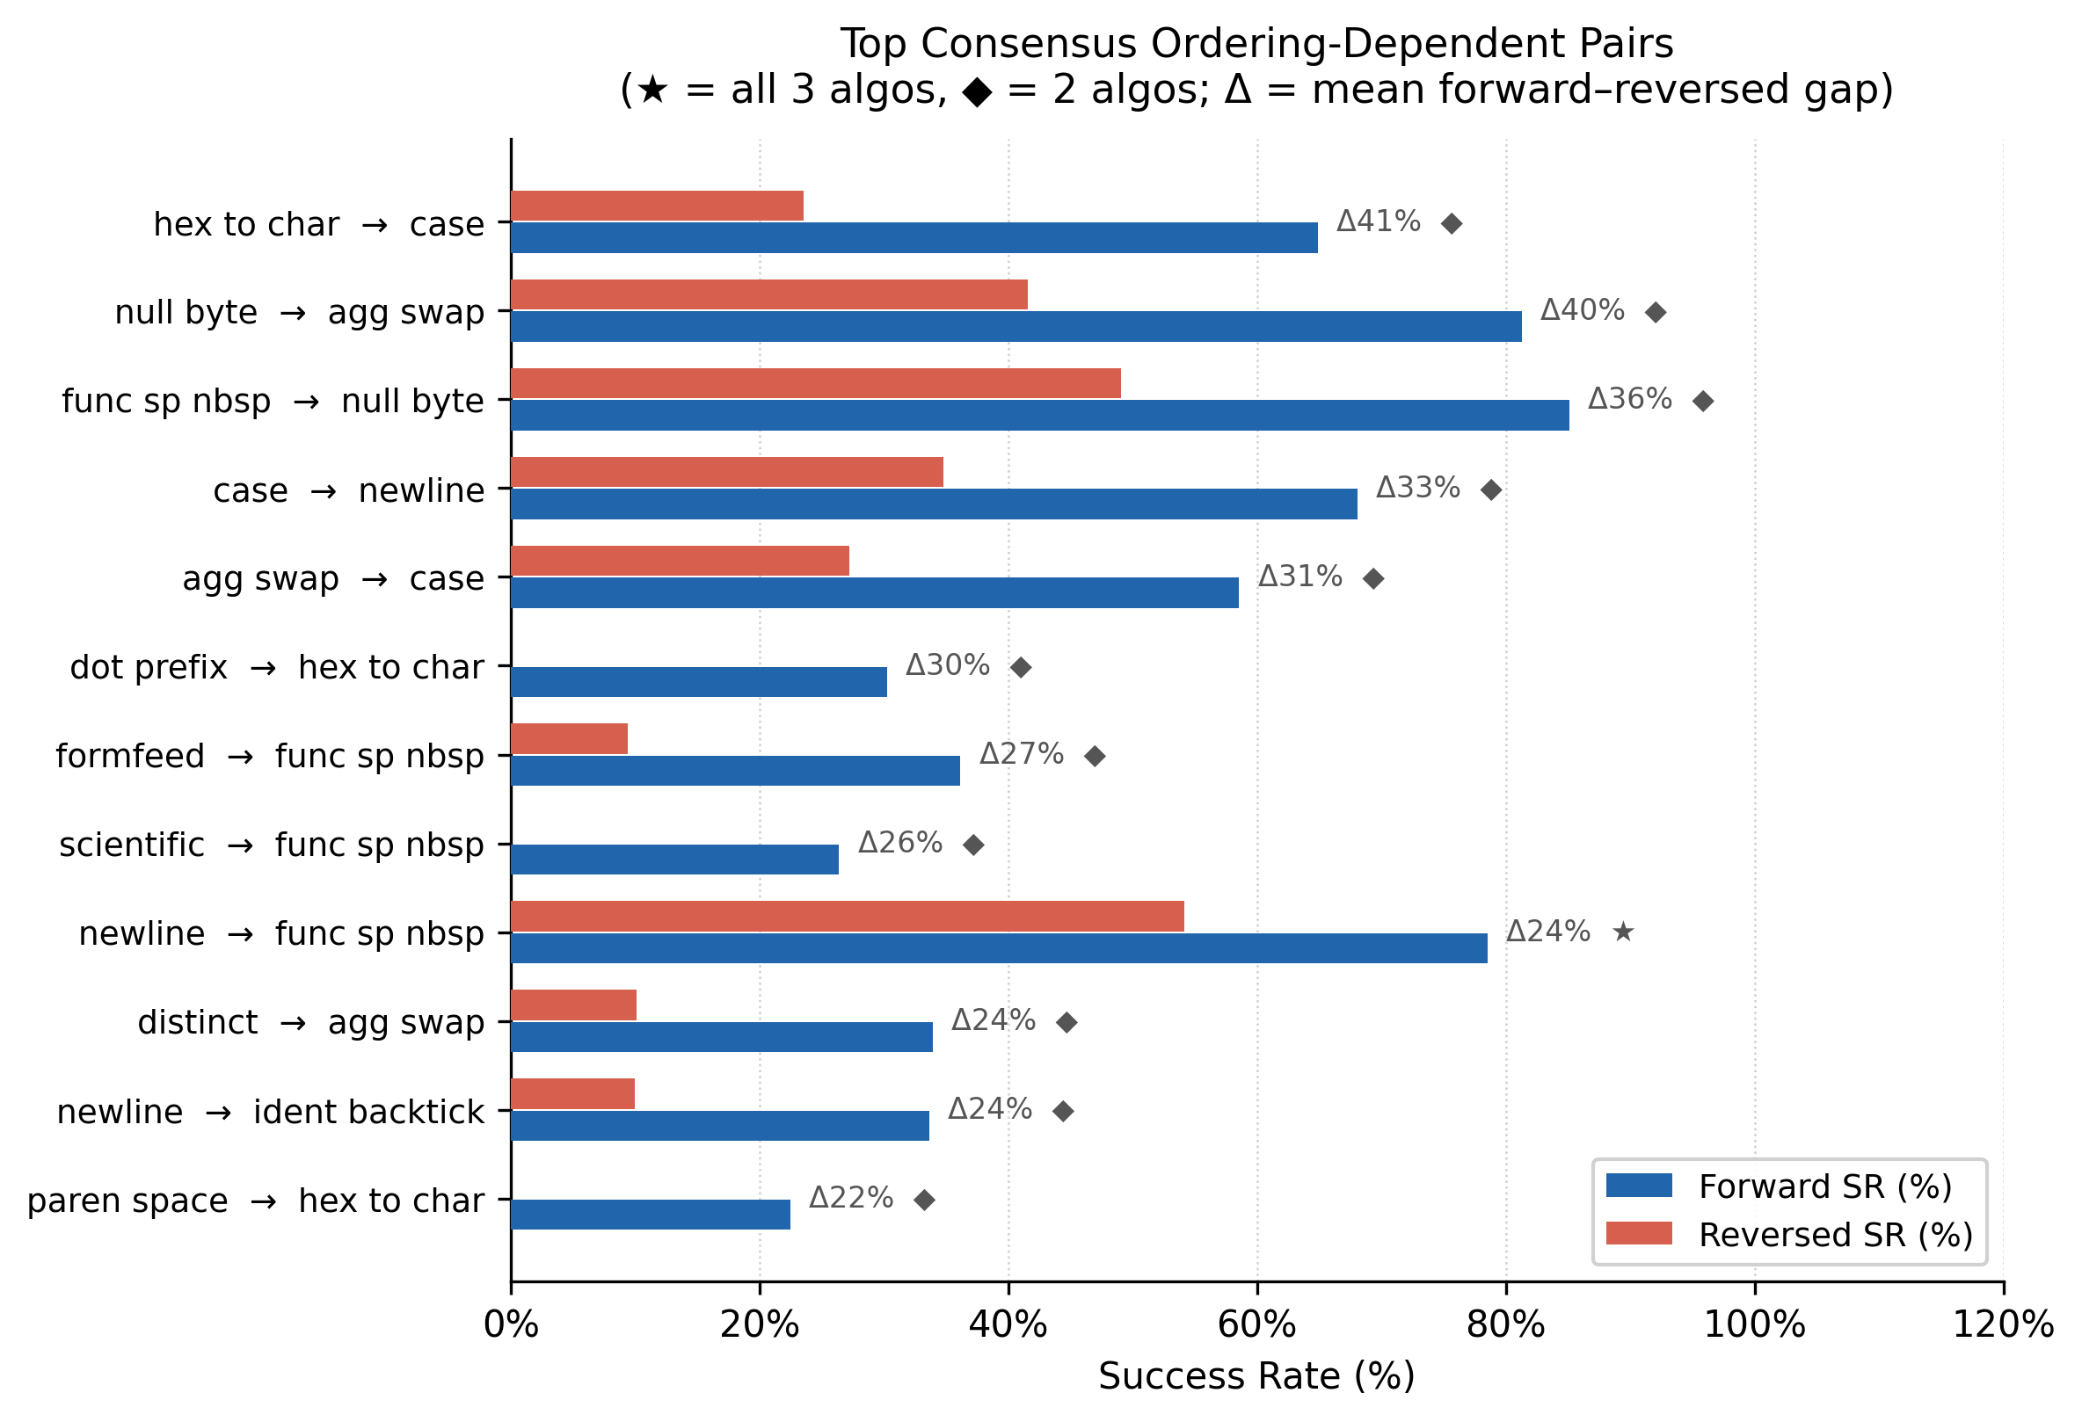
RQ3 — Does Mutation Order Matter?
Yes — 35 consensus pairs succeed only in the correct order
Key Findings:
35 consensus pairs: A->B succeeds; B->A fails
Strongest gap: ident_backtick -> hex_to_char Fwd 98% | Rev 0%
Pattern consistent across all 3 algorithms
Ordering originates from WAF rule topology, not algorithm dynamics
Notes:
ORDERING (~1.5 min)
35 consensus pairs from training logs.
Most extreme: ident_backtick->hex_to_char: 98% vs 0%.
hex_to_char corrupts identifier token before backtick can be applied.
Same pattern in 3 algorithms -> originates from WAF rule structure, not learning dynamics.

Slide 15
Conclusion
1. SeqSQLi effectively learns to bypass WAF
TRPO achieves 99.1% bypass rate — 107 out of 108 initially blocked payloads succeeded
2. TRPO > PPO > A2C across all metrics
Trust-region / KL-bound constraint is superior for sparse-reward, long-horizon episodes
3. Mutation ordering is a learnable structural signal
35 cross-algorithm consensus pairs confirm ordering originates from WAF rule topology
4. Complex tier is the true discriminator
Trivial and medium tiers are saturated; complex tier reveals real capability differences
Notes:
CONCLUSION (~1 min)
1. RL works for WAF bypass. TRPO nearly solves the problem.
2. TRPO wins — KL bound advantage in sparse/long-horizon.
3. Ordering is real and structural, not an artifact.
4. Complex tier is the true benchmark.

Slide 16
Limitations & Future Work
Limitations
Future Work
- Single WAF target (ModSecurity only)
- RQ2: Zero-shot transfer to Safeline CE (ML-based WAF, neural network detection)
- Single injection type (union-based)
- Extend corpus to error-based (216 total)
- Single application & injection point
- Explore XSS & second-order SQLi
- No evaluation on commercial WAFs
- Publication to KIIT Journal
Notes:
FUTURE WORK (~45 sec)
Limitations: one WAF, one injection type, one app.
Most exciting: RQ2 zero-shot transfer to Safeline CE (ML-based WAF).

Slide 17
Thank You
Questions?
Roby Firnando Yusuf | roby@example.com
Notes:
CLOSING
Thank you for your attention. Happy to take questions.

