Slide 1
SeqSQLi
Sequential SQL Injection WAF Bypass via Deep Reinforcement Learning
PROGRESS REPORT - Lab Meeting

Slide 2
RQ1 — Algorithm Comparison Results ✅
Union corpus: 108 payloads × 3 complexity tiers | 150k timesteps | ModSecurity CRS v3.3.2
Algorithm
IFNR ↑
SPBARC ↓
Trivial
Medium
Complex
TRPO
99.1%
6.07
100%
100%
97.2%
PPO
88.9%
6.89
100%
100%
66.7%
A2C
76.9%
10.08
100%
97.2%
33.3%
IFNR = Improved False Negative Rate (% of initially blocked payloads bypassed) SPBARC = Successful Payload Bypass Avg Request Count (lower = more efficient)
Key Finding: Complex tier is the discriminator
All 3 algorithms reach ~100% on Trivial & Medium. Performance diverges sharply on Complex (97.2% vs 66.7% vs 33.3%). Complex payloads require longer, order-constrained mutation chains — where TRPO's hard KL-bound constraint provides the critical stability advantage.

Slide 3
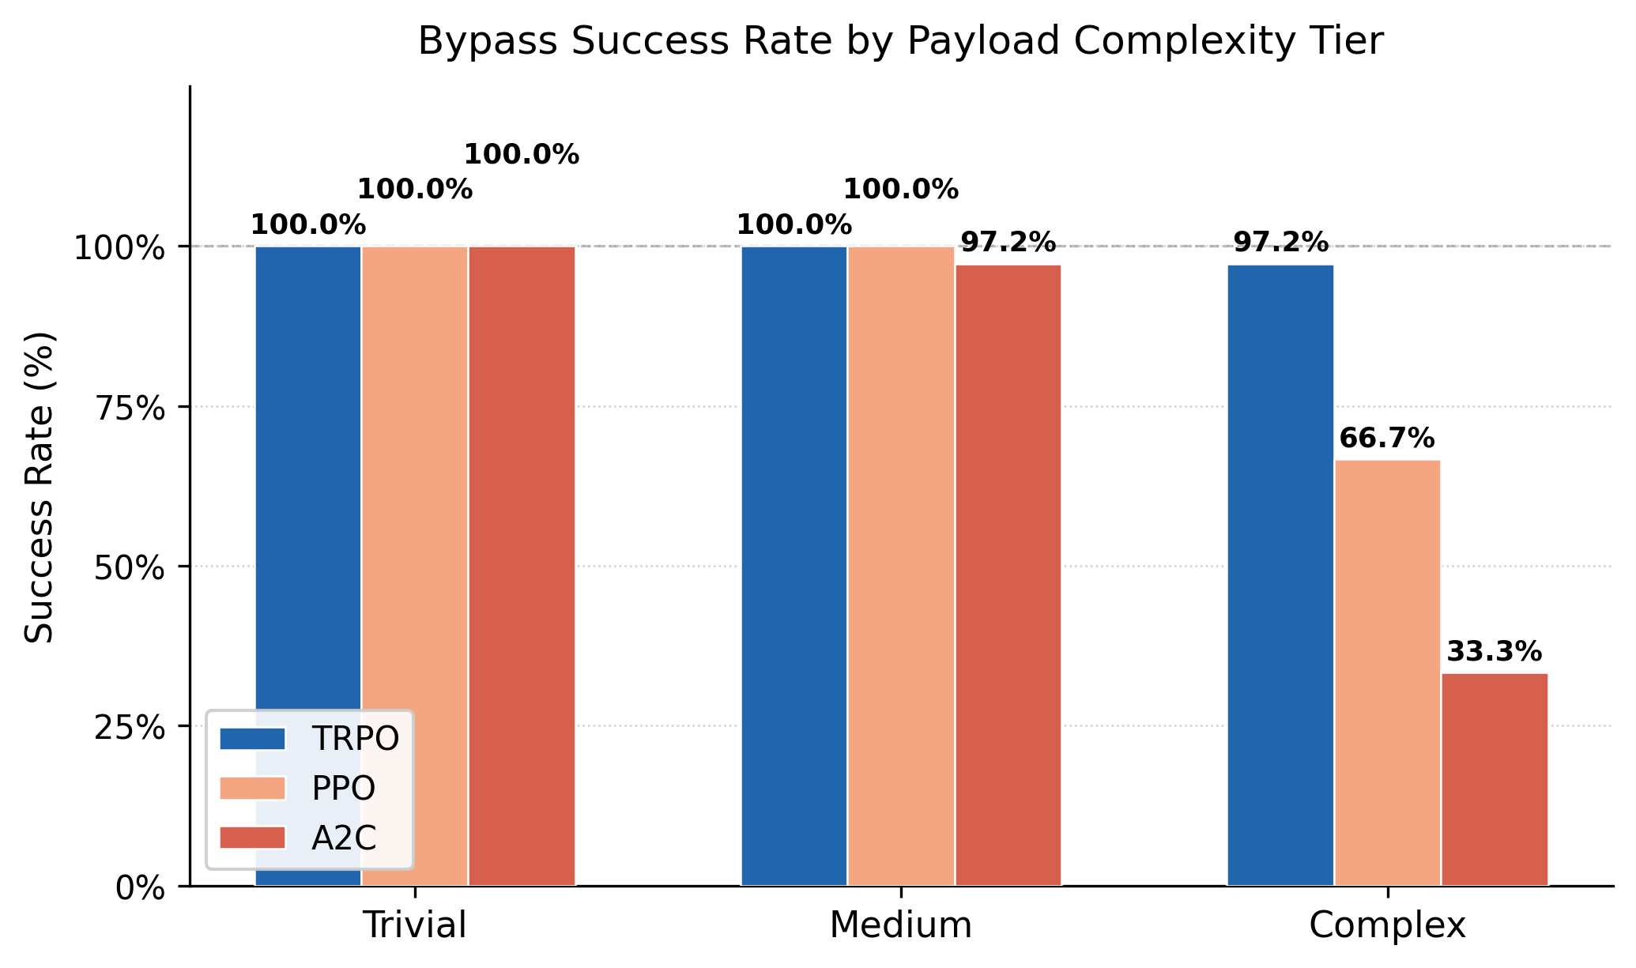
RQ1 — Per-Tier Breakdown
Why trivial and medium are saturated; complex is the real challenge
Tier Definition
Trivial
Case + whitespace only
Medium
+ Aggregate fn rule (GROUP_CONCAT blocked)
Complex
+ Hex encoding + FROM users → 3 rule families simultaneously
agg_swap mutation (GROUP_CONCAT→JSON_ARRAYAGG) unlocked medium tier — was 0% before

Slide 4
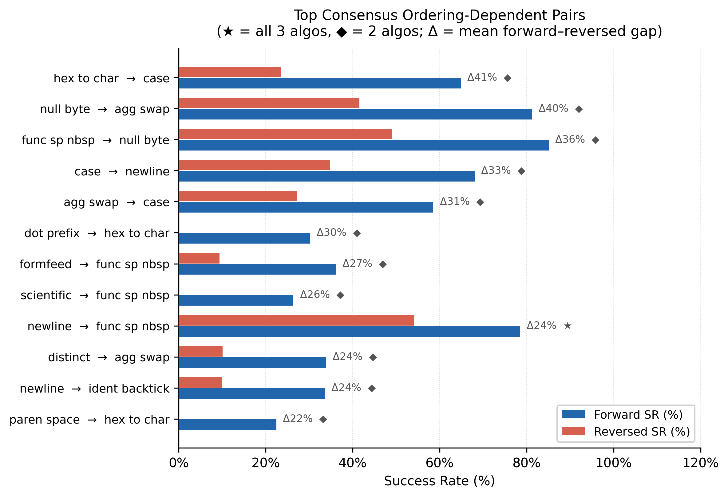
RQ3 — Does Mutation Order Matter? ✅
Answer: Yes — ordering encodes structural signal from WAF rule topology
Summary
35 consensus pairs (≥2 algorithms agree)
Strongest: ident_backtick→hex_to_char Forward: 98% | Reversed: 0%
Pattern consistent across PPO, TRPO, A2C
Conclusion: causal from WAF rule structure, not learning artifact

Slide 5
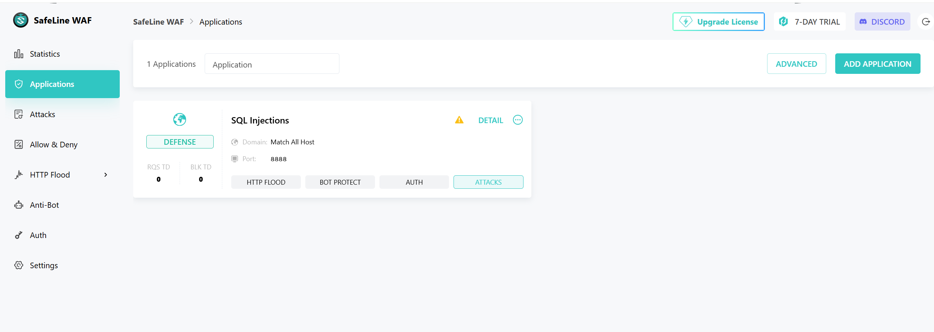
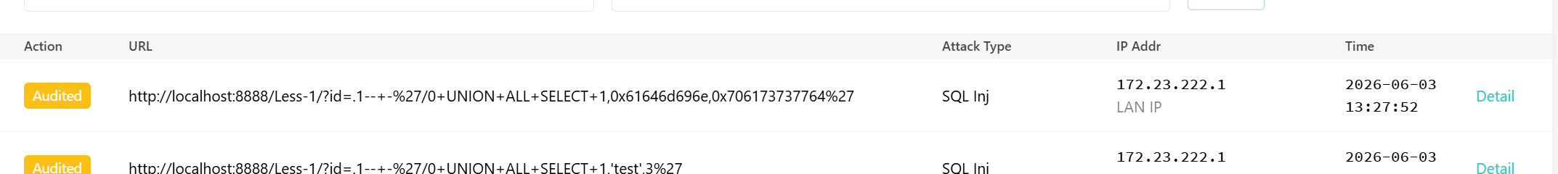
Safeline WAF overview
Safeline WAF is using semantic analysis and machine learning detection

Slide 6
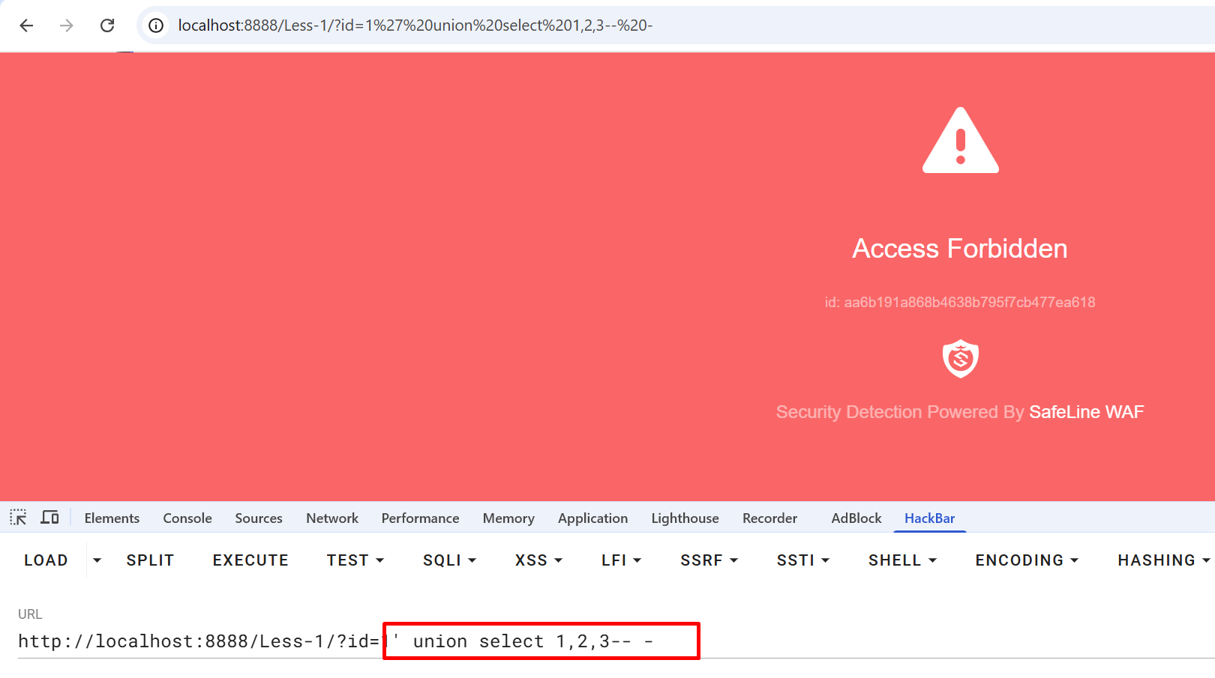
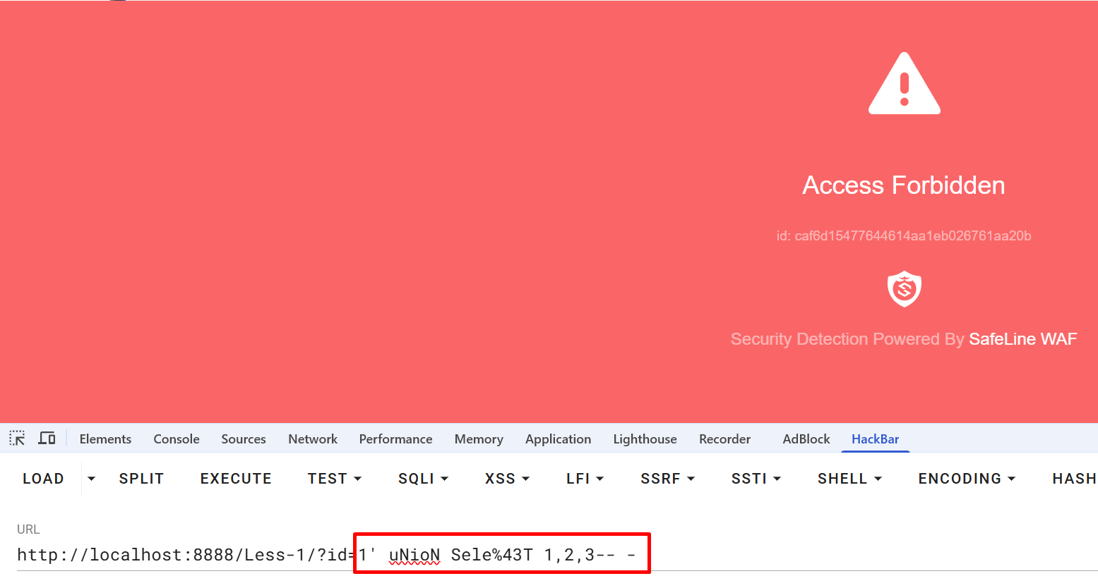
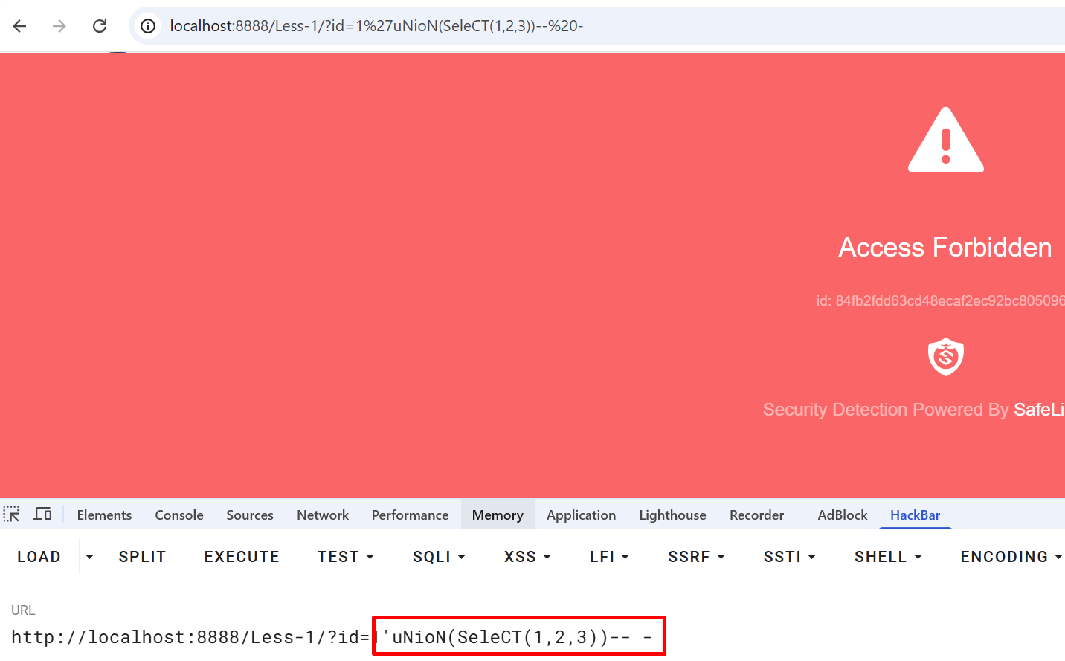
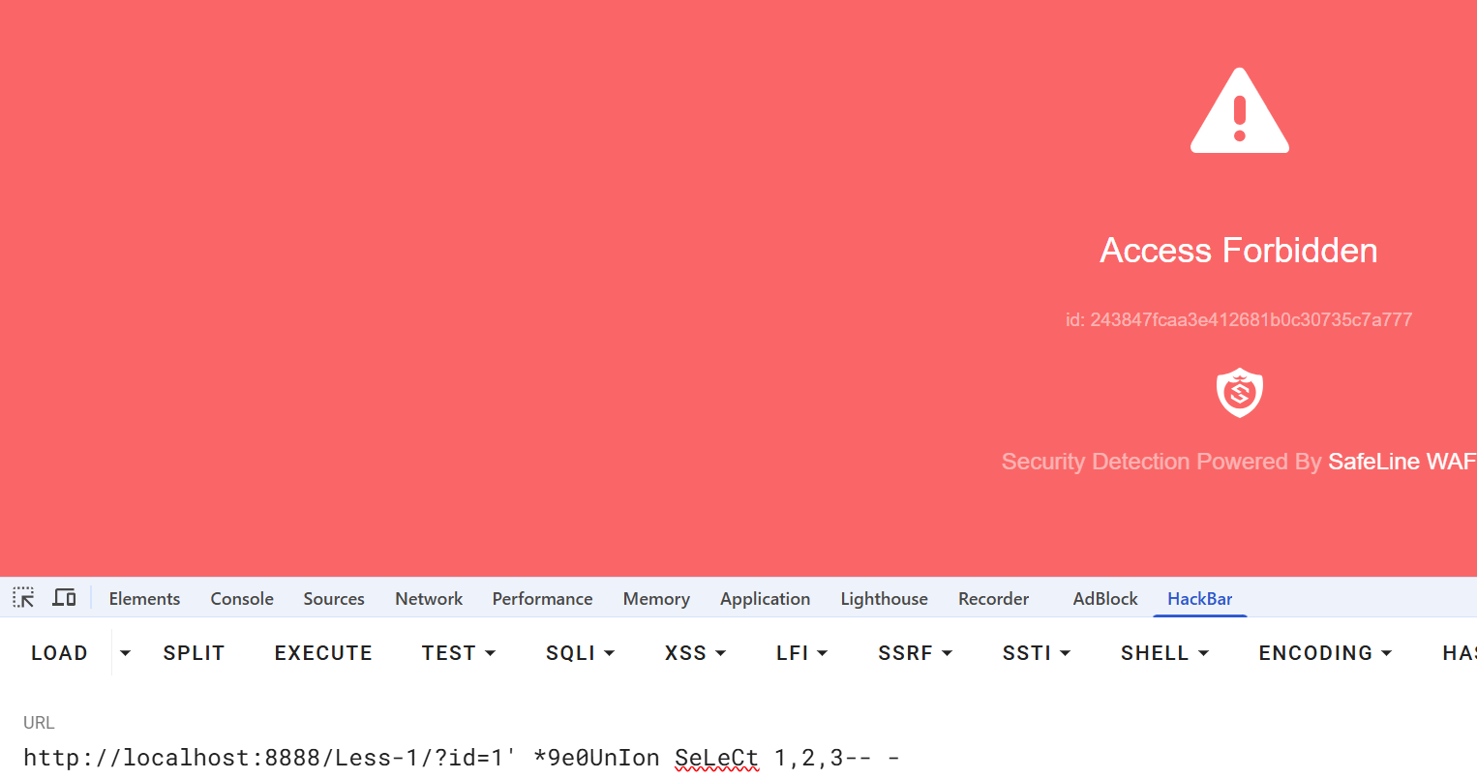
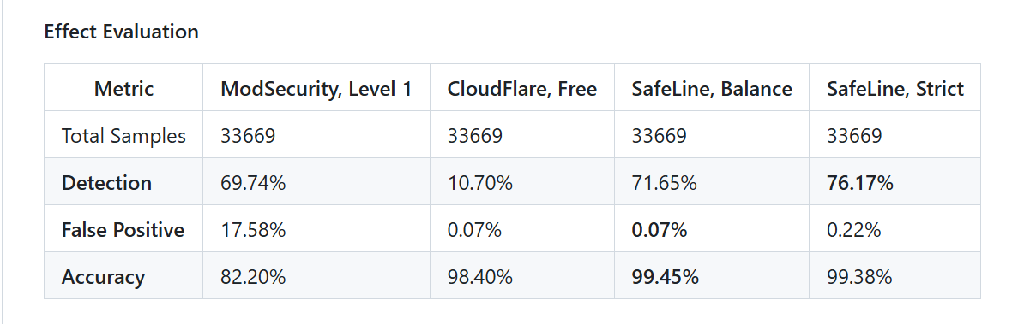
Safeline WAF
Bypass attempts
Case sensitive + partials encode query: blocked
Normal query: blocked
Scientific notation union bypass query: blocked
No whitespace bypass query: blocked

Slide 7
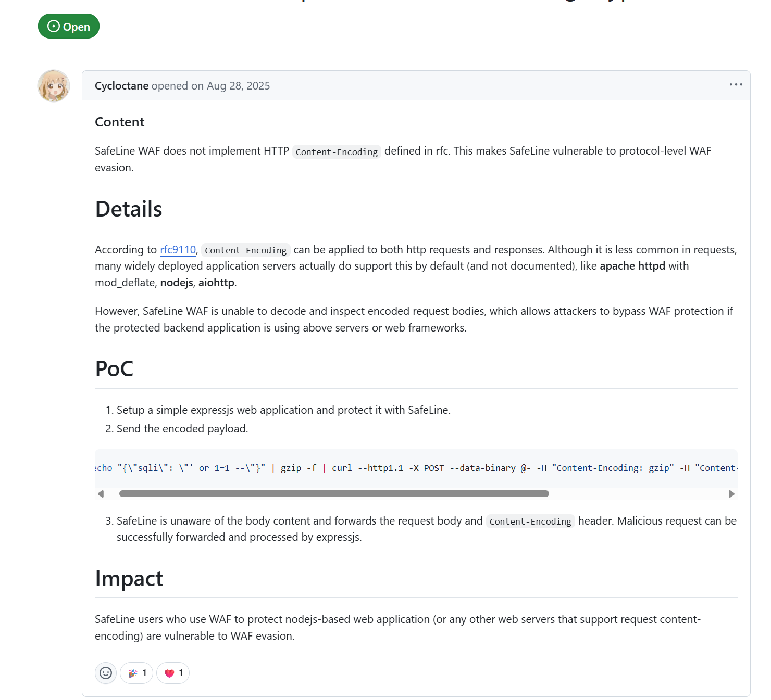
Bypass 1: doesn’t implement HTTP content–encoding protection
Safeline WAF
https://github.com/chaitin/SafeLine/issues/1222

Slide 8
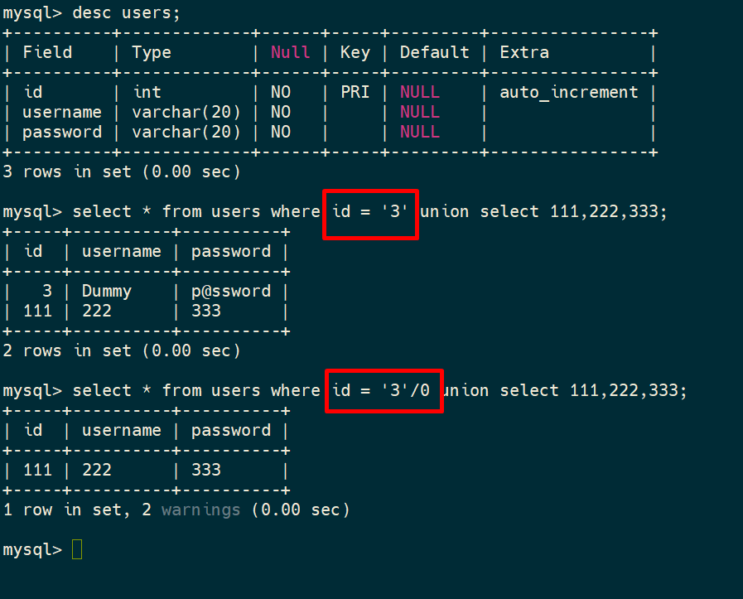
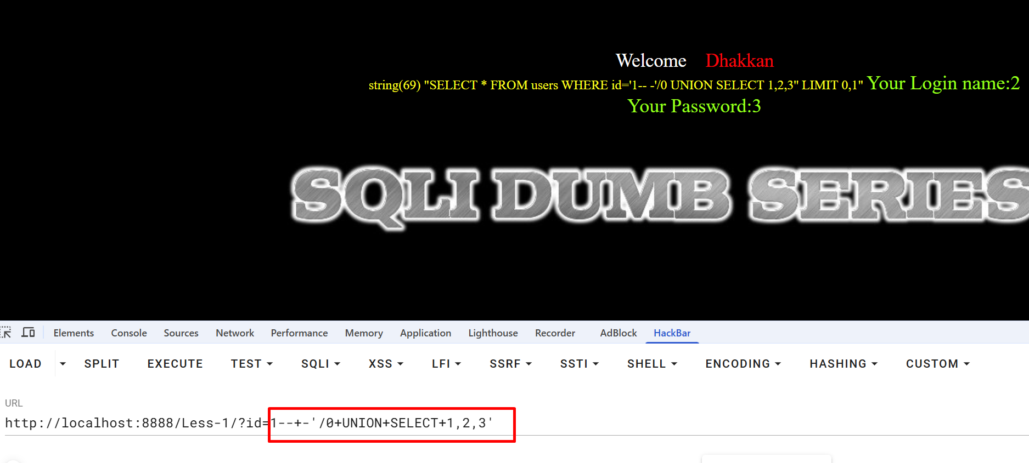
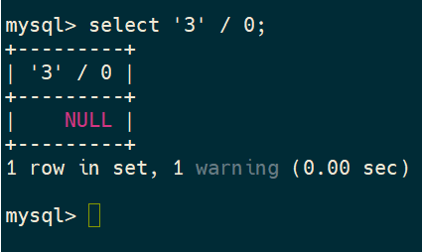
Bypass 2: We found Novel bypass query on Safeline WAF
Safeline WAF
Using division approach to print vulnerable column
Confusing safeline WAF parser with malicious comment sql -> false negative
1.
2.
limitation: can’t print any database information
String divided by 0 = NULL

Slide 9
Next Steps — RQ2: Transfer to Safeline CE
Zero-shot policy transfer: ModSecurity (rule-based) → Safeline CE (ML-based WAF)
Safeline CE Setup
Research Design
✅ Docker container running
Target WAF:
Safeline CE (Chaitin Tech) Neural-network based detection
✅ Port 8888 active
Method:
Zero-shot transfer — same trained model, new WAF endpoint
✅ Verified: normal=200, SQLi=403
Corpus:
108 union payloads (same as RQ1)
✅ Eval commands prepared
⬜ Run FNR₀ baseline
Metrics:
IFNR + SPBARC at Safeline
⬜ Run TRPO/PPO/A2C zero-shot eval
Key metric:
Transferability gap = IFNR(ModSec) − IFNR(Safeline)
⬜ Compute transferability gap
Hypothesis: mutations effective against rule-based WAF may be less effective against ML-based WAF — different detection mechanism (token distribution vs. pattern matching)

Slide 10
Timeline & Milestones
Done
Done
TBD
TBD
Training & eval RQ1 + RQ3 union based
Figure generation
Run eval Union based on Safeline (RQ2)
Add corpus Error-based
Immediate priorities:
1. Evaluation eval union based on safeline RQ(2)
2. Add corpus error based
3. Training & eval RQ1 + RQ3 (error based)

