Slide 1
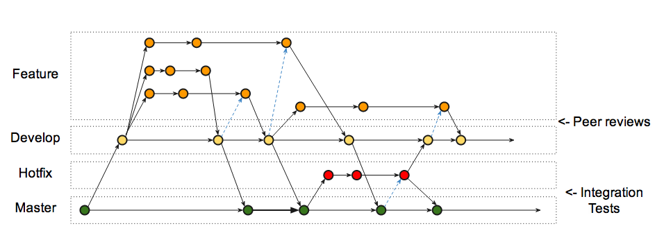
Git version control
C Grandin, March 17 2014
Image source: http://nxvl.blogspot.ca/2012/07/a-continous-delivery-git-branching-model.html

Slide 2
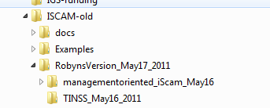
What is version control?
Does this ugly file structure look familiar?
If you are making copies of projects and renaming them so that you can make some modifications, you should be using version control.
If you are taking somebody’s changes to their project and manually changing your slightly-different project to include the newest changes, you should be using version control.
If you want to try something new (no matter how silly) with your code but don’t want to risk breaking your project, you should be using version control.

Slide 3
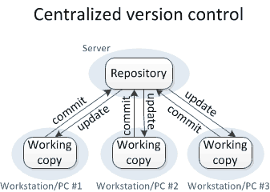
SVN
SVN (subversion) is a centralized version control system used by many. Google code uses it, the ADMB project uses it.
It requires a dedicated computer running SVN server software.
Users on workstations require client software.
If you want information about changes to the repository, or commit logs, you must be connected to the internet and send the server your request.
Branches are created on the server only, and are full copies of the original.
If the server’s hard drive fails and backups were incorrectly maintained you have permanently lost all information about the repository!
Image from: http://homes.cs.washington.edu/~mernst/advice/version-control.html

Slide 4
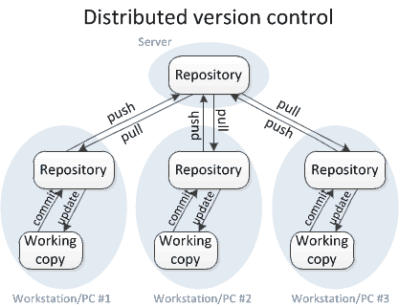
GIT
GIT is a distributed version control system. It was originally designed for Linux kernel developers in 2005.
No server required, but in team projects a master repository is used on a server, we will be using GitHub.com, but there are others.
If you want information about changes to the repository, or commit logs, it is all stored locally and no internet connection is required.
Branches are created locally and are simply a 20-byte file write operation, no copying.
Because server communication is not required, GIT is 100 times faster than SVN (Drier, 2006).
Dreier, Roland (2006-11-13). "Oh what a relief it is"., observing that "git log" is 100x faster than "svn log" because the latter has to contact a remote server.
Image from: http://homes.cs.washington.edu/~mernst/advice/version-control.html

Slide 5
GIT first steps
Decide on how you want to work. If you are:
Working very closely with someone – they should be a committer to your project or you to theirs. If this is the choice you/they will need to be added as a collaborator to the project via the GitHub web interface.
Working asynchronously with someone – you should fork their project, which makes a copy on your GitHub account and treat that as your own. You can still pull and do merges from their project at any time so that you incorporate their changes and remain in-sync. You will not be allowed to push your changes to their home project unless they added you as a committer, they have to pull yours (you send them a pull request in GitHub).
Or, you can do both!
Clone the project from GitHub:
Open the Git Shell
git clone https://github.com/cgrandin/git-workshop
git clone https://github.com/{Your-github-name}/iSCAM (Do this later – it takes a long time)
cd git-workshop
Notes:
shortcut is C:\Users\grandinc\AppData\Local\GitHub\GitHub.appref-ms --open-shell

Slide 6
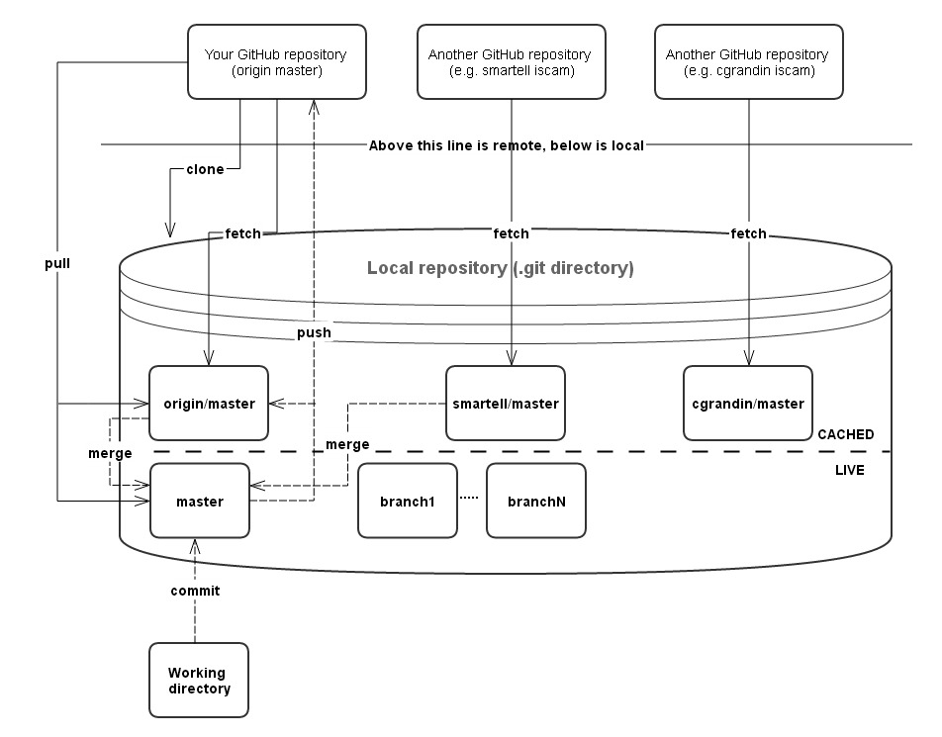
GIT repository logic
Notes:
The main thing to note is that merges and in fact all changes happen on your local machine. You push those merges/changes once completed.
Also

Slide 7
GIT repository logic
After running the git clone command successfully, there are three copies of the project on your machine:
origin/master - This is your local cached copy of the cloned repository. The only commands which will change this are git fetch, which will update it to what is on the remote server, and git push, which will push your changes to GitHub and update your local copy.
master – This is your local repository’s main (default) branch. When you do a git commit this will be changed.
Working copy – These are the files you are working on. They must be committed to your local master repository before any changes are seen by git.
The remote server, in this case Github.com, holds one branch. This is called:
origin master
Note the space between origin and master, unlike your local cached copy of it which is origin/master.

Slide 8
GIT Shell (posh-git)
posh-git is based on a Microsoft Powershell command prompt.
The blue text master tells you which branch you are currently in.
The + tells you how many files have been added in your working copy when compared with your local repository.
The ~ tells you how many files have been modified in your working copy when compared with your local repository.
The - tells you how many files have been deleted in your working copy when compared with your local repository.
The ! tells you how many files in your working copy are in a conflicted state when compared with your local repository.
A trailing ! Means that there are untracked files which have not been added to GIT.
This does not reflect your working copy’s status compared to the GitHub repository.
posh-git is explained in detail here: https://github.com/dahlbyk/posh-git

Slide 9
GIT commands (1) – modifying a file
In the posh-git shell, try these commands:
git status
Shows the status of your working copy compared with your local repository. Upon fresh git clone this should return the following:
# On branch master
nothing to commit, working directory clean
git remote -v
Lists the URLs for the GIT remote repository that you cloned from or added after.
Try changing something small in the Readme.md file and save it, then:
git status
The changes must now be committed to your local repository:
git commit -a -m “Added the file test.txt”
The prompt will change showing you that the file was committed and your local repository is up-to-date with your working copy.
git status
will tell you that your local repository is ahead of the remote master by 1 commit.
git push
Will update the remote repository on GitHub. Look at the webpage to confirm this.

Slide 10
GIT commands (2)- adding a file
Create a new text file however you usually do it, call it test.txt, edit it, type something in it, and save the file.
git status
This will tell you that your new file is untracked, and the prompt will have an ! at the end. You must add it to the list of things to commit to your repository.
git add test.txt
The prompt will change to reflect that the new file was added.
git status
Now the file is tracked, but it must be committed to your local repository:
git commit -a -m “Added the file test.txt”
The prompt will change again showing you that the file was committed and your local repository is up-to-date with your working copy.
git status
will tell you that your local repository is ahead of origin/master by 1 commit.
git push
Will update the remote repository on GitHub. Look at your webpage to confirm this.

Slide 11
GIT commands (3)- deleting a file
Now to remove the test.txt file
git rm test.txt
The prompt will change to reflect that the new file was removed. It should be gone from your working folder now.
git status
Now the file is removed, but this change must be committed to your local repository:
git commit –a -m “Removed the file test.txt”
The prompt will change again showing you that the file was committed as removed and your local repository is up-to-date with your working copy.
git status
will tell you that your local repository is ahead of the remote by 1 commit:
git push
Will update the remote repository on GitHub. Look at the webpage to confirm this. The file test.txt should be gone.

Slide 12
GIT config file and Aliasing
The commands in GIT can get long and tedious. You can simplify them by creating aliases. For example, instead of typing git commit –a –m “Message” all the time, you can create an alias so that you can just type git com “Message”.
To use the aliases I have already set up, go to your HOME directory (C:\Users\{your username}\) and you will find the file .gitconfig. Overwrite this file with the one provided in the git-workshop repository. Make sure to edit the file and change the name and email to match your GitHub account.
Some of these aliases won’t work for you unless you have ‘sh.exe’ installed on your PATH. *Rtools or MinGW provide sh.exe.
Look at the Readme.md for a description of the included aliases. Try these for fun:
git dlc
git ls
git ld

Slide 13
Branching (1)
Branching in GIT is not like SVN. In SVN it is used for major changes and projected deviations from the core project. In GIT it is used in everyday workflow.
Say you want to change something, but don’t want your code to break in the meantime. Create a branch to do this and go to it:
git checkout –b test
Or, with the provided alias:
git cb test
You will now have a new branch called test, identical to the master. You will be in that branch, as seen in your shell prompt.
To view all branches:
git branch
To change to a branch:
git checkout test
Or, with the provided alias:
git co test
To delete a branch:
git branch –d test

Slide 14
Branching (2) – pushing to GitHub
Making sure you are in the new branch test, delete or modify a bunch of text from Readme.md and commit the change:
git com “Useful message”
And push it to GitHub
git push origin test
Check the GitHub webpage and you will see that there is a new branch added.
Change back to master…
git co master
And edit the Readme.md again to see that the text you deleted is back.
Change back to the branch test:
git co test
And edit the Readme.md again. The advanced section is gone.
GIT is smart and keeps track of all the changes, so you will never have to cut/paste folders and files again.

Slide 15
Branching (3)
Making sure you are in the master branch, you can now delete the branch test
git branch –d test
Check the GitHub webpage and you will see that this did not remove the branch from your GitHub project, only your local repository. If you want to delete it from GitHub you must use the command:
git push origin --delete test
Check GitHub again to verify that the branch test is gone.
To checkout a branch that exists in the origin:
git checkout -b test origin/test

Slide 16
Stashing
If your working directory is in a state where you don’t want to commit yet, but you would like to change branches, GIT won’t let you. You need to stash your changes.
git stash
Your changes are stashed for retrieval later. Now you can switch branches.
git status
Will show you that there is now nothing to commit. It will still show you untracked files, because they are still there.
git stash list
Shows you all the stashes you have stored. Go away and do some other work, and then when you are ready, you can bring back your changes by changing to the branch where you stashed something and typing:
git stash apply
Or if the stash you want is not on the top of the list but the Nth one down:
git stash apply stash@{N}

Slide 17
Merging
So you want to merge your changes with the remote (GitHub) repository. This is the order you should do things..
git remote –v Check to see what remote you are about to fetch from. Make sure they have the correct URL.
git fetch – Get the latest changes to the remote repository. This does not do a merge of your current working copy, instead it caches a copy of the current repository (from GitHub). The prompt will change to show you how different your master repository is compared with the current remote copy.
Then, if git status tells you that you are N commits behind and can fast-forward:
- git pull – fetches and merges in one step. It’s best not to use this at this point unless git tells you to.
Otherwise, if git status says you have diverged, use git merge
- git merge origin/master – merges the remote copy you just got into your current working copy without involving the outside world. Resolve any conflicts at this stage before pushing your work back onto the remote.
git push – Push the contents of your master to the remote master (origin master). Your working copy is not involved at all.
Notes:
Fetch is always good, it will not overwrite anything at all in your repository. Pull will change your repository by merging the current Github repo with yours.

Slide 18
Merge conflicts
If Git tells you that there are merge conflicts for a merge or rebase operation, you must manually fix them. There are several ways to do this, git status will tell you which files have conflicts, you can edit these files and look for this:
<<<<<<< HEAD
Conflicted section in the branch you are in.
=======
Conflicted section in the branch you tried to merge into your current branch.
>>>>>>> origin/master
You must delete all the <<<<, =====, and >>>> lines and one of the conflicted sections. You can also rewrite the section if you need functionality from both branches.
You can also use DiffMerge, which is a nice graphical tool for merging. Get it here: https://sourcegear.com/diffmerge/downloads.php. Once installed, use it by typing:
git mergetool
Once fixed, you must do a:
git commit –a to tell git you are committed on your merge conflicts.
git push to save your merge commit to GitHub
Notes:
Fetch is always good, it will not overwrite anything at all in your repository. Pull will change your repository by merging the current Github repo with yours.

Slide 19
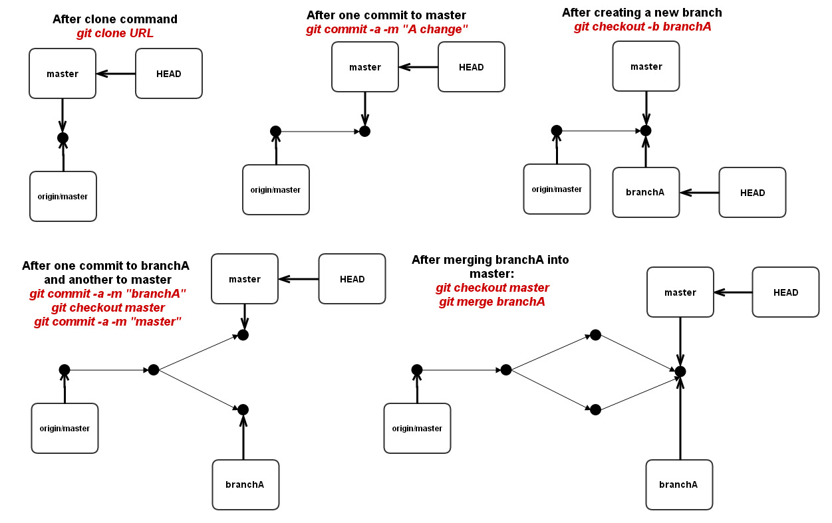
Branching/merging logic
Notes:
Merge does a three-way merge between the branch you are in, the branch you send to the call, and their common ancestor. HEAD is which commit is currently pointed at.

Slide 20
Rebasing
Rebase is another way to merge. Many argue this is better in the long term because it flattens out the commit history and merges all commit messages from branches that are merged into the master.
Rebase tells git to go back to the closest common ancestor, and replay the commits in the branch to the master’s commits.
If you rebase commits that you have previously pushed to a repository on GitHub, it will create duplicate commits, which is not desirable.
Notes:
Fetch is always good, it will not overwrite anything at all in your repository. Pull will change your repository by merging the current Github repo with yours.

Slide 21
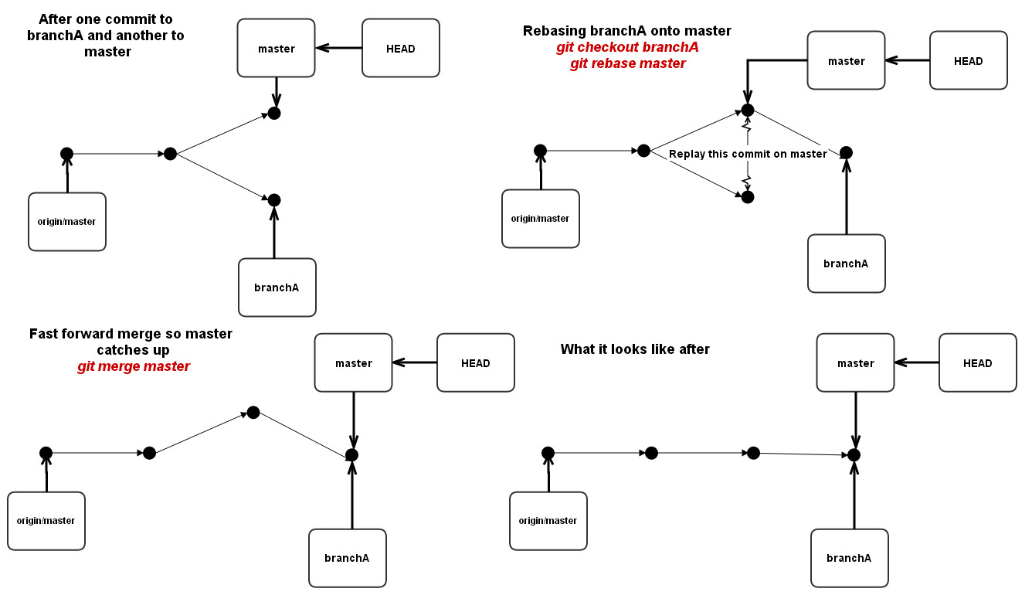
Rebasing

Slide 22
Remotes
If you want to bring changes in from someone else’s repository, which you originally forked from, you must add their URL to your list of repositories to fetch from.
git remote add cgrandin https://github.com/cgrandin/git-workshop
git remote –v should show you something like this:
cgrandin https://github.com/cgrandin/git-workshop (fetch)
cgrandin https://github.com/cgrandin/git-workshop (push)
origin https://github.com/{your git account name}/git-workshop (fetch)
origin https://github.com/{your git account name}/git-workshop (push)
git fetch cgrandin
This command will create (or update) the cgrandin/master cache in your local repository. Look at the first figure in this PowerPoint to see this. You may now try to merge it with your local master:
git checkout master
git merge cgrandin/master
To fetch all branches from someone’s repository, use:
git fetch –all cgrandin
To fetch all remotes
git remote update

Slide 23
Undoing commits
If you made an error in a commit, you have two choices to undo it:
git reset --soft HEAD~1
This is the best choice, all your changes are saved and the commit is removed from the commit list. It’s like your UNDO button, as long as you haven’t pushed.
git reset --hard HEAD~1
Destroys all your changes since your last commit. There is still a way to resurrect these changes if you make a mistake, but it involves some more advanced manipulations in Git.
See this webpage for a nice explanation of it:
http://stackoverflow.com/questions/927358/how-to-undo-the-last-git-commit/6866485#6866485

Slide 24
Blame
See who is responsible for every line of code in a given file.
git blame filename
If you want to save the results to a text file so you can search for a particular author or time/date then do this:
git blame filename > log_file.txt
Then open log_file.txt in any text editor to see the results.
You can also do this in GitHub by clicking on a file link and then clicking “Blame”.

Slide 25


