Slide 1

MSBA Project Commodity Pricing
Nate Garn
Robyn Kotter
Jessica Stoker

Slide 2
Agenda
Problem and Objective
Scope
Market Trends and Analysis
Modeling
Business Recommendations
Q & A
Appendix
Sources

Slide 3
Problem & Objective

Slide 4
Business Problem
Unknown Commodities Pricing -
Aluminum, Sugar, Coffee, Cotton, Soybeans, Soybean Oil, Corn
Missed opportunity -
Proactive Pricing Measures for Future

Slide 5
Scope

Slide 6

In-Scope
Data Exploration
Selecting and Evaluating Models
3- and 12-month Predictions

Slide 7

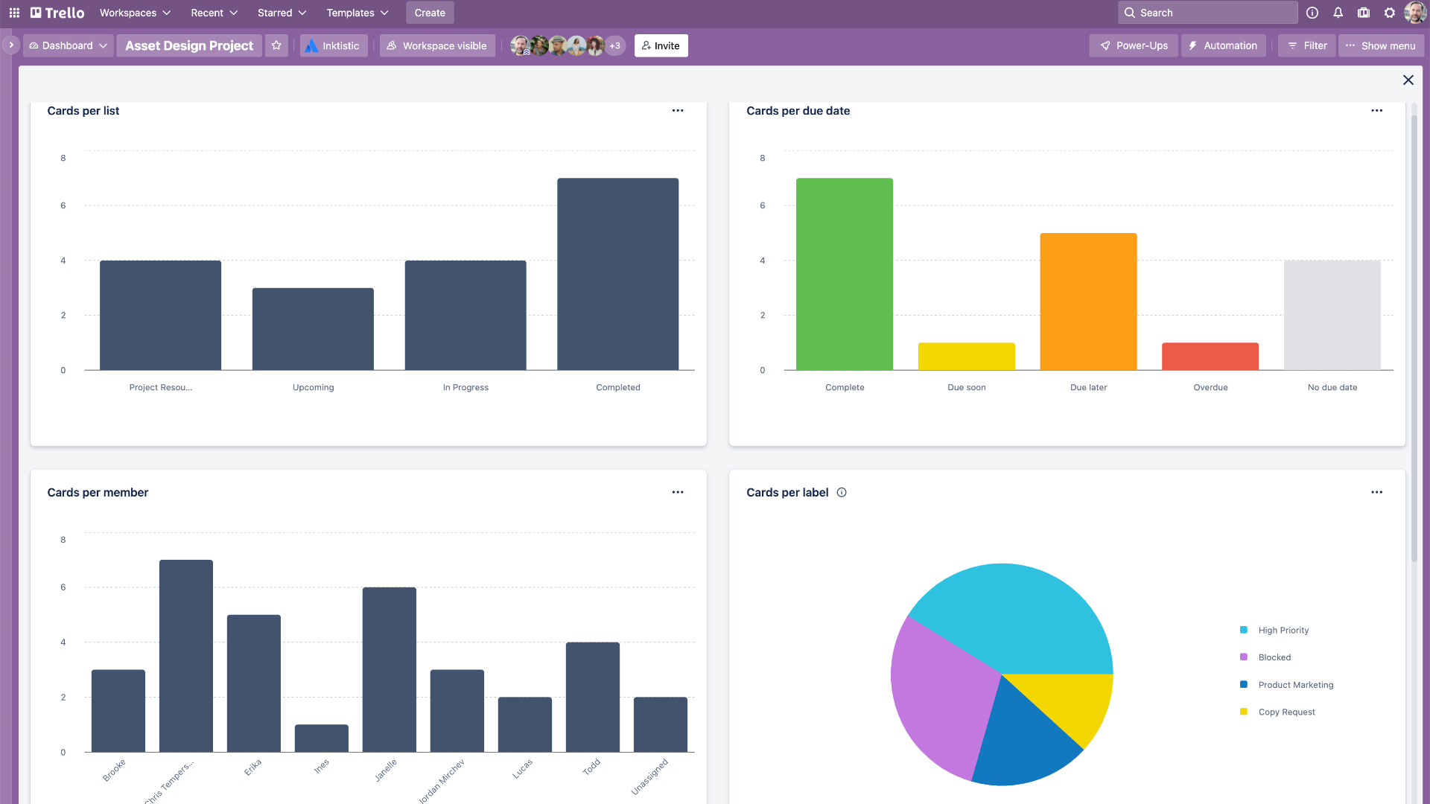
Out-of-Scope
API Connected Dashboard
Decision Models

Slide 8
Analytical Objective
Appropriate Model Selection
Long- and Short-Term Predictions

Slide 9
Market Trends & Analysis

Slide 10
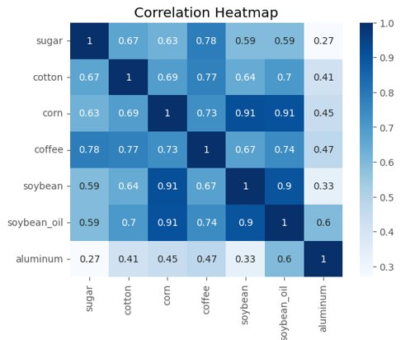
Strong correlation between all agricultural commodities Less correlation w/ aluminum Highest correlation between corn & soybean/soybean oil

Slide 11
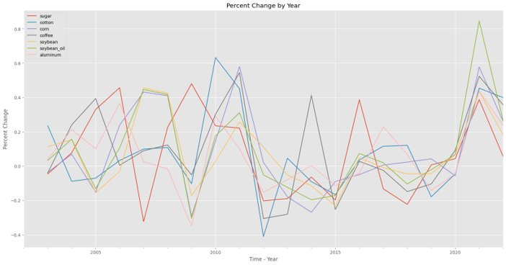
Commodities move in the same direction; 6 year cyclical trends

Slide 12
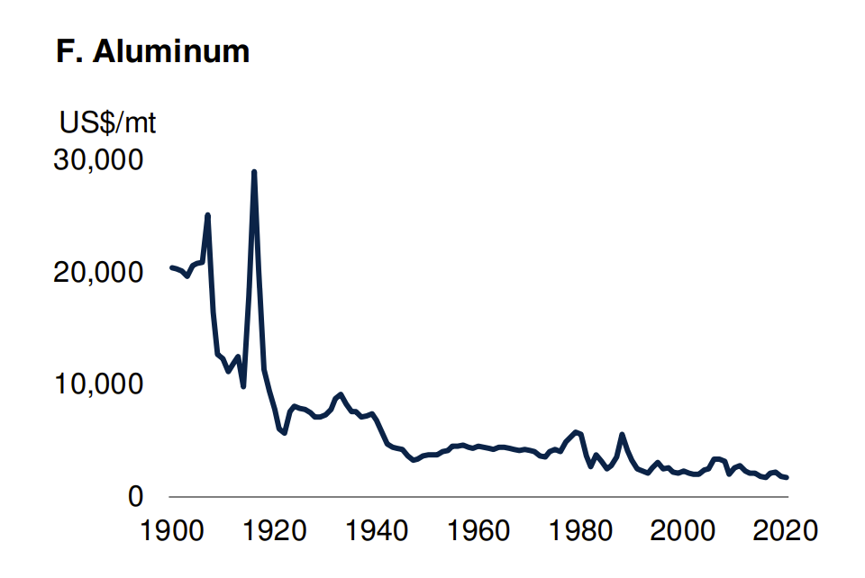
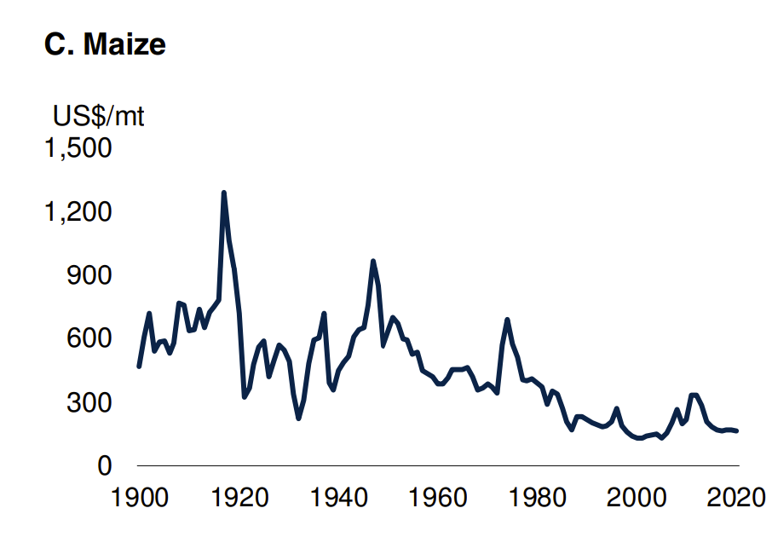
Market Trends
Aluminum and Corn inflation are controlled for here
*Charts taken from world bank

Slide 13
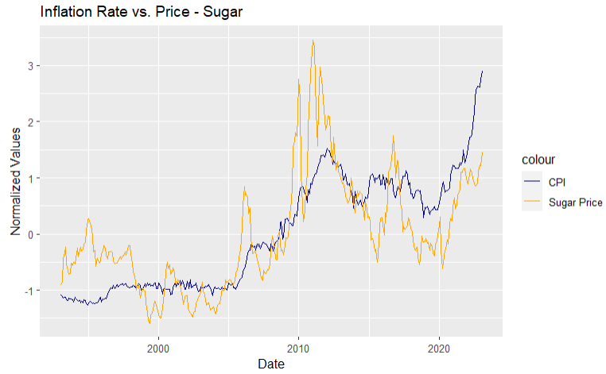
Market Trends
Inflation currently - Sugar

Slide 14
Market Factors
Factor Impact Example
Emerging Technologies Type of commodity used changes Biofuel as a replacement for
fossil fuels
Population Growth Increased Consumption Increased usage of food
commodities
Climate Change Commodity Production Freezing Weather,
Hurricanes, etc.
Heterogeneity Prices are impacted by similar drivers Metals are more closely tied
to economic growth than
other commodities
Interest Rates Higher rates can decrease Oil price shocks of the 70's
price inflation brought under control by
increased interest rates
*Stats taken from World Bank Repot – See Appendix

Slide 15
Market Factors - Volatility
50% of volatility stems from demand shocks
20% of volatility stems from supply shocks
*Stats taken from World Bank Repot - See Appendix

Slide 16
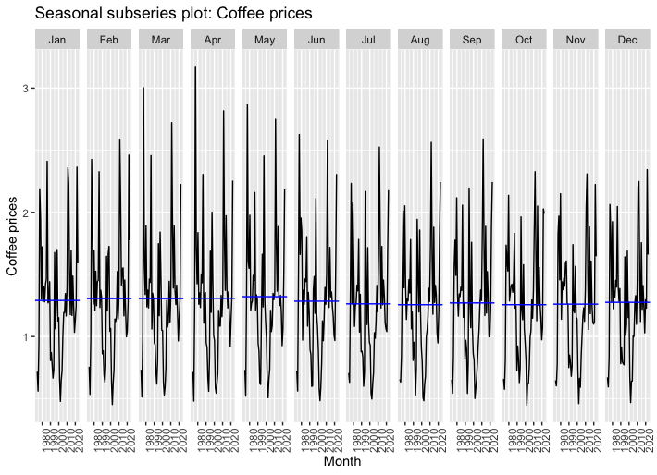
Seasonality
More cyclicality than seasonality
Slight seasonal trends

Slide 17
Modeling

Slide 18
Models Attempted
ARIMA
SARIMA
SGARCH
EGARCH
LSTM
ETS

Slide 19
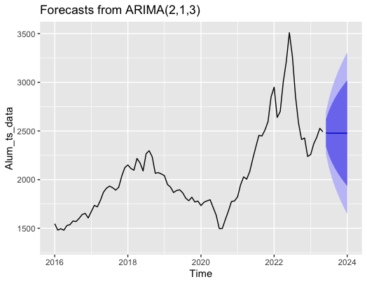
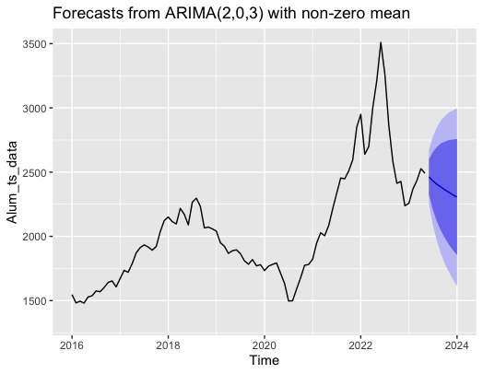
Arima Model
Accurate for time series
d = trend
p = auto regressive
q =moving average
Flexible
Easily Interpretable

Slide 20
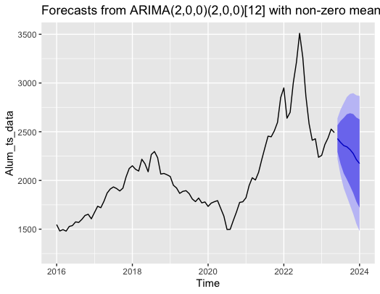
Sarima Model
Builds on ARIMA
additional parameters
Models seasonal component

Slide 21
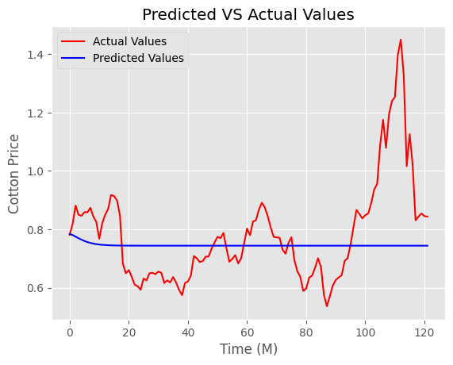
LSTM Model
RNN – Recurrent Neural Network
Good for Long-Term trends, Seasonality
Not the Best fit for our Data

Slide 22
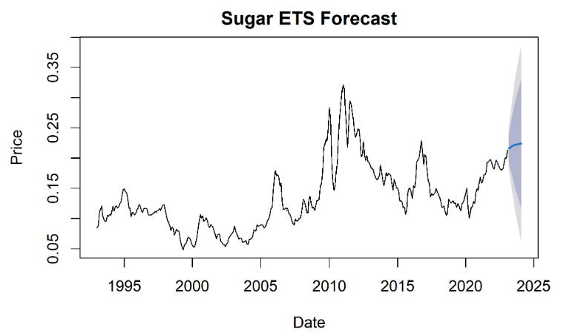
ETS Model
Effective with highly-seasonal time series
Data was not seasonal

Slide 23
GARCH Model
Effective with volatile data
Allows for Heteroskedasticity(changing volatility over time)
High performance
AIC
BIC
RMSE
MSE

Slide 24
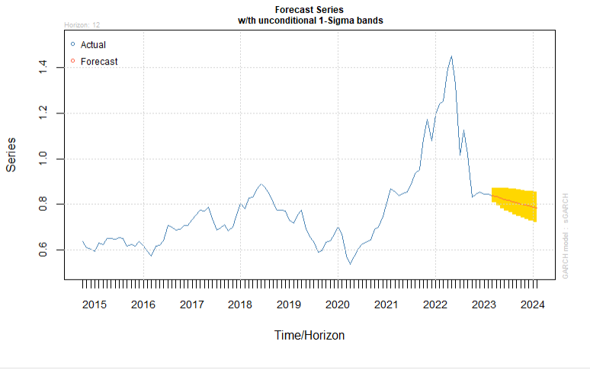
GARCH Model-Cotton Forecast
Shorter confidence intervals

Slide 25
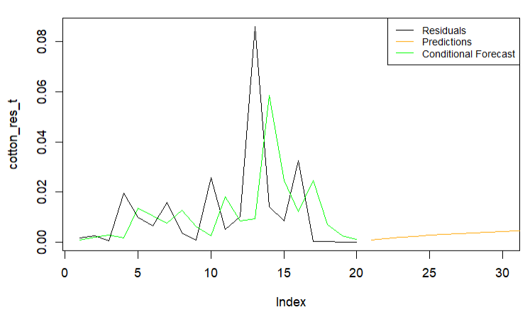
GARCH Model
Residuals and volatility – Cotton
Index shows number of periods in months

Slide 26
Business Recommendations

Slide 27
Model Recommendations
Recommended - The GARCH models consistently performed well
Commodity data is highly volatile
Good predictions
Measure of volatility
The ARIMA models performed well – could use in times of more certainty

Slide 28

Using different timeframes
Model performance differed by timeframe
ARIMA models RMSE by Timeframe
Commodity​ | All Data​ | Recent Data ​
Aluminum​ | 106.13​ | 117.4017​
Sugar​ | ​0.0106 | ​0.0113
Cotton​ | ​0.05219 | ​0.05912
Coffee​ | ​0.1102 | ​0.10039
Corn​ | ​0.2246 | ​0.269
Soybean​ | ​0.5071 | ​0.502
Soybean Oil​ | ​0.018 | 0.022​

Slide 29
Decision Modeling
Forecast predictions can be used in decision modeling
Factor inventory cost and projected future costs
A decision model can incorporate confidence intervals

Slide 30
Results
Commodity | March 2023 | April 2023 | May 2023 | June 2023 | July 2023 | August 2023 | September 2023 | October 2023 | November 2023 | December 2023 | January 2024 | February 2024
Sugar | 0.11639059 | 0.116391 | 0.116391 | 0.116391 | 0.116391 | 0.11639059 | 0.11639059 | 0.11639059 | 0.11639059 | 0.11639059 | 0.11639059 | 0.11639059
Coffee | 0.83820136 | 0.832699 | 0.827336 | 0.822109 | 0.817014 | 0.81204744 | 0.807206654 | 0.802488261 | 0.797889168 | 0.79340636 | 0.789036896 | 0.78477791
Aluminum | 1338.16666 | 1338.167 | 1338.167 | 1338.167 | 1338.167 | 1338.16662 | 1338.166612 | 1338.166605 | 1338.166597 | 1338.166589 | 1338.166581 | 1338.166573
Soybean | 15.266169 | 15.25313 | 15.2401 | 15.22709 | 15.2141 | 15.2011295 | 15.1881753 | 15.17523894 | 15.1623204 | 15.14941965 | 15.13653667 | 15.12367143
Soybean Oil | 0.2654041 | 0.265404 | 0.265404 | 0.265404 | 0.265404 | 0.2654041 | 0.2654041 | 0.2654041 | 0.2654041 | 0.2654041 | 0.2654041 | 0.2654041
Corn | 6.77390659 | 6.768205 | 6.76251 | 6.756823 | 6.751142 | 6.74546872 | 6.739802314 | 6.73414294 | 6.728490592 | 6.72284526 | 6.717206937 | 6.711575613
Cotton | 0.83820136 | 0.832699 | 0.827336 | 0.822109 | 0.817014 | 0.81204744 | 0.807206654 | 0.802488261 | 0.797889168 | 0.79340636 | 0.789036896 | 0.78477791

Slide 31
Conclusions
Prices cyclical
Prices subject to volatility
GARCH Model for forecasting
Opportunity for decision modeling using forecast

Slide 32
Q & A

Slide 33
Appendix

Slide 34
Coffee Seasonality Slight dip in average coffee prices from May into June but otherwise prices hold relatively consistent through January – December.

Slide 35
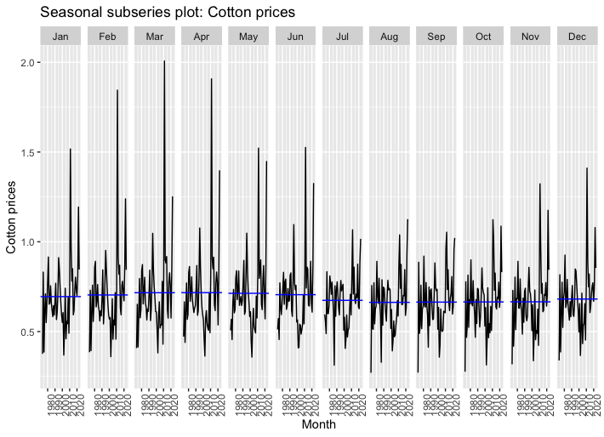
Cotton Seasonality Slight dip in average cotton prices from June into July but otherwise prices hold relatively consistent through January – December.

Slide 36
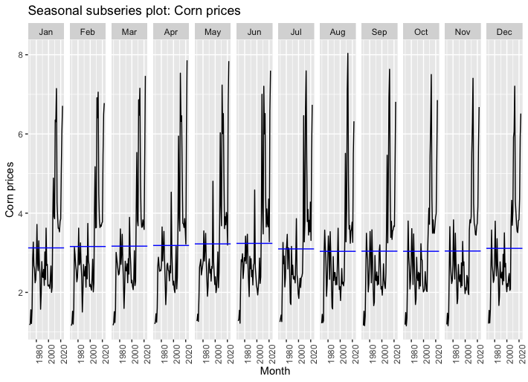
Corn Seasonality Average corn prices trend slightly higher from January-June, drop in July and stay lower until a slight increase in December.

Slide 37
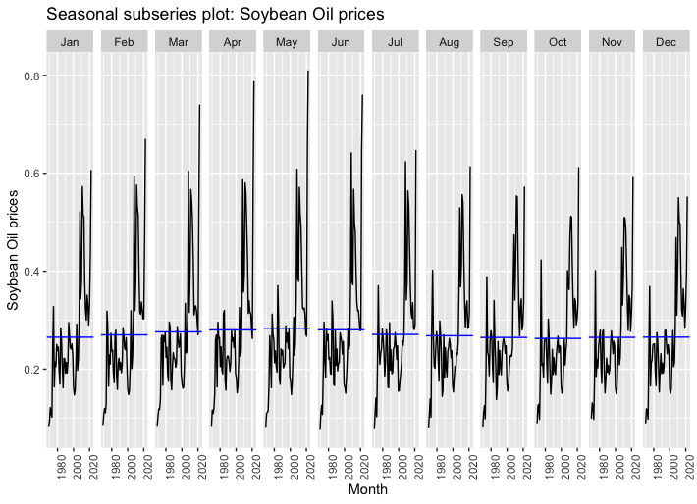
Soybean Oil Seasonality Slight dip in average Soybean Oil prices from June into July but otherwise prices hold relatively consistent through January – December.

Slide 38
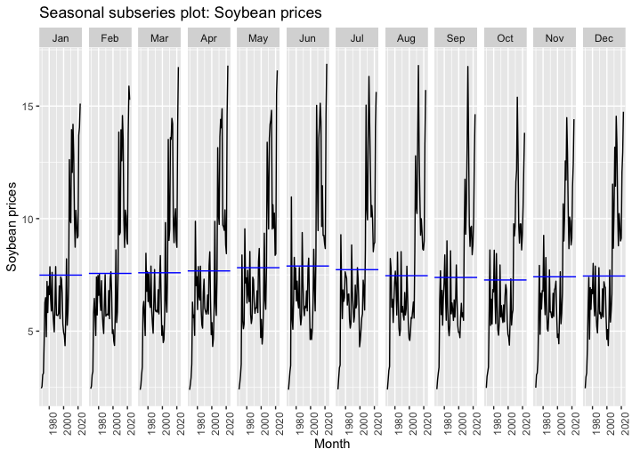
Soybean Seasonality Slight increase in average Soybean prices in May and June and a slight decrease in prices August-September but overall, relatively consistent prices.

Slide 39
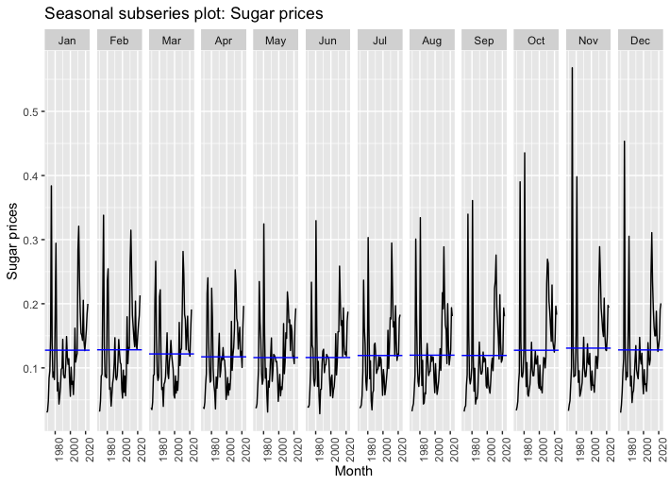
Sugar Seasonality Sugar prices tend to be slightly lower April-September but overall, relatively consistent prices (there is a large outlier in 1974 that may be inflating November average prices).

Slide 40
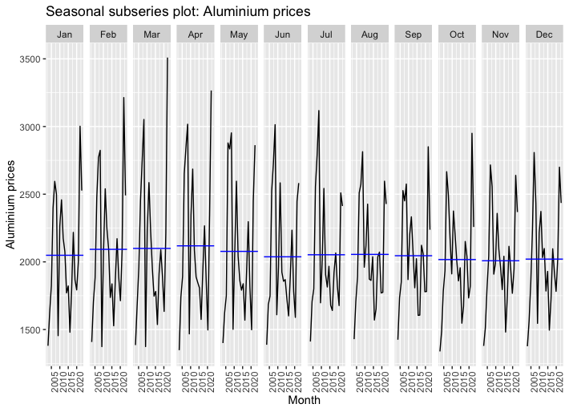
Aluminum Seasonality Aluminum prices tend to be slightly higher February –April but overall, relatively consistent prices.

Slide 41
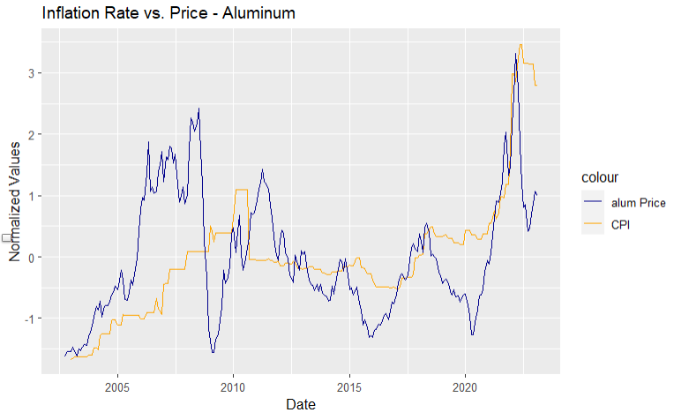
Market Trends
Inflation currently - Aluminum

Slide 42
Model Comparisons
​ | ARIMA​ | GARCH​ | ETS​ | LSTM​
​ | RMSE​ | RMSE​ | RMSE​ | RMSE​
Aluminum​ | 106.0232​ | 1276.58​ | 111.0128​ | 485.6076​
Sugar​ | 0.0106​ | 0.0170​ | 0.0114​ | 0.0413​
Coffee​ | 0.1102​ | 0.1004​ | 0.1147​ | 0.3820​
Cotton​ | ​0.0522 | ​0.1060 | ​0.0623 | ​0.1740
Corn​ | ​0.2206 | ​4.3500 | ​0.2820 | ​1.5425
Soybean​ | ​0.4845 | ​0.05192 | ​0.5410 | ​2.2926
Soybean Oil​ | ​0.0180 | ​0.0547 | ​0.0197 | ​0.1255

Slide 43
Sources

Slide 44
World Bank: Commodity Markets – Evolution, Challenges, and Policies
Edited by John Baffes and Peter Nagle
GARCH 101: An Introduction to the use of ARCH/GARCH models in Applied Econometrics
Robert Engle
Price Data Download: macrotrends
CPI Data: U.S. Bureau of Labor Statistics

