Slide 1
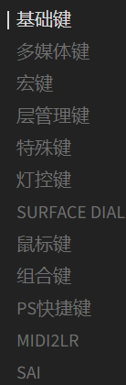
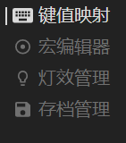

KEY MAPPING |  | BASIC
 |  | MULTIMEDIA
MACRO EDITOR |  | MACRO
 |  | LAYER MANAGEMENT
LED LIGHT MANAGEMENT |  | SPECIAL KEYS
 |  | LED LIGHT CONTROL
ARCHIVE (CONFIGURATION) MANAGEMENT |  | SURFACE DIAL EMULATION
 |  | MOUSE BUTTONS
 |  | KEY COMBINATIONS
 |  | PHOTOSHOP SHORTCUTS
 |  | MIDI
 |  | SAI
CLOSE (CTRL+W) | CONFIGURATION | KEYBOARD TEST | SETUP

