Slide 1
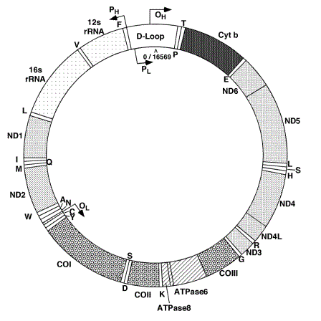
CIRCULAR SEQUENCE COMPARISON: ALGORITHMS AND APPLICATIONS

Slide 2
CIRCULAR SEQUENCE COMPARISON: ALGORITHMS AND APPLICATIONS
Circular Sequence Comparison: Algorithms and Applications
Authors:
Nadia Pisanti, Roberto Grossi (University of Pisa)
and 5 others (King’s College London).
Soon to be published on BMC Bioinformatics.
These slides are available at:
https://github.com/robzan8/csc
Roberto Zanotto |18/05/16

Slide 3
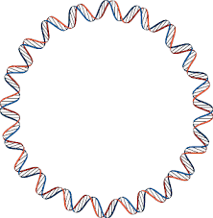
CIRCULAR SEQUENCE COMPARISON: ALGORITHMS AND APPLICATIONS
A ∙ G ∙ A ∙ A ∙ T ∙ C ∙ C ∙ T ∙ G ∙ A ∙ G ∙ G ∙ G ∙ T ∙ T ∙ A ∙ G ∙ C ∙ T ∙ C ∙ A ∙ A ∙ G ∙ T ∙
Circular Sequences
Examples:
Bacterial chromosomes and plasmids;
Mitochondrial DNA;
Viral genomes;
Circular proteins;
And more…
Roberto Zanotto |18/05/16

Slide 4
CIRCULAR SEQUENCE COMPARISON: ALGORITHMS AND APPLICATIONS
Comparisons
A ∙ A ∙ A ∙ A ∙ C ∙ C ∙ C ∙ C ∙ G ∙ G ∙ G ∙ T ∙ T ∙ T ∙
A A A A C C C C G G G T T T
A A A A C C C C G G G T T T
A A A A C C C C G G G T T T _
?
A A A A C C C C G G G T T T
?
A A A _ C C T C G G G T T T T
G G T T T T A A A C C T C G
A ∙ A ∙ A ∙ C ∙ C ∙ T ∙ C ∙ G ∙ G ∙ G ∙ T ∙ T ∙ T ∙ T ∙
A A A C C T C G G G T T T T
G G T T T T A A A C C T C G
Roberto Zanotto |18/05/16

Slide 5



CIRCULAR SEQUENCE COMPARISON: ALGORITHMS AND APPLICATIONS
Rotation
A ∙ A ∙ A ∙ A ∙ C ∙ C ∙ C ∙ C ∙ G ∙ G ∙ G ∙ T ∙ T ∙ T ∙
$$x$$
A A A A C|C C C G G G T T T
$$x^{5}$$
C C C G G G T T T|A A A A C
$$\left(xx\right)[5…n+5]$$
A A A A C|C C C G G G T T T|A A A A C|C C C G G G T T T
Roberto Zanotto |18/05/16

Slide 6
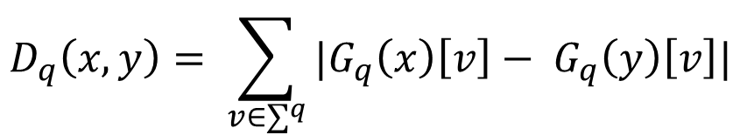
CIRCULAR SEQUENCE COMPARISON: ALGORITHMS AND APPLICATIONS
q-gram distance
Approximation of edit distance, defined as:
$$D_{q}\left(x, y\right)= \sum_{v∈∑^{q}}{|G_{q}\left(x\right)\left[v\right]− G_{q}\left(y\right)\left[v\right]|}$$
where $G_{q}\left(x\right)\left[v\right]$ counts the number of occurrences of q-gram $v$ in $x$.
Can be computed in linear time and space with an hash table that
associates to each $v$the $diff$ $G_{q}\left(x\right)\left[v\right]− G_{q}\left(y\right)\left[v\right]$
Roberto Zanotto |18/05/16

Slide 7
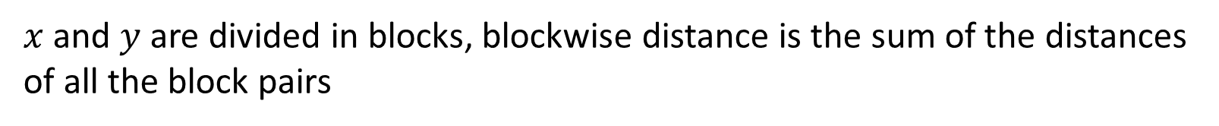
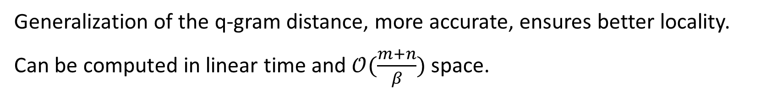



CIRCULAR SEQUENCE COMPARISON: ALGORITHMS AND APPLICATIONS
β-blockwise q-gram distance
$x$ and $y$ are divided in blocks, blockwise distance is the sum of the distances of all the block pairs
$$x$$
A A A A|C C C C|G G G T|T T A A
$$D_{β, q}\left(x, y\right)$$
$$y$$
A A A C|C T C G|G G T T|T T A A
Generalization of the q-gram distance, more accurate, ensures better locality.
Can be computed in linear time and $𝒪(\frac{m+n}{β})$ space.
Roberto Zanotto |18/05/16

Slide 8
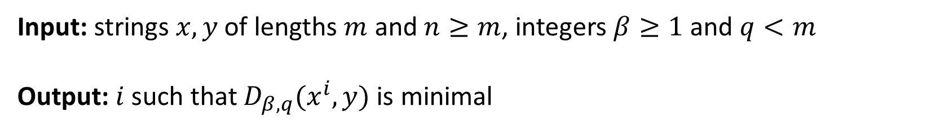
CIRCULAR SEQUENCE COMPARISON: ALGORITHMS AND APPLICATIONS
Circular Sequence Comparison problem (CSC)
Input: strings $x, y$ of lengths $m$ and $n≥m$, integers $β≥1$ and $q<m$
Output: $i$ such that $D_{β, q}(x^{i},y)$ is minimal
Naïve algorithm (nCSC) complexity: $𝒪(m\left(m+n\right))$
Roberto Zanotto |18/05/16

Slide 9




CIRCULAR SEQUENCE COMPARISON: ALGORITHMS AND APPLICATIONS
Heuristic algorithm (hCSC)
Step 1: divide $xx$ in $2β$ blocks and $y$ in $β$ blocks.
Step 2: calculate $δ_{j}=D_{β, q}(x^{j\frac{m}{β}},y)$ shifting the window block by block.
Step 3: starting form position with best $δ_{j}$, refine search by moving left
and right by $m/β$ characters.
$$xx$$
A A A A|C C C C|G G G T|T T A A|A A A A|C C C C|G G G T|T T A A
$$y$$
A A A C|C T C G|G G T T|T T A A
$$j=3$$
Roberto Zanotto |18/05/16

Slide 10
CIRCULAR SEQUENCE COMPARISON: ALGORITHMS AND APPLICATIONS
Analysis of hCSC
Step 2 (block-by-block search) $𝒪(β\left(m+n\right))$
Step 3 (char-by-char local search) $𝒪(\frac{m}{β}\left(m+n\right))$
Total $𝒪\left(\left(β+\frac{m}{β}\right)\left(m+n\right)\right)$
By letting $β=\sqrt{m}$ $𝒪(\sqrt{m}\left(m+n\right))$
Linear additional space
Does not necessarily find global optimum!
Roberto Zanotto |18/05/16

Slide 11






CIRCULAR SEQUENCE COMPARISON: ALGORITHMS AND APPLICATIONS
Exact algorithm based on suffix array (saCSC)
SA
A A A | 0
A A G | 1
A A T | 2
A T C | 3
C A A | 4
C C A | 5
C C C | 6
T C C | 7
Step 1: Construct the suffix array of $xxy$ and create $x′$ and $y′$
from $xx$ and $y$ substituting each q-gram with its rank
$$x$$
$$x$$
$$y$$
A A A T C C C|A A A T C C C|C C C A A A G
0 2 3 7 6 5 4 0 2 3 7 6
6 5 4 0 1
$$x′$$
$$y′$$
Roberto Zanotto |18/05/16

Slide 12


CIRCULAR SEQUENCE COMPARISON: ALGORITHMS AND APPLICATIONS
Exact algorithm based on suffix array (saCSC)
Step 2: Compute the blockwise q-gram distance for the initial window position,
keeping a $diff$ array for each block
$$x′$$
9 6 2 2|8 0 1 5|7 9 0 1|3 7 4 5|9 6 2 2 8 0 1 5 7 9 0 1 3 7 4 5
$$y′$$
0 1 3 7|4 5 9 6|2 2 8 0|1 5 7 9
Roberto Zanotto |18/05/16

Slide 13

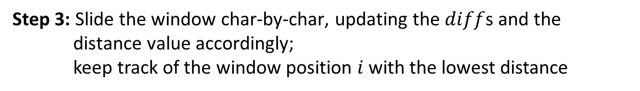

CIRCULAR SEQUENCE COMPARISON: ALGORITHMS AND APPLICATIONS
Exact algorithm based on suffix array (saCSC)
Step 3: Slide the window char-by-char, updating the $diff$s and the distance value accordingly;
keep track of the window position $i$ with the lowest distance
$$x′$$
9 6 2 2 8 0 1 5 7 9|0 1 3 7|4 5 9 6|2 2 8 0|1 5 7 9|0 1 3 7 4 5
$$y′$$
0 1 3 7|4 5 9 6|2 2 8 0|1 5 7 9
Roberto Zanotto |18/05/16

Slide 14
CIRCULAR SEQUENCE COMPARISON: ALGORITHMS AND APPLICATIONS
Analysis of saCSC
Suffix array calculation $𝒪\left(m+n\right)$
Distance with sliding window $𝒪(βm+n)$
Total (for both time and space) $𝒪(βm+n)$
Roberto Zanotto |18/05/16

Slide 15



CIRCULAR SEQUENCE COMPARISON: ALGORITHMS AND APPLICATIONS
saCSC refinement step (saCSCr)
Alignment of the first and last $p$ blocks of $x^{i}$ and $y$with Needleman-Wunsch, considering all possible rotations
G T T T|A T G T|A G C T|$ $ $ $|$ $ $ $|$ $ $ $|C A A A|C T C C|A A A G
$$x′′$$
$$p=3$$
T G T A|G C T T|T A G C|$ $ $ $|$ $ $ $|$ $ $ $|C C C A|A A G G|T T T A
$$y′′$$
T G T A G C T|$ $ $ $ $ $ $ $ $ $ $ $ C A A A C|T C C A A A G G T T T A
T G T A G C T|T T A G C $ $ $ $ $ $ $ $ $ $ $ $|C C C A A A G G T T T A
Time complexity: $𝒪\left({(p\frac{m}{β})}^{3}\right)$
Roberto Zanotto |18/05/16

Slide 16
CIRCULAR SEQUENCE COMPARISON: ALGORITHMS AND APPLICATIONS
Experimental results
Algorithm tested on various real and synthetic data
Applications on real data:
Chimpanzee - human MtDNA (from GenBank) comparison:
85% similarity and ~1200 gaps with EMBOSS Needle vs
91% similarity and 77 gaps with correct rotation;
Distance-based phylogenetic reconstruction:
MtDNA, viroid RNA, circular proteins.
saCSCr gives the same results as cNW (“brute force” Needleman-Wunsch), but with much smaller execution times!
Roberto Zanotto |18/05/16

Slide 17
CIRCULAR SEQUENCE COMPARISON: ALGORITHMS AND APPLICATIONS
Time performance
Experimental performance is in line with theoretical expectations
saCSC (q-gram dist, suffix array) $𝒪\left(βm+n\right)$
hCSC (q-gram dist, heuristic) $𝒪(\sqrt{m}\left(m+n\right))$
hSW (Smith-Waterman, heuristic) $𝒪(mn)$
nCSC (q-gram dist, naïve) $𝒪(m(m+n))$
cNW (Needleman-Wunsch, naïve) $𝒪(m^{2}n)$
Roberto Zanotto |18/05/16

Slide 18
CIRCULAR SEQUENCE COMPARISON: ALGORITHMS AND APPLICATIONS
Conclusions
β-blockwise q-gram distance can be computed efficiently and used effectively
saCSC solves the CSC problem exactly and fast
Refinement step bridges the gap between q-gram approximation and optimal solution
saCSCr to be implemented in BEAR (state-of-the-art tool for multiple circular sequence alignment)
Q&A!
Roberto Zanotto |18/05/16

