Slide 1
DATA ANALYSIS · E-COMMERCE
Did Free Shipping Increase Profit?
Shipping Cost Analysis — Jan–Sep 2024 (Before vs. Free-Shipping Promotion)
Prepared for the Finance Team, following the July 2024 free-shipping rollout on orders > €50
prepared by: Robel Tsegay

Slide 2
01 · DATA QUALITY SUMMARY
What we found in the raw data
Issue | Where | Impact
Malformed order-line rows | 452 rows in order_lines.csv | Extra column shifted parsing; dropped
Duplicate line_id | 220 of 47,753 order lines | Verified as exact full-row duplicates before dropping
Missing shipping_cost | 595 orders | Filled using business rule (€5.95 / €0.00)
Missing unit_price & line_total | 927 order lines | Back-calculated from order_total minus known line totals
Comma decimal in unit_cost | products.csv | Cost values failed to parse; corrected before casting
order_total ≠ sum(line_total) | ~2% of orders | Source-system inconsistency; order_total treated as authoritative
2

Slide 3
02 · CLEANING DECISIONS & METHODOLOGY
What we did about it, and why
raw CSVs → pandas (inspect) → pandas (clean) → merge → EDA & visualization
• Verified the 220 duplicate line_ids were true full-row duplicates (same product, quantity, price) before dropping — not just colliding IDs
• Filled missing shipping_cost using the business rule: €5.95 before July, €0.00 for qualifying (>€50) promotion orders
• Back-calculated missing unit_price from order_total minus each order's known line-item total, after confirming order_total excludes shipping
• Engineered shipping_promotion_period (before / on_promotion) and profit_margin = (unit_price − unit_cost) × quantity per line item
• Merged orders + order_lines + products into one analysis table for all downstream EDA
3

Slide 4
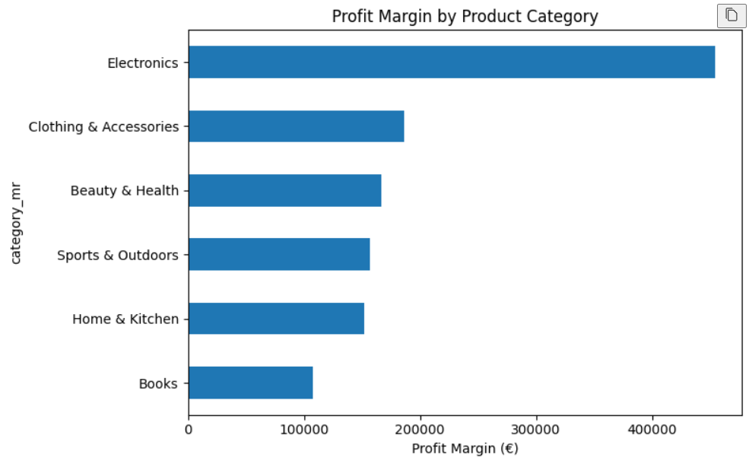
03 · KEY FINDING
The bigger picture
• Every region grew during the promotion — East fastest (+49% monthly profit run-rate), West slowest (+27%). No region was left behind.
• Electronics dominates revenue (45.1% of category revenue) but converts to a smaller share of profit (37.1%) — a margin story worth a pricing review, not just a volume win.
• Customers shifted spending behavior: orders over €360 grew from 15.7% to 21.0% of all orders — shoppers are padding carts to clear the €50 free-shipping bar.
• August, July and September — the entire promotion window — are the three highest-profit months of the year, while monthly gross margin stays flat at ~30% throughout. It's a volume story, not a margin story.
5

Slide 5
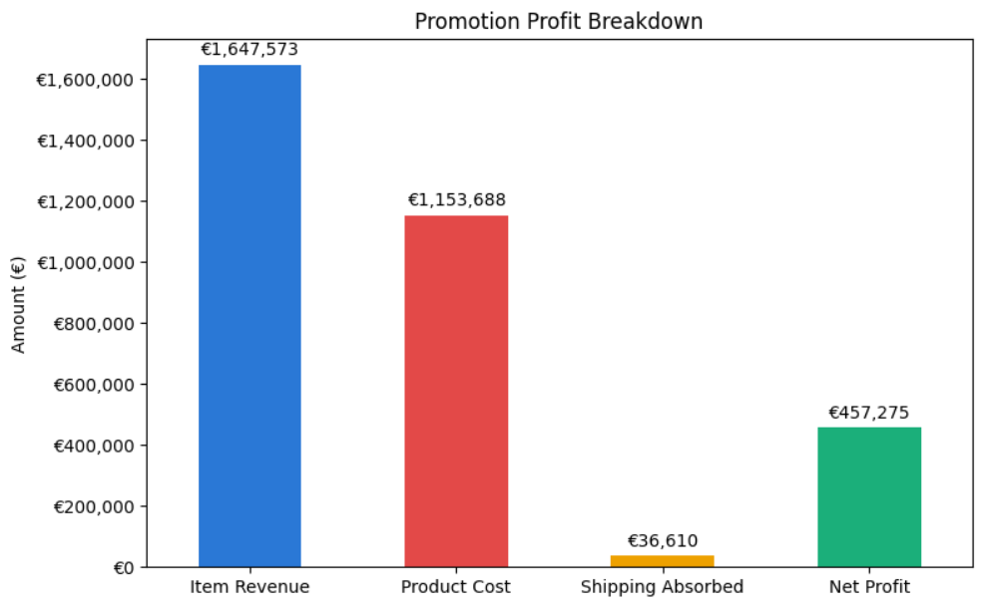
03 · KEY FINDING
Is the shipping giveaway actually a loss?
−€36,610 → +€457,275
Shipping absorbed on qualifying orders (>€50) during the promotion was more than covered. Net promotion profit of the company comfortably paid for the giveaway shipping cost.
4

Slide 6
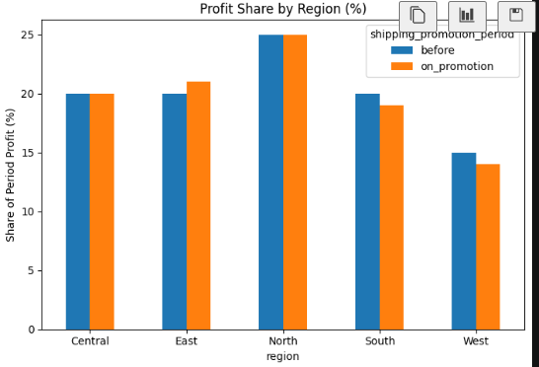
ate Change (%)

Slide 7
04 · RECOMMENDATIONS & CAVEATS
What the company should do next
• Keep free shipping above €50 — net profit comfortably outweighs the absorbed shipping cost, in every region.
• Test the €50 threshold (e.g. €60–€70): customers are already clustering just above it, suggesting room to capture more without losing the behavioral nudge.
• Investigate the West region's weaker response
Caveats
• Before period is 6 months, promotion period is 3 months — all comparisons are normalized for this difference.
• No full-year baseline is available for seasonal comparison.
• 452 malformed rows and 220 duplicate line items were dropped; if non-random, results may be slightly biased.
6

