Slide 1

Rainfall Prediction Using Machine Learning
Presented By :
Souvik Das
Biki Deka
Nikhil Kumar Yadav

Slide 2
Contents
Introduction
Aim & Objective
Machine Learning Algorithms
Project Execution
Result analysis

Slide 3
Introduction
What is machine learning?
According to “Arthur Samuel”, Machine Learning algorithms enable the computers to learn from data and even improve themselves, without being explicitly programmed.
1

Slide 4
Importance of rainfall prediction
Rainfall plays an important role in forming of fauna and flora of natural life as well as in agriculture and farming.
The changing of climatic conditions and the increasing greenhouse emissions have made it difficult for the human beings
Therefore, it has become significant to analyse the changing patterns of the rainfall and try to predict the rain not just for the human needs but also to predict for natural disasters that could cause by the unexpected heavy rainfall.
2

Slide 5
Aim & Objective
The aim of the study is the prediction of the rainfall using historical data based on artificial intelligence methodologies such as Logistic Regression and Decision Tree. The extraction procedures/algorithms will produce the output by classification of the data according to the categories. The similar data will be grouped for the accurate and precise information that will predict rainfall more correctly and with perfect figures.
The accurate and exact predictions will help in developing the more appropriate strategies for agriculture and water reserves and will also be informed about the flood to implement precautionary measures.
3

Slide 6
Machine Learning Algorithms
Logistic Regression :
Logistic regression models the data using the sigmoid function. Logistic regression becomes a classification technique only when a decision threshold is brought into the picture.
Decision Tree :
Decision tree is the most powerful and popular tool for classification and prediction. A Decision tree is a flowchart like tree structure, where each internal node denotes a test on an attribute, each branch represents an outcome of the test, and each leaf node holds a class label.
Random Forest classifier :
A Random Forest is an ensemble technique capable of performing both regression and classification tasks with the use of multiple decision trees and a technique called Bootstrap and Aggregation, commonly known as bagging.
4

Slide 7
Project Execution
Data Exploration: The dataset consists of different data like temperature, wind-speed, humidity etc. of different Australian cities. Our target feature is “Rain Tomorrow”. But it is an unbalanced dataset because of class imbalance of target feature. The ratio between “0” and “1” in target feature is 78.2. So, we need to balance the dataset
Handling Class Imbalance for Rainfall Prediction: Using sklearn’s resample method we have up sampled the minority class in target feature. We up sampled because dataset was small
Filling missing values: filled missing values using mean and mode.
Also, categorical features are converted to numeric using Label encoder.
Detecting and removing outliers: An outlier is a data point that is noticeably different from the rest. We have detected outliers using the inter-quartile range (IQR) and remove them to get the final working dataset. Whichever data do not fall into the IOR we removed them.
Correlation between features: Two features sometime co relate to each other. In that case one feature changes in relation to the other. We checked correlation but did not find correlation 1 for any so did not remove any feature.
5

Slide 8
Training Rainfall Prediction Model with Different Models: We will divide the dataset into training (75%) and test (25%) sets respectively to train the rainfall prediction model. For best results, we will standardize our X_train and X_test data:
Three different models have been used are:
Logistic Regression
Decision Tree Classifier
Random Forest Classifier
Then models are trained
6

Slide 9
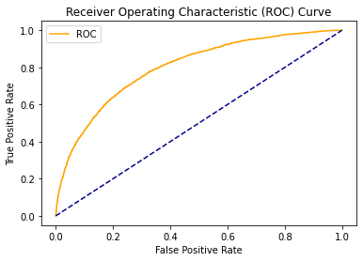
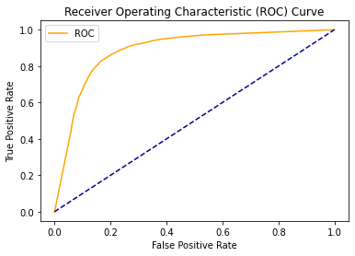
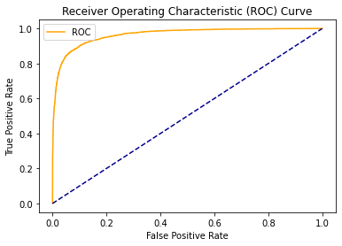
Result analysis
After training is done, here is the performances on the test data of all models
ROC Curve comparision
Logistic regeression
Decision tree
Random forest
7

Slide 10
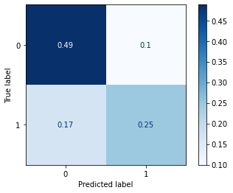
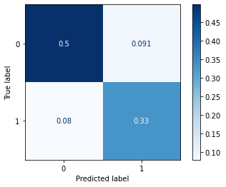
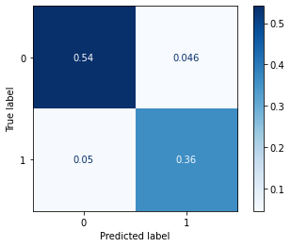
Confusion Metrics
Logistic regeression
Decision tree
Random forest
8

Slide 11
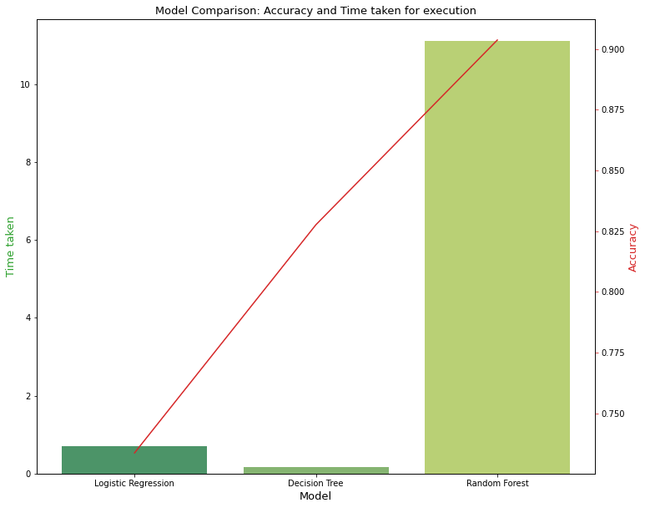
Accuracy of models
We have taken accuracy to choose the model, and random forest model have best accuracy so that is the best model.
9

Slide 12
THANK YOU

