Slide 1

Design and Evaluation of Flow Buffering Strategies for FEC Encoding on SmartNICs
Andreu Roca
Final presentation presentation
Chair of Integrated Systems
School of Computation, Information, and Technology
Technical University of Munich

Slide 2
Introduction
Background
Design overview
  Flow ingest
  Packet writer
  Packet reader
Evaluation
Conclusions and future steps

Slide 3
Introduction
Background
Design overview
  Flow ingest
  Packet writer
  Packet reader
Evaluation
Conclusions and future steps

Slide 4
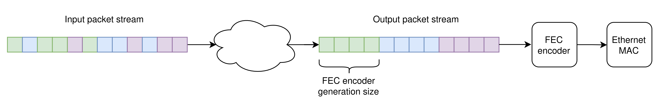
Introduction
Part of the HyperNiC project
Resiliance is key, but CPUs alone cannot keep up with high speeds (> 100Gbps)
Offload resiliance capabilities to SmartNiC → FEC encoding directly on the SmartNiC
FEC encoding happens on a per-flow basis but packet arrival is independent from it, hence we need a flow-aware mechanism to buffer and re-order incoming packets.

Slide 5
Introduction: scope and limitations
TX side
Design + first synthesizable implementation to test the approach
The implementation is expandable and modular
  Configurable parameters at compile time (HBM channels, number of flows...)
  Pipelined design capable of backpressure → more stages can be added
  Modules can be swapped for functionally equal with additonal stages (FIFOs, tables…)
Out-of-context synthesis without FPGA integration

Slide 6
Introduction
Background
Design overview
  Flow ingest
  Packet writer
  Packet reader
Evaluation
Conclusions and future steps

Slide 7
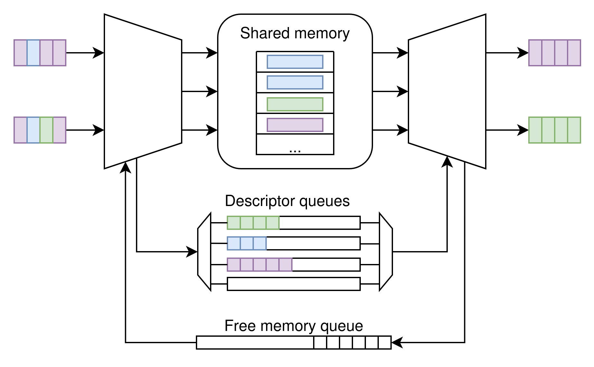
Backrground: shared-memory architecture
Pkts stored in a shared memory pool
Descriptor queues store pkt address
in a per-flow basis
Global free memory queue
Improved scalability
Data/control split
Usually used in network switches

Slide 8
Introduction
Background
Design overview
  Flow ingest
  Packet writer
  Packet reader
Evaluation
Conclusions and future steps

Slide 9

Requirements
Xilinx OpenNiC platform and U55C board
  100 Gb/s Ethernet CMAC
  250MHz clock in user logic box
  AXI Stream input (512 bits wide)
FEC Encoder
  ~10s to ~100s us latency
  Gensize of 16 - 64
100 Gb/s throughput
>10 us avg. Latency
Configurable:
  Queue lenghts
  Number of flows
  Generation size

Slide 10
Assumptions
1 flow ←→ 1 queue
The desired configuration can’t be known until the full system requirements are known, so as a starting point, the assumed configuration is:
  128 flows
  2048 free memory queue length
  64 pkts per flow queue

Slide 11
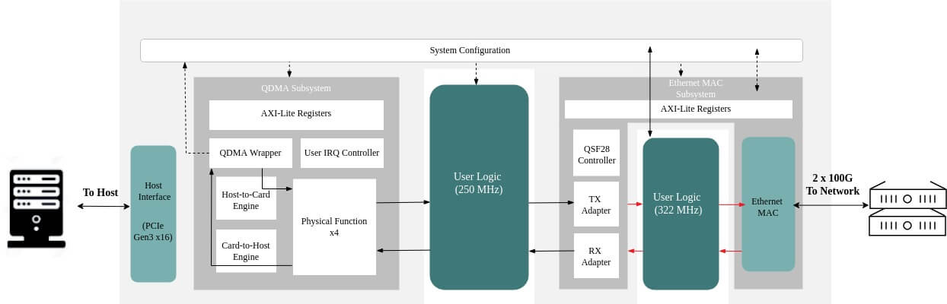
Overview: where are we?
Source: https://www.iwavesystems.com/wp-content/uploads/2024/05/FPGA-Design-BD-1024x329.jpg

Slide 12
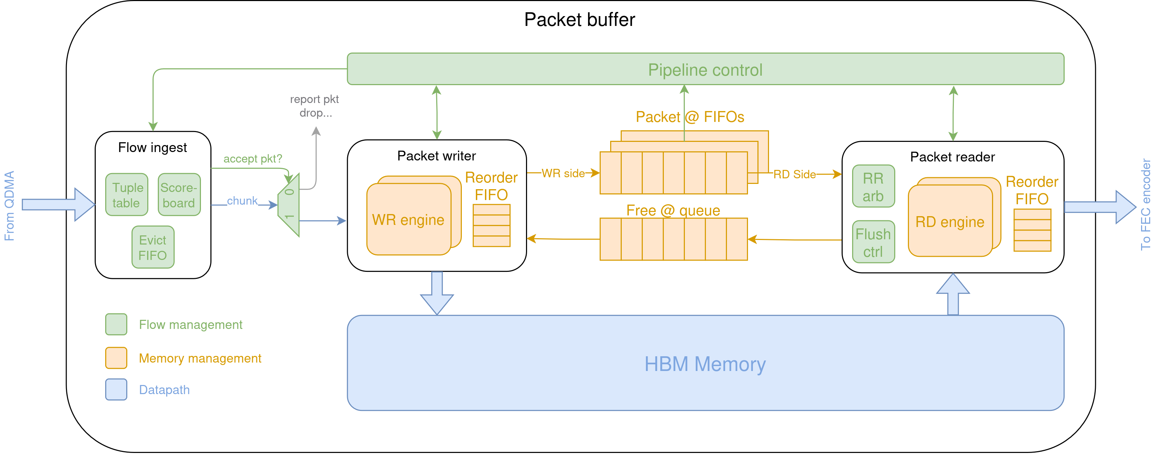
Design overview: top level

Slide 13
Design overview: HBM Controller configuration
128 flows x 64 pkts x 1500 bytes/packet → ~12.3 MB → Too large to use URAM/BRAM, HBM is preferred
In fixed addr mode, 512 MB per HBM pseudo channel
HBM AXI Stream ports are 256 bits wide, so we use 2 in parallel to maintain the 512 bit/cycle throughput
~30 cycles of access latency
Since space is plentiful (1024 MB), 2KB are allocated for every packet

Slide 14
Design overview
AXI Stream I/O (512b tdata)
1GB of HBM for pkt buffering
2KB range per pkt
1 pkt FIFO per active flow
Global free memory queue

Slide 15
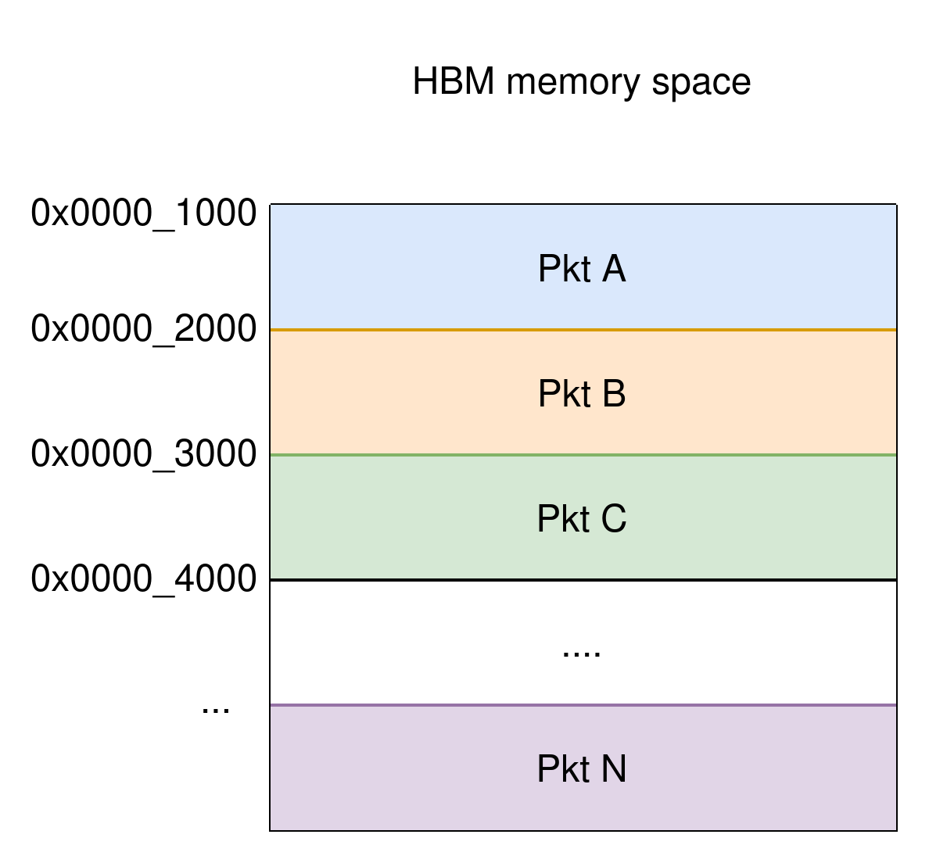
Design overview: memory distribution
Address space split in 2KB region
1 region per packet (no fragmentation)
Memory and pkt FIFOs store starting addresss of the corresponding region, and the number of chuks

Slide 16
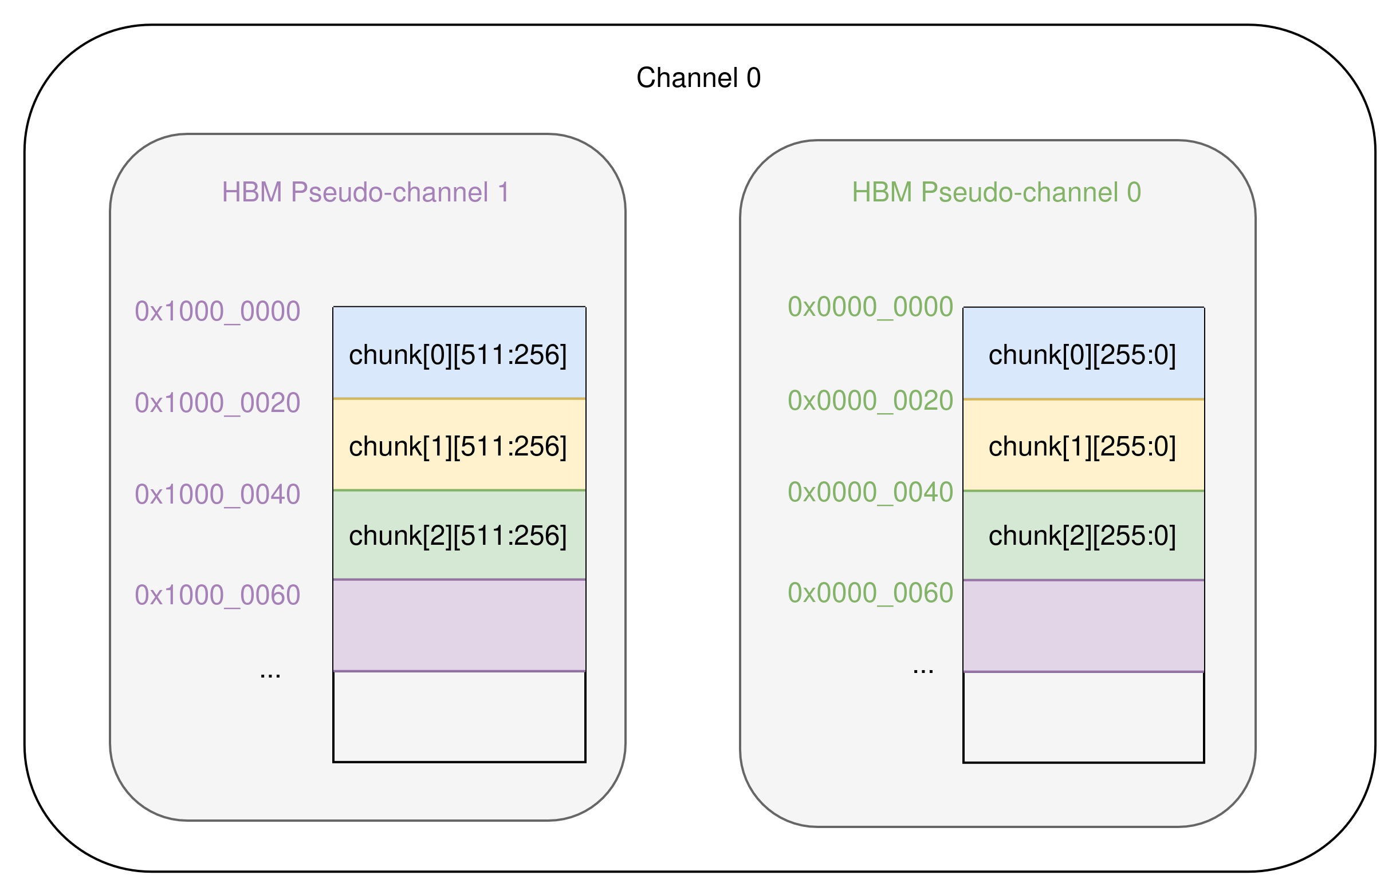
Design overview: physical memory distribution
Pseudo-channels have fixed memory ranges of 256 MB, and data width of 256b.
2 channels are grouped together, storing half a chunk in each
We send AXI requests in parallel but response latency may vary between the two pseudo-channels. This requires additional buffering and reordering.

Slide 17
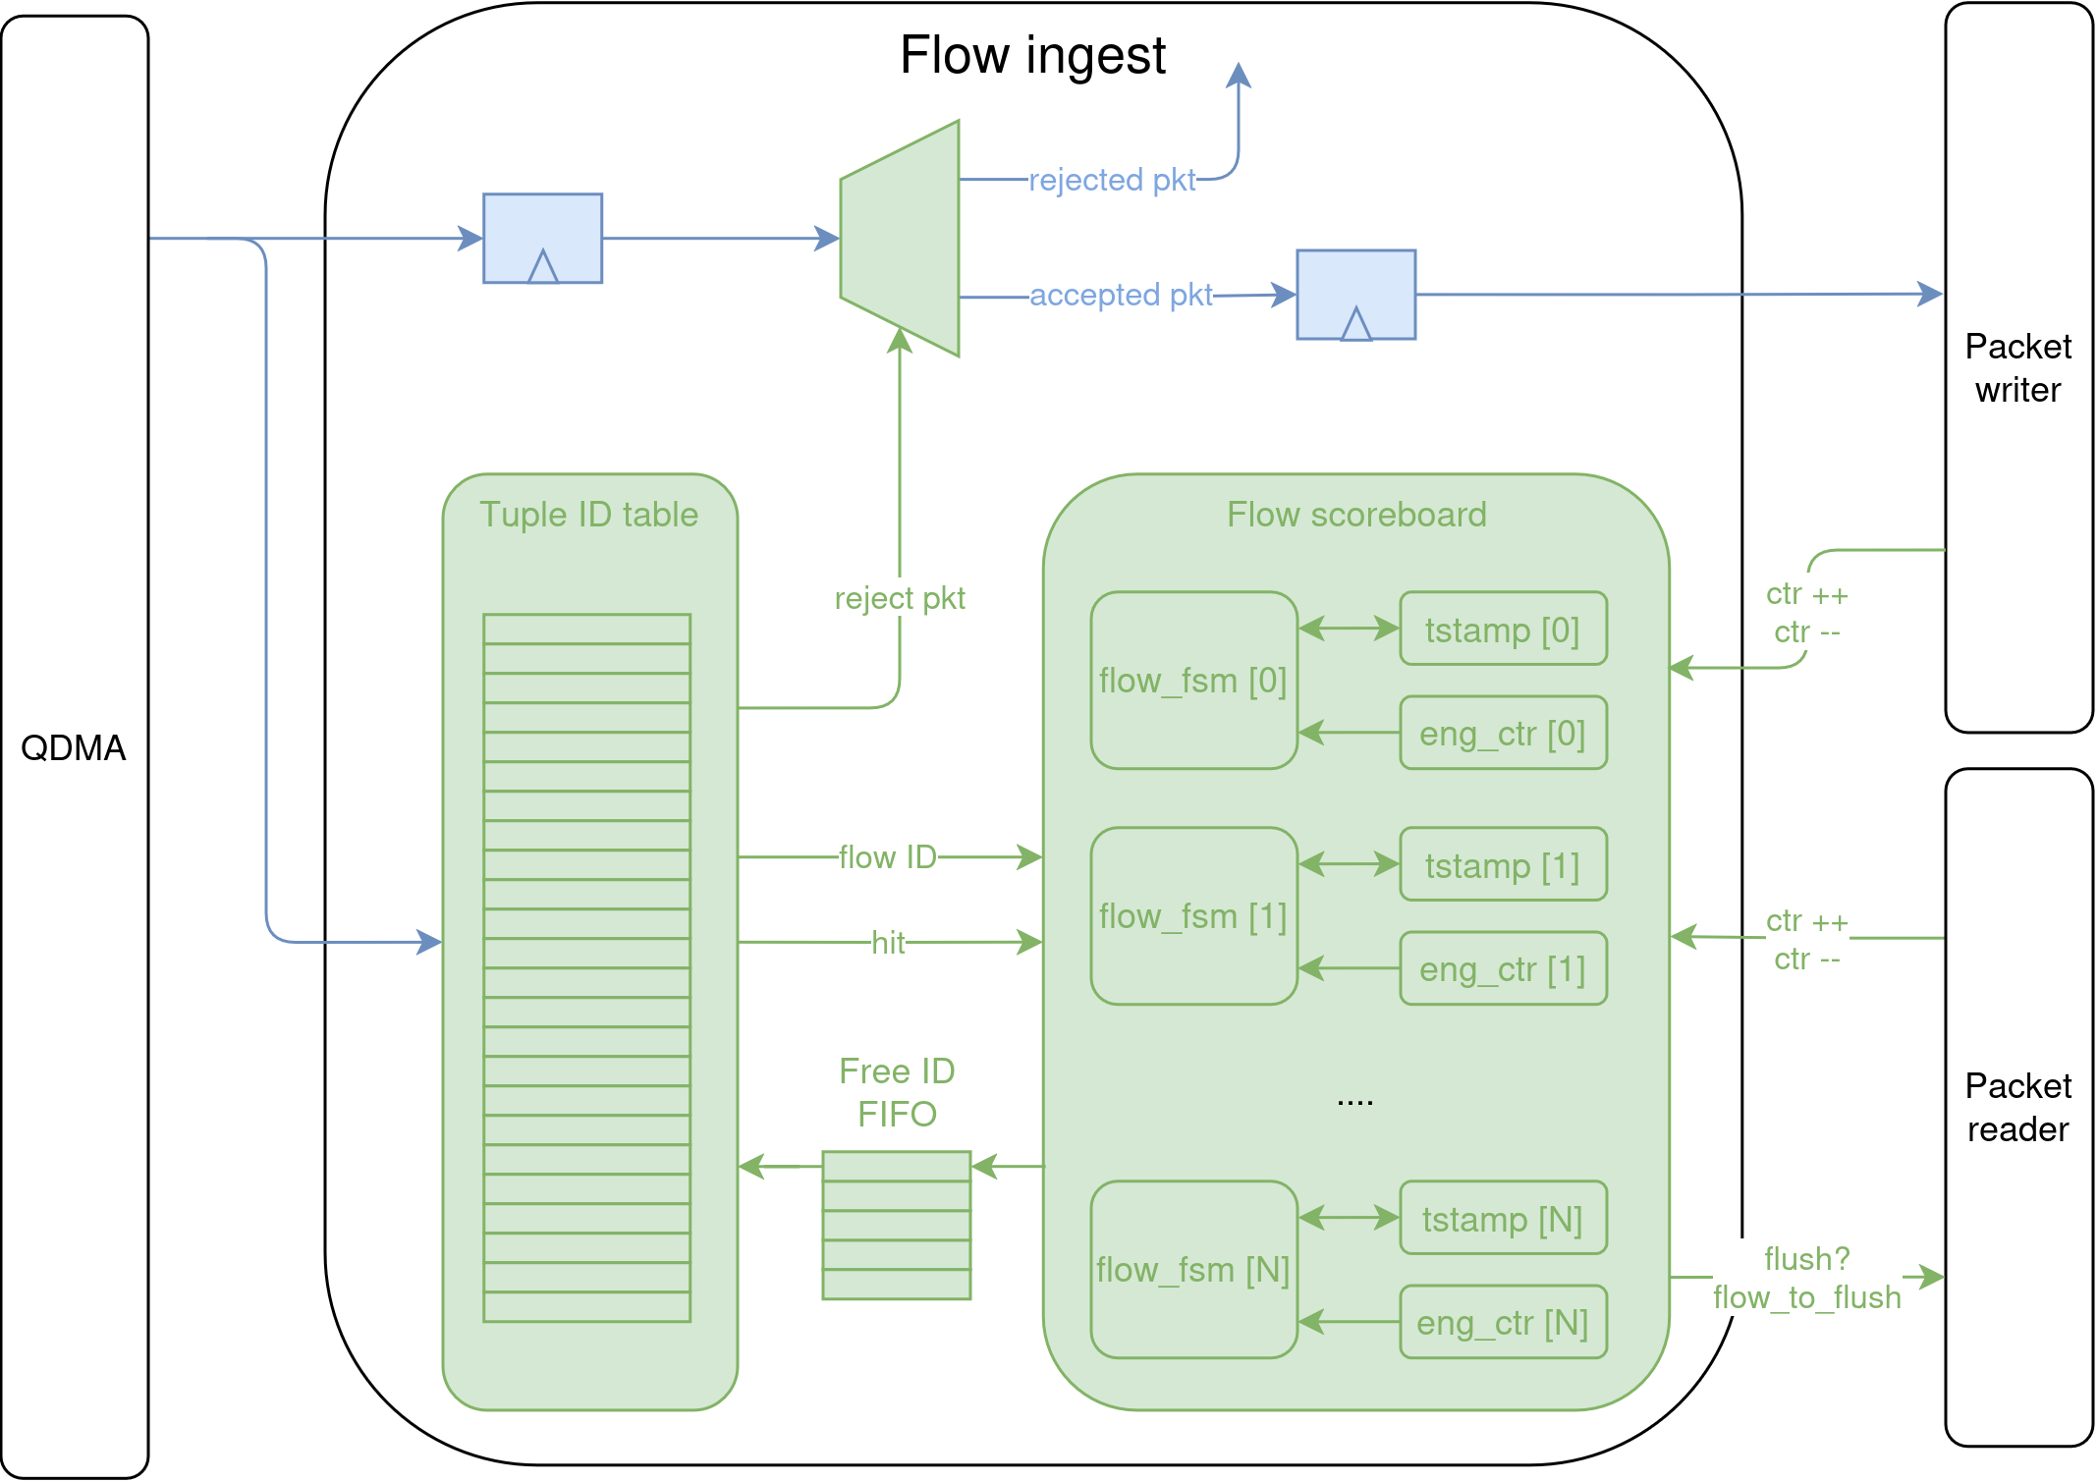
Design overview: flow ingest
Tuple table tags incoming flow
Metadata table tracks flow state and evicts inactive IDs
Flows can be declared inactive by timeout or empty queues
Packets may be dropped if no new flow ID are available

Slide 18
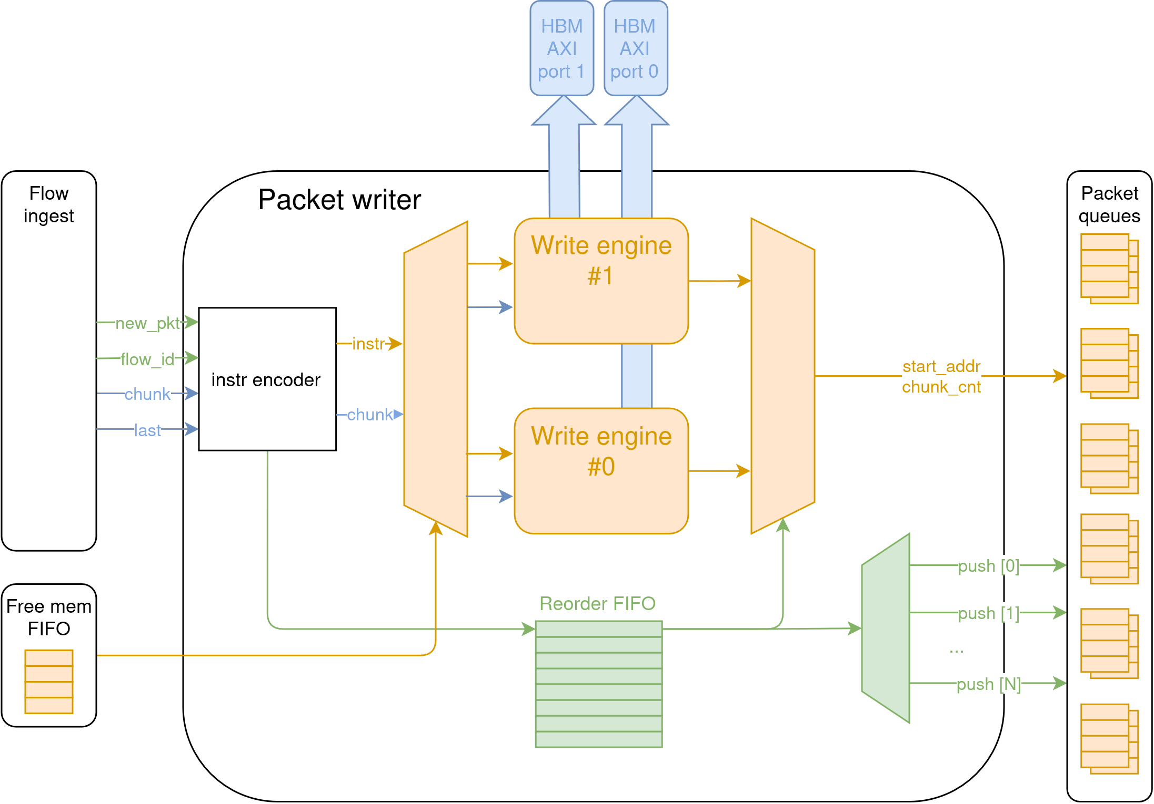
Design overview: packet writer
On pkt arrival, a new base address is popped from the free memory queue
The base addresse is pushed to the corresponding pkt FIFO once writing to HBM is completed.
The write engine sends write requests and keeps track of In-flight transactions

Slide 19
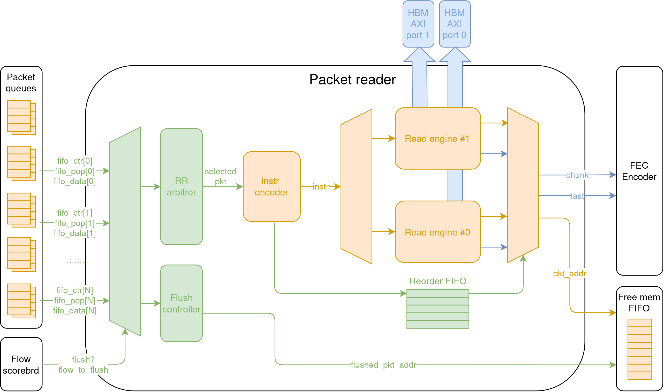
Design overview: packet reader
Pipelined packet reads
A round robin arbitrer decides flow to attend next
The read engine sends read requests and keeps track of In-flight transactions
Read chunks are buffered to absorb backpressure from the FEC encoder

Slide 20
Introduction
Background
Design overview
  Flow ingest
  Packet writer
  Packet reader
Evaluation
Conclusions and future steps

Slide 21
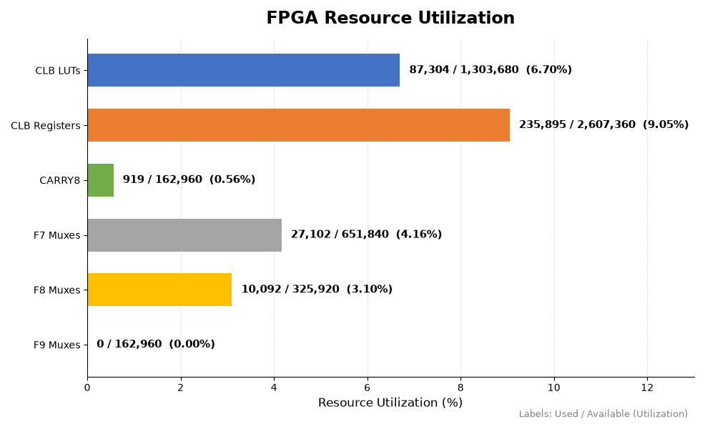
Evalutaion: utlization (out of context)
128 flows, 64 pkts per flow, 1024 total pkts
~60% of FF usage from packet FIFOs
~20% of FF usage from rd/wr engine FIFOs
~40% of LUT usage from HBM subsystem

Slide 22
Evalutaion: throughput and latency
Add graphs with different tests across:
- Gensize
- Pkt size
- Burst len
- NR flows (test with 2x supported flows to check pkt drop rate)

Slide 23
Next steps
Perfromance metrics (per-flow latency and throughput, pkt drop) for different pkt arrival distributions:
Random
Short same-flow burts
Long same-flow burts
…
Adding priority for flow tuple ranges
Runtime configuration (gensize, flow priority) via AXI registers
RX side

Slide 24
Future design optimizations
Convert FIFOs to BRAM/URAM-based queues. Total latency is not an issue, so it is acceptable (FEC encoder is in the ~10us)
Parallelize HBM AXI Master channel handshakes and bump frequency to 450 MHz
Runtime configuration (gensize, flow priority) via AXI registers
Indirect data handling (DMA descritptors)

