Slide 1

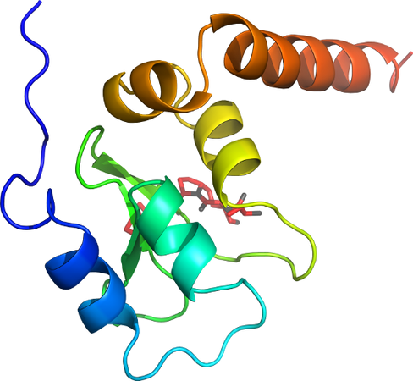

Protein-Protein
Docking
with Rosetta (ROSIE)
Rocco Moretti
Vanderbilt University

Slide 2
Protein-Protein Interactions
Cell growth and proliferation
Morphology and motility
Gene expression
Cellular
Metabolism
Intercellular communications
Nanobodies
In the
Lab
Protein
Probes
Infections
and
diseases
Viruses, prions and bacteria
Antibodies
Neurodegenerative diseases
Protein-Protein Interactions are essential

Slide 3
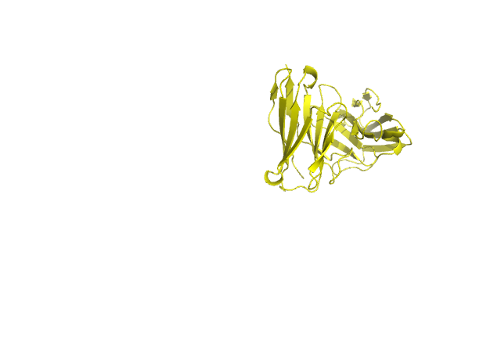
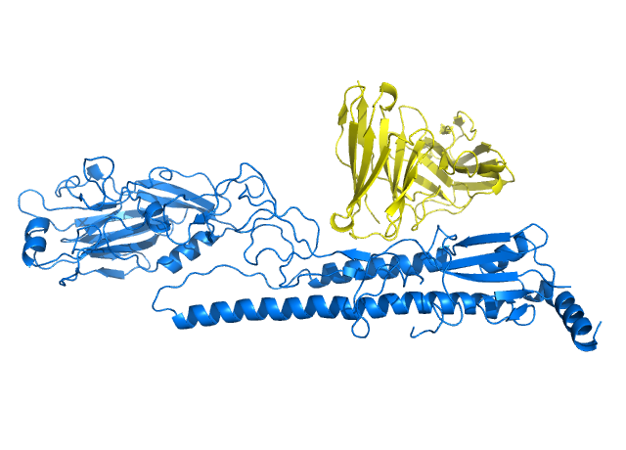
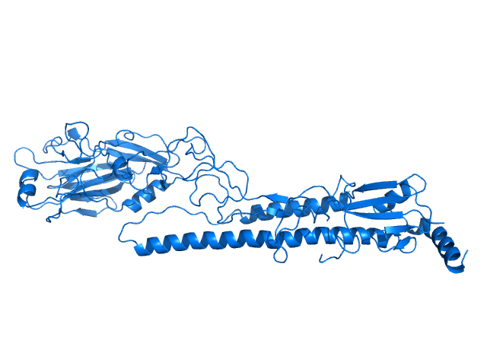
Protein-Protein Docking in Rosetta
Protein A
Complex AB
Rosetta Docking
Binding Site
Protein B
Rosetta can be used to predict the bound structure of two proteins starting from unbound structures.

Slide 4
Global vs. Local Docking
Global Docking
Local Docking
Global Docking is used when there is no information about the binding between two proteins, or when the binding is known but not the exact position on the proteins.
Advantages:
- No need of prior info about the proteins
Limitations:
- Only two partners are accepted
- Less accurate than the Local Docking
- Works best for small complexes (<450 aa)
Local Docking is used when the interaction and the position of the two (or more) proteins is known.
Advantages:
- More accurate than the Global Docking
- Multiple partners accepted
- Can integrate experimental data
Limitations:
- Requires prior information about the binding site

Slide 5
Rosetta Docking Protocol
Local Docking Protocol
Input Preparation
Rosetta is very flexible
The general protocol can be adapted to different needs:
Global Docking Protocol
Stage 0 - Randomization of the initial positions
Stage 1 - Low Resolution
Stage 2 - High Resolution
Stage 1
Low Resolution
Stage 2
High Resolution
Outputs Analysis

Slide 6
Protein Docking - Prep
Local Docking Protocol
1- The PDB structure:
The two (or more) partners must be in the same pdb file, with different chain names, and within 10 Å distance at the binding pocket site.
The starting structure must be prepacked in order to lower the energy of the side-chains outside of the docking interface...
Extra steps might be required to prepare the partners:
- reducing size to reduce the calculation time
- closing breakchains / modeling loops
- preparing ensembles of conformers
Input Preparation
Stage 1
Low Resolution
Stage 2
High Resolution
The docking protocol requires a single pdb with all partners in a close distance.
Outputs Analysis

Slide 7
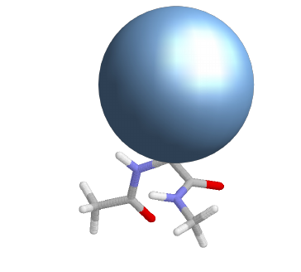
Low Resolution Stage
Local Docking Protocol
Low Resolution Docking:
Centroid-mode / Coarse-grain
Side-chains are represented by spheres with similar properties (charge, size, ...).
In this stage, Rosetta attempts to find the rough orientation of the docking partners.
Advantages:
- Faster calculation time
Limitations:
- Lower accuracy
Input Preparation
Input Preparation
Stage 1
Low Resolution
Stage 2
High Resolution
Stage 2
High Resolution
The low-resolution stage defines the initial orientation of the docking partners.
Outputs Analysis
Outputs Analysis

Slide 8
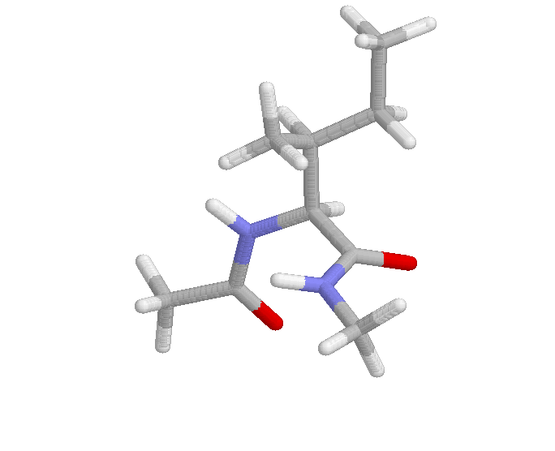
High Resolution Stage
Local Docking Protocol
High Resolution Docking:
All-Atom / Full-Atom
Centroid residues are replaced with the side-chains atoms in unbound conformation.
Rotamers are tested and, if accepted, the complex is minimized and repacked.
Advantages:
- More accurate than centroid-mode
Limitations:
- Requires higher calculation time
Input Preparation
Stage 1
Low Resolution
Stage 2
High Resolution
The high resolution stage includes minimization and repacking.
Outputs Analysis

Slide 9
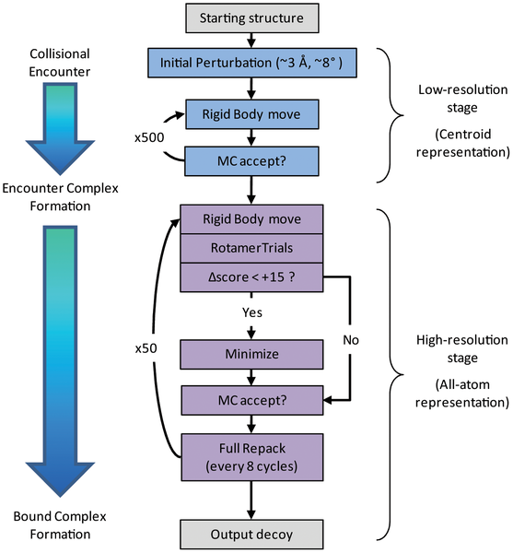
Docking Protocol
Local Docking Protocol
Input Preparation
Stage 1
Low Resolution
Stage 2
High Resolution
Outputs Analysis
Rosetta performs multiple cycles for both the low- and the high-resolution stages.

Slide 10
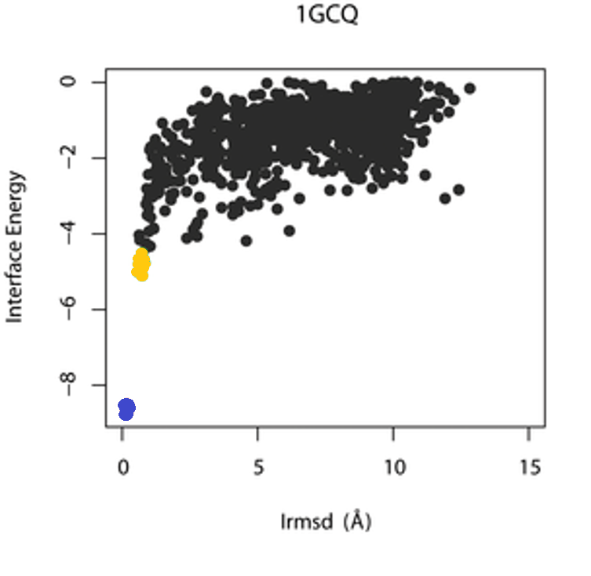
Output Analysis
Local Docking Protocol
From the analysis results we can extract and plot:
1- RMSD vs Total Energy
2- RMSD vs Binding Energy
For both we expect a funnel-like plot, in which the lower scoring models should be close to the native structure in terms of energy and conformation.
Input Preparation
Stage 1
Low Resolution
All models
Top models
Native complex
Stage 2
High Resolution
Outputs Analysis
RMSD vs Total Energy and RMSD vs Binding Energy should give a funnel-plot.

Slide 11
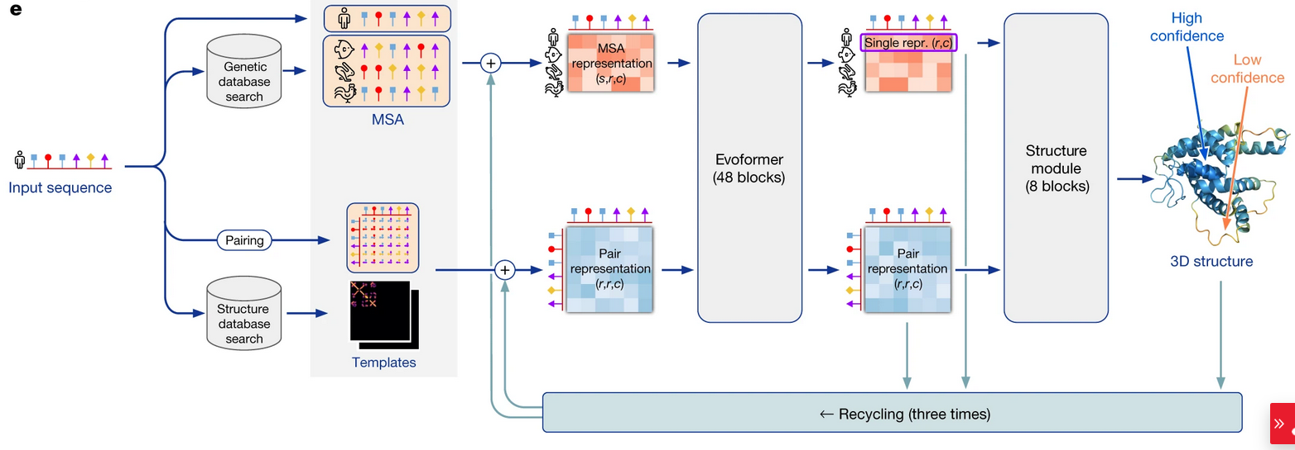
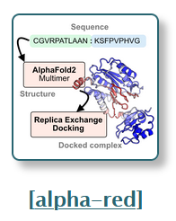
Machine Learning?
Why “classic” approaches?
Systems where ML still struggles (Antibodies)
Evaluation of ML models
“Restraints”/Experimental Data

Slide 12
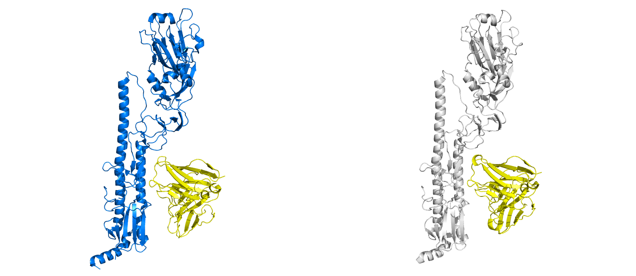
The Tutorial Today
3gbm
3gbn
The antibody CR6261 binds to multiple sub-types of influenza antigen hemagglutinin (HA). In the crystal structure 3gbm, the antibody is bound to the sub-type H5N1, while in the structure 3gbn it is bound to H1N1.
The sequence of the antibody is the same in the two structures, but the conformations are slightly different.
Here we will perform a cross-docking experiment, in which we will dock the CR6261 protein from 3gbn to the H5N1 structure of 3gbm.
H5N1
H1N1
CR6261

Slide 13
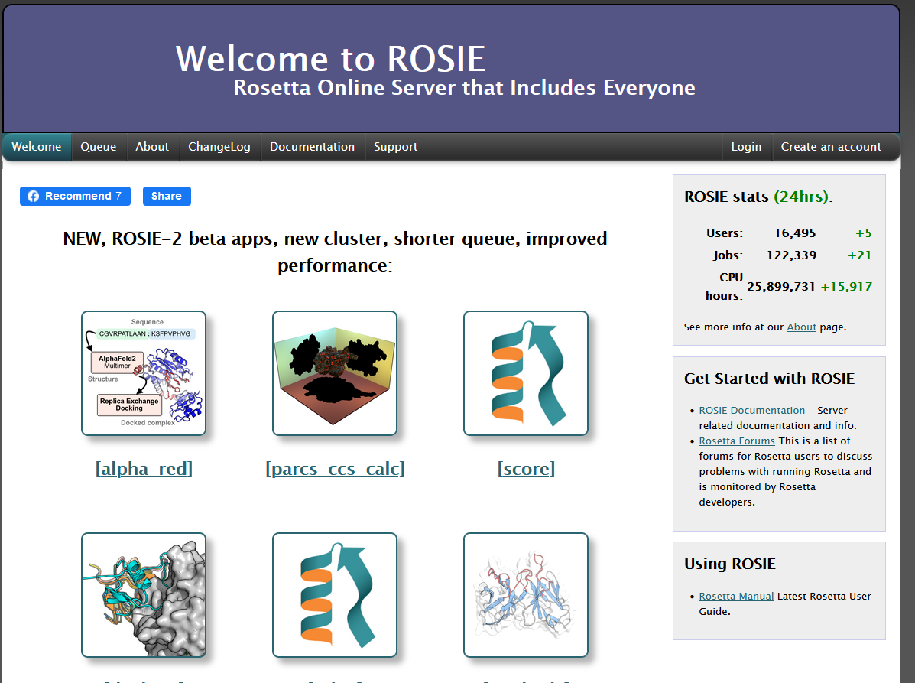
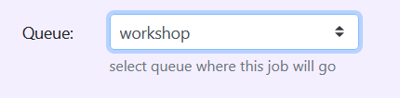
ROSIE

Slide 14
Want More?
Registration Just Opened -- Vanderbilt RosettaWorkshop:
https://meilerlab.org/rosetta-workshop-spring-2025/rosetta-workshop-registration/
HPC Cluster-Based Tutorials On:
1) RFDiffusion
2) Protein design in Rosetta (with ProteinMPNN integration)
3) Protein-Protein Docking
4) Ligand Docking
5) Enzyme design with ML (RFDiffusion-AA & LigandMPNN)
6) Peptide design with Rosetta (with noncanonical amino acids)

Slide 15
References
Gray, J. J.; Moughon, S.; Wang, C.; Schueler-Furman, O.; Kuhlman, B.; Rohl, C. A.; Baker, D., Protein-protein docking with simultaneous optimization of rigid-body displacement and side-chain conformations. Journal of molecular biology 2003, 331 (1), 281-99.
Daily, M. D.; Masica, D.; Sivasubramanian, A.; Somarouthu, S.; Gray, J. J., CAPRI rounds 3-5 reveal promising successes and future challenges for RosettaDock. Proteins 2005, 60 (2), 181-6.
Chaudhury, S.; Sircar, A.; Sivasubramanian, A.; Berrondo, M.; Gray, J. J., Incorporating biochemical information and backbone flexibility in RosettaDock for CAPRI rounds 6-12. Proteins 2007, 69 (4), 793-800.
Sivasubramanian, A.; Sircar, A.; Chaudhury, S.; Gray, J. J., Toward high-resolution homology modeling of antibody Fv regions and application to antibody-antigen docking. Proteins 2009, 74 (2), 497-514.
Sircar, A.; Chaudhury, S.; Kilambi, K. P.; Berrondo, M.; Gray, J. J., A generalized approach to sampling backbone conformations with RosettaDock for CAPRI rounds 13-19. Proteins 2010, 78 (15), 3115-23.
Sircar, A.; Gray, J. J., SnugDock: paratope structural optimization during antibody-antigen docking compensates for errors in antibody homology models. PLoS computational biology 2010, 6 (1), e1000644.
Chaudhury, S., Berrondo, M., Weitzner, B. D., Muthu, P., Bergman, H., Gray, J. J.; Benchmarking and analysis of protein docking performance in RosettaDock v3.2. PLoS One 2011.
Marze, N. A., Jeliazkov, J. R., Roy Burman, S. S., Boyken, S. E., DiMaio, F., Gray, J. J.; Modeling oblong proteins and water-mediated interfaces with RosettaDock in CAPRI rounds 28-35. Proteins 2016, 85(3):479-486.

