Slide 1
Claude.Bricks + Azure ML
A DP-100 Study Project for Azure Data Scientist Associate
LEGO-themed project for hands-on Azure ML practice
Every lab maps to DP-100 exam skills
Terraform, Azure ML, MLflow, and LLM optimization
Terraform Infrastructure
Azure ML Experiments
MLflow Tracking
LLM Optimization
Notes:
This course uses a single, coherent LEGO-themed project instead of scattered demos. The Claude.Bricks scenario touches most DP-100 exam skills in a concrete way. We tie each module to the official study guide, including the four domains and their percentages. After this class, you should feel more confident both working in Azure ML and sitting the DP-100 exam.

Slide 2
What You Will Be Able To Do
1
2
3
4
Design & Prepare
Explore & Experiment
Train & Deploy
Optimize LLMs
Set up Azure ML environments with Terraform: workspaces, compute, datastores, data assets
Run experiments, track with MLflow, use AutoML, and tune models across scenarios
Package training as script jobs, build pipelines, deploy managed online endpoints
Use prompt flow, RAG with Azure AI Search, and fine-tuning for language models
Each objective maps directly to one of the four DP-100 exam domains.
Notes:
These outcomes line up with the four DP-100 domains: Design and prepare (20-25%), Explore data and run experiments (20-25%), Train and deploy models (25-30%), Optimize language models (25-30%). Each lab references one or more of these.

Slide 3
Prerequisites and Lab Setup
You Should Already
Lab Environment
• Be comfortable with basic Python and Git – or at least understand it
• Understand core ML concepts (features, labels, train/test split)
• Have an Azure subscription with contributor access
• Have Terraform, Azure CLI, and a Python environment installed
• Resource group and Azure ML workspace via Terraform
• GPU quota requested for your region (optional but recommended)
• Access to Azure OpenAI and Azure AI Search where available
• Most labs work on CPU if GPU is unavailable
Notes:
You do not need to be an expert data scientist, but you should know basics of classification, regression, and evaluation metrics. For Azure, you need permissions to create a workspace, compute, datastores, and related resources. GPU and Azure OpenAI approvals can take time, so plan ahead.

Slide 4
Alignment with the DP-100 Study Guide
Domain
Weight
Our Coverage
Design & Prepare a ML Solution
20–25%
Terraform deployment, workspace design, compute selection, datastores, data assets, environments (Module 1)
Explore Data & Run Experiments
20–25%
Notebooks, AutoML, MLflow tracking, model evaluation, responsible AI concepts (Module 2)
Train & Deploy Models
25–30%
Script jobs, pipelines, model registration, managed online endpoints, blue-green deployment (Module 3)
Optimize Language Models for AI Apps
25–30%
Model catalog, prompt flow, RAG, Azure AI Search, fine-tuning workflows (Module 4)
Notes:
The percentages and domain names come directly from the official DP-100 study guide. I encourage you to keep the study guide open and mark off items as we go. If you see a bullet we have not touched, bring it up.

Slide 5
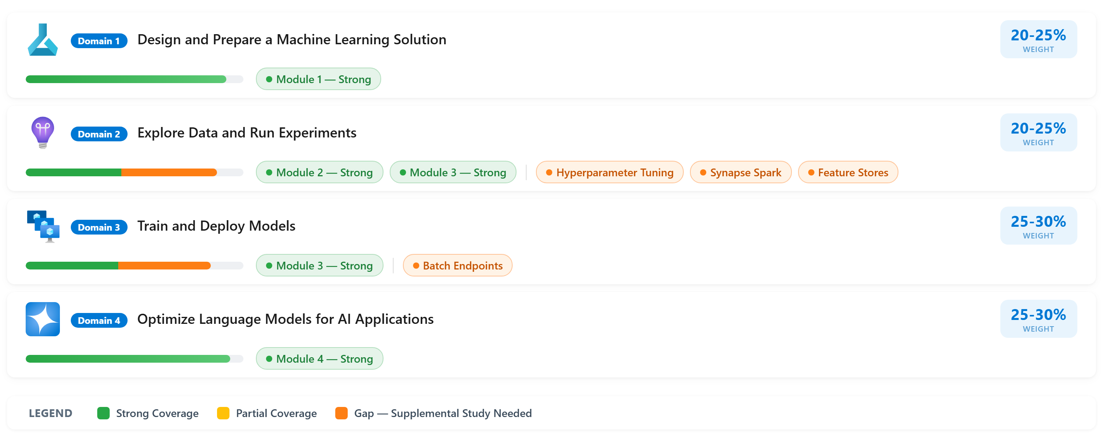
DP-100 Domain Coverage Matrix
Exam domains mapped to course modules — identifying strengths and gaps

Slide 6
Claude.Bricks: The Project Story
A fictional LEGO architect that produces structured building specs from images and reference models.
Inputs
Processing
Outputs
• Inspiration photos of real streets and buildings
• .ldr reference files from existing LEGO models
• User prompts describing desired style and scale
• Claude agents extract features and descriptions
• Azure ML runs classification, detection, clustering
• MLflow tracks experiments and model performance
• Structured building specs (height, style, roof, facade)
• Validated .ldr files ready for building
• Deployed endpoints other agents can call
Notes:
Claude.Bricks is playful, but the Azure ML patterns are standard: workspaces, experiments, datasets, models, endpoints, and monitoring. The codebase includes multiple Claude agents handling different tasks, with Azure ML running the heavy lifting.

Slide 7
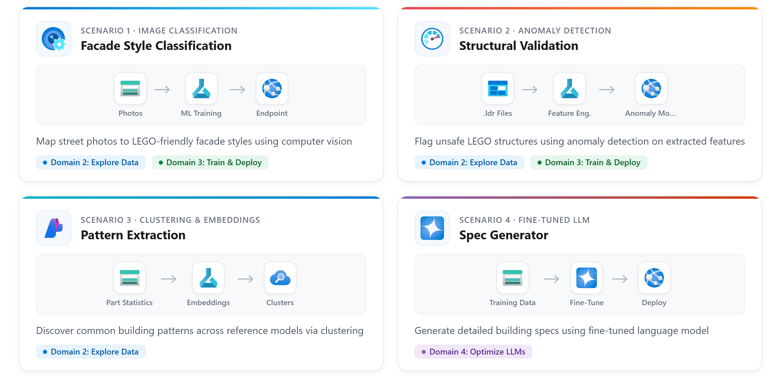
Claude.Bricks — Four ML Scenarios
Each scenario applies Azure ML to LEGO modular building design

Slide 8
How the Claude.Bricks Pipeline Works
Ingest
Enrich
Train
Deploy
Store images and .ldr files in blob storage, register as data assets
Claude agents read raw files, produce structured metadata like style and dimensions
Azure ML jobs take enriched data, train models, log metrics with MLflow
Register models, deploy to managed online endpoints for agent consumption
Mapping to DP-100:
This pipeline mirrors the exam flow: design a solution, set up your workspace, explore and train, then deploy. Claude is the outer shell; Azure ML is the platform.
Notes:
Think of Claude as the outer shell orchestrating the logic, and Azure ML as the platform that runs heavy lifting. The script generation pipeline follows: Ingest, Enrich, Train, Deploy.

Slide 9
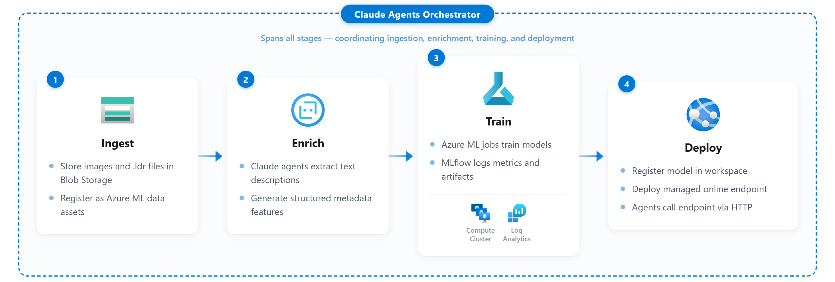
Claude.Bricks Pipeline Flow
End-to-end ML pipeline from data ingestion to deployed endpoint

Slide 10
How Applications Consume Azure ML
Any calling application — Claude.Bricks, a web app, a scheduled script — interacts with Azure ML through three main patterns.
1
2
3
Submit Jobs
Call Endpoints
Track & Query
Training & Pipelines
Real-Time & Batch Inference
MLflow, Registry, & Monitoring
• Submit script jobs or pipeline runs via SDK or CLI
• Azure ML provisions compute, runs the code, stores outputs
• Caller checks job status and retrieves artifacts when done
• Send HTTP requests to managed online endpoints
• Endpoints handle scaling, authentication, and traffic splitting
• Batch endpoints process large datasets asynchronously
• Log metrics, parameters, and artifacts during training runs
• Query the model registry for versions, lineage, and metadata
• Monitor endpoint health and data drift over time
Exam: understand when to use jobs vs endpoints, how MLflow integrates with the workspace, and how external applications authenticate to Azure ML.
Notes:
This slide is about the Azure ML surface area, not about any specific calling application. Claude.Bricks happens to be our caller, but a Flask app or an Azure Function would use the same three patterns. The exam tests your understanding of jobs, endpoints, and MLflow integration.

Slide 11
Scenario 1: Image Classification for Facade Style
Goal
Azure Resources
Map street photos to a limited set of LEGO-friendly facade styles (historic, modern, industrial, etc.)
• Azure ML workspace
• Compute cluster
• Blob storage + datastores
• Data assets (images)
• Managed online endpoint
• MLflow experiment tracking
Approach in Azure ML
• Prepare labeled image dataset with facade style categories
• Run computer vision model via custom training or AutoML
• Track metrics with MLflow, select the best model
• Deploy as a managed online endpoint for inference
Exam: compute choice, experiment tracking, real-time deployment
Notes:
This scenario aligns with 'explore data and run experiments' and 'train and deploy models' domains. Walk through registering the dataset, submitting a training job, logging metrics, and pushing a model to an endpoint.

Slide 12

Scenario 1: Image Classification Lifecycle
End-to-end ML pipeline from raw photos to real-time inference

Slide 13
Scenario 2: Anomaly Detection for .ldr Validation
Goal: Flag unusual or unsafe LEGO structures in .ldr files
Overhang Ratio
Approach in Azure ML
Number and size of unsupported overhangs relative to footprint
• Collect labeled .ldr examples (pass / fail)
• Engineer numeric features from each file
• Train anomaly detection or classification model
• Deploy as managed online endpoint for Validator agent
Collision Count
Number of intersecting or overlapping bricks detected
Height-to-Base Ratio
Tall-to-basewidth measurement for stability assessment
Layer Density
Distribution of bricks per layer, flagging sparse sections
Notes:
The current rule-based validator catches obvious errors, but a model can learn patterns like 'this amount of overhang usually leads to instability.' In DP-100 terms, this exercises data preparation, feature engineering, model selection, evaluation, and deployment.

Slide 14
Scenario 3: Pattern Extraction from Reference Files
Goal: Discover common patterns across many .ldr reference models
Raw Reference Files
Clustered Patterns & Insights
• Hundreds of .ldr files with varied structures
• Part-usage statistics per building section
• Facade, roof, and interior component counts
• No clear groupings or labels
• Cluster labels: "narrow corner shops," "tall glass towers"
• Recurring facade and roof combinations identified
• Spec Generator reuses successful patterns
• AutoML or custom training, logged with MLflow
Azure ML
Notes:
We treat each building as a point in a high-dimensional space defined by part counts. Clustering gives us groups of similar builds. This can align with AutoML for tabular data or custom training. Exam questions may ask about compute choice, data asset management, or experiment tracking.

Slide 15
Scenario 4: Fine-Tuned Language Model for Specs
Goal: Generate detailed, consistent building specs from prompts and reference patterns
A
Select Base Model
Browse the Azure AI model catalog, compare models on benchmarks relevant to structured generation
B
Prepare Training Data
Format spec examples as structured JSON or text, upload as data assets in the workspace
C
Fine-Tune
Submit a fine-tuning job where regional access allows; fall back to prompt engineering if not
D
Deploy & Evaluate
Host the model on a managed online endpoint, evaluate against baseline prompts, iterate
Fine-tuning availability is region- and model-specific. Costs can be significant. Some tenants may use prompt-only or RAG approaches instead.
Notes:
The DP-100 study guide now explicitly includes optimizing language models, including fine-tuning. Focus on the workflow rather than specific regions or SKUs. The exam may test your understanding that fine-tuning is not universally available.

Slide 16
Azure Resources Used in the Project
Core Resources
ML Workspace
Central hub for all ML assets and experiments
Compute
Clusters and instances for training and dev
Storage Account
Data, artifacts, and model files
Online Endpoints
Managed deployments for real-time inference
Container Registry
Docker images for environments
AI Search
Vector store and search index for RAG scenarios
Support Resources
Key Vault
Secrets, keys, and certificates
Log Analytics
Monitoring and diagnostics workspace
Notes:
This slide lists Azure AI Search explicitly, fixing the earlier gap where we discussed RAG but did not list the resource. From a DP-100 standpoint, be comfortable describing what each resource does and how it relates to the workspace.

Slide 17
Cost Overview and Quotas
Low
$/hr
Pay-per-use
Variable
Fixed baseline: workspace, storage, ACR, Key Vault
CPU & GPU compute: pay for what you use, autoscale helps
Azure AI services: driven by API calls and index size
GPU & OpenAI quotas: region- and tenant- specific availability
These are rough guidance numbers. Always verify in Azure Pricing Calculator for your region and subscription. The exam tests cost-aware design conceptually.
Notes:
Prices and discounts change frequently. The main lesson is how to think about cost drivers: compute time, storage, and LLM usage. Low-priority GPUs can make labs more affordable but are not guaranteed.

Slide 18
How the Resources Connect
Terraform Provisions
Register Data Assets
Run Jobs on Compute
Register & Deploy Models
RAG via AI Search
Creates RG, workspace, storage, ACR, Key Vault, Log Analytics
Datastores point to storage; data assets define logical datasets
Jobs read from datastores, write outputs and metrics
Models + environments registered; endpoints serve inference
Indexes text + vectors; prompt flow chains retrieval + generation
The exam expects you to reason about which component does what, how data moves between storage and compute, and where models are tracked and deployed.
Notes:
This is the big picture diagram slide. The exam expects you to reason about component relationships, data movement between storage and compute, and where models are tracked and deployed.

Slide 19
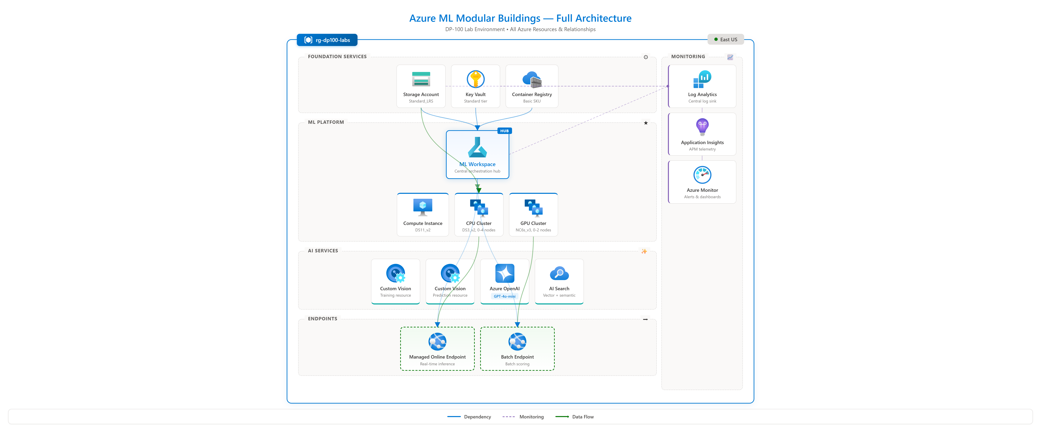
Full Azure Resource Architecture
All Azure resources and their relationships in the lab environment

Slide 20
Terraform: The tf/ Folder
Terraform Responsibilities
Benefits for DP-100 Prep
• Create and configure the Azure ML workspace
• Provision storage, ACR, Key Vault, Log Analytics, compute
• Set basic RBAC at the resource group or workspace level
• Output connection strings and resource IDs for labs
• Consistent, repeatable environment every time
• Practice with real-world IaC patterns
• More class time on ML, less on portal clicks
• Students can map Terraform outputs to exam topics
Notes:
DP-100 does not test Terraform directly, but IaC is common in real projects. Students should understand what Terraform creates and which settings matter for ML workloads. That awareness helps map IaC outputs to exam topics.

Slide 21
Lab Defaults and Production Hardening
Lab Defaults (for simplicity)
Production Hardening Goals
• Public endpoints enabled for all services
• ACR admin user enabled
• Key Vault purge protection off
• Minimal firewall rules
• Fewer network restrictions
• Private endpoints for all data services
• Disable public network access
• Managed identities instead of admin keys
• Key Vault soft delete and purge protection
• Centralized logging via Azure Monitor
Some exam questions assume a more hardened environment than our lab uses. Keep this distinction in mind when answering security-related questions.
Notes:
For a classroom lab, we choose simplicity to avoid long debugging sessions. At the same time, model good habits by showing the clear separation between lab defaults and production hardening. Exam questions often test secure-by-default thinking.

Slide 22
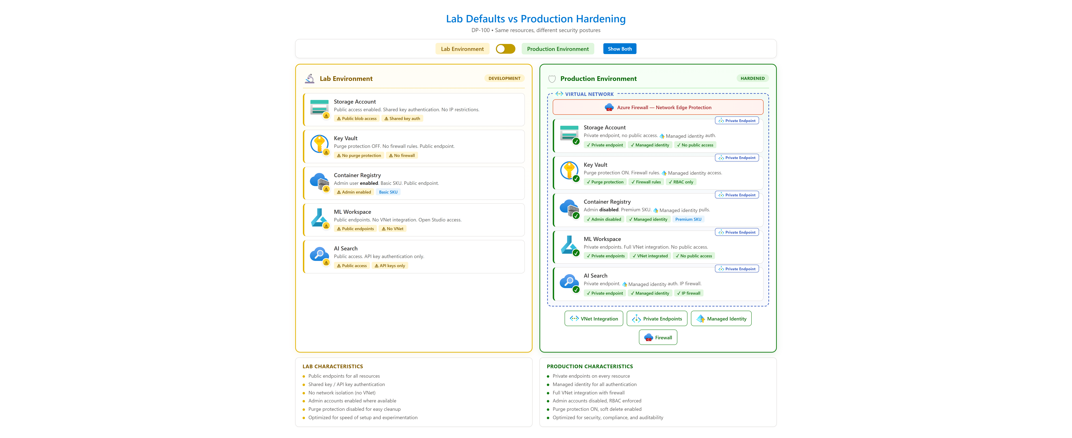
Lab Defaults vs Production Hardening
Same resources, different security postures

Slide 23
RBAC at the Resource Group Level
Owner / Contributor
Instructor
Full control over the resource group, workspace, and all lab resources
Contributor / ML Workspace Contributor
Students
Create and manage ML assets, run experiments, deploy models within the workspace
Reader
Observers / Auditors
View resources and configurations without making changes
Keep roles simple for lab use. In production, use least-privilege custom roles. DP-100 assumes you can recognize which tasks need contributor vs. read-only access.
Notes:
RBAC complexity can derail a lab. We keep it simple: single resource group, broad contributor access for students, clear understanding of cost and security ownership.

Slide 24
Module 1: Design and Prepare a ML Solution
Module 1 Design & Prepare
Module 2 Explore & Experiment
Module 3 Train & Deploy
Module 4 Optimize LLMs
20–25% of DP-100
Exam Focus
In This Module
• Design a machine learning solution
• Create and manage Azure ML workspaces
• Create and manage datastores and compute targets
• Create and manage data assets, environments, registries
• Plan the Claude.Bricks Azure ML environment
• Deploy it with Terraform
• Register datastores and data assets
• Set up compute and environments for training
Notes:
This module lines up directly with the first DP-100 domain. We work from architecture principles into actual deployment: sketching what the solution needs, then configuring and creating those resources in Azure ML.

Slide 25
Module 1: Concepts, Labs, and Exam Traps
Core Concepts
Lab Tasks
Exam Traps
• Workspace as central hub
• Datastores vs data assets
• Compute instances vs clusters
• Environments and images
• Registries for cross-workspace sharing
• Inspect Terraform outputs in portal
• Create and verify datastores
• Configure data assets
• Set up compute clusters with autoscale
• Define and register environments
• Confusing datastores with data assets
• Wrong compute type for workload
• Overlooking environment versioning
• Missing GPU configuration
• Ignoring reproducibility requirements
Notes:
Help students connect hands-on work to the exam mental model. In the lab, use the portal and SDK to inspect what Terraform built, then add or adjust assets. Common traps include mixing up datastores and data assets.

Slide 26
Module 1 Knowledge Check
When would you create a new datastore instead of a new data asset?
Q1
New datastore: different storage resource or credentials. New data asset: new logical dataset on an existing datastore.
What are two reasons to use a compute cluster instead of a compute instance?
Q2
Cluster: scaled-out training, autoscaling, multi-user scenarios. Instance: interactive development and notebooks.
How do environments support reproducible experiments?
Q3
Pin package versions and base images so the same code runs consistently across experiments, retrains, and deployments.
Notes:
Pause and discuss answers as a group. These are the kinds of reasoning questions the exam uses. Reinforce that students are building habits and vocabulary the exam assumes.

Slide 27
Module 2: Explore Data, and Run Experiments
Module 1 Design & Prepare
Module 2 Explore & Experiment
Module 3 Train & Deploy
Module 4 Optimize LLMs
20–25% of DP-100
Exam Focus
In This Module
• Use AutoML for tabular, vision, and NLP tasks
• Use notebooks with compute instances and Spark
• Retrieve features from a feature store
• Track training with MLflow
• Evaluate models with responsible AI guidelines
• Explore datasets for the four scenarios
• Run at least one AutoML experiment
• Use notebooks to wrangle data and launch jobs
• Log metrics and artifacts with MLflow
Notes:
This module combines exploratory data science with structured experiment tracking. The exam cares that you know which tools to use when. Our lab will use standard compute instances; we treat feature stores as an advanced topic to review separately.

Slide 28
Module 2: Hands-On Work and Coverage Gaps
Core Concepts
AutoML configuration (task type, metrics, time budget), notebooks, MLflow runs/metrics/artifacts, train/validation/test splits, fairness checks
Lab Tasks
Run AutoML for anomaly detection or clustering, use notebooks for data wrangling, log runs and metrics via MLflow, compare models
Study Separately
Wrangling with Synapse Spark and serverless Spark, retrieving features from a feature store (complete at least one Microsoft Learn module on these)
Notes:
In the lab, set up an AutoML run and let Azure ML explore model options. Synapse Spark and feature stores are important for the exam but add weight to a limited class. Recommend at least one Microsoft Learn module on those topics.

Slide 29
Module 2 Knowledge Check
1
2
3
When would you choose AutoML over a custom training script?
What are two benefits of tracking experiments with MLflow?
How might responsible AI guidelines influence your model evaluation?
AutoML is good when you want to search model and hyperparameter space quickly, or when you are unsure which algorithm family fits best.
Consistent tracking of runs, metrics, parameters, and artifacts. Simplifies model registration and comparison.
Examine performance across subgroups, penalize models poor for certain populations, reject models relying on sensitive features.
Notes:
These are the kinds of reasoning questions the exam often uses. Discuss in groups and encourage students to articulate the trade-offs.

Slide 30
Module 3: Train and Deploy Models
Module 1 Design & Prepare
Module 2 Explore & Experiment
Module 3 Train & Deploy
Module 4 Optimize LLMs
25–30% of DP-100
Exam Focus
In This Module
• Run model training scripts as jobs
• Implement training pipelines
• Manage models in Azure ML
• Deploy to managed online endpoints
• Monitor deployments and handle updates
• Convert experiments into repeatable script jobs
• Build a simple Azure ML pipeline
• Register models and manage versions
• Deploy and test managed online endpoints
Notes:
This is where the course moves from one-off experiments into operational patterns. The exam wants you to recognize training pipelines, deployment options, and basic monitoring.

Slide 31
Module 3: From Training Scripts to Live Endpoints
Package Training Code
1
Take notebook code and turn it into a standalone script job with defined inputs, outputs, and environment
Build a Pipeline
2
Chain steps: data prep, training, evaluation. Azure ML manages dependencies and can rerun individual stages
Register the Model
3
Log the trained model to the workspace registry with version, metrics, and lineage metadata
Deploy to Endpoint
4
Create a managed online endpoint, configure instance count and SKU, route traffic, and test with sample requests
Exam focus: choosing deployment type (batch vs real-time), understanding rollback strategies, and configuring traffic splitting for blue-green patterns.
Notes:
In the lab, take code that started in a notebook and turn it into a script job. Then create a pipeline, register the model, deploy it, and send test requests. Pay attention to configuration options like instance count, SKU, and traffic splitting.

Slide 32
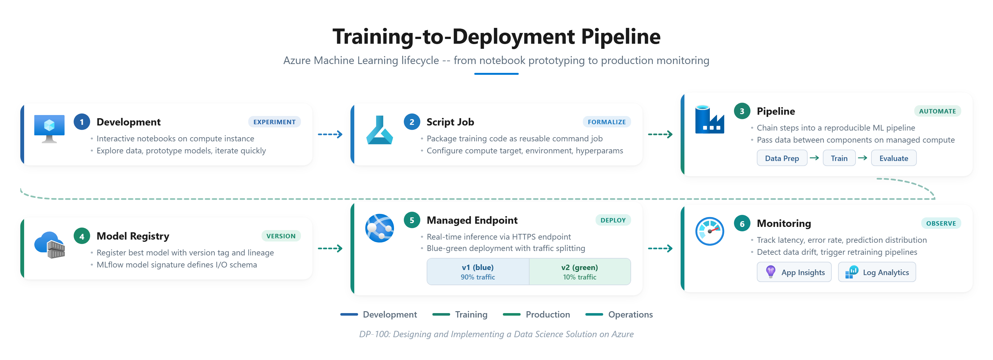
Training-to-Deployment Pipeline
Azure ML lifecycle from notebook prototyping to production monitoring

Slide 33
Module 3 Knowledge Check
Q1: When would you use a pipeline instead of a single script job?
Key Takeaway
Pipelines are useful when you have multiple steps that should run in sequence or as part of a recurring process (data prep, training, evaluation).
These patterns are common in DP-100 scenarios and in real projects. The exam rewards people who understand the operational side of ML: how models move from experiments to production, and how to manage that transition safely.
Q2: What do you need before deploying to a managed online endpoint?
Expected load, latency needs, compute requirements (CPU vs GPU), environment images, and any secrets or dependencies.
Q3: How could you safely roll out a new model version?
Deploy side-by-side, shift a small percentage of traffic, monitor results, then increase. If issues arise, shift traffic back to the previous version.
Notes:
Discuss these questions as a group. The exam tests operational thinking: when to use pipelines, how to configure deployments, and how to safely update models in production.

Slide 34
Module 4: Optimize Language Models for AI Apps
Module 1 Design & Prepare
Module 2 Explore & Experiment
Module 3 Train & Deploy
Module 4 Optimize LLMs
25–30% of DP-100
Exam Focus
In This Module
• Select and deploy from model catalog
• Compare models with benchmarks and playground
• Optimize prompts and flows with prompt flow
• Implement RAG with vector stores and AI Search
• Fine-tune models and evaluate results
• Deploy a language model from the catalog
• Build and test prompt flows
• Configure RAG with Azure AI Search
• Discuss fine-tuning workflows and constraints
Notes:
This domain is newer and carries large exam weight. Microsoft expects data scientists to integrate language models using Azure AI Foundry, prompt flow, and Azure AI Search. Our LEGO scenario uses LLMs to generate building specs and reference summaries.

Slide 35
Deploy, Test, and Optimize Language Models
Model Catalog
Playground
Prompt Flow
Evaluation
• Browse available foundation models
• Compare benchmarks for your task
• Deploy with a few clicks or SDK
• Manual prompt testing and iteration
• Quick evaluation of model behavior
• Useful for rapid prototyping
• Define flows with chained steps
• Create variants for A/B testing
• Add tracing for debugging
• Compare prompt strategies
• Measure quality and consistency
• Choose: prompt eng, RAG, or fine-tune
Exam: when to deploy from catalog, when to use playground for evaluation, and how to build prompt flows with chaining and tracing.
Notes:
The exam treats model catalog, playground, and prompt flow as standard tools. In the lab, we build simple but real flows: read context, call a model, shape the output into a spec. Tracing lets you see each step for debugging.

Slide 36
Retrieval-Augmented Generation with Azure AI Search
Prepare Data
Create Embeddings
Build Index
Retrieve Chunks
Generate Output
Clean, chunk, and format docs
Generate vector representations
Azure AI Search vector + keyword
Similarity search for relevant context
LLM combines context with prompt
Lab Tasks
• Ingest a small set of reference building descriptions
• Create embeddings and store them in a vector store
• Configure an Azure AI Search-based index
• Build a prompt flow that uses RAG to enrich building specs
Exam: knowing when RAG is appropriate vs fine-tuning, and understanding how Azure AI Search fits into language model optimization.
Notes:
This aligns directly with DP-100 bullets on RAG, vector stores, and Azure AI Search. In the Claude.Bricks project, RAG supplies patterns from reference buildings. The LLM combines retrieved snippets with the current prompt for richer specs.

Slide 37
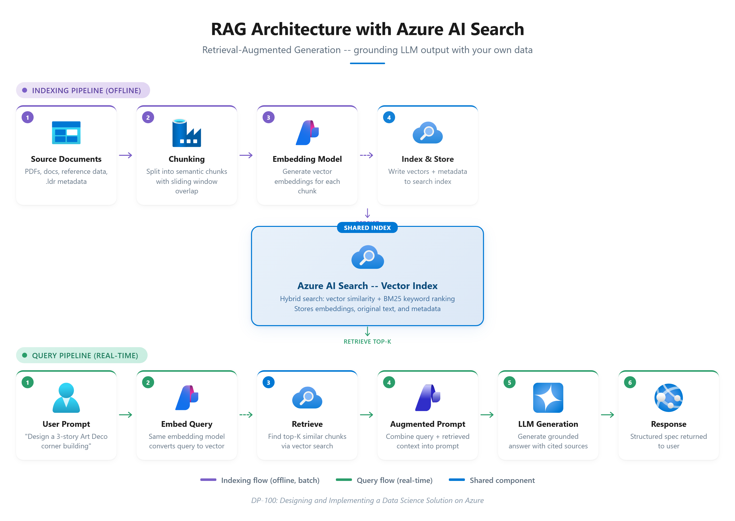
RAG Architecture with Azure AI Search
Indexing pipeline (offline) and query pipeline (real-time)

Slide 38
Fine-Tuning, Constraints, and Knowledge Check
Prepare Data
Select Model
Run Job
Evaluate
Label in required format
Supports fine-tuning
Configure and submit
Compare vs baseline
Fine-tuning availability is region- and model-specific. Costs can be significant. Focus on understanding the workflow and trade-offs, not memorizing SKUs.
Knowledge Check
When would you choose fine-tuning instead of RAG?
When you need very consistent behavior on a narrow task and prompt engineering plus RAG do not get you there.
What are two risks of over-relying on fine-tuning?
Higher cost, lock-in to a specific model, and overfitting to training examples which may reduce generalization.
Notes:
Optimization is a set of tools, and you pick the one that fits constraints. Fine-tuning makes sense for very consistent narrow-task behavior. Risks include higher cost, model lock-in, and overfitting.

Slide 39
Topics Not Fully Covered in This Project
DP-100 skills we only touch lightly or not at all:
Synapse Spark
Serverless Spark for data wrangling at scale, a separate compute paradigm from ML clusters
Feature Stores
Registering, versioning, and retrieving features for training and inference pipelines
Responsible AI Toolbox
Deep use of fairness dashboards, error analysis, and model interpretability tools
Azure Databricks
As a data processing and training environment, separate from Azure ML compute
NLP-Specific AutoML
Beyond our scenarios, AutoML has NLP-specific configurations worth understanding
Complete at least one Microsoft Learn module for each gap. Use practice assessments and read the official study guide end-to-end.
Notes:
This slide is deliberately transparent. The project covers a large portion of exam skills, but not every detail. Synapse, feature stores, and Databricks deserve dedicated time. The study guide is the most reliable description of what's in scope.

Slide 40
DP-100 Coverage Tracker and Next Steps
Design & Prepare
Module 1 & 2
Explore & Experiment
Module 2 & 3
Train & Deploy
Module 3
Optimize LLMs
Module 4
Your Next Steps
A
Review this deck with the DP-100 study guide beside you
C
Plan targeted practice labs or reading for those areas
B
Identify 3-5 bullets where you still feel unsure
D
Take a timed practice exam once you feel ready
The exam rewards people who have actually used the tools. Use Claude.Bricks to anchor your memory.
Notes:
Use the LEGO project to anchor your memory. When an exam question mentions workspaces, endpoints, or RAG, picture how we did it in Claude.Bricks. That concrete anchor makes abstract questions easier. From here, your best move is practice: run more experiments, redeploy models, and build variations.

Slide 41
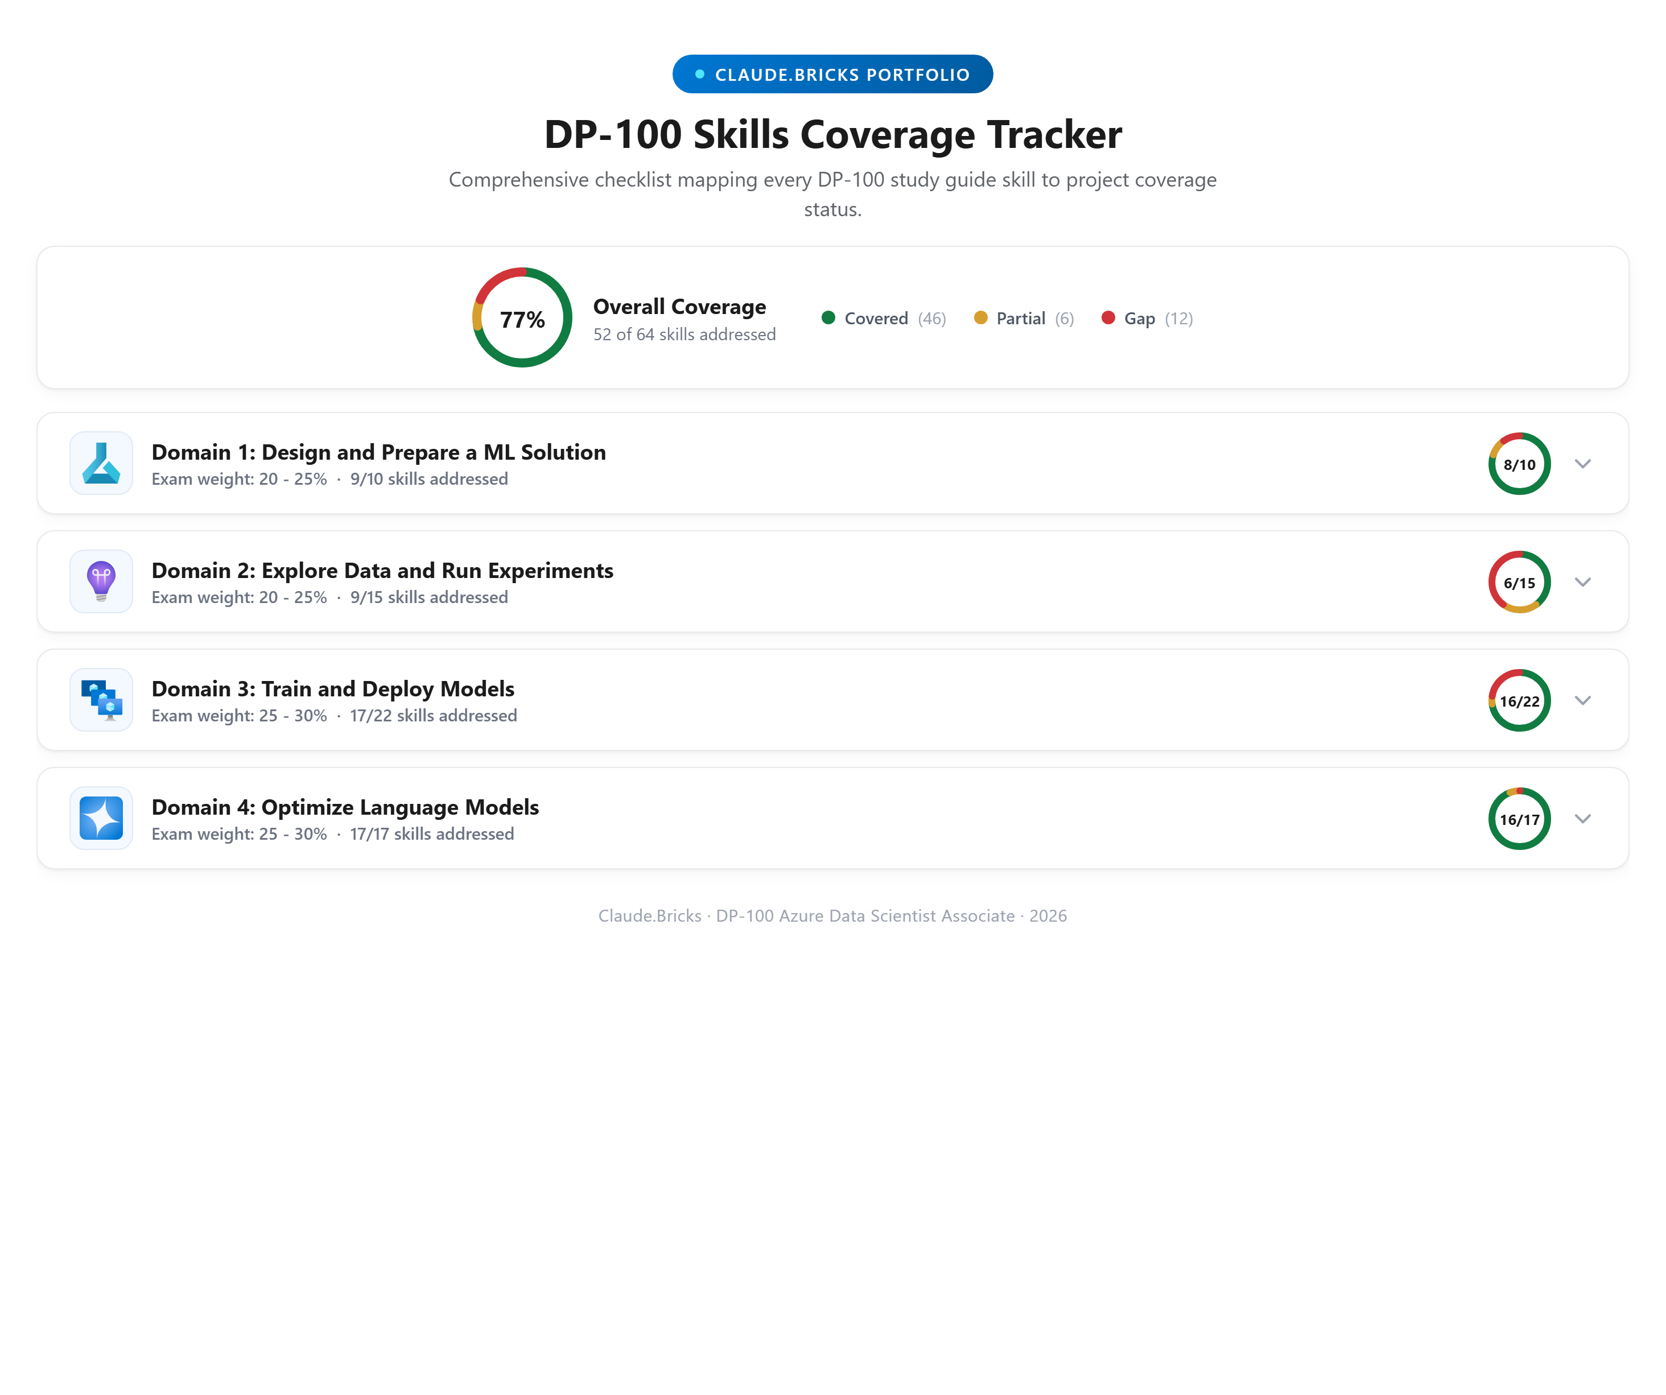
DP-100 Skills Coverage Tracker
Comprehensive checklist mapping every DP-100 study guide skill

