Slide 1
Polaron
2020 04 25

Slide 2
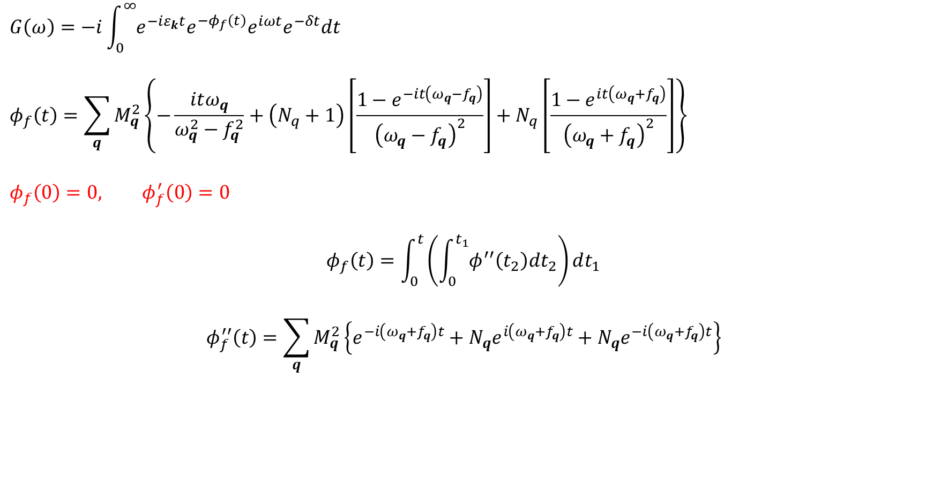
Calculation technic
$$G\left(ω\right)=−i\int_{0}^{∞}{e^{−{iε}_{k}t}e^{−φ_{f}\left(t\right)}e^{iωt}e^{−δt}dt}$$
$$φ_{f}\left(t\right)=\sum_{q}{M_{q}^{2}\left\{−\frac{itω_{q}}{ω_{q}^{2}−f_{q}^{2}}+\left(N_{q}+1\right)\left[\frac{1−e^{−it\left(ω_{q}−f_{q}\right)}}{{\left(ω_{q}−f_{q}\right)}^{2}}\right]+N_{q}\left[\frac{1−e^{it\left(ω_{q}+f_{q}\right)}}{{\left(ω_{q}+f_{q}\right)}^{2}}\right]\right\}}$$
$$φ_{f}\left(0\right)=0, φ_{f}^{′}\left(0\right)=0$$
$$φ_{f}\left(t\right)=\int_{0}^{t}{\left(\int_{0}^{t_{1}}{φ^{′′}\left(t_{2}\right)dt_{2}}\right)dt_{1}}$$
$$φ_{f}^{′′}\left(t\right)=\sum_{q}{M_{q}^{2}\left\{e^{−i\left(ω_{q}+f_{q}\right)t}+N_{q}e^{i\left(ω_{q}+f_{q}\right)t}+N_{q}e^{−i\left(ω_{q}+f_{q}\right)t}\right\}}$$

Slide 3
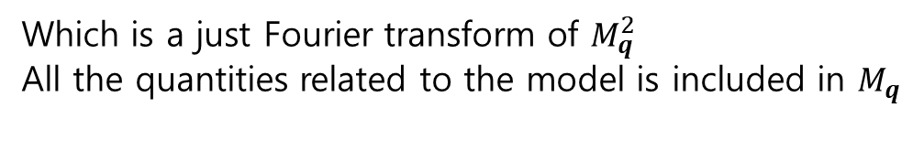
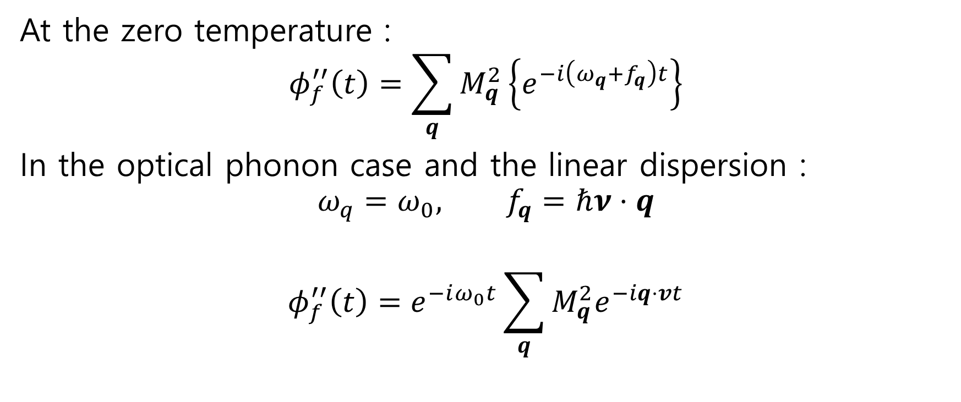
Calculation technic
At the zero temperature :
$$φ_{f}^{′′}\left(t\right)=\sum_{q}{M_{q}^{2}\left\{e^{−i\left(ω_{q}+f_{q}\right)t}\right\}}$$
In the optical phonon case and the linear dispersion :
$$ω_{q}=ω_{0}, f_{q}=ℏν⋅q$$
$$φ_{f}^{′′}\left(t\right)=e^{−iω_{0}t}\sum_{q}{M_{q}^{2}e^{−iq⋅vt}}$$
Which is a just Fourier transform of $M_{q}^{2}$
All the quantities related to the model is included in $M_{q}$

Slide 4
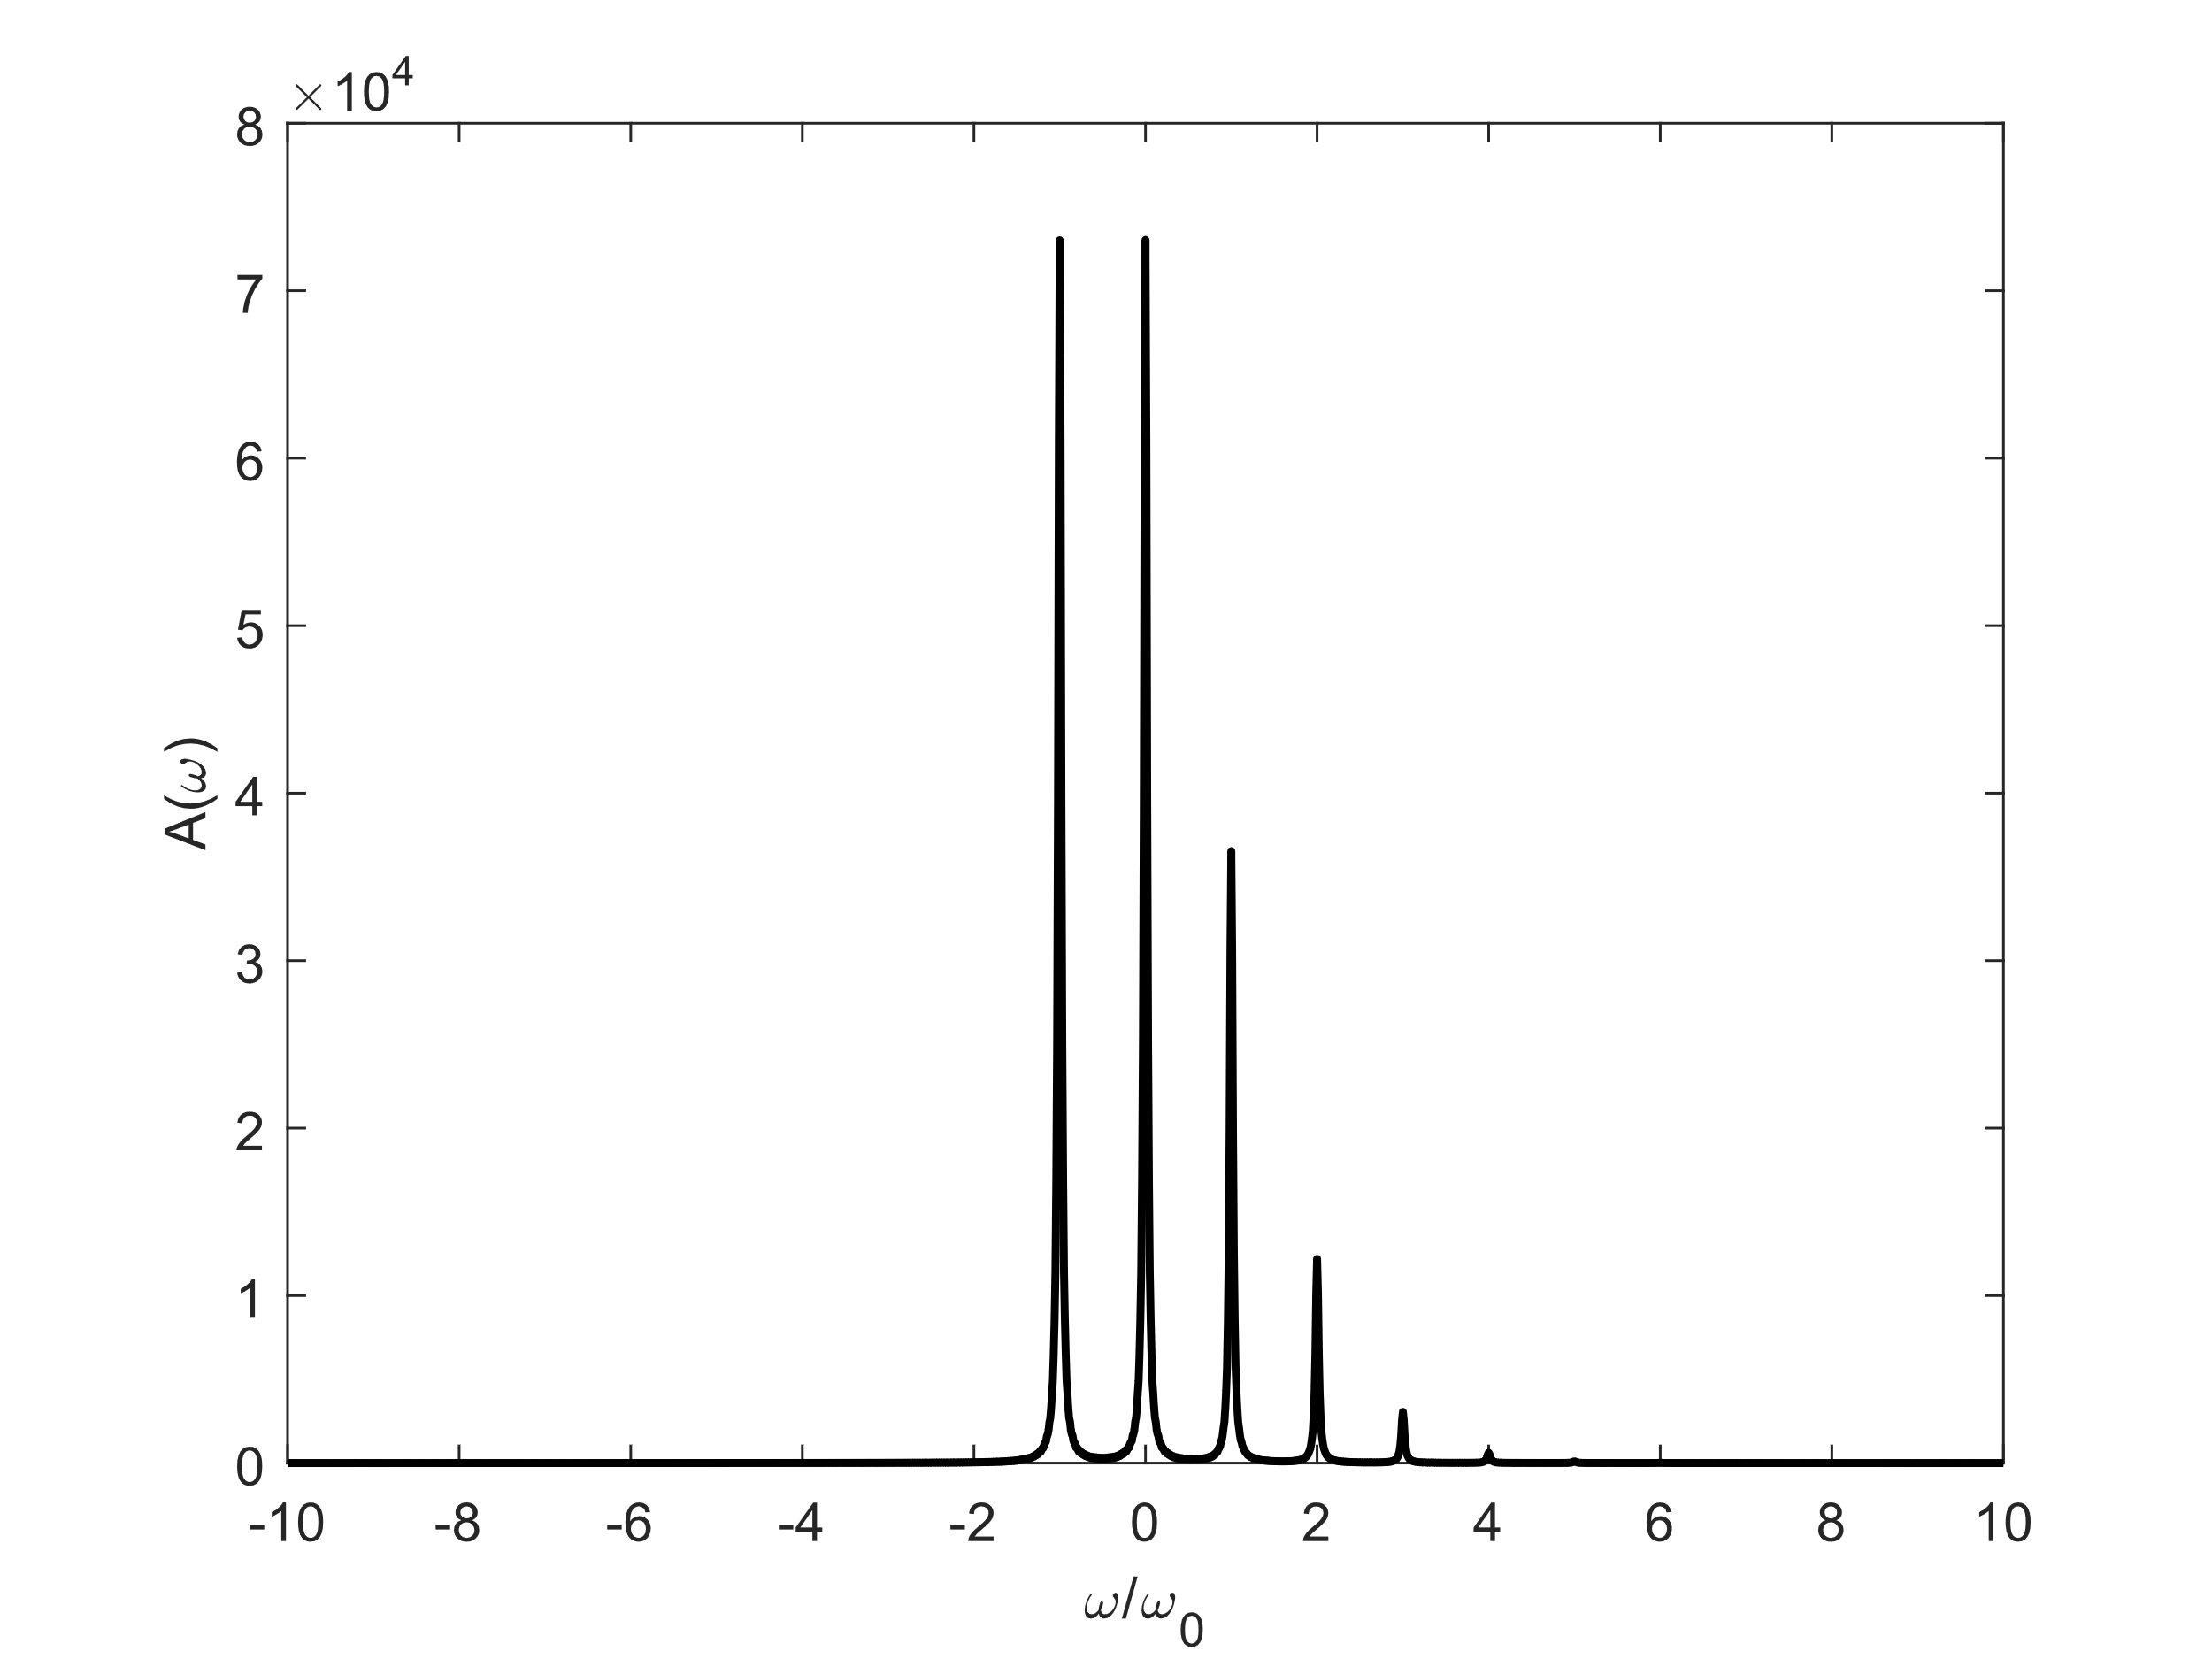

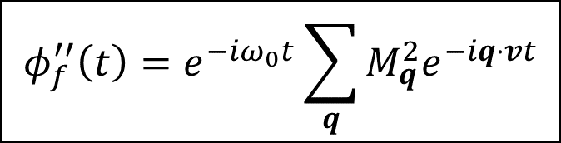
Core state
$$φ_{f}^{′′}\left(t\right)=e^{−iω_{0}t}\sum_{q}{M_{q}^{2}e^{−iq⋅vt}}$$
$$v→0(Core state limit)$$
$$φ_{f}^{′′}\left(t\right)=e^{−iω_{0}t}\sum_{q}{M_{q}^{2}}$$

Slide 5
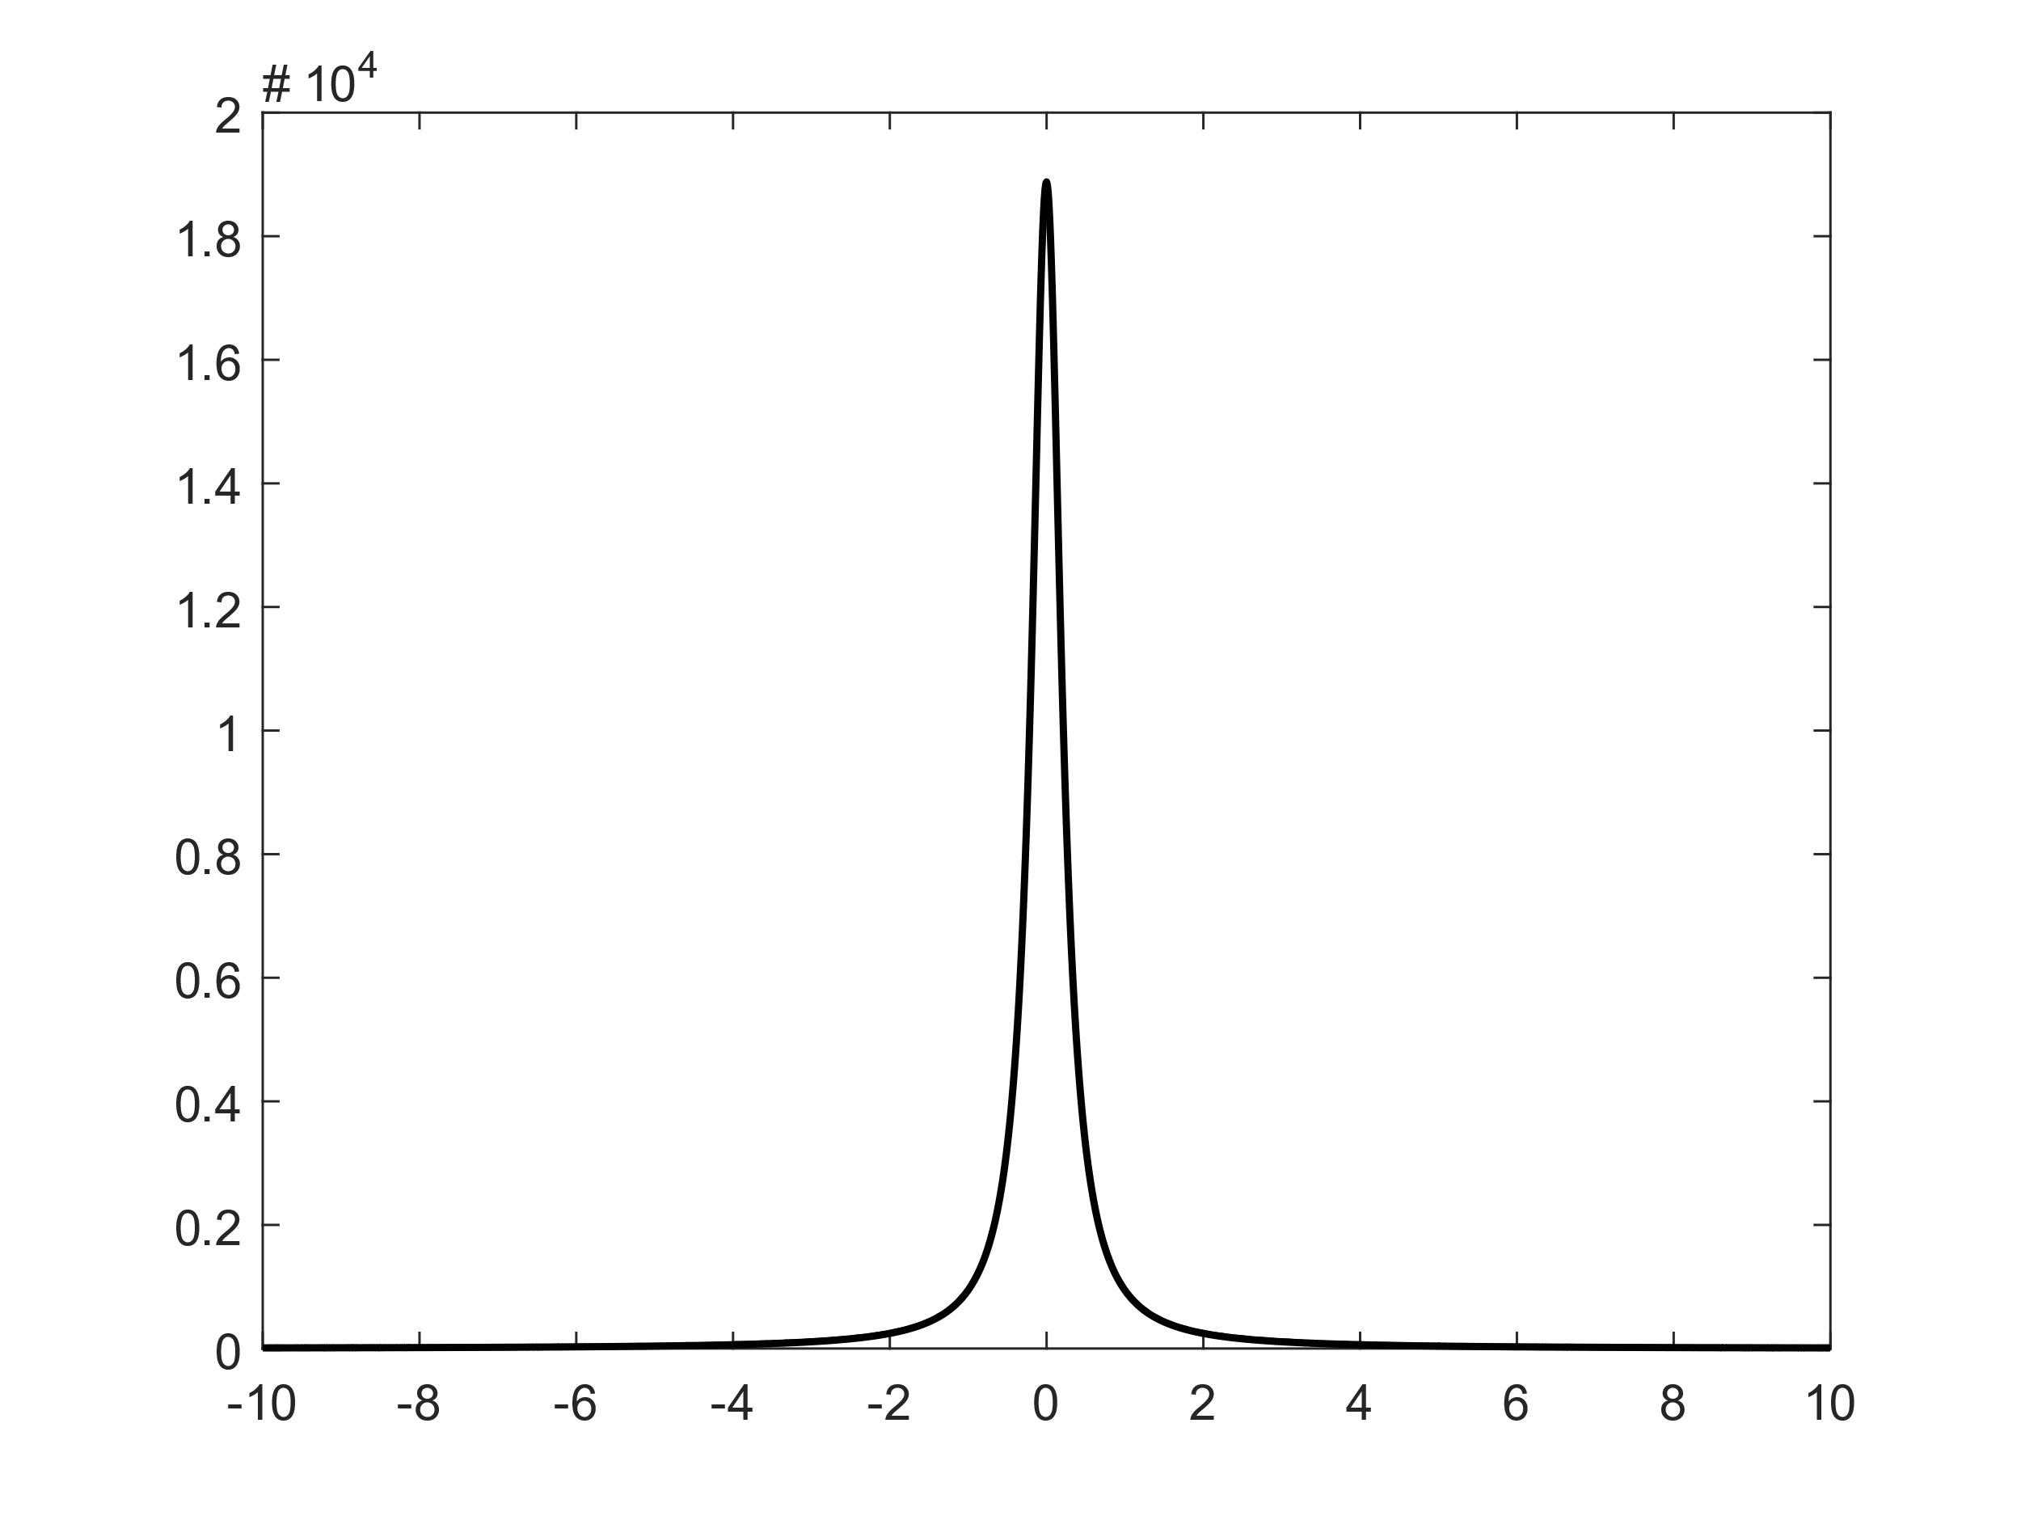

edge state
$$φ_{f}^{′′}\left(t\right)=e^{−iω_{0}t}\sum_{q}{{M_{q}^{2}e}^{−iq⋅vt}}$$

