Slide 1
INDEPENDENT EQUITY RESEARCH
Royal Bank
of Canada
BUSINESS QUALITY / CREDIT RISK / VALUATION
NYSE: RY • FY2025 actuals • FY2026–27 outlook
Aamir Sohaib
Research cut-off: 05 Nov 2026 • Stock reference close: 05 Nov 2026

Slide 2
INDEPENDENT EQUITY RESEARCH / INVESTMENT VIEW
02 / 23
The thesis | quality business, demanding price
Provisional stance: HOLD / WATCHLIST, based on an illustrative scenario model
16.3%
13.5%
C$20.37B
15.7×
FY2025 ROE
Q3 FY2026 CET1
FY2025 NET INCOME
FY2027E P/E*
At 05 Nov close, FX assumption
Why own it
Why be selective
Diversified fee businesses, scale advantages, strong capital and FY2025 ROE support an earnings-quality premium.
Credit stress, a high starting multiple, currency effects and a narrow modeled base-case upside constrain expected returns.
Watch for FY2026 results on 03 Dec 2026; reassess FY2027 EPS, credit costs and entry valuation.
* P/E = US$203.76 / (C$17.91 FY2027 consensus EPS × US$0.723/C$). FX assumption is illustrative.
AAMIR SOHAIB • 05 NOV 2026
Sources: RBC FY2025, Q3 FY2026; Yahoo Finance; model assumptions

Slide 3
INDEPENDENT EQUITY RESEARCH / COMPANY PROFILE
03 / 23
RBC’s business model | diversified sources of revenue
FY2025 reported segment revenue; C$ billions
Wealth Management
22.38B
Personal Banking
19.85B
Capital Markets
14.43B
Commercial Banking
8.56B
Insurance
1.32B
Corporate Support revenue: C$0.064B; five operating segments + Corporate Support reconcile to C$66.605B.
AAMIR SOHAIB • 05 NOV 2026
Source: RBC FY2025 Annual Report, Table 14

Slide 4
INDEPENDENT EQUITY RESEARCH / GEOGRAPHY
04 / 23
Canada anchors the franchise
FY2025 geographic revenue shares; borrower/client footprint differs from office locations
Canada
62.8%
Home-market concentration
United States
25.8%
City National + capital markets
Other international
11.3%
Cross-border and institutional businesses
Interpretation: domestic concentration supports franchise density but increases sensitivity to Canadian credit and rates.
AAMIR SOHAIB • 05 NOV 2026
Source: RBC FY2025 Annual Report, geographic revenue table

Slide 5
INDEPENDENT EQUITY RESEARCH / FINANCIAL SNAPSHOT
05 / 23
FY2025 | profitability plus balance-sheet scale
CAD figures; fiscal year ended 31 October 2025
C$66.61B
C$20.37B
C$2.33T
REVENUE
NET INCOME
ASSETS
C$1.52T
C$14.07
16.3%
DEPOSITS
DILUTED EPS
ROE
Revenue grew 16.1% and reported net income grew 25.4% versus FY2024.
AAMIR SOHAIB • 05 NOV 2026
Source: RBC FY2025 Annual Report

Slide 6
INDEPENDENT EQUITY RESEARCH / HISTORICAL PERFORMANCE
06 / 23
Underlying earnings trajectory | FY2023–FY2025
Reported C$ amounts; FY2023 onward uses IFRS 17 comparable reporting basis
REVENUE · C$B
NET INCOME · C$B
2023
51.46
2023
14.61
2024
57.34
2024
16.24
2025
66.61
2025
20.37
Avoid naïve FY2022 → FY2023 comparisons: the FY2023 insurance accounting basis changed under IFRS 17.
AAMIR SOHAIB • 05 NOV 2026
Source: RBC FY2025 Annual Report, selected annual data

Slide 7
INDEPENDENT EQUITY RESEARCH / EARNINGS DRIVERS
07 / 23
What drove net income higher in FY2025?
A fully reconciled reported earnings bridge, C$ billions
+9.26
-2.34
-1.13
-1.66
20.37
16.24
FY2024 NI
Revenue
Expenses
Credit losses
Taxes
FY2025 NI
C$16.24B + 9.26 revenue – 2.34 operating expense – 1.13 PCL – 1.66 tax = C$20.37B.
AAMIR SOHAIB • 05 NOV 2026
Source: RBC FY2025 Annual Report, Table 16

Slide 8
INDEPENDENT EQUITY RESEARCH / PROFITABILITY
08 / 23
Profitability | stronger operating efficiency
Reported results; adjusted metrics are separately labeled
16.3%
54.9%
C$20.87B
FY2025 ROE
EFFICIENCY RATIO
ADJUSTED NET INCOME
+190 bps vs. 2024
59.7% in 2024
Reported: C$20.37B
Earnings quality
Critical distinction
Profit growth exceeded revenue growth as efficiency improved; provisioning and taxes still absorbed a material part of incremental revenue.
Adjusted earnings exclude specified non-GAAP items. Valuation calculations must consistently distinguish adjusted versus reported EPS.
Bank metrics to emphasize: ROE, efficiency, capital, PCL, impaired loans and forward P/E / P-B.
AAMIR SOHAIB • 05 NOV 2026
Source: RBC FY2025 Annual Report; FY2025 earnings release

Slide 9
INDEPENDENT EQUITY RESEARCH / CREDIT & CAPITAL
09 / 23
Capital protects | credit quality requires monitoring
FY2025 annual credit measures vs FY2024; Q3 FY2026 is a separate reporting period
Gross impaired loan ratio
0.83%
FY24: 0.59%
Worsened by 24 bps YoY
PCL / avg. net loans
0.43%
FY24: 0.35%
Credit costs increased 8 bps YoY
CET1 ratio, Q3 FY2026
13.5%
Latest Q3
Capital remains above requirements
PCL / loans, Q3 FY2026
36 bps
Latest Q3
Annualized quarterly ratio; not FY2025
Rising impaired loans are a key counterweight to RBC’s strong capital and earnings momentum.
AAMIR SOHAIB • 05 NOV 2026
Sources: RBC FY2025 Annual Report, Table 46; Q3 FY2026 results

Slide 10
INDEPENDENT EQUITY RESEARCH / SEGMENT ECONOMICS
10 / 23
Not all revenue converts equally into profit
FY2025 C$ net income by operating segment; reported basis
Personal Banking
7.11B
Capital Markets
5.39B
Wealth Management
4.29B
Commercial Banking
3.02B
Insurance
0.83B
Corporate Support: –C$0.266B. Five segments plus Corporate Support = C$20.369B consolidated.
AAMIR SOHAIB • 05 NOV 2026
Source: RBC FY2025 Annual Report, Table 14

Slide 11
INDEPENDENT EQUITY RESEARCH / CAPITAL RETURN
11 / 23
Capital return | dividend plus buybacks
FY2025 payouts; dividends reported in C$, not USD
C$6.04
43%
15.24M
DIVIDEND / SHARE
DIVIDEND PAYOUT
SHARES REPURCHASED
Capital return is supported by profitability, but must remain sensitive to credit costs and capital rules.
FY2025 reported combined common dividends and repurchases: C$11.3B; total payout ratio 57%.
AAMIR SOHAIB • 05 NOV 2026
Source: RBC FY2025 Annual Report

Slide 12
INDEPENDENT EQUITY RESEARCH / RELATIVE ANALYSIS
12 / 23
Peer lens | use comparisons carefully
Two Canadian peers and four international banks; stock performance uses NYSE USD listings
CANADA
CANADA
GLOBAL
BMO
Bank of Montreal
BNS
Scotiabank
BCS
Barclays
GLOBAL
GLOBAL
GLOBAL
UBS
UBS Group
HSBC
HSBC Holdings
SAN
Banco Santander
Warning: fiscal calendars, bank structures, revenue recognition and adjusted-vs-reported EPS can differ.
AAMIR SOHAIB • 05 NOV 2026
Sources: original slide deck, RBC + peer FY2025 filings

Slide 13
INDEPENDENT EQUITY RESEARCH / MARKET VALUATION
13 / 23
Relative valuation | RY commands a premium
Approximate public forward P/E figures (NYSE, 05 Nov 2026)
RY
16.36×
BMO
15.02×
BNS
13.83×
UBS
11.67×
HSBC
9.77×
SAN
9.05×
BCS
7.54×
Premium is not automatically mispricing: relate multiple to ROE, stability, growth and credit risk.
AAMIR SOHAIB • 05 NOV 2026
Source: StockAnalysis ticker valuation pages; values can change intraday

Slide 14
INDEPENDENT EQUITY RESEARCH / VALUATION FRAMEWORK
14 / 23
Is the valuation premium justified?
Evidence supporting premium pricing, and the variables that could undermine it
Support for a premium
Reasons to apply a discount
16.3% FY2025 ROE, 13.5% latest CET1, scale advantages, recurring wealth fees and earnings diversification.
FY2025 impaired loan ratio increased to 0.83%; Canadian geographic concentration and higher interest rates create sensitivity.
A multiple deserves support only if excess profitability survives the credit cycle.
AAMIR SOHAIB • 05 NOV 2026
Analytical interpretation of RBC financial disclosures

Slide 15
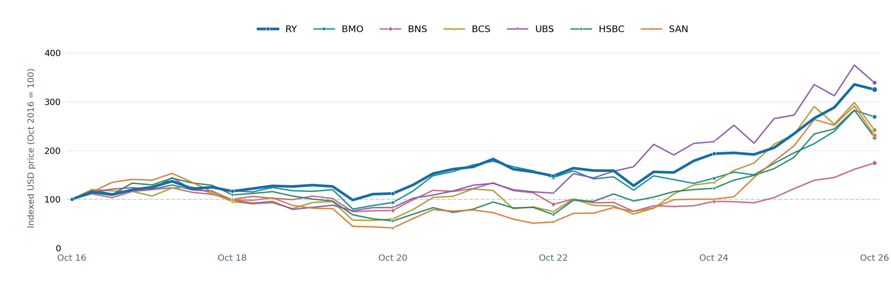
INDEPENDENT EQUITY RESEARCH / PRICE HISTORY
15 / 23
10-year stock-price performance
NYSE USD prices; split-adjusted; dividends excluded; 31 Oct 2016–30 Oct 2026
RY
+224.9%
UBS
+238.9%
BMO
+169.1%
BNS
+74.4%
BCS
+141.9%
HSBC
+127.0%
SAN
+131.2%
AAMIR SOHAIB • 05 NOV 2026
Source: Alpaca SIP stock bars, supplied source chart

Slide 16
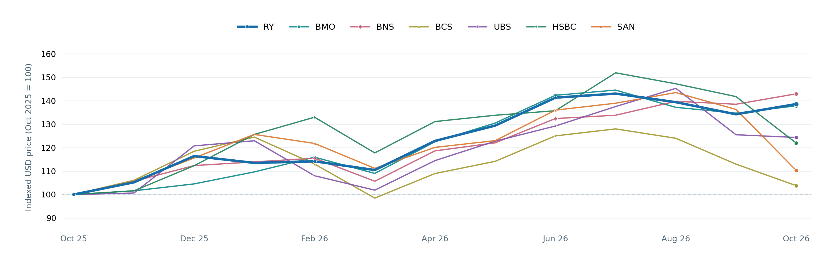
INDEPENDENT EQUITY RESEARCH / PRICE HISTORY
16 / 23
1-year stock-price performance
NYSE USD prices; split-adjusted; dividends excluded; 31 Oct 2025–30 Oct 2026
RY
+38.6%
BNS
+42.9%
BMO
+37.8%
UBS
+24.3%
HSBC
+21.9%
SAN
+10.2%
BCS
+3.8%
AAMIR SOHAIB • 05 NOV 2026
Source: Alpaca SIP stock bars, supplied source chart

Slide 17
INDEPENDENT EQUITY RESEARCH / PORTFOLIO RISK
17 / 23
Diversification | bank shares remain positively correlated
Pearson correlation of 260 weekly split-adjusted USD log returns, Nov 2021–Oct 2026
RY
BMO
BNS
BCS
UBS
HSBC
SAN
RY
1.00
0.77
0.76
0.60
0.57
0.45
0.48
Portfolio implication
BMO
0.77
1.00
0.73
0.58
0.58
0.45
0.48
RY–BMO correlation is about 0.77. Pairing Canadian banks does not eliminate shared macroeconomic and credit exposure.
BNS
0.76
0.73
1.00
0.53
0.50
0.41
0.41
BCS
0.60
0.58
0.53
1.00
0.70
0.67
0.69
UBS
0.57
0.58
0.50
0.70
1.00
0.57
0.65
Relatively lower pair
HSBC
0.45
0.45
0.41
0.67
0.57
1.00
0.67
RY–HSBC correlation is about 0.45 in this sample, but correlations change and cannot guarantee a hedge.
SAN
0.48
0.48
0.41
0.69
0.65
0.67
1.00
AAMIR SOHAIB • 05 NOV 2026
Source: Alpaca SIP; reproduced against source deck

Slide 18
INDEPENDENT EQUITY RESEARCH / EARNINGS TRACK RECORD
18 / 23
Quarterly EPS | four consecutive beats
RY adjusted diluted EPS, C$; one consistent consensus data source
Q4 FY25
Q1 FY26
Q2 FY26
Q3 FY26
C$3.85
C$4.08
C$3.90
C$4.28
Actual adjusted EPS
Actual adjusted EPS
Actual adjusted EPS
Actual adjusted EPS
C$3.55 consensus
C$3.84 consensus
C$3.79 consensus
C$4.07 consensus
+8.5% beat
+6.2% beat
+2.9% beat
+5.2% beat
Surprise percentages are recalculated from rounded displayed actual/estimate amounts; vendor surprises may differ slightly.
AAMIR SOHAIB • 05 NOV 2026
Source: Yahoo Finance RY earnings-history table, accessed 05 Nov 2026

Slide 19
INDEPENDENT EQUITY RESEARCH / EARNINGS OUTLOOK
19 / 23
Consensus outlook | FY2026 and FY2027
C$ estimates, not yet reported results; as displayed 05 Nov 2026
REVENUE
66.61B
72.42B
76.44B
FY2025 actual
FY2026E
FY2027E
FY26E growth: +8.7% FY27E growth: +5.6%
ADJUSTED EPS
14.43
16.42
17.91
FY2025 actual
FY2026E
FY2027E
FY26E growth: +13.8% FY27E growth: +9.1%
AAMIR SOHAIB • 05 NOV 2026
Sources: Yahoo Finance RY analysis; RBC FY2025 Annual Report

Slide 20
INDEPENDENT EQUITY RESEARCH / LEADERSHIP
20 / 23
Governance and management | continuity matters
Biographies as of Nov 2026; no third-party executive portraits reused
Jacynthe Côté
David McKay
Katherine Gibson
Independent Board Chair
President & Chief Executive Officer
Chief Financial Officer
Director since 2014; chair since Apr 2023
CEO since Aug 2014
CFO since Sep 2024
What to monitor: succession planning, capital allocation discipline, credit controls and execution on the HSBC Canada integration.
AAMIR SOHAIB • 05 NOV 2026
Sources: RBC leadership page; RBC 2026 Proxy Circular

Slide 21
INDEPENDENT EQUITY RESEARCH / DRIVERS & RISKS
21 / 23
Catalysts and risks | a balanced forward view
Management disclosures through Q3 FY2026 and Bank of Canada decision of 28 Oct 2026
Tailwinds
Headwinds
Wealth-management fees and capital-markets activity; Personal and Commercial Banking balance growth; HSBC Canada cross-sell; CET1 at 13.5%.
FY2025 impaired loans rose; Q3 FY2026 PCL was ~C$1.0B; a 2.50% policy rate can constrain borrower demand and credit performance.
Key asymmetry: stable credit costs support premium valuation; credit deterioration can compress both earnings and the P/E multiple.
AAMIR SOHAIB • 05 NOV 2026
Sources: RBC Q3 FY2026; Bank of Canada 28 Oct 2026

Slide 22
INDEPENDENT EQUITY RESEARCH / SCENARIO VALUATION
22 / 23
Illustrative 12-month valuation | scenario not a price target
FY2027 EPS assumptions × terminal P/E × illustrative USD/CAD factor
BEAR
BASE
BULL
US$172
US$214
US$261
-15.6% price return
+4.9% price return
+28.1% price return
C$17.00 EPS × 14.0× P/E
C$17.91 EPS × 16.5× P/E
C$19.00 EPS × 19.0× P/E
FX: US$0.723/C$
FX: US$0.723/C$
FX: US$0.723/C$
FY2027 consensus EPS is ~C$17.91; bear/bull EPS and all terminal multiples are author assumptions. No dividend, fees or FX changes in price return.
AAMIR SOHAIB • 05 NOV 2026
Stock benchmark US$203.76 (05 Nov close); USD/CAD conversion 0.723

Slide 23
INDEPENDENT EQUITY RESEARCH / INVESTMENT DECISION
23 / 23
Investment conclusion | HOLD / WATCHLIST
An independent analytical judgment, not personalized investment advice
High-quality bank ≠ attractive entry at every price
What I like
Durable franchise, diversified earnings, strong capital and improving FY2025 efficiency.
Why I would wait
The model’s base case has limited price upside while credit and multiple risks remain meaningful.
What changes my mind
A lower entry multiple, upside to FY2027 EPS, or evidence of stabilizing impaired loans and PCL.
Next catalyst: fiscal FY2026 results — 03 Dec 2026.
AAMIR SOHAIB • 05 NOV 2026
For educational research; assumptions and sources in repository

