Slide 1
Graian Capital Management SA
Data Operations
Business Case
Python Pipeline · HTML Report · PDF Report · Power BI Dashboard
Schema-Agnostic · Drift Detection · Per-Page PDFs · 20 Quality Checks
Adriele Rocha Weisz
Data Operations Engineer / Analyst
April 2026
Graian Capital Management SA · Data Operations Business Case · v6.0 · Confidential

Slide 2
What Was Delivered
Loan Exposure & LTV
In % · all four views ·
Loan Exposure & LTV · by portfolio and by issuer · at any date via slicer · P2 and P3
Loan Exposure % and Avg LTV % · by portfolio and by issuer · P4
Over time · dynamic window
Data quality · flagged and handled
Loan Exposure by month · zoom slider + date slicer · P5
Python pipeline finds issues before Power BI loads · 4 outliers flagged · excluded from averages
Graian Capital Management SA · Data Operations Business Case · v6.0 · Confidential

Slide 3
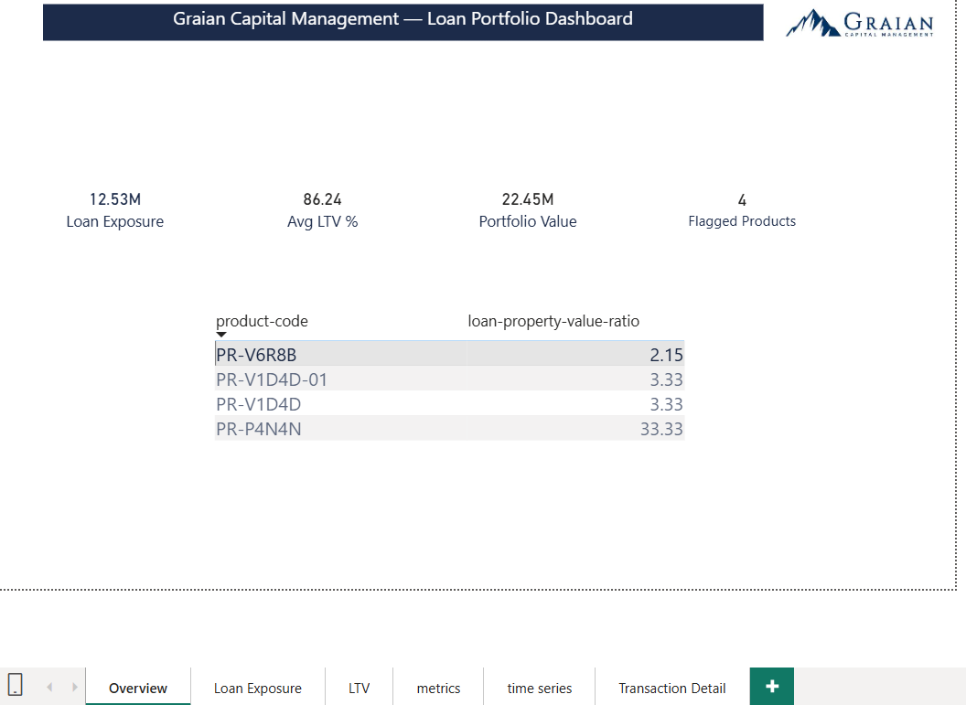
Power BI Dashboard — 6 Pages
P1 Overview
P2 Loan Exposure
P3 LTV
P4 Metrics
P5 Time Series
P6 Transaction Detail
Why I created the Overview page:
When opening any financial report, the first question is always "is everything okay?" before any detail. I designed as a true summary
Why these 4 KPIs:
Loan Exposure : the primary deliverable of the brief
Avg LTV % : the risk metric, with outliers excluded so the number is honest
Portfolio Value : needed as context for the % calculation
Flagged Products: because the brief explicitly warned about data quality. Surfacing it on the first screen means it cannot be missed or ignored
P2 Loan Exposure
P3 LTV (decimal)
P5 Time Series
P6 Drillthrough
Why the flagged products table here: A KPI count of "4" alone is not enough. The analyst needs to see which products immediately, without navigating away. So the table sits directly below the KPIs.
Graian Capital Management SA · Data Operations Business Case · v6.0 · Confidential

Slide 4
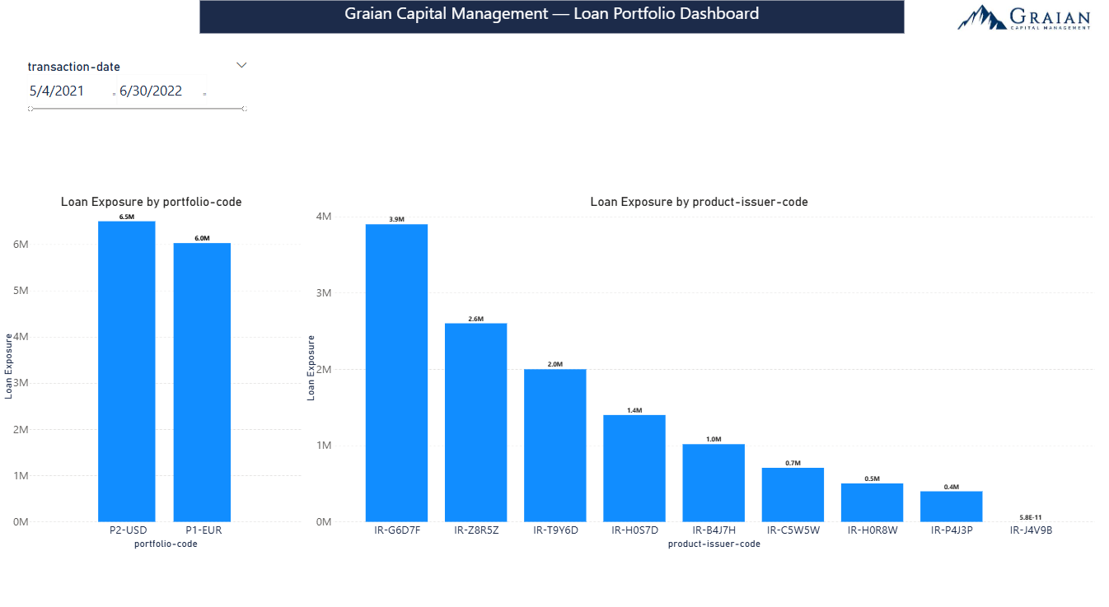
Power BI Dashboard — 6 Pages
P1 Overview
P2 Loan Exposure
P3 LTV
P4 Metrics
P5 Time Series
P6 Transaction Detail
P2 Loan Exposure
P3 LTV (decimal)
Loan Exposure by Portfolio and by Issuer Requirements 1 and 2 answered in a single view, side by side.
Design Decisions LN filter applied in DAX, so it holds regardless of what new product types appear in future datasets. FX conversion via LASTNONBLANK ensures the EUR portfolio is always comparable to USD. Both charts share one date slicer for slection of given date.
P5 Time Series
P6 Drillthrough
What to Watch Concentration in a single issuer is a risk signal — the bar chart makes it visible immediately. A position dropping to zero means the loan was fully repaid in the selected period. Drag the date slicer back to see it when it was active. Right-click any bar to drill into individual transactions.
Graian Capital Management SA · Data Operations Business Case · v6.0 · Confidential

Slide 5
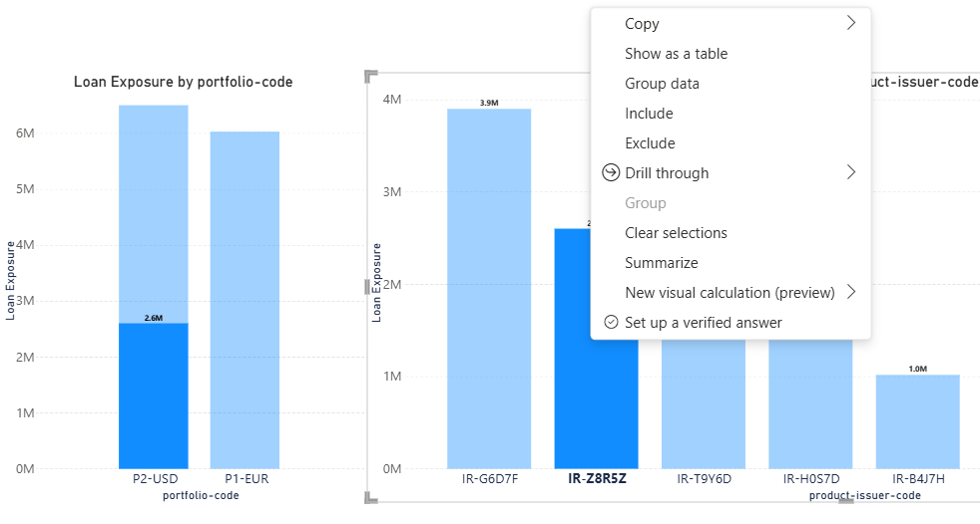
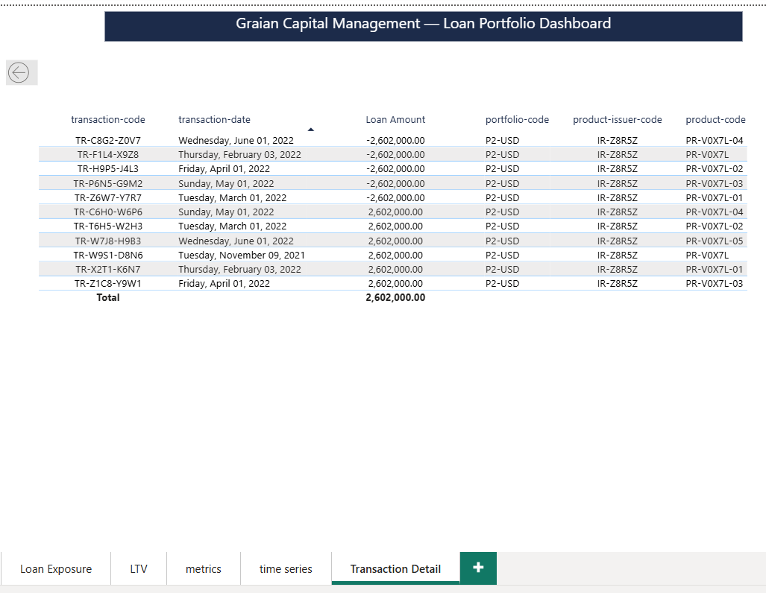
Power BI Dashboard — 6 Pages
P1 Overview
P2 Loan Exposure
P3 LTV
P4 Metrics
P5 Time Series
P6 Transaction Detail
P2 Loan Exposure
P3 LTV (decimal)
P5 Time Series
Drill Through tool: A bar chart shows the total. But when a number looks unexpected the portfolio manager needs to see the individual transactions behind it, without leaving the page or building a new report.
Usage: Right-click any bar → Drill through → Transaction Detail. Every transaction for that issuer or portfolio is there filterable, auditable.
Why these fields where chosen is explain in the P6 Transaction Detail of this presentation
Graian Capital Management SA · Data Operations Business Case · v6.0 · Confidential

Slide 6
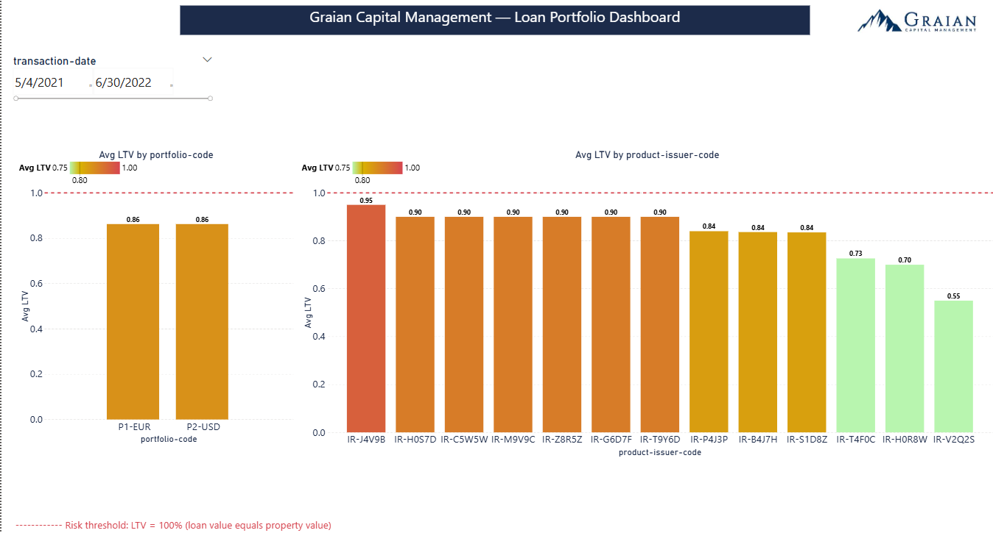
Power BI Dashboard — 6 Pages
P1 Overview
P2 Loan Exposure
P3 LTV
P4 Metrics
P5 Time Series
P6 Transaction Detail
Loan-to-Value by Portfolio and by Issuer Requirements 3 and 4 LTV measures how well each loan is collateralised against the underlying property. The brief defines it as: value of loan divided by value of property.
How Risk is Shown Fixed colour gradient grounded in Swiss regulation:
Green below 0.75: within FINMA's maximum LTV for investment properties.
Amber 0.75 to 1.0: above the regulatory threshold, monitor closely.
Red at 1.0: loan equals property value, collateral no longer covers the risk.
P2 Loan Exposure
0.75
0.8
1
P5 Time Series
What can be seen: Both portfolios sit in the amber zone at ~0.86. IR-J4V9B is the highest-risk issuer at 0.95 approaching the collateral threshold. Three issuers fall below 0.75, within the FINMA safe zone..
¹ Strike Advisory — Loan-to-value (LTV) and mortgages in Switzerland — strike-advisory.ch "Most mortgage institutions do not grant mortgages if the loan-to-value ratio is over 80%"
² FINMA / Mondaq — Swiss Regulator Further Restricts Mortgage Loan Requirements — mondaq.com, December 2019 "The maximum loan-to-value ratio is set at 75% for investment properties"
³ Brief definition — business case.xlsx, Requirements sheet "loan-to-value = value of loan divided by value of property" — LTV = 1.0 means loan equals property value
Graian Capital Management SA · Data Operations Business Case · v6.0 · Confidential

Slide 7
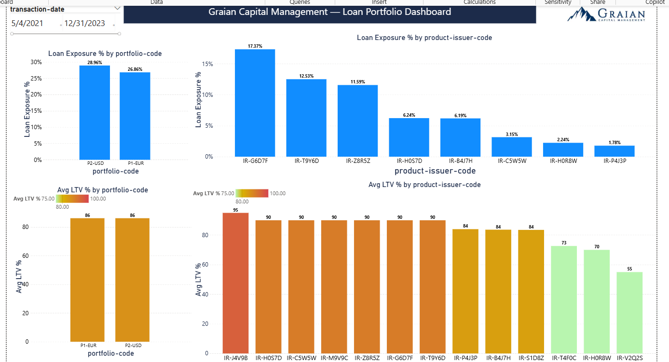
Power BI Dashboard — 6 Pages
P1 Overview
P2 Loan Exposure
P3 LTV
P4 Metrics
P5 Time Series
P6 Transaction Detail
P2 Loan Exposure
P3 LTV (decimal)
P6 Drillthrough
Requirement 5: Cases 1 to 4 in % All four metrics from requirements 1 to 4 expressed as percentages in a single view. Loan Exposure % and LTV % side by side — two questions answered simultaneously: how big is the position and how risky is it?
Design Decisions Loan Exposure % uses DIVIDE([Loan Exposure], [Portfolio Value]): zero-safe, returns BLANK for closed positions automatically. LTV % is [Avg LTV] × 100 , same calculation as P3, same fixed gradient, scaled to percentage. Thresholds remain 75% and 100% grounded in the same FINMA regulation as P3.
Graian Capital Management SA · Data Operations Business Case · v6.0 · Confidential

Slide 8
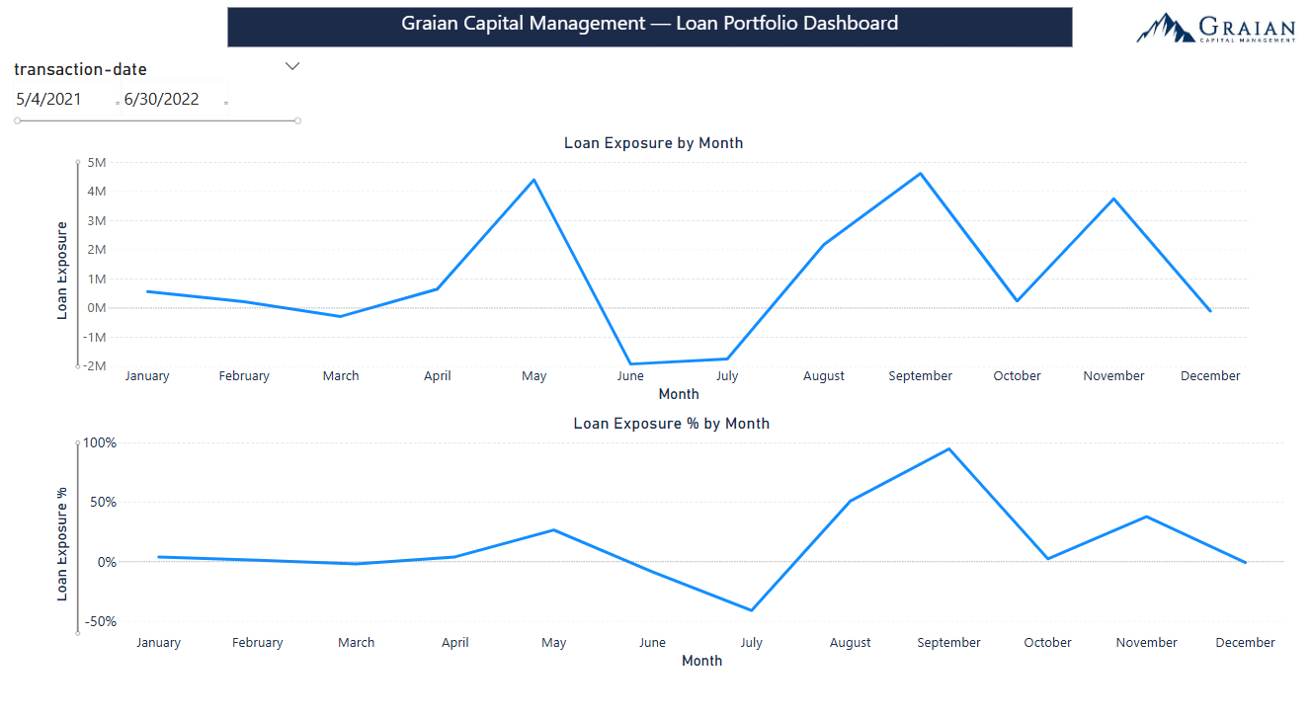
Power BI Dashboard — 6 Pages
P1 Overview
P2 Loan Exposure
P3 LTV
P4 Metrics
P5 Time Series
P6 Transaction Detail
P2 Loan Exposure
P3 LTV (decimal)
Loan Exposure Over Time Requirement 6: cases 1 to 4 over time with a dynamic slicing window. Two line charts show monthly loan exposure in absolute value and as a percentage of portfolio value simultaneously.
Design Decisions The date slicer controls the window. The zero reference line from the Analytics pane makes months where sells exceed buys immediately visible without needing to read the axis carefully.
P6 Drillthrough
Negative Months : June and July show negative exposure. This means sells exceeded buys in those months — loans were being repaid faster than new ones were issued. This is not a data error. It is the loan book contracting. The tool reports what happened accurately.
Graian Capital Management SA · Data Operations Business Case · v6.0 · Confidential

Slide 9
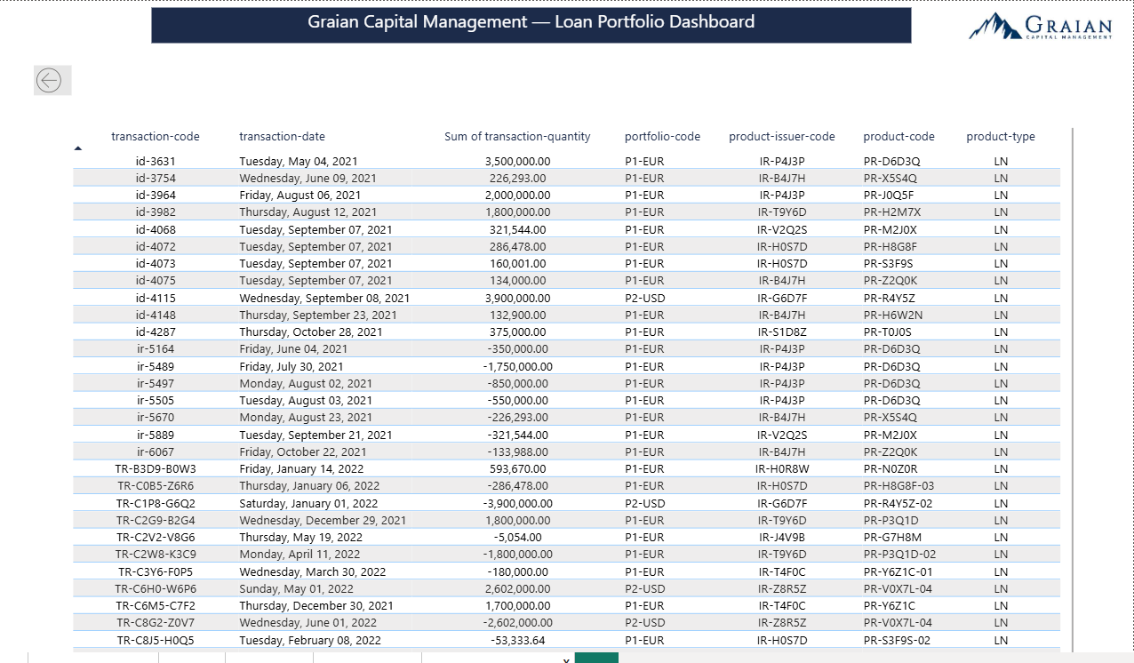
Power BI Dashboard — 6 Pages
P1 Overview
P2 Loan Exposure
P3 LTV
P4 Metrics
P5 Time Series
P6 Transaction Detail
P2 Loan Exposure
Why these fields:
transaction-code: unique identifier, so the auditor or manager can trace any row back to the source system.
transaction-date: when did this happen? Essential for understanding if a position is recent or historical.
Loan Amount: the actual value of the transaction. This is what the bar chart summarised
portfolio-code: which portfolio does this belong to. Especially relevant when drilling from the issuer chart where both portfolios may appear.
P6 Drillthrough
product-issuer-code: confirms which issuer you drilled into. Useful when multiple products belong to the same issuer.
product-code: the specific loan product. Allows the manager to identify which exact instrument is driving the exposure.
Graian Capital Management SA · Data Operations Business Case · v6.0 · Confidential

Slide 10
Power BI Dashboard — 6 Pages
P1 Overview
P2 Loan Exposure
P3 LTV
P4 Metrics
P5 Time Series
P6 Transaction Detail
P2 Loan Exposure
P3 LTV (decimal)
Why these fields:
transaction-code — unique identifier, so the auditor or manager can trace any row back to the source system. Traceability is non-negotiable in a regulated environment.
transaction-date — when did this happen? Essential for understanding if a position is recent or historical.
Loan Amount — the actual value of the transaction. This is what the bar chart summarised — here you see each individual component.
portfolio-code — which portfolio does this belong to. Especially relevant when drilling from the issuer chart where both portfolios may appear.
product-issuer-code — confirms which issuer you drilled into. Useful when multiple products belong to the same issuer.
product-code — the specific loan product. Allows the manager to identify which exact instrument is driving the exposure.
P5 Time Series
Graian Capital Management SA · Data Operations Business Case · v6.0 · Confidential

Slide 11
DAX Measures — 5 Measures, 3 Design Principles
Loan Exposure
VAR Result = ROUND(CALCULATE(SUMX(...), product-type="LN"), 2)
RETURN IF(Result = 0, BLANK(), Result)
WHY: VAR + BLANK() eliminates floating point artifacts from cancelled positions — no filters needed anywhere.
Portfolio Value
CALCULATE(LASTNONBLANK(prices[price-date],1), prices[price-date] <= MAX(transactions[transaction-date]))
WHY: No hard date join. Adapts dynamically to any date range in the current dataset.
Avg LTV
AVERAGEX(FILTER(products, product-type="LN"), DIVIDE(1, loan-property-value-ratio))
WHY: Inverts the stored ratio inside DAX. Raw data untouched — every calculation is auditable.
Loan Exposure %
DIVIDE([Loan Exposure], [Portfolio Value])
WHY: DIVIDE() returns BLANK when denominator is zero — never an error. Using / would break charts.
Avg LTV %
Same formula as Avg LTV — formatted as % in the visual (not ×100 in code)
WHY: Formatting is a visual property. No logic duplication. Toggling format doesn't change the measure.
Graian Capital Management SA · Data Operations Business Case · v6.0 · Confidential

Slide 12

DAX variables— Architecture
For the detailed DAX documentation:
Scan the QR Code or CLIQUE HERE
Graian Capital Management SA · Data Operations Business Case · v6.0 · Confidential

Slide 13
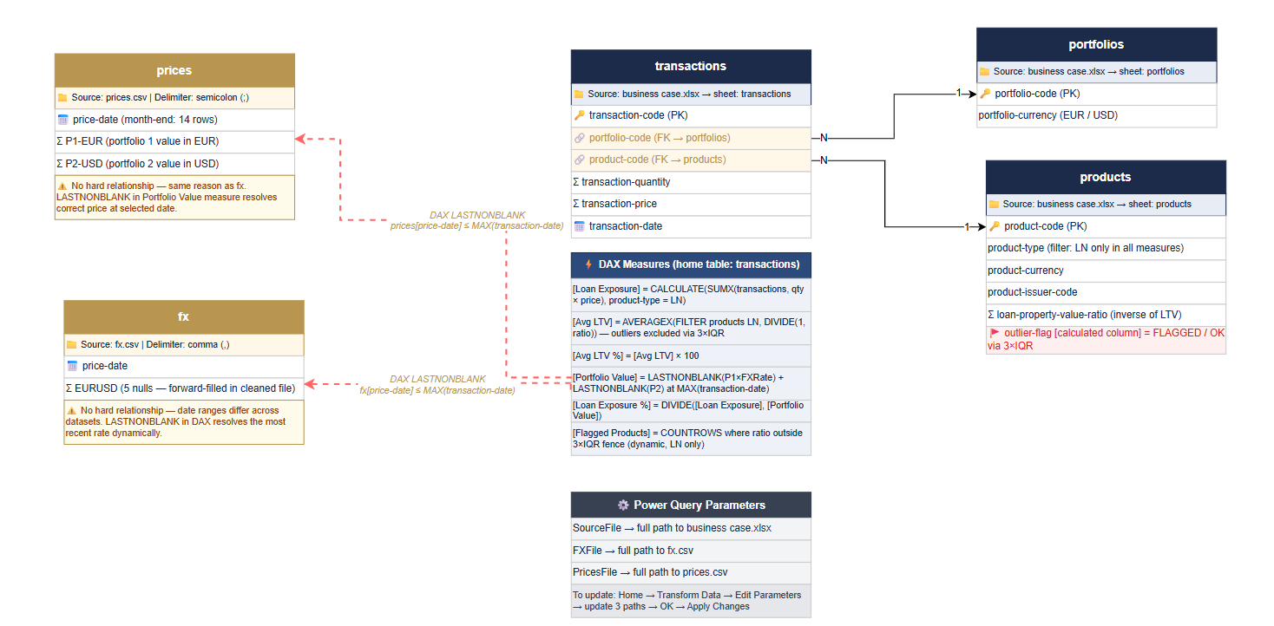
Data Model — 5 Tables, 2 Relationships + DAX Date Logic
Only the source file paths need updating
Graian Capital Management SA · Data Operations Business Case · v6.0 · Confidential

Slide 14
Python Pipeline — What It Found
0
0
4
6
High Severity
Breaks calculations
Medium Severity
Distorts metrics
Low Severity
Investigate & flag
Observations
Expected behaviour
The tool runs 20 checks that are deterministic, so no LLM is used and is versionized
Outputs generated automatically:
8-page HTML report
Section PDFs (per severity)
Excel checklist (to do list)
Graian Capital Management SA · Data Operations Business Case · v6.0 · Confidential

Slide 15
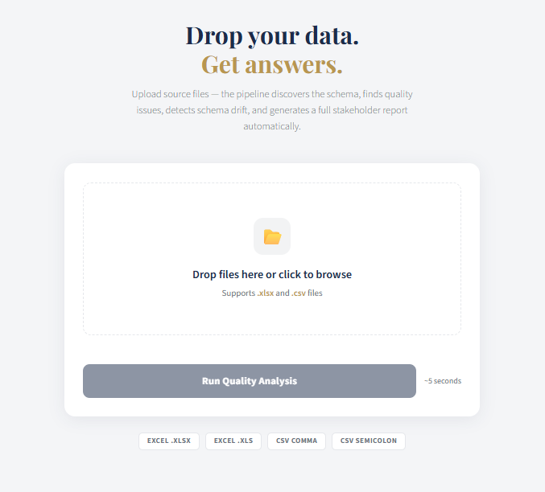
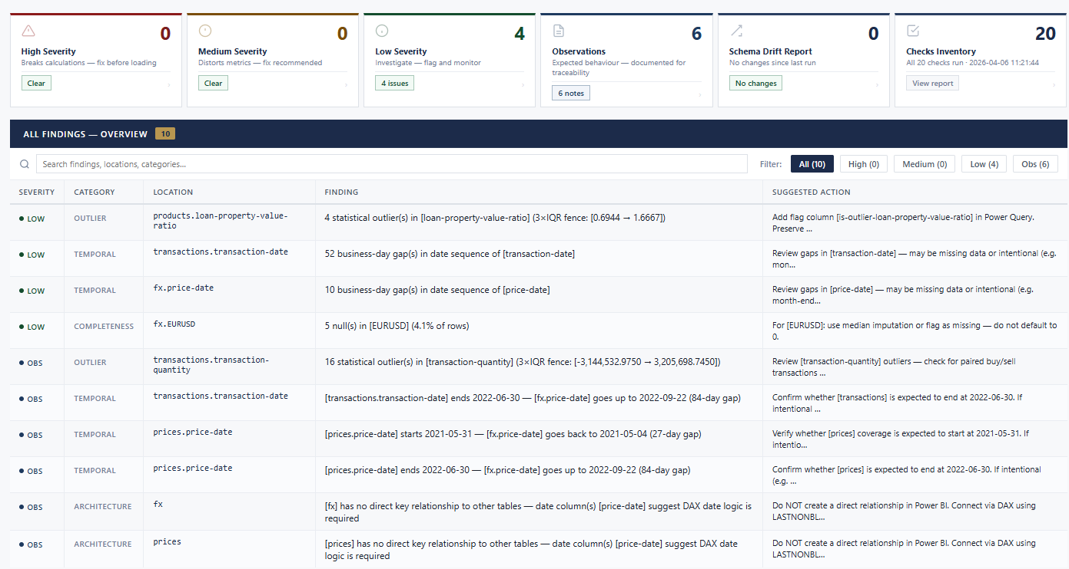
Tool Overview
Navigate to the triggers to see detailed findings
Drift is based on this business case files
Graian Capital Management SA · Data Operations Business Case · v6.0 · Confidential

Slide 16

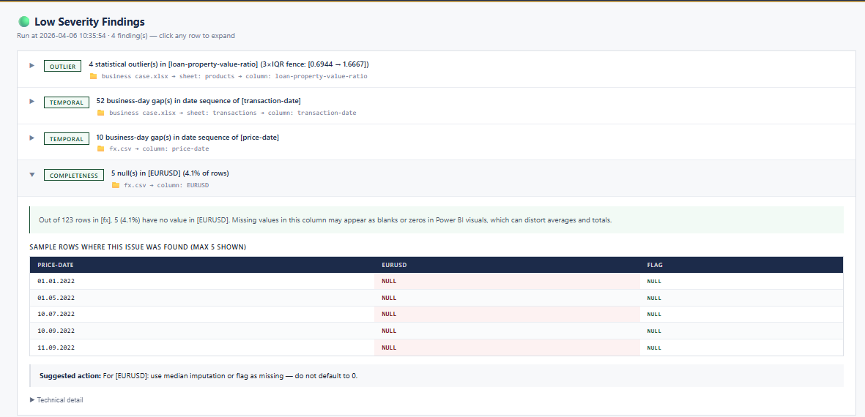

Tool Overview
CLICK HERE for Full PDF report sample
A summary list of the finding is presented; you can explode them to detailed analyses of what it found. The user can download the PDF of each page
Graian Capital Management SA · Data Operations Business Case · v6.0 · Confidential

Slide 17
How to Run the Pipeline
Option A — Non-technical (bat file)
Option B — Technical (terminal)
1
Download the project folder
Unzip to any folder on your computer
1
$ pip install -r requirements.txt
Once only — all pure Python, no Docker
2
Double-click: launch_pipeline.bat
2
$ python app.py
Installs dependencies + starts server automatically
Server starts at localhost:5000 — keep terminal open
3
Browser opens automatically
localhost:5000 — Chrome, Edge, Safari, Firefox
3
Open browser
Navigate to http://localhost:5000
4
Drag & drop your files
business_case.xlsx + fx.csv + prices.csv
4
Drag & drop your files
business_case.xlsx + fx.csv + prices.csv
Both paths produce the same result: 8-page HTML report
Graian Capital Management SA · Data Operations Business Case · v6.0 · Confidential

Slide 18
April 13th — Demo Workflow
Eric confirmed by email (1 Apr 2026): "Same data structure. Only data may change. The idea is to ensure the tool embeds a proper and safe update process."
1 Before the meeting
2 Live demo — Python pipeline
· Run: python app.py → open localhost:5000
· Drag and drop the v2 files into the web interface
· Upload ORIGINAL files once to set the drift baseline
· Pipeline runs in ~5 seconds — show the drift report first
· Have business_case_v2.xlsx · fx_v2.csv · prices_v2.csv ready
· Point out: tool caught that row counts and LTV max changed before Power BI touched anything
· Open Power BI Desktop with the .pbix file loaded
· Show accordion UI: click to expand any finding
3 Live demo — Power BI
4 Key points to make
· Home → Transform Data → Data Source Settings → Change Source
· Non-technical users can run this without touching a terminal
· Point to new files → Close & Apply → Refresh
· Every DAX measure explicitly filters product-type = LN — future-proofed
· Dashboard updates automatically with new data
· Fixed LTV gradient thresholds — risk story is always honest, not relative
· Drillthrough demo: right-click bar on P2 → Drill through → Transaction Detail
· FINMA context: every finding traced to a specific deterministic calculation
Graian Capital Management SA · Data Operations Business Case · v6.0 · Confidential

Slide 19
Confirmed by the Evaluator
📧 Re: Business Case — Dataset Question · 1 April 2026 14:07 · From: eric.dellanegra@graian.com
"Yes, same data structure. Only data may change.
The idea behind this is to ensure the tool embeds a proper and safe update process."
— Eric Della-Negra, COO, Graian Capital Management SA
'Same structure' means:
✅ Same column names in every table
✅ Same file format (.xlsx and .csv)
✅ Same sheet names in the Excel file (products · transactions · portfolios)
✅ Data VALUES change — the pipeline handles this automatically
Graian Capital Management SA · Data Operations Business Case · v6.0 · Confidential

Slide 20
Known Limitations & Roadmap
Current Scope
Roadmap
⚠️ Single user only
🚀 gunicorn multi-user
localhost:5000 serves one user at a time. Multi-user requires gunicorn.
WSGI deployment for concurrent users
⚠️ No authentication
🚀 Power BI Service refresh
Anyone on the same network can access. Acceptable for internal demo.
Scheduled dataset refresh via API
⚠️ ML not appropriate
🚀 Domain business rules UI
80–180 rows is too small for ML training signal. All checks are statistical.
Configure LTV thresholds via web interface
⚠️ No scheduled refresh
🚀 Database connectors
Power BI Desktop requires manual refresh. Power BI Service needed for automation.
SQLAlchemy support for SQL Server / PostgreSQL
⚠️ Sessions not auto-cleaned
🚀 Session auto-cleanup
output/sessions/ grows over time. Delete old session folders manually.
Configurable retention policy for output/sessions/
Graian Capital Management SA · Data Operations Business Case · v6.0 · Confidential

Slide 21
Thank You
Adriele Rocha Weisz
Data Operations Engineer / Analyst
📧 Adrielerocha.jb@gmail.com
🏢 Graian Capital Management SA, Lugano, Switzerland
📅 Presentation: Monday, 13 April 2026
👤 Evaluator: Eric Della-Negra (COO)
Python Pipeline · Power BI Dashboard · Schema-Agnostic · Per-Page PDFs · April 2026

