Slide 1
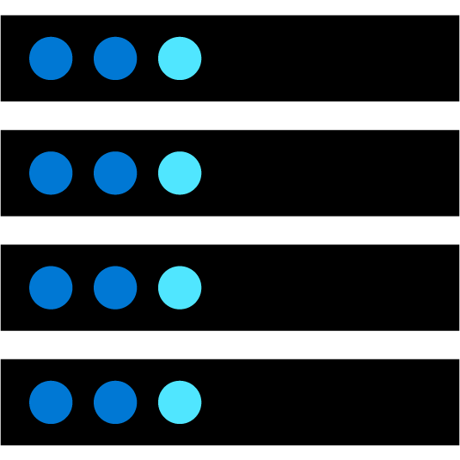











What is cloud computing?
Cloud Computing is the delivery of computing services over the internet, enabling faster innovation, flexible resources, and economies of scale.
Compute
Networking
Storage
Analytics
Notes:
Cloud Computing is:
A model for enabling on-demand access to a shared pool of configurable computing resources – servers, network, storage, applications, and services
Ubiquitous, convenient, on-demand network access
Rapidly provisioned and released with minimal management effort or service provider interaction
Definitions found at:
Cloud computing - https://azure.microsoft.com/en-us/overview/what-is-cloud-computing/
NIST definition - https://csrc.nist.gov/publications/detail/sp/800-145/final
Learn and SkillPipe content order note: https://docs.microsoft.com/en-us/learn/modules/intro-to-azure-fundamentals/what-is-cloud-computing
There are 4 additional slides in Learn (and SkillPipe) that cover a high level introduction to Azure:
What is Azure? https://docs.microsoft.com/en-us/learn/modules/intro-to-azure-fundamentals/what-is-microsoft-azure
Tour of Azure Services https://docs.microsoft.com/en-us/learn/modules/intro-to-azure-fundamentals/tour-of-azure-services
Get started with Azure accounts https://docs.microsoft.com/en-us/learn/modules/intro-to-azure-fundamentals/get-started-with-azure-accounts
Case study introduction (Tailwind Traders) https://docs.microsoft.com/en-us/learn/modules/intro-to-azure-fundamentals/case-study-introduction Throughout the Azure Fundamentals learning paths, we'll work with Tailwind Traders, a fictitious home improvement retailer. It operates retail hardware stores across the globe and online. The scenarios are in both the SkillPipe and Learn content.

Slide 2
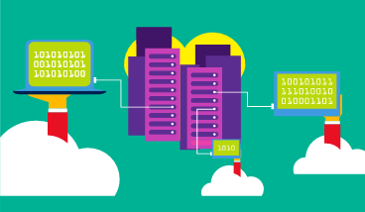
Public cloud
Owned by cloud services or hosting provider.
Provides resources and services to multiple organizations and users.
Accessed via secure network connection (typically over the internet).
Notes:
What are public, private, and hybrid clouds? - https://azure.microsoft.com/en-us/overview/what-are-private-public-hybrid-clouds/
Learn and SkillPipe content order note:
Slides 7-10 https://docs.microsoft.com/en-us/learn/modules/fundamental-azure-concepts/types-of-cloud-computing

Slide 3
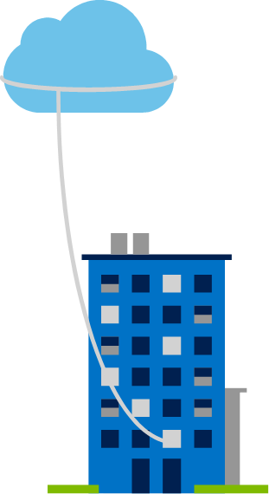
Private cloud
Organizations create a cloud environment in their datacenter.
Organization is responsible for operating the services they provide.
Does not provide access to users outside of the organization.
Notes:
Owned and operated by the organization that uses cloud resources.
Organizations create a cloud environment in their datacenter.
Self-service access to compute resources provided to users within the organization.
Organization is responsible for operating the services they provide.
Learn and SkillPipe content order note:
Slides 7-10 https://docs.microsoft.com/en-us/learn/modules/fundamental-azure-concepts/types-of-cloud-computing

Slide 4
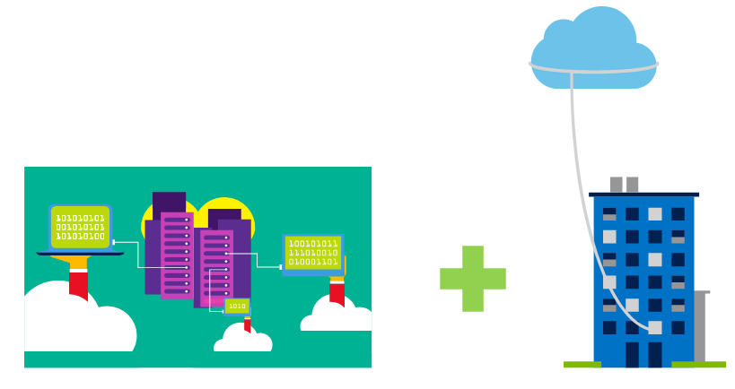
Hybrid cloud
Combines Public and Private clouds to allow applications to run in the most appropriate location.
Notes:
Hybrid cloud models have the following characteristics:
Resource location. Specific resources run or are used in a public cloud, and others run or are used in a private cloud.
Cost and efficiency. Hybrid cloud models allow an organization to leverage some of the benefits of cost, efficiency, and scale that are available with a public cloud model.
Control. Organizations retain management control in private clouds.
Skills. Technical skills are still required to maintain the private cloud and ensure both cloud models can operate together.
Learn and SkillPipe content order note:
Slides 7-10 https://docs.microsoft.com/en-us/learn/modules/fundamental-azure-concepts/types-of-cloud-computing

Slide 5
Cloud model comparison
Public Cloud
No capital expenditures to scale up.
Applications can be quickly provisioned and deprovisioned.
Organizations pay only for what they use.
Private Cloud
Organizations have complete control over resources and security.
Hybrid Cloud
Provides the most flexibility.
Organizations determine where to run their applications.
Organizations control security, compliance, or legal requirements.
Organizations are responsible for hardware maintenance and updates.
Hardware must be purchased for start-up and maintenance.
Notes:
Learn and SkillPipe content order note:
Slides 7-10 https://docs.microsoft.com/en-us/learn/modules/fundamental-azure-concepts/types-of-cloud-computing

Slide 6

Cloud Benefits
High availability
Fault tolerance
Scalability
Elasticity
Global reach
Customer latency capabilities
Agility
Predictive cost considerations
Disaster recovery
Security
Notes:
There is a term reference guide available at https://azure.microsoft.com/en-us/overview/cloud-computing-dictionary/
Learn and SkillPipe content order note:
Slides 11-15 https://docs.microsoft.com/en-us/learn/modules/fundamental-azure-concepts/benefits-of-cloud-computing

Slide 7
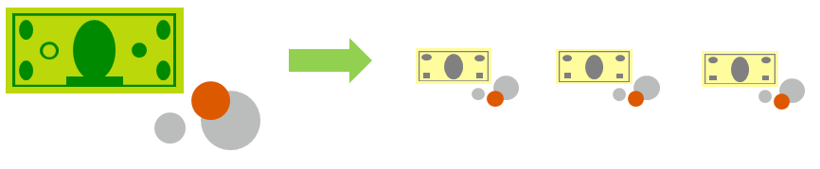
Compare CapEx vs. OpEx
Capital Expenditure (CapEx)
The up-front spending of money on physical infrastructure.
Costs from CapEx have a value that reduces over time.
Operational Expenditure (OpEx)
Spend on products and services as needed, pay-as-you-go
Get billed immediately
Notes:
Capital Expenditure (CapEx)
Spend on physical infrastructure upfront.
Deduct the expense from your tax bill.
High upfront cost, but the value of your 6investment reduces over time.
Operational Expenditure (OpEx)
Spend on services or products as needed.
Get billed immediately.
Deduct the expense from your tax bill in the same year.
No upfront cost, pay-as-you use.
Learn and SkillPipe content order note:
Slides 11-15 https://docs.microsoft.com/en-us/learn/modules/fundamental-azure-concepts/benefits-of-cloud-computing

Slide 8











Consumption-based model
Cloud service providers operate on a consumption-based model, which means that end users only pay for the resources that they use. Whatever they use is what they pay for.
Better cost prediction
Prices for individual resources and services are provided
Billing is based on actual usage
Notes:
This consumption-based model brings with it many benefits, including:
No upfront costs.
No need to purchase and manage costly infrastructure that they may or may not use to its fullest.
The ability to pay for additional resources when they are needed.
The ability to stop paying for resources that are no longer needed.
Learn/SkillPipe content note:
Slides 11-15 https://docs.microsoft.com/en-us/learn/modules/fundamental-azure-concepts/benefits-of-cloud-computing

Slide 9
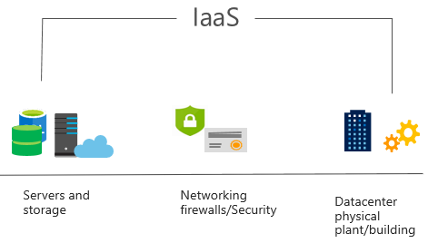
Infrastructure as a Service (IaaS)
Build pay-as-you-go IT infrastructure by renting servers, virtual machines, storage, networks, and operating systems from a cloud provider.
Notes:
For more information on IaaS, visit https://azure.microsoft.com/en-us/overview/what-is-iaas/
Most basic cloud computing services category.
Build pay-as-you-go IT infrastructure by renting servers, virtual machines, storage, networks, and operating systems from a cloud provider.
Instant computing infrastructure, provisioned and managed over the internet.
Learn and SkillPipe content order note:
Slides 11-15 https://docs.microsoft.com/en-us/learn/modules/fundamental-azure-concepts/benefits-of-cloud-computing

Slide 10
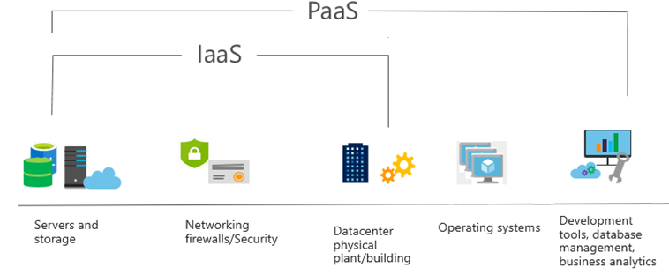
Platform as a Service (PaaS)
Provides environment for building, testing, and deploying software applications; without focusing on managing underlying infrastructure.
Notes:
For more information on PaaS, see https://azure.microsoft.com/en-us/overview/what-is-paas/
Provides environment for building, testing, and deploying software applications.
Helps create applications quickly, without focusing on managing underlying infrastructure.
Learn and SkillPipe content order note:
Slides 16-23 https://docs.microsoft.com/en-us/learn/modules/fundamental-azure-concepts/categories-of-cloud-services

Slide 11
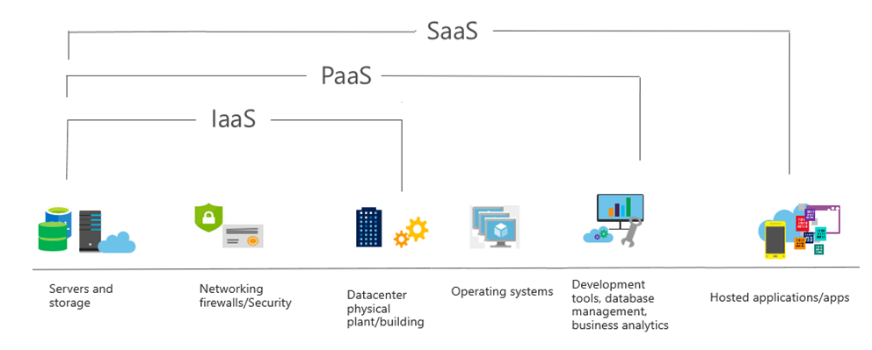
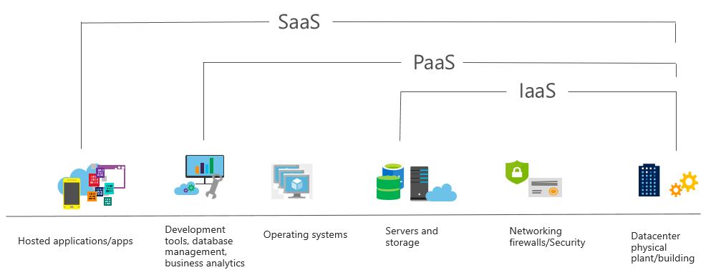
Software as a Service (SaaS)
Users connect to and use cloud-based apps over the internet: for example, Microsoft Office 365, email, and calendars.
Notes:
Common usage scenarios:
Examples of Microsoft SaaS services include Microsoft Office 365, Skype, and Microsoft Dynamics CRM Online.
For more information on SaaS, see https://azure.microsoft.com/en-us/overview/what-is-saas/
Learn and SkillPipe content order note:
Slides 16-23 https://docs.microsoft.com/en-us/learn/modules/fundamental-azure-concepts/categories-of-cloud-services

Slide 12
Cloud service comparison
IaaS
PaaS
SaaS
The most flexible cloud service.
Focus on application development.
Pay-as-you-go pricing model.
You configure and manage the hardware for your application.
Platform management is handled by the cloud provider.
Users pay for the software they use on a subscription model.
Notes:
The slide contains only so
Learn and SkillPipe content order note:
Slides 16-23 https://docs.microsoft.com/en-us/learn/modules/fundamental-azure-concepts/categories-of-cloud-services

Slide 13
Shared responsibility model
On-Premises
( Private Cloud )
Infrastructure
( as a Service )
Platform
( as a Service )
Software
( as a Service )
Data & Access
Data & Access
Data & Access
Data & Access
Applications
Applications
Applications
Applications
You Manage
Runtime
Runtime
Runtime
Runtime
Cloud Provider Manages
Operating System
Operating System
Operating System
Operating System
Virtual Machine
Virtual Machine
Virtual Machine
Virtual Machine
Compute
Compute
Compute
Compute
Networking
Networking
Networking
Networking
Storage
Storage
Storage
Storage
Notes:
IaaS, PaaS, and SaaS have dedicated topics, coming up.
Learn and SkillPipe content order note:
Slides 16-23 https://docs.microsoft.com/en-us/learn/modules/fundamental-azure-concepts/categories-of-cloud-services

Slide 14

Azure Management Tools - Objective Domain
Describe the functionality and usage of:
Azure Portal, Azure PowerShell, Azure CLI, Cloud Shell, and Azure Mobile App.
Azure Advisor.
Azure Resource Manager (ARM) templates.
Azure Monitor.
Azure Service Health.
Notes:
Learn and SkillPipe content order note:
Multiple Learn units cover the content in slide 13-15
https://docs.microsoft.com/en-us/learn/modules/management-fundamentals/1-introduction
https://docs.microsoft.com/en-us/learn/modules/management-fundamentals/2-identify-product-options
https://docs.microsoft.com/en-us/learn/modules/management-fundamentals/3-analyze-decision-criteria
https://docs.microsoft.com/en-us/learn/modules/management-fundamentals/4-use-azure-portal
https://docs.microsoft.com/en-us/learn/modules/management-fundamentals/5-use-azure-powershell
https://docs.microsoft.com/en-us/learn/modules/management-fundamentals/6-use-azure-cli
https://docs.microsoft.com/en-us/learn/modules/management-fundamentals/7-use-azure-mobile-app

Slide 15


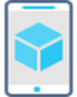





Management tools available in Azure
Azure Portal
Azure PowerShell
Command-Line Interface (CLI)
Azure Mobile App
Azure REST API
Azure Cloud Shell
Azure Resource Manager (ARM)
Notes:
Learn and SkillPipe content order note:
Multiple Learn units cover the content in slide 13-15
https://docs.microsoft.com/en-us/learn/modules/management-fundamentals/1-introduction
https://docs.microsoft.com/en-us/learn/modules/management-fundamentals/2-identify-product-options
https://docs.microsoft.com/en-us/learn/modules/management-fundamentals/3-analyze-decision-criteria
https://docs.microsoft.com/en-us/learn/modules/management-fundamentals/4-use-azure-portal
https://docs.microsoft.com/en-us/learn/modules/management-fundamentals/5-use-azure-powershell
https://docs.microsoft.com/en-us/learn/modules/management-fundamentals/6-use-azure-cli
https://docs.microsoft.com/en-us/learn/modules/management-fundamentals/7-use-azure-mobile-app

Slide 16
Core Azure architectural components – Objective Domain
Describe the benefits and usage of:
Regions and Region Pairs
Availability Zones
Azure Resources
Resource Groups
Azure Resource Manager
Subscriptions
Azure Management Groups
Notes:
Learn and SkillPipe content order note:
Slides 3-5
https://docs.microsoft.com/en-us/learn/modules/azure-architecture-fundamentals/introduction
https://docs.microsoft.com/en-us/learn/modules/azure-architecture-fundamentals/overview

Slide 17
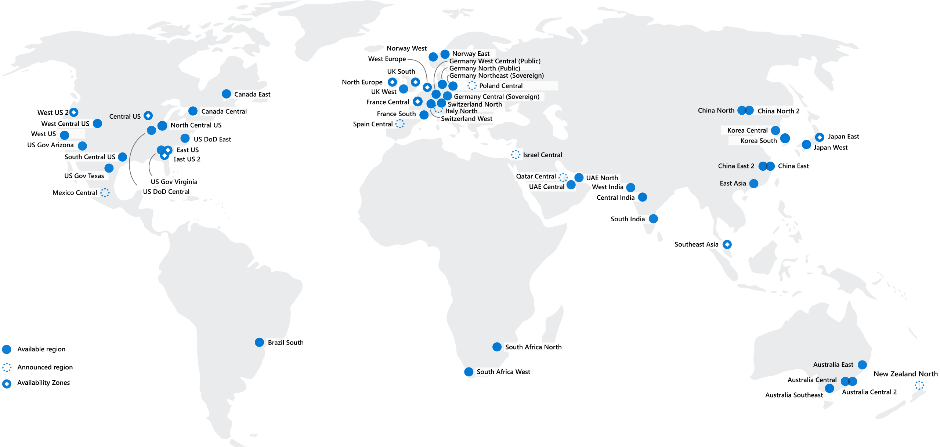
Regions
Azure offers more global regions than any other cloud provider with 60+ regions representing over 140 countries
Regions are made up of one or more datacenters in close proximity.
Provide flexibility and scale to reduce customer latency.
Preserve data residency with a comprehensive compliance offering.
© Copyright Microsoft Corporation. All rights reserved.
Notes:
A region represents a collection of datacenters.
Provide flexibility and scale.
Preserve data residency.
Select regions close to your users.
Be aware of region deployment availability.
There are global services that are region independent.
A list of regions and their locations is available at https://azure.microsoft.com/en-us/global-infrastructure/locations/
Learn and SkillPipe content order note:
Slides 6-10
https://docs.microsoft.com/en-us/learn/modules/azure-architecture-fundamentals/regions-availability-zones

Slide 18




Region Pairs
Region
North Central US​
East US​
West US 2​
US East 2​
Canada Central​
North Europe​
UK West​
Germany Central​
South East Asia​
East China​
Japan East​
Australia Southeast​
India South​
Brazil South (Primary)​
Region
South Central US​
West US​
West Central US​
Central US​
Canada East​
West Europe​
UK South​
Germany Northeast​
East Asia​
North China​
Japan West​
Australia East​
India Central​
South Central US ​
At least 300 miles of separation between region pairs.
Automatic replication for some services.
Prioritized region recovery in the event of outage.
Updates are rollout sequentially to minimize downtime.
Web Link: https://aka.ms/PairedRegions
© Copyright Microsoft Corporation. All rights reserved.
Notes:
Each Azure region is paired with another region.
Azure prefers at least 300 miles of separation between datacenters in a regional pair.
Some services provide automatic replication to the paired region.
In an outage, recovery of one region is prioritized out of every pair.
Azure system updates are rolled out to paired regions sequentially (not at the same time).
List of geographies, regions, region-pairs, and other details -https://azure.microsoft.com/en-us/global-infrastructure/geographies/
A full list of region pairs is available at https://docs.microsoft.com/en-us/azure/best-practices-availability-paired-regions#what-are-paired-regions
Learn and SkillPipe content order note:
Slides 6-10
https://docs.microsoft.com/en-us/learn/modules/azure-architecture-fundamentals/regions-availability-zones

Slide 19
Availability Options
VM SLA
99.9% with Premium Storage
VM SLA
99.99%
MULTI-REGION DISASTER RECOVERY
Region 1
Region 2
SINGLE VM
Easier lift and shift
AVAILABILITY ZONES
Protection from entire datacenter failures
REGION PAIRS
Regional protection within Data Residency Boundaries
Notes:
This slide is to introduce the upcoming topics. You could also use the slide at the end of the lesson to
Learn and SkillPipe content order note:
Slides 6-10
https://docs.microsoft.com/en-us/learn/modules/azure-architecture-fundamentals/regions-availability-zones
review.

Slide 20
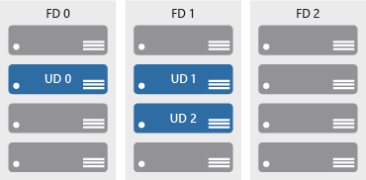

Availability zones
Azure Region
Provide protection against downtime due to datacenter failure.
Physically separate datacenters within the same region.
Each datacenter is equipped with independent power, cooling, and networking.
Connected through private fiber-optic networks.
Availability Zone 1
Availability Zone 2
Availability Zone 3
© Copyright Microsoft Corporation. All rights reserved.
Notes:
Physically separate locations within an Azure region.
Takes availability sets to the next level
Includes one or more datacenters, equipped with independent power, cooling, and networking.
Acts as an isolation boundary.
If one availability zone goes down, the other continues working.
More details about Availability Zones in Azure are available at https://docs.microsoft.com/en-us/azure/availability-zones/az-overview
Learn and SkillPipe content order note:
Slides 6-10
https://docs.microsoft.com/en-us/learn/modules/azure-architecture-fundamentals/regions-availability-zones

Slide 21






Azure Resources
Azure resources are components like storage, virtual machines, and networks that are available to build cloud solutions.
Virtual Machines
Storage Accounts
Virtual Networks
App Services
SQL Databases
Functions
Notes:
Learn and SkillPipe content order note:
Slides 11-13
https://docs.microsoft.com/en-us/learn/modules/azure-architecture-fundamentals/resources-resource-manager

Slide 22
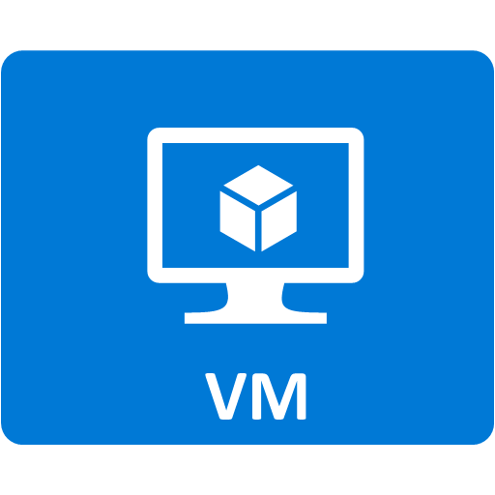


Resource groups
Resource groups (web + DB, VM, Storage) in one group
A resource group is a container to manage and aggregate resources in a single unit.
Resources can exist in only one resource group.
Resources can exist in different regions.
Resources can be moved to different resource groups.
Applications can utilize multiple resource groups.
OR
Web and DB resource group
Virtual machine resource group
Storage resource group
© Copyright Microsoft Corporation. All rights reserved.
Notes:
Containers for multiple resources that share the same life cycle.
Aggregates resources into a single manageable unit.
Every Azure resource must exist in one (and only one) resource group.
Secure at the resource group (or resource) level - using role-based access control (RBAC).
Learn and SkillPipe content order note:
Slides 11-13
https://docs.microsoft.com/en-us/learn/modules/azure-architecture-fundamentals/resources-resource-manager

Slide 23
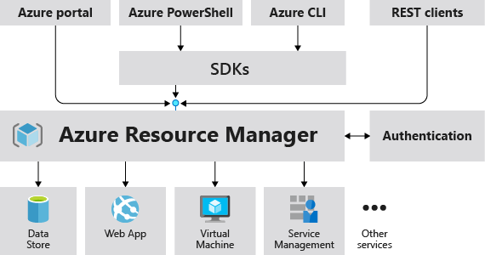
Azure Resource Manager
The Azure Resource Manager (ARM) provides a management layer that enables you to create, update, and delete resources in your Azure subscription.
© Copyright Microsoft Corporation. All rights reserved.
Notes:
Provides a management layer that enables you to create, update, and delete resources in your Azure subscription.
Create, configure, manage and delete resources and resource groups.
Organizes resources.
Controls access and resources.
Automates using different tools and SDKs.
Stores layouts in JSON files.
You can view more details about Azure Resource Manager at https://docs.microsoft.com/en-us/azure/azure-resource-manager
Learn and SkillPipe content order note:
Slides 11-13
https://docs.microsoft.com/en-us/learn/modules/azure-architecture-fundamentals/resources-resource-manager

Slide 24
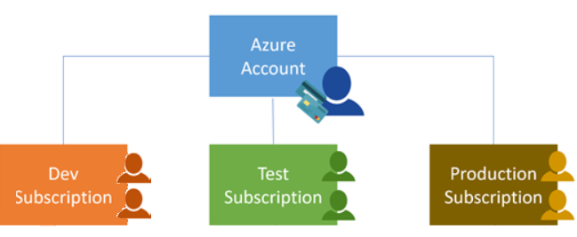
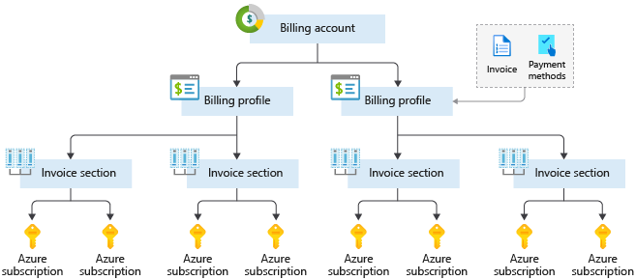
Azure Subscriptions
An Azure subscription provides you with authenticated and authorized access to Azure accounts.
Billing boundary: generate separate billing reports and invoices for each subscription.
Access control boundary: manage and control access to the resources that users can provision with specific subscriptions.
Notes:
An account can have one subscription or multiple subscriptions.
Azure subscription offers - https://azure.microsoft.com/en-us/support/legal/offer-details/
Learn and SkillPipe content order note:
Slides 14 & 16
https://docs.microsoft.com/en-us/learn/modules/azure-architecture-fundamentals/management-groups-subscriptions

Slide 25
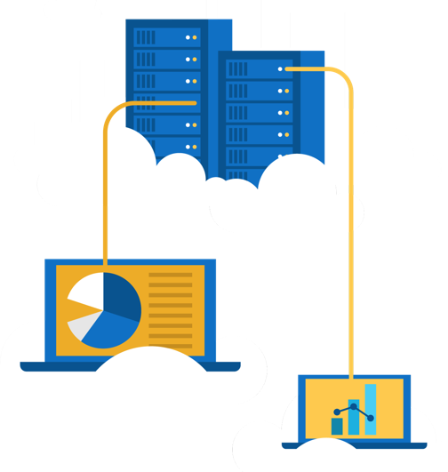
Walkthrough – Explore the Azure Portal
Launch the Azure Portal and have a look at the common components used everyday building cloud solutions
Connect to https://portal.azure.com
Explore the home screen.
Find “All Services” and see what is available.
Notes:
Learn and SkillPipe content order note:
Learn has a sandbox exercise at roughly the same place as this one, but that isn’t specifically aligned to this one, but does give some experience in the Azure portal - Exercise - Create a website hosted in Azure
https://docs.microsoft.com/en-us/learn/modules/azure-architecture-fundamentals/exercise-create-website

Slide 26
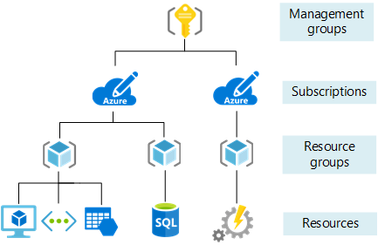
Management Groups
Management groups can include multiple Azure subscriptions.
Subscriptions inherit conditions applied to the management group.
10,000 management groups can be supported in a single directory.
A management group tree can support up to six levels of depth.
Notes:
Management groups can include multiple Azure subscriptions.
Subscriptions inherit conditions applied to the management group.
10,000 management groups can be supported in a single directory.
A management group tree can support up to six levels of depth.
Management groups - https://docs.microsoft.com/en-us/azure/governance/management-groups/
Learn and SkillPipe content order note:
Slides 14 & 16
https://docs.microsoft.com/en-us/learn/modules/azure-architecture-fundamentals/management-groups-subscriptions

