Slide 1
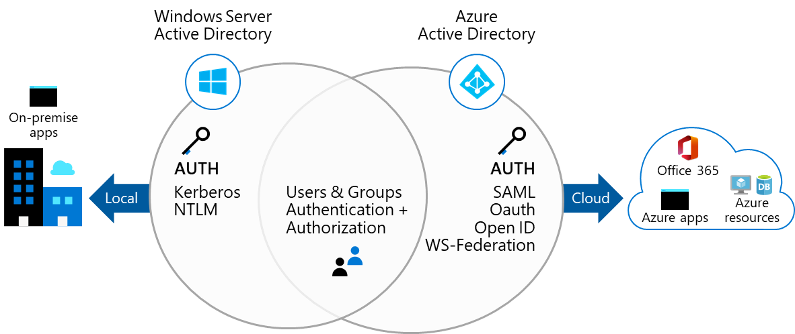
Describe Azure Active Directory Benefits and Features
A cloud-based suite of identity management capabilities that enables you to securely manage access to Azure services and resources for your users
Provides application management, authentication, device management, and hybrid identity
Notes:
What is Azure Active Directory? - https://docs.microsoft.com/en-us/azure/active-directory/fundamentals/active-directory-whatis

Slide 2
Describe Azure AD Concepts
Concept | Description
Identity | An object that can be authenticated
Account | An identity that has data associated with it
Azure AD account | An identity created through Azure AD or another Microsoft cloud service
Azure AD tenant/directory | A dedicated and trusted instance of Azure AD, a Tenant is automatically created when your organization signs up for a Microsoft cloud service subscription​ ​ Additional instances of Azure AD can be created​ Azure AD is the underlying product providing the identity service​ The term Tenant means a single instance of Azure AD representing a single organization​ The terms Tenant and Directory are often used interchangeably​
Azure subscription | Used to pay for Azure cloud services
Notes:
Azure AD Terminology - https://docs.microsoft.com/en-us/azure/active-directory/fundamentals/active-directory-whatis#terminology

Slide 3
Compare AD DS to Azure Active Directory
Azure AD is primarily an identity solution, and designed for HTTP and HTTPS communications
Queried using the REST API over HTTP and HTTPS. Instead of LDAP
Uses HTTP and HTTPS protocols such as SAML, WS-Federation, and OpenID Connect for authentication (and OAuth for authorization). Instead of Kerberos
Includes federation services, and many third-party services (such as Facebook)
Azure AD users and groups are created in a flat structure, and there are no Organizational Units (OUs) or Group Policy Objects (GPOs)
Notes:
Compare Active Directory to Azure Active Directory - https://docs.microsoft.com/en-us/azure/active-directory/fundamentals/active-directory-compare-azure-ad-to-ad
✔️ Azure AD is a managed service. You only manage the users, groups, and policies. Deploying AD DS with virtual machines using Azure means that you manage the deployment, configuration, virtual machines, patching, and other backend tasks. Do you see the difference? How are they similar?

Slide 4
Select Azure Active Directory Editions
Feature | Free | Microsoft 365 Apps | Premium P1 | Premium P2
Directory Objects | 500,000 objects | No object limit | No object limit | No object limit
Single Sign-On | Unlimited | Unlimited | Unlimited | Unlimited
Core Identity and Access | X | X | X | X
B2B Collaboration | X | X | X | X
Identity & Access for O365 |  | X | X | X
Premium Features |  |  | X | X
Hybrid Identities |  |  | X | X
Advanced Group Access |  |  | X | X
Conditional Access |  |  | X | X
Identity Protection |  |  |  | X
Identity Governance |  |  |  | X
Notes:
Azure AD Pricing Editions - https://azure.microsoft.com/en-us/pricing/details/active-directory/
✔️ Did you look through the pricing list to determine which features your organization needs and to compare edition capabilities?

Slide 5
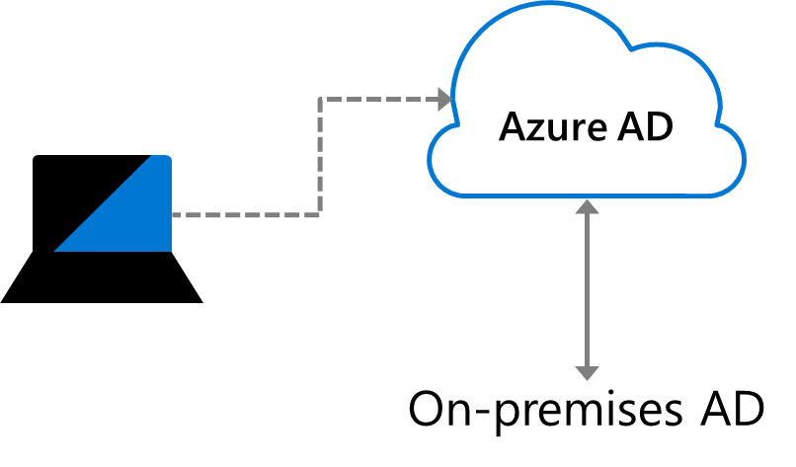
Implement Azure AD Join
Single-Sign-On to your Azure managed SaaS apps and services
Enterprise state roaming of user settings across joined devices
Access to Microsoft Store for Business
Windows Hello support
Restriction of access to apps from only compliant devices
Seamless access to on-premises resources
Notes:
Azure AD joined devices - https://docs.microsoft.com/en-us/azure/active-directory/devices/concept-azure-ad-join
✔️ Although AD Join is intended for organizations that do not have on-premises Windows Server Active Directory infrastructure it can be used for other scenarios like branch offices.

Slide 6
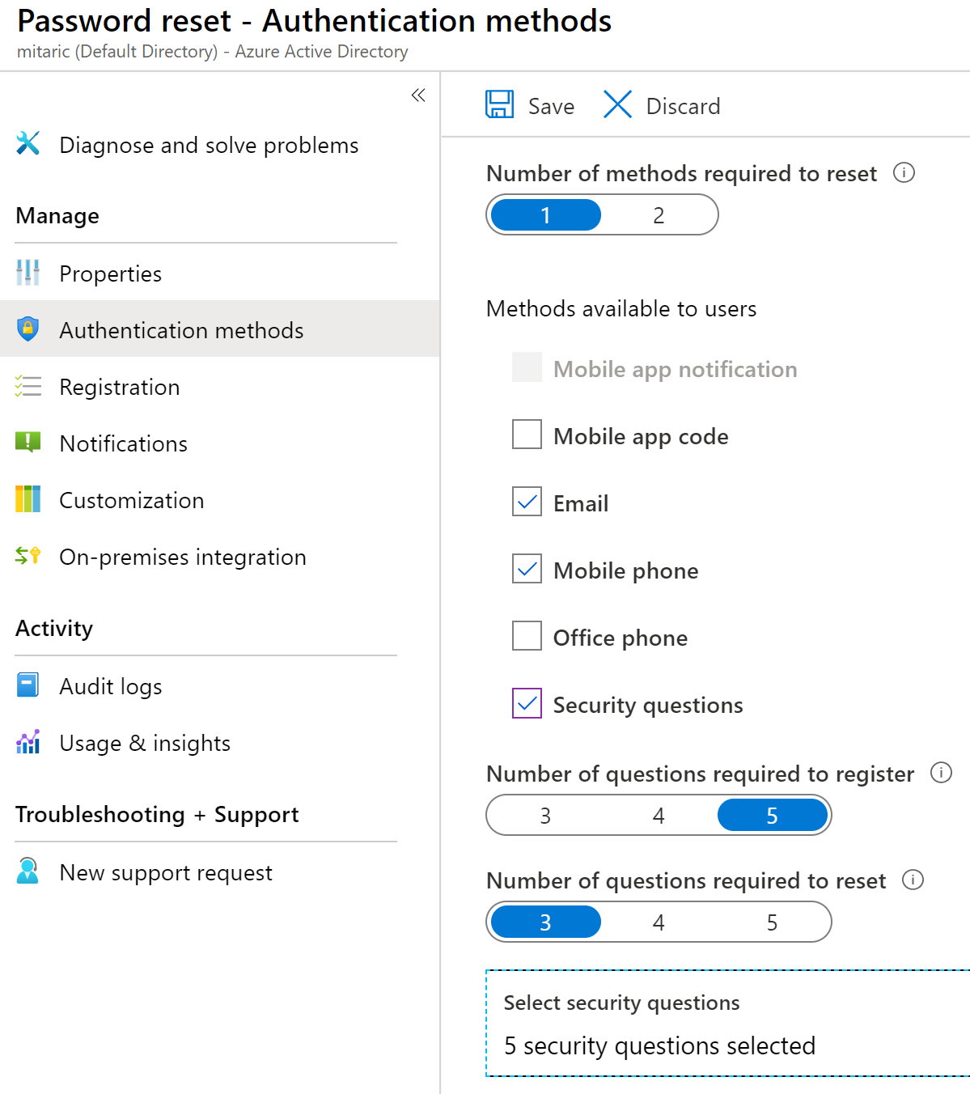
Implement Self-Service Password Reset
Determine who can use self-service password reset
1
2
Choose the number of authentication methods required and the methods available (email, phone, questions)
3
You can require users to register for SSPR (same process as MFA)
Notes:
Plan an Azure Active Directory self-service password reset deployment - https://docs.microsoft.com/en-us/azure/active-directory/authentication/howto-sspr-deployment

Slide 7
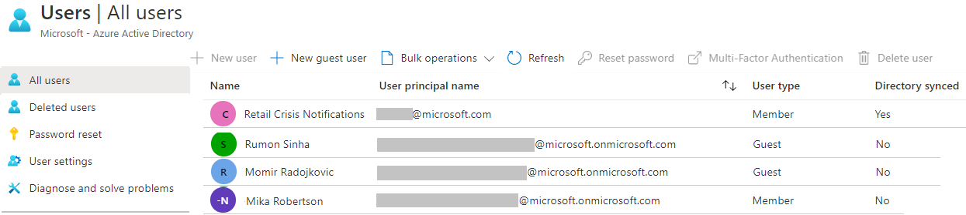
Create User Accounts
All users must have an account
The account is used for authentication and authorization
Each user account has additional properties
Notes:
✔️ Have you given any thought as to the type of users you will need?

Slide 8
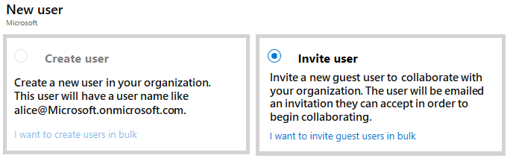
Manage User Accounts
Must be Global Administrator or User Administrator to manage users
User profile (picture, job, contact info) is optional
Deleted users can be restored for 30 days
Sign in and audit log information is available
Notes:
Add or delete users using Azure Active Directory - https://docs.microsoft.com/en-us/azure/active-directory/fundamentals/add-users-azure-active-directory

Slide 9
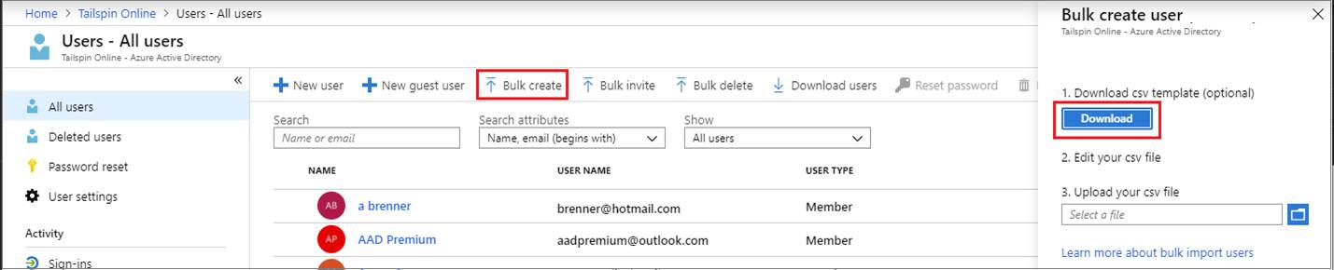
Create Bulk User Accounts
Azure AD supports bulk user create, delete, and list
Create the comma-separated values (CSV) template you can download from the Portal
Must be signed in as a Global administrator or User administrator
Notes:
Bulk create users in Azure Active Directory - https://docs.microsoft.com/en-us/azure/active-directory/users-groups-roles/users-bulk-add
✔️ Establish or implement a naming convention for usernames, display names and aliases. The password for the new users needs to conform to the password complexity rules you have set for your directory. User parameters include User Principal Name, Display Name, Given Name, Department, and Job Title.

Slide 10
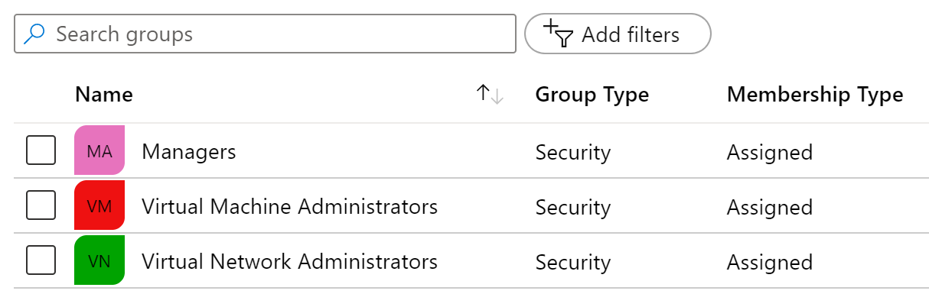
Create Group Accounts
Group Types
Security groups
Microsoft 365 groups
Assignment Types
Assigned
Dynamic User
Dynamic Device (Security groups only)
Notes:
Manage app and resource access using Azure Active Directory groups – https://docs.microsoft.com/en-us/azure/active-directory/fundamentals/active-directory-manage-groups
Quickstart: View your organization's groups and members in Azure Active Directory - https://docs.microsoft.com/en-us/azure/active-directory/fundamentals/active-directory-groups-view-azure-portal
✔️ Have you given any thought to which groups you need to create? How will you assign users to groups?

Slide 11
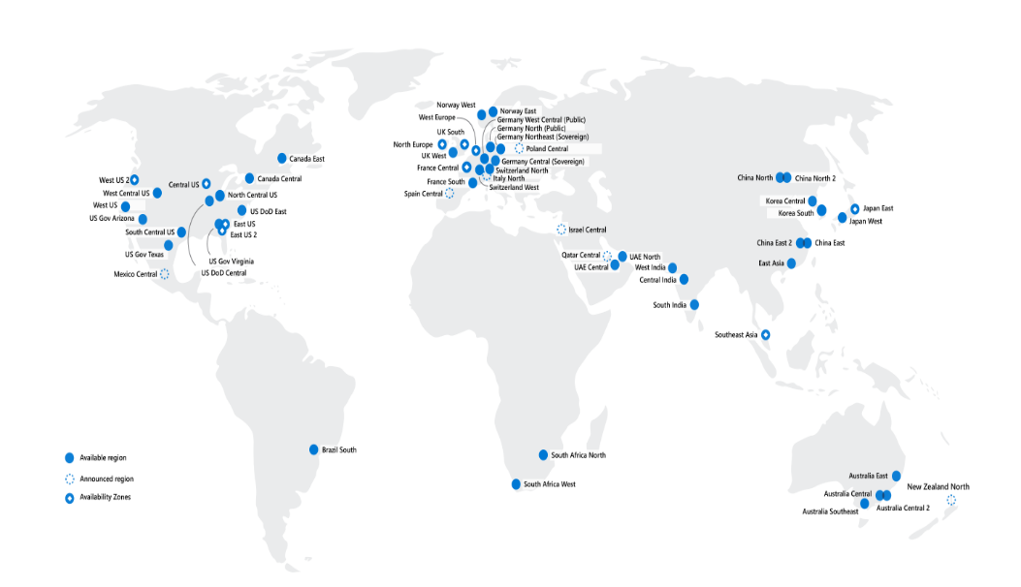
Identify Regions
A region represents a collection of datacenters
Provides flexibility and scale
Preserves data residency
Select regions close to your users
Be aware of region deployment availability
There are global services that are region independent
Worldwide there are 60+ regions representing 140 countries
Regions are paired for high availability
Notes:
A list of regions and their locations is available at https://azure.microsoft.com/en-us/global-infrastructure/locations/

Slide 12
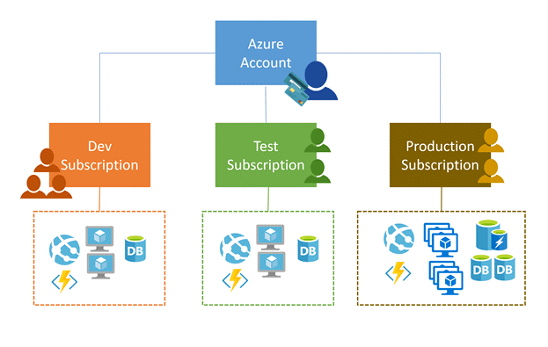
Implement Azure Subscriptions
Only identities in Azure AD, or in a directory that is trusted by Azure AD, can create a subscription
Logical unit of Azure services that is linked to an Azure account
Security and billing boundary
Notes:
Create an additional Azure subscription - https://docs.microsoft.com/en-us/azure/cost-management-billing/manage/create-subscription
Change your Azure subscription to a different offer - https://docs.microsoft.com/en-us/azure/cost-management-billing/manage/switch-azure-offer
✔️ Do you know how many subscriptions your organization has?
Clarification on the last bullet - Only Identities in Azure Active Directory (Azure AD) or in a directory that is trusted by Azure AD (such as a work or school organization) can create a Subscription. For example, Account Owner role can be used to create a Subscription in an Enterprise Agreement.

Slide 13
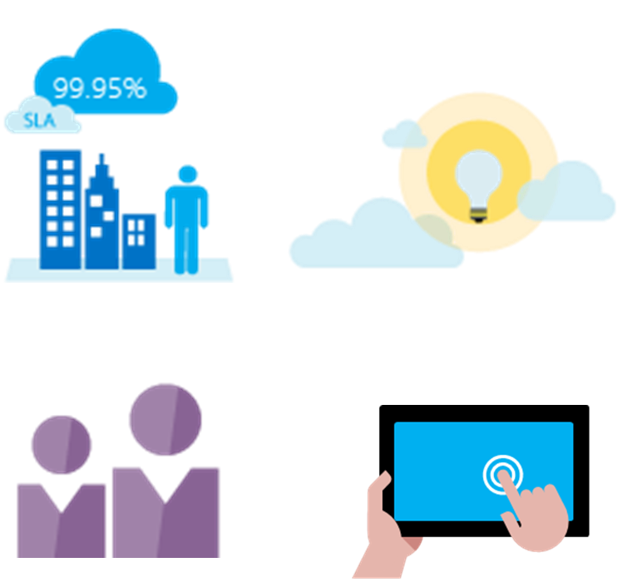
Obtain a Subscription
Enterprise Agreement customers make an upfront monetary commitment and consume services throughout the year
Resellers provide a simple, flexible way to purchase cloud services
Partners can design and implement your Azure cloud solution
Personal free account – Start right away
Notes:
Subscription decision guide - https://docs.microsoft.com/en-us/azure/cloud-adoption-framework/decision-guides/subscriptions/
✔️ Which subscription model are you most interested in?

Slide 14
Identify Subscription Usage
Subscription | Usage
Free | Includes a $200 credit for the first 30 days, free limited access for 12 months
Pay-As-You-Go | Charges you monthly
CSP | Agreement with possible discounts through a Microsoft Cloud Solutions Provider Partner – typically for small to medium businesses
Enterprise | One agreement, with discounts for new licenses and Software Assurance – targeted at enterprise-scale organizations
Student | Includes $100 for 12 months – must verify student access
Notes:
Credit card information is used for identity verification only. You won’t be charged for any services until you upgrade.

Slide 15
Implement Cost Management
Conduct cost analysis
Create a budget
Review recommendations
Export the data
Notes:
What is Azure Cost Management and Billing? - https://docs.microsoft.com/en-us/azure/cost-management-billing/cost-management-billing-overview
Quickstart: Explore and analyze costs with cost analysis - https://docs.microsoft.com/en-us/azure/cost-management-billing/costs/quick-acm-cost-analysis
Analyze costs and create budgets with Azure Cost Management - https://docs.microsoft.com/en-us/learn/modules/analyze-costs-create-budgets-azure-cost-management/

Slide 16
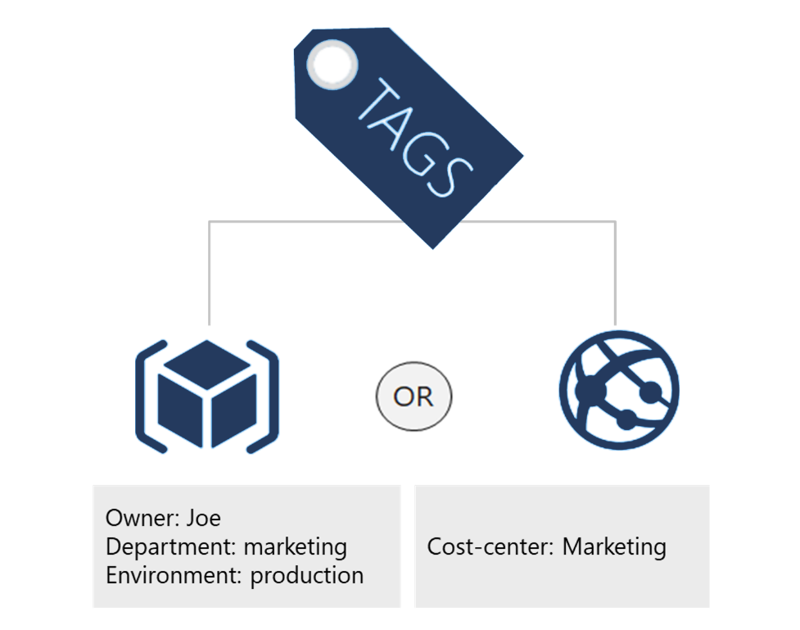
Apply Resource Tagging
Provides metadata for your Azure resources
Logically organizes resources into a taxonomy
Consists of a name-value pair
Very useful for rolling up billing information
Notes:
Resource naming and tagging decision guide - https://docs.microsoft.com/en-us/azure/cloud-adoption-framework/decision-guides/resource-tagging
✔️ If you need to create a lot of tags you will want to do that programmatically. You can use PowerShell or the CLI.

Slide 17
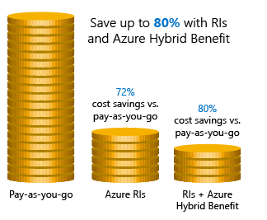
Apply Cost Savings
Azure Reservations – Helps you save money by pre-paying for services
Azure Hybrid Benefits – Use Windows Server and SQL Server on-premises licenses with Software Assurance
Azure Credits – Monthly credit benefit that allows you to experiment with, develop, and test new solutions on Azure
Regions – Choose low-cost locations and regions
Notes:
Cost savings - https://docs.microsoft.com/en-us/learn/modules/predict-costs-and-optimize-spending/4-save-on-infrastructure-costs

Slide 18
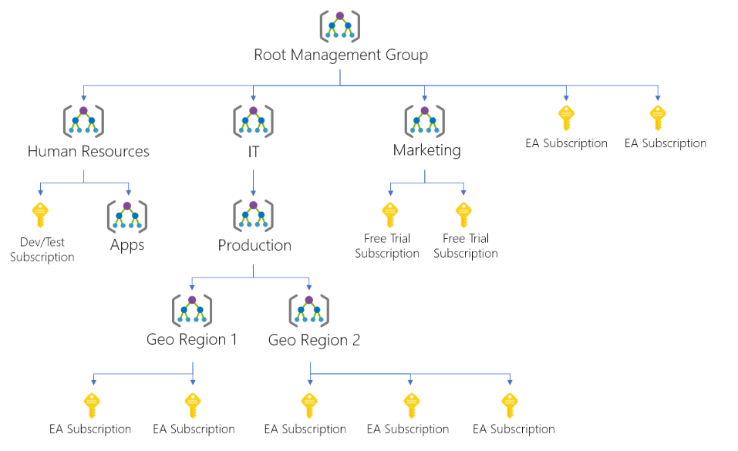
Create Management Groups
Provides a level of scope above subscriptions
Targeting of policies and spend budgets across subscriptions and inheritance down the hierarchies
Compliance and cost reporting by organization (business/teams)
Notes:
Create management groups for resource organization and management - https://docs.microsoft.com/en-us/azure/governance/management-groups/create
Manage your resources with management groups - https://docs.microsoft.com/en-us/azure/governance/management-groups/manage

Slide 19
Implement Azure Policies
A service to create, assign, and manage policies
Usage Cases
Allowed resource types – Specify the resource types that your organization can deploy
Allowed virtual machine SKUs – Specify a set of virtual machine SKUs that your organization can deploy
Allowed locations – Restrict the locations your organization can specify when deploying resources
Require tag and its value – Enforces a required tag and its value
Azure Backup should be enabled for Virtual Machines – Audit if Azure Backup service is enabled for all Virtual machines
Runs evaluations and scans for non-compliant resources
Advantages:
Enforcement and compliance
Apply policies at scale
Remediation
Notes:
What is Azure Policy? - https://docs.microsoft.com/en-us/azure/governance/policy/overview
Quickstart: Create a policy assignment to identify non-compliant resources - https://docs.microsoft.com/en-us/azure/governance/policy/assign-policy-portal

Slide 20
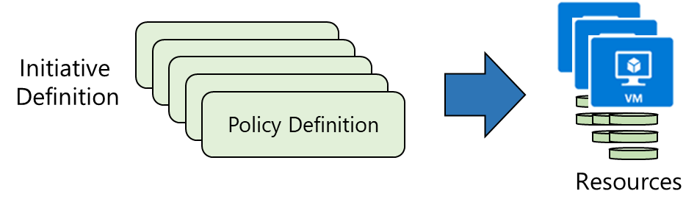
Create Azure Policies
Create Policy Definitions
Create Initiative Definitions
Scope the Initiative Definition
Determine Compliance
Notes:
Tutorial: Create and manage policies to enforce compliance - https://docs.microsoft.com/en-us/azure/governance/policy/tutorials/create-and-manage
Apply and monitor infrastructure standards with Azure Policy (Learn) - https://docs.microsoft.com/learn/modules/intro-to-governance/
The next topics step you through creating an Azure policy.
✔ Even if you have only a few Policy Definitions, we recommend creating an Initiative Definition.

Slide 21
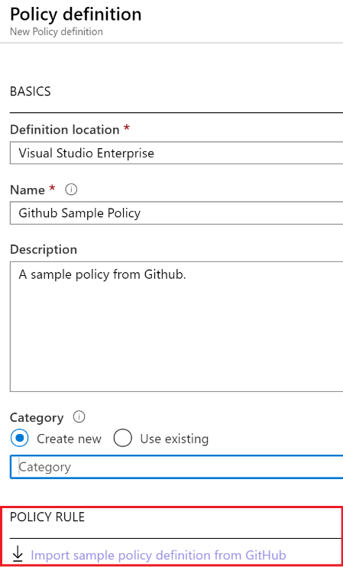
1. Create Policy Definitions
Many policy definitions are available
You can import policies from GitHub
Policy Definitions have a specific JSON format
You can create custom policy definitions
Notes:
Azure Policy built-in policy definitions - https://docs.microsoft.com/en-us/azure/governance/policy/samples/built-in-policies
✔️ Policy Definitions have a specific JSON format. As an Azure Administrator you will not need to create files in this format, but you may want to review, so you are familiar. Review the available definitions in the portal and in GitHub.

Slide 22
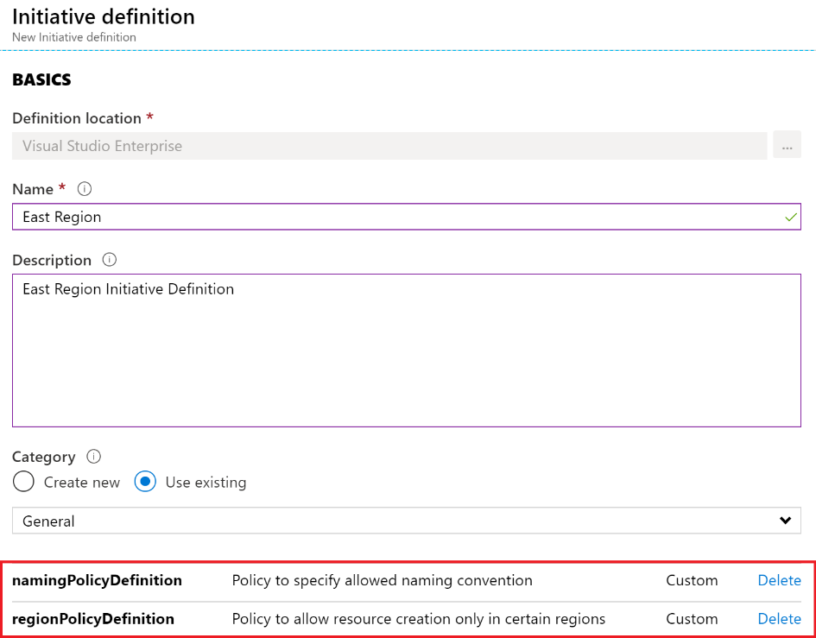
2. Create Initiative Definitions
Group policy definitions
Include one or more policies
Requires planning
Notes:
Azure Policy built-in initiative definitions - https://docs.microsoft.com/en-us/azure/governance/policy/samples/built-in-initiatives
✔️ Can you see how this will require some planning to organize your policies?

Slide 23
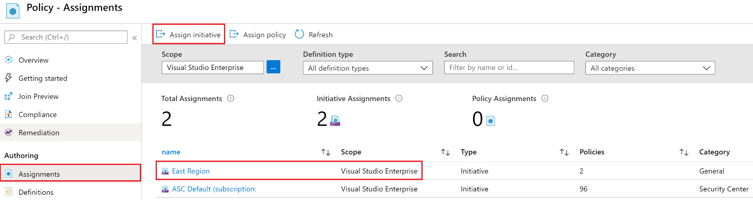
3. Scope the Initiative Definition
Assign the definition to a scope
The scope enforces the policy
Select the subscription, and optionally the resource group

Slide 24
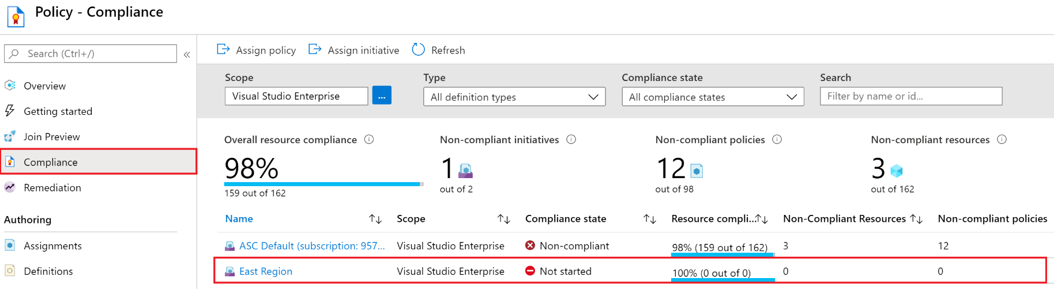
4. Determine Compliance
Non-compliant initiatives
Non-compliant policies
Non-compliant resources
Notes:
✔️ Policy evaluation happens about once an hour, which means that if you make changes to your policy definition and create a policy assignment then it will be re-evaluated over your resources within the hour.

Slide 25
Demonstration – Azure Policy
Assign a policy
Create and assign an initiative definition
Check for compliance
Check for remediation tasks
Remove your policy and initiative
Notes:
✔ Always consider having students walk-through the demonstrations themselves. Also, consider the overlap with the formal labs and your best use of time.

Slide 26
Implement Role-Based Access Control
Provides fine-grained access management of resources in Azure​
Concepts​
Built on Azure Resource Manager
Segregate duties within your team ​
Grant only the amount of access to users that they need to perform their jobs​
Security principal. Object that represents something that is requesting access to resources​
Role definition. Collection of permissions that lists the operations that can be performed​
Scope. Boundary for the level of access that is requested​
Assignment. Attaching a role definition to a security principal at a particular scope​:
Users can grant access described in a role definition by creating an assignment​
Deny assignments are currently read-only and are set by Azure Blueprints and Azure Managed Apps
Notes:
What is role-based access control (RBAC) for Azure resources? - https://docs.microsoft.com/en-us/azure/role-based-access-control/overview

Slide 27
Create a Role Definition
Collection of permissions that lists the operations that can be performed
Contributor
Owner
Contributor
Reader
…
Backup Operator
Security Reader
User Access Administrator
Virtual Machine Contributor
"Actions": [
"*"
],
"NotActions" : [
"Authorization/*/Delete",
"Authorization/*/Write",
"Authorization/elevateAccess/Action"
],
"DataActions" : [],
"NotDataActions": [],
"AssignableScopes" : [
"/"
]
Built-in
Reader Support Tickets
Virtual Machine Operator
Custom
Notes:
List role definitions in Azure RBAC - https://docs.microsoft.com/azure/role-based-access-control/role-definitions-list
Create custom roles for Azure resources with role-based access control - https://docs.microsoft.com/learn/modules/create-custom-azure-roles-with-rbac/

Slide 28




Create a Role Assignment
Process of binding a role definition to a user, group, or service principal at a scope for the purpose of granting access
1
Security principal
User
Group
Service principal
2
Role definition
Role assignment
3
Scope
Owner
Contributor
Reader
…
Backup Operator
Security Reader
Contributor
"Actions": [
"*"
],
"NotActions": [
"Auth/*/Delete",
"Auth/*/Write",
"Auth/elevate"
]
Management group
Marketing group
Subscription
Resource group
Pharma-sales Resource group
Reader Support Tickets
Virtual Machine Operator
Contributor
Resource
Notes:
Add or remove role assignments using Azure RBAC and the Azure portal - https://docs.microsoft.com/azure/role-based-access-control/role-assignments-portal
Explain that the role assignment completes the process of implementing RBAC and combining service principals, a role definition, and a scope.

Slide 29

Compare Azure RBAC Roles to Azure AD Roles
Azure and Azure AD offer two types of roles
Azure RBAC roles | Azure AD roles
Manage access to Azure resources | Manage access to Azure AD objects
Scope can be specified at multiple levels | Scope is at the tenant level
Role information can be accessed in the Azure portal, Azure CLI, Azure PowerShell, Azure Resource Manager templates, REST API | Role information can be accessed in Azure portal, Microsoft 365 admin portal, Microsoft Graph, Azure Active Directory PowerShell for Graph
Classic administrator roles should be avoided if using Azure Resource Manager

Slide 30





Apply RBAC Authentication
Azure AD
Admin roles
Azure Active
Directory tenant
Global admin
Application admin
Application developer
Billing admin …
Global admin/User access admin (elevated access)
Root
Azure RBAC
roles
Root management group
Owner
Contributor
Reader
User access admin
…
Management group
Subscription
Azure RBAC
roles
Resource group
Azure account
Owner
Contributor
Reader
User access admin
…
Resource
Notes:
Manage access to an Azure subscription by using Azure role-based access control - https://docs.microsoft.com/learn/modules/manage-subscription-access-azure-rbac/3-elevate-your-access-user-access-admin

Slide 31
Determine Azure RBAC Roles
RBAC role in Azure | Permissions | Notes
Owner | Has full access to all resources and can delegate access to others | The Service Administrator and Co-Administrators are assigned the Owner role at the subscription scope. This applies to all resource types
Contributor | Creates and manages all types of Azure resources but cannot grant access to others | This applies to all resource types
Reader | Views Azure resources | This applies to all resource types
User Access Administrator | Manages user access to Azure resources | This applies to managing access, rather than to managing resources
Notes:
Custom roles for Azure resources - https://docs.microsoft.com/azure/role-based-access-control/custom-roles

Slide 32
Lab 02a – Manage Subscriptions and Azure RBAC
Lab scenario
To improve the management of Azure resources in Contoso, you have been tasked with implementing the following functionality:
Using management groups for the Contoso’s Azure subscriptions
Granting user permissions for submitting support requests. This user would only be able to create support request tickets and view resource groups
Objectives
Task 1: Implement Management Groups
Task 2: Create custom RBAC roles
Task 3: Assign RBAC roles
Next slide for an architecture diagram
Notes:
LAB 02a - Manage Subscriptions and RBAC - ESTIMATED DURATION 30 MIN
Lab Repository - https://microsoftlearning.github.io/AZ-104-MicrosoftAzureAdministrator/

