Slide 1

Go4Local
Vision:
For working professionals and senior citizens who want to buy groceries but do not have time to go out, our new product Go4Local helps connect them with local grocery store owners. Unlike Big Basket, we deliver products from local brands freshly delivered at a lower cost.
Members:
Ashutosh Vishwakarma
Krishna Unnikrishnan
Prateek Revadi
Rochana Dudwadkar

Slide 2



Customer Segments and Needs
Buyer
Seller
Working professionals
Hectic schedule
Prefers online shopping
Saves time
Prefers doorstep delivery
Likes refund policy
Senior Citizens
Health conditions
Prefer home delivery
Need fresh grocery
Prefer local brands and shops
Grocery Store Owner
Losing customer due to COVID- 19
Need delivery person
Want to increase business

Slide 3







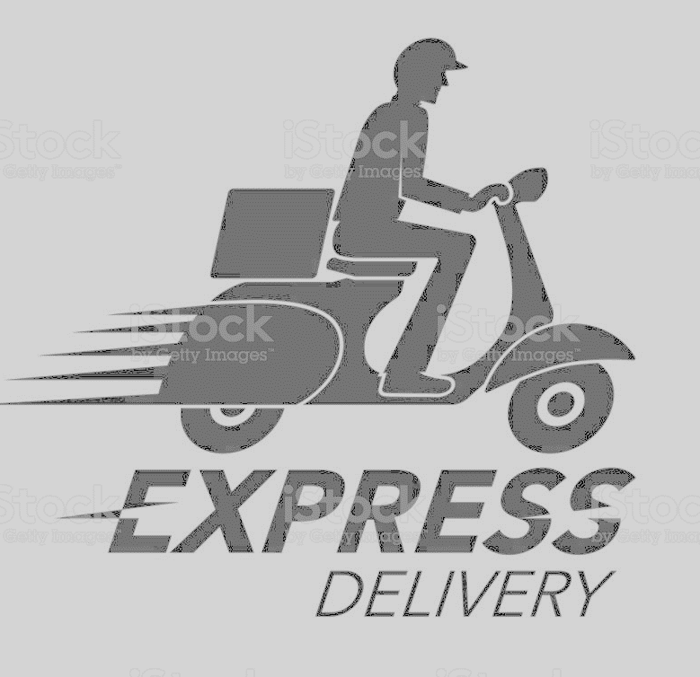

Proposed Solutions
Low delivery distance & quick delivery
Low cost per delivery
Operational Timings
Delivery of Fresh groceries
Better Quality of Products

Slide 4
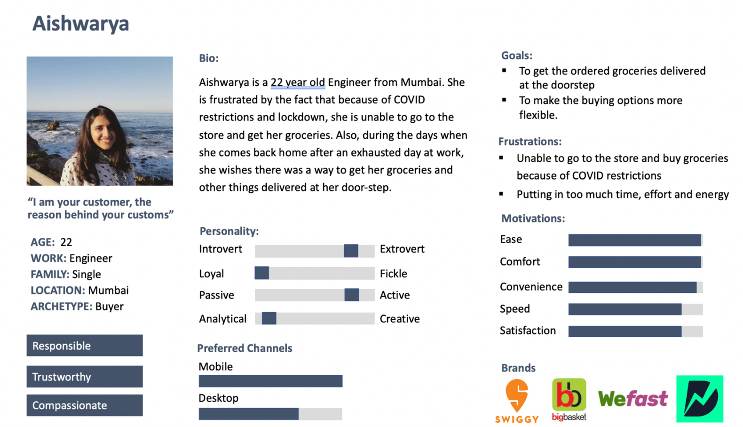
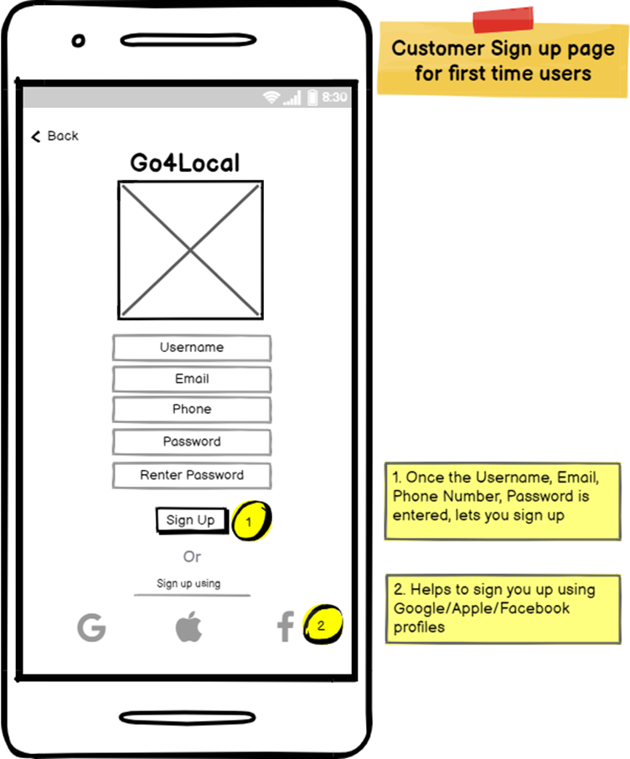
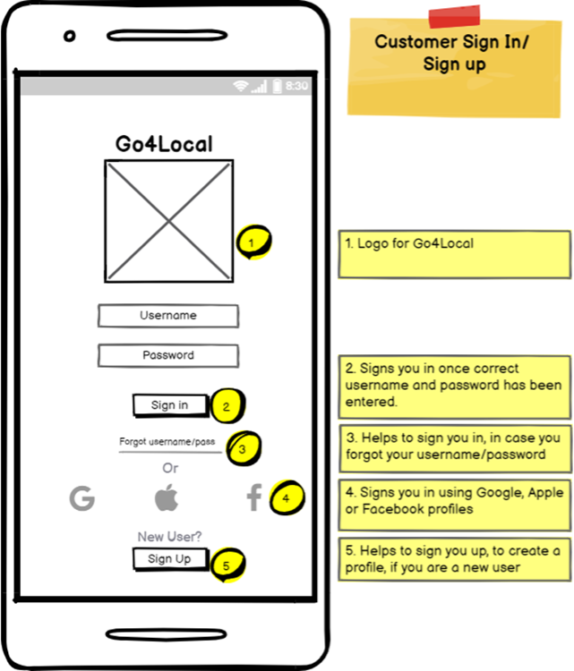
Storyboard
Use Case: Signup to Checkout
Name: Aishwarya
Age: 22
Work: Engineer
Family: Single
Location: Mumbai, India
Archetype: Buyer

Slide 5
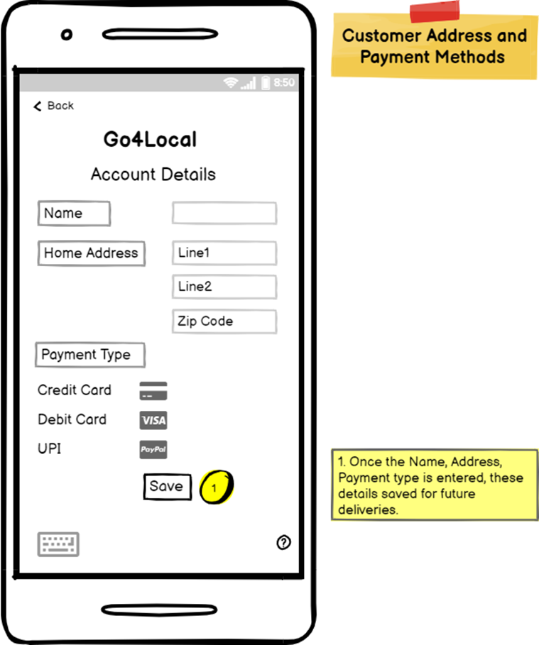
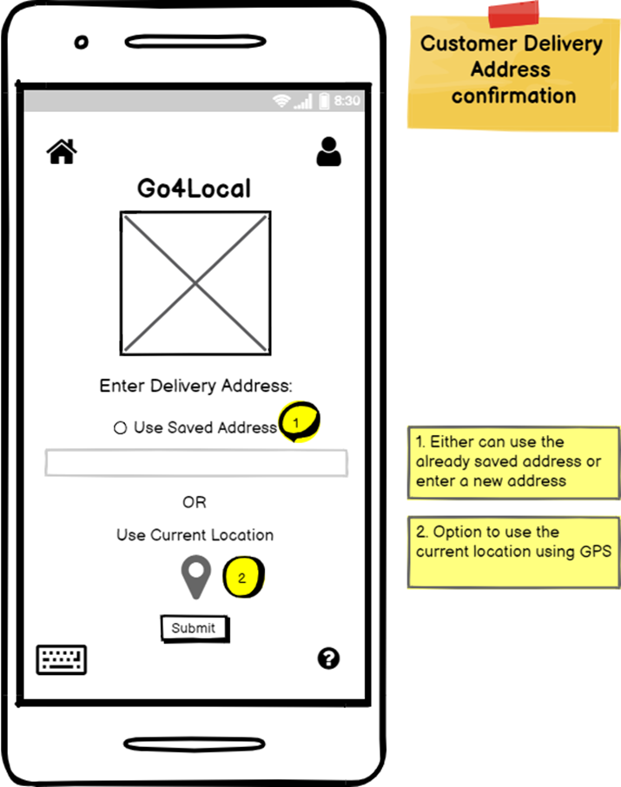
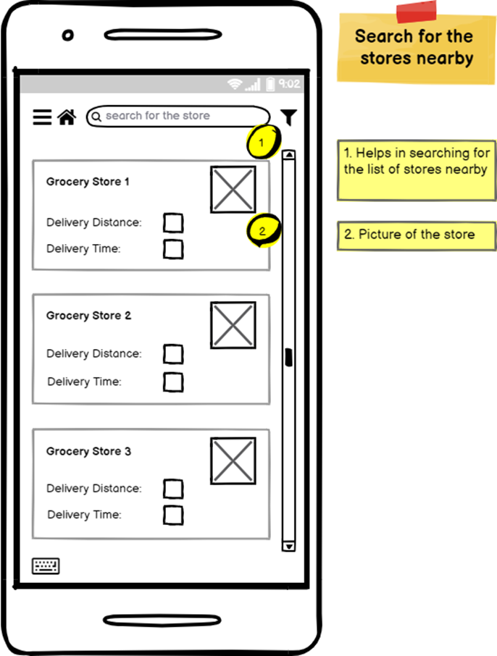
Storyboard

Slide 6
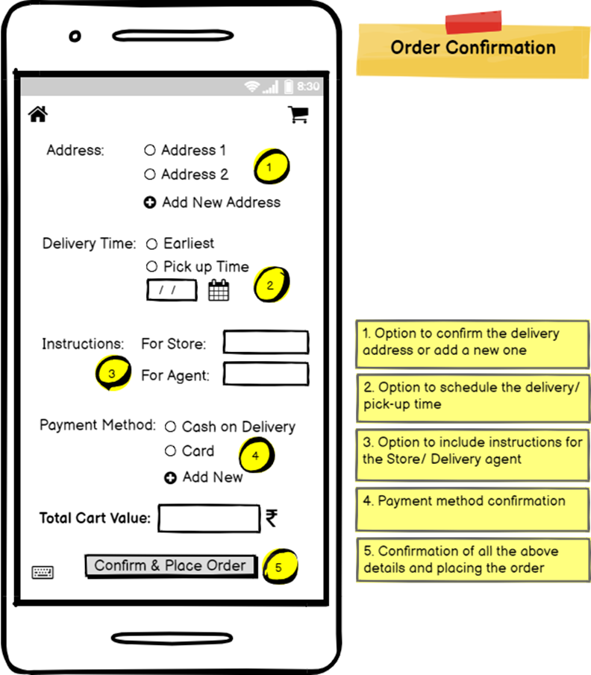
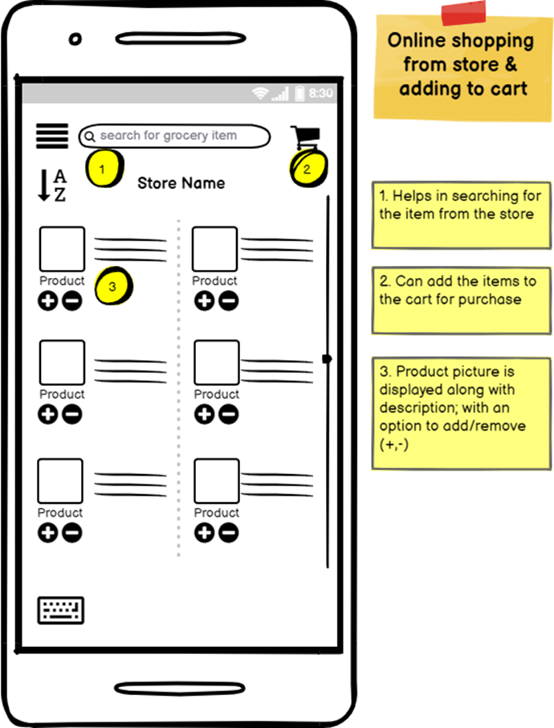
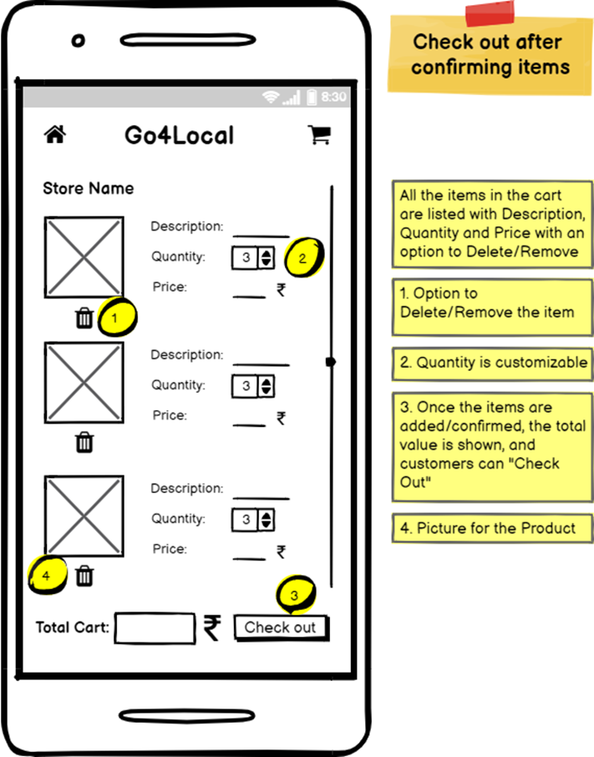
Storyboard

Slide 7
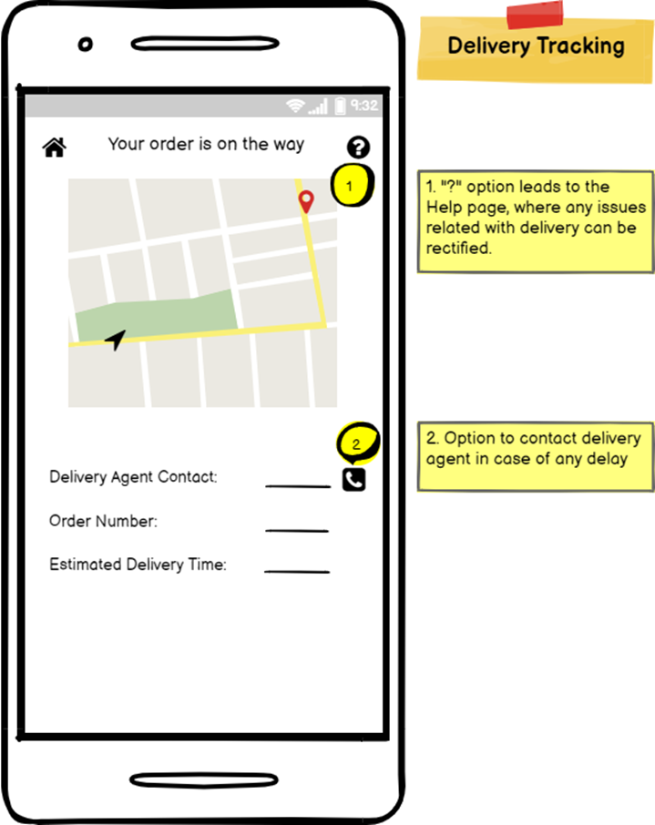
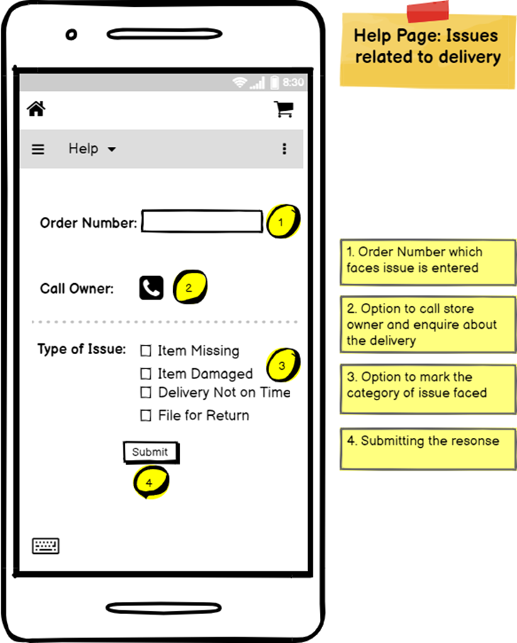
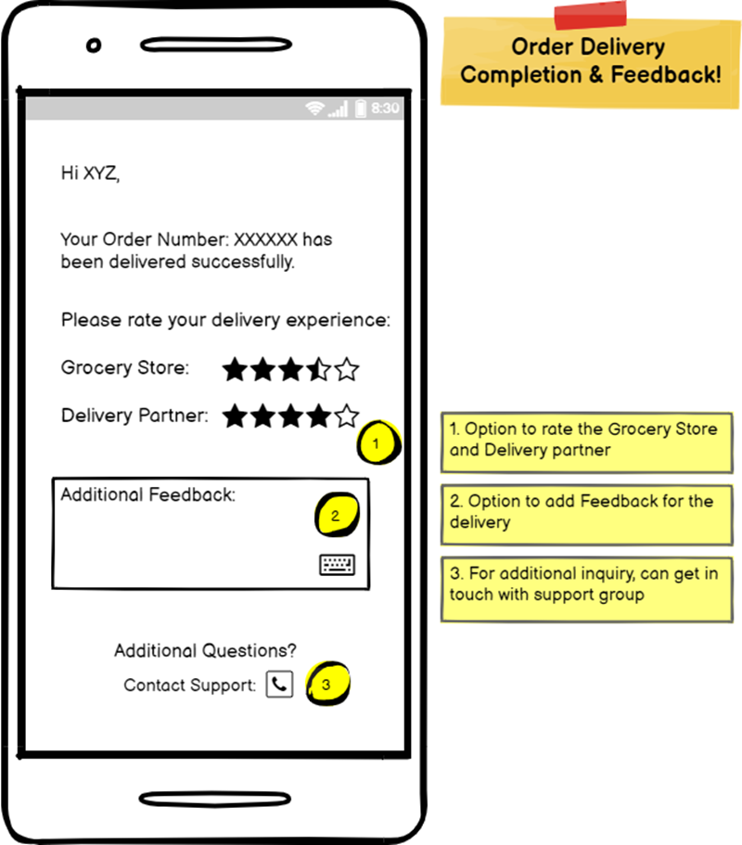
Storyboard

Slide 8
Product Roadmap
Acquiring Customers and Grocery Store Owner’.
Fixed Delivery timeline.
Q1
Increased Product Catalog.
Multi store Delivery.
Q2
Referral Program
Improved Delivery time and Distance
Q3
C2C Delivery of Product
Chemist Chat Feature
Q4

Slide 9











Product Features
User Onboarding
Save Address
Save Payment Method
Enter Current Location
Search stores
Search products
View Cart
Check Out
Live Tracking
Help- Report Issues
Feedback
Notes:
Input address and payment method
Enter current location to view nearby stores
Search a local store
Search products in a store
View cart to see product description, price and quantity
Check out page to confirm address, schedule delivery, payment method
Live delivery tracking
Use Help to report issues
Feedback page after delivery completion

Slide 10
Minimum Viable Product (MVP)
Buyer
User Registration
Create Profile
Search Store and Product(s)
Add Item to Cart
Check Out
Track Order
Help and Feedback
Seller
User Registration
Add Store(s) and Products
Accept Delivery Request from Buyer(s)
Track Order(s)
Help and Feedback

Slide 11
Key Metrics
Core User Action | Description | Metrics
Creation | Sellers list their products on the platform | Number of product listings per week Number of sellers onboarded per week
Consumption | Buyers order products | Avg. Order value No. Of orders processed per hour Revenue from repeat customer
Curation | Buyers can provide feedback on store, product, delivery agent | Customer satisfaction score
The company earns revenue every time a buyer orders grocery.
Thus, the most important metric for this product is avg order value per buyer per month.

Slide 12
Operational Needs
Development and Testing Team
Initial Development of the product – MVP.
Continuous Development of the application throughout Product Lifecycle.
Testing team - To handle prototyping and handling of new features .
Design Team
Design UI / UX of the application.
Prototype and document new design and features.
Data Analytics Team
Customer research and analysis
Competitor research and analysis
Forecasting future trends
Sales and Marketing Team
Customer and Grocery Store acquisition.
Marketing of the application.
Handle social media presence.

Slide 13
Projected Cost
Assumption | Description
No. Of pages | Total 30 pages of mobile app need for the MVP which is launched within 4 months of beginning development
Engineers needed | Each engineer develops 6 pages
Engineer; Product Manager salary | $800/month; $900/month (India)
AWS S3 infrastructure | $2,400/month
Category | Cost
Team: 1PM + 5Engineers | $58,800/month
Computer systems: 6 | $4,200
Cloud storage: Amazon S3 | $2,400/month
Total: $65,400/year

Slide 14
Risks
Risk | Mitigation
Cash Flow – Company runs burns faster than it raises money | Predictive analysis of cash flow - Plan funding raising rounds Lean design – Minimize operational cost through process optimization & feature prioritization
Privacy Concern – Stakeholders concerned about important data like bank detail, personal identity, etc. | Team skilled in secure data storage & retrieval
Interdependence – Unorganized cross-functional work may lead to out of sync teams, delaying milestones | Hiring Project Managers to track & manage projects

