Slide 1

The Seed in the Machine: Will a More Connected World Support a More Sustainable World?
Rochelle J. March | May 2017

Slide 2
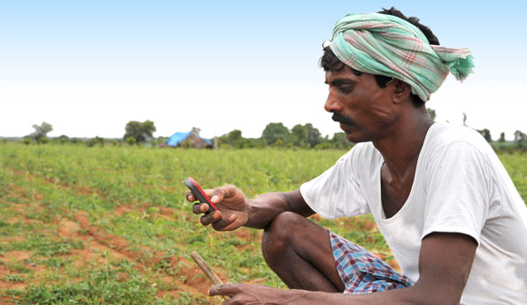
Motivation: Clarifying the link between ICT and sustainable development
The Problem
It is well-understood that there is a need for increased global sustainable development.
Information communications technology (ICT), which includes technologies such as mobile phones, broadband and the Internet, can deliver communications and therefore solutions at an unprecedented speed and scale. ICT may be a key enabler for sustainable development, particularly in its ability to:
Increase access to information
Connect people and organizations to one another
Improve efficiencies in resource, labor and market productivity
What sustainable development goals could most improve from leveraging information communications technologies?

Slide 3
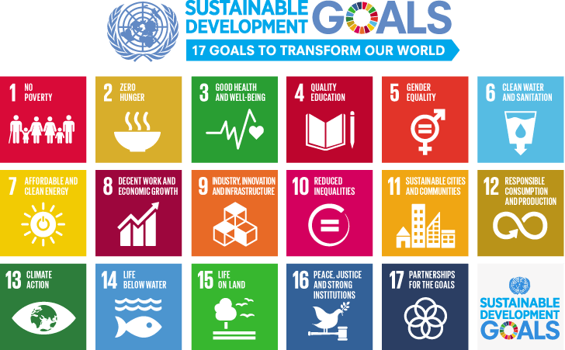
Background: The Sustainable Development Goals
History of the Sustainable Development Goals (SDGs)
At the UN Sustainable Development Summit in September 2015, over 150 world leaders agreed upon a new sustainable development agenda. For the first time, these world leaders also included business leaders, who now must clarify what commitments their companies will make to support the Goals.
The Goals offer an ambitious and transformational vision for the future, with a target of 2030. Over the next fifteen years, these Goals will help mobilize efforts to end all forms of poverty, fight inequality, and tackle climate change, among other aims.

Slide 4
Goals of the Project: Explore and Practice
Explore the relationship between ICT and sustainable development through data
Build off existing research and efforts by the UN, ITU and technology companies (e.g., Huawei, Ericsson, Intel, ARM, etc.)
Explore what are the areas to prioritize ICT investment to support further sustainable
If there is a positive relationship between ICT development and sustainable development, determine what areas could see more immediate and greater results from increased ICT investment.
Practice using supervised and unsupervised machine learning algorithms to determine correlations and clusters
Determine relationship between ICT and sustainable development using linear regression and regularization (Lasso and Ridge)
Determine if there are country clusters in terms of ICT and certain types of sustainable development

Slide 5


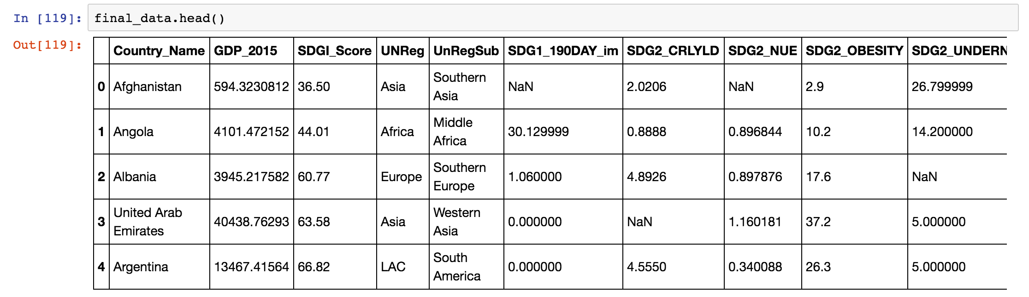
Data: Gathering and cleanup
Gather the data
Sustainable development data: http://www.sdgindex.org/download/#data
ICT data: http://www.itu.int/net4/ITU-D/idi/2016/
GDP data: http://data.worldbank.org/indicator/NY.GDP.PCAP.CD
Merge using pandas merge and an outer join
Inspect for NaNs and fill or drop them
Fill with mean of column: filled_final_data = final_data.fillna(final_data.mean())
Drop remaining nulls: final_final_data = filled_final_data.dropna(subset=['GDP_2015'])
Create dummies for regional data that is categorical
UNReg_dummies = pd.get_dummies(final_final_data.UNReg, prefix='UNReg').iloc[:, 1:]final_final_data = pd.concat([final_final_data, UNReg_dummies], axis=1)

Slide 6
Linear Regression: Steps
Data gathering and cleanup
Merge three different datasets to get data for ICT, sustainable development and GDP
Deal with NaNs (or null values)
Create dummy variables for categorical variables (e.g., UNReg, UNSubReg)
After test and train, normalize/scale data using StandardScaler
Data inspection and visualization
Correlation matrix
Linear regression
Run linear regression using Scikit-Learn for dependent variable “IDI_Value_2016” which is a measure of ICT development of a country
Test and train model
Isolate relevant features using Lasso and Ridge regression and find best coefficients via GridSearch
Robustness & model selection
Compare R² scores of different regression algorithms to determine the preferred model
Analysis of results

Slide 7
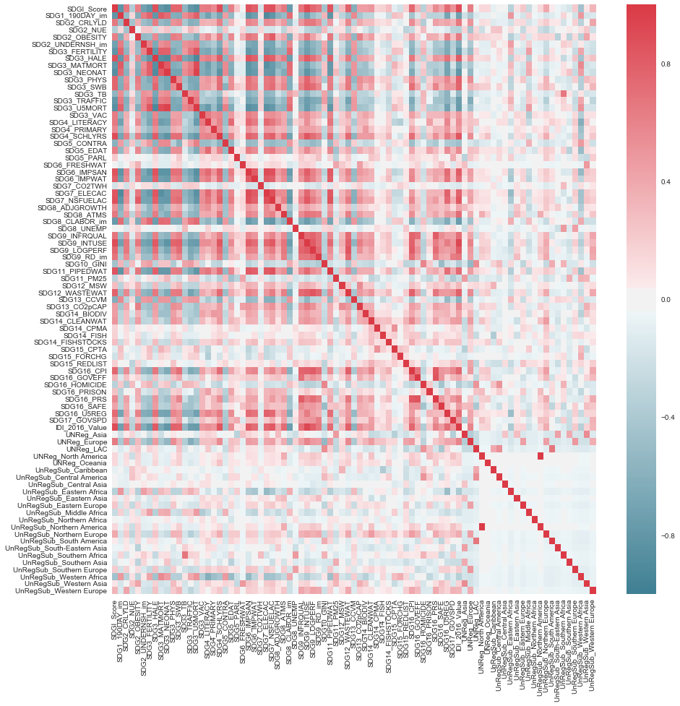
Data: Regression visualization
Correlation Matrix
Areas with dark blue and dark red have high correlation >0.8 or <-0.8
Too many variables, going to try to find the relevant ones through Lasso and Ridge

Slide 8
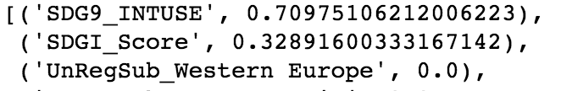
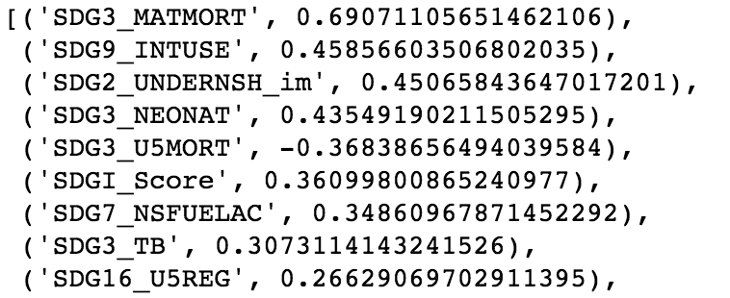
Results: Linear Regression
Linear regression
High R² = LR R2: 0.966786435801
But too many variables
Lasso
Lasso regression is a regularization that drops non-important features
R² = Lasso R2: 0.58355930028
Relevant coefficients are only two features now
Ridge
Ridge will not drop non-relevant features but will shrink them near to zero
R² = Ridge R2: 0.667475255468
Relevant coefficients are now more ~7
Analysis
Most of the high coefficients are health related (SDG 3: Good Health and Well-being), but are positively correlated except for mortality under 5 years
Second most highly correlated is Internet use, which may be collinear
Lasso
Ridge

Slide 9
Cluster Analysis: Steps
Same data gathering and clean-up
Data inspection and visualization
Scatter plots
Clustering
Run clustering algorithm
Methods tests: K-means, DBSCAN
Use Silhouette Coefficient to determine number of clusters
Robustness & model selection
Compare silhouette scores of different clustering algorithms to determine the preferred model
Analysis of results

Slide 10
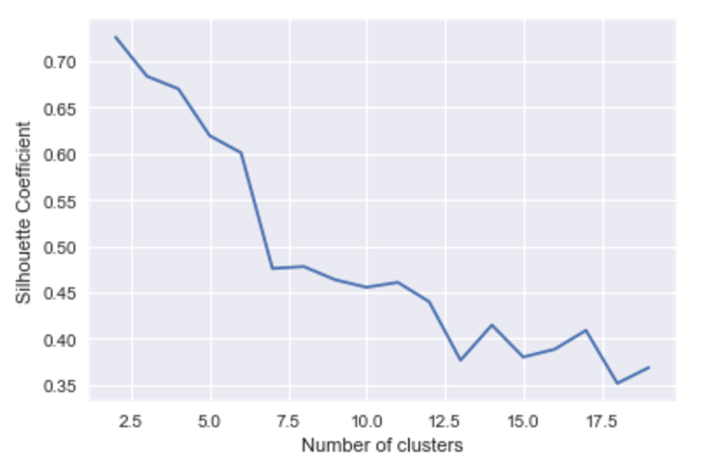
Data: Clusters visualization
Clusters determined by silhouette score – 3 clusters = 0.68399092238790271

Slide 11
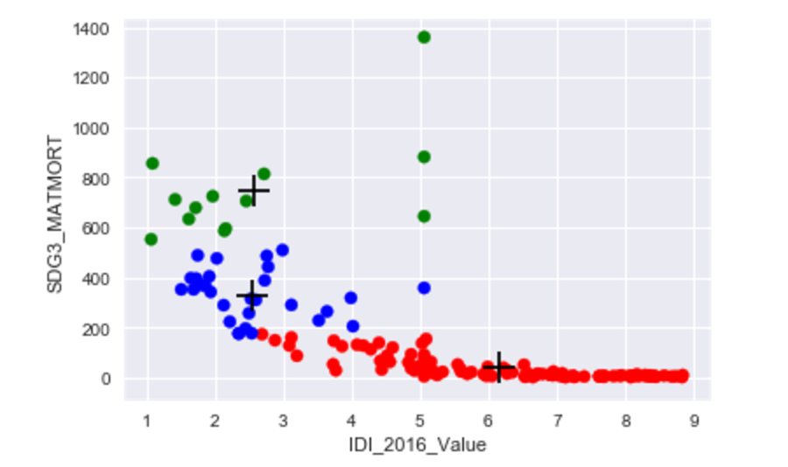
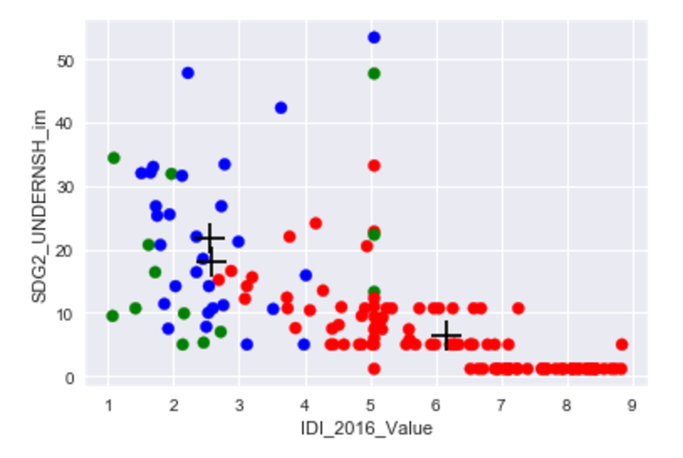
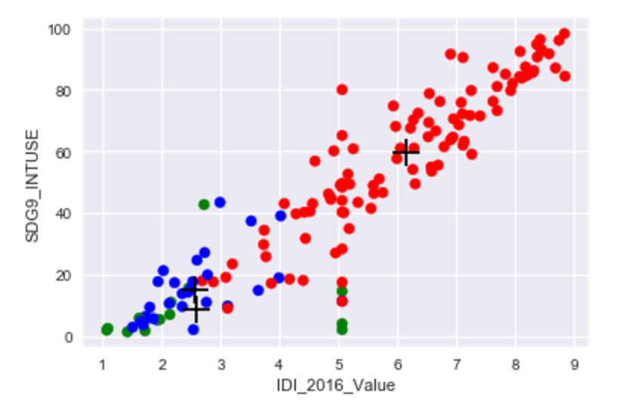
Data: Clusters visualization
Scatter plot
Variables chosen from Lasso
Correlation matrix (next time)
Clusters determined by silhouette score

Slide 12
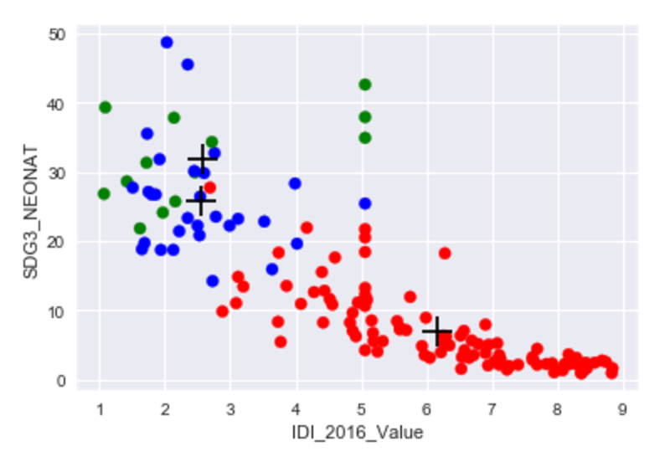
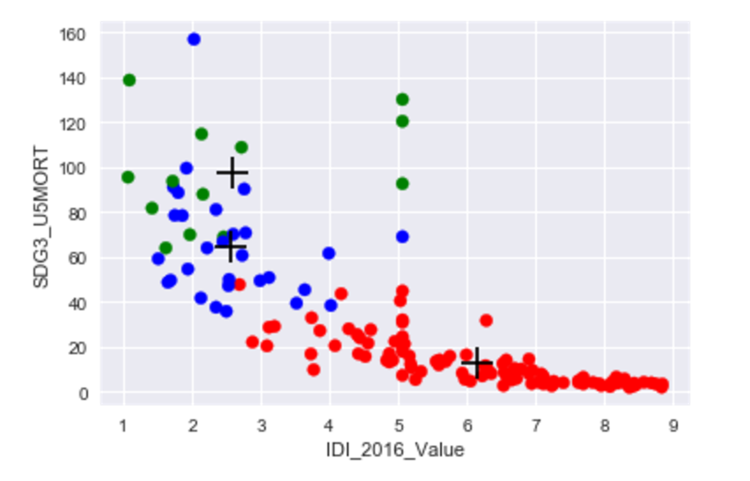
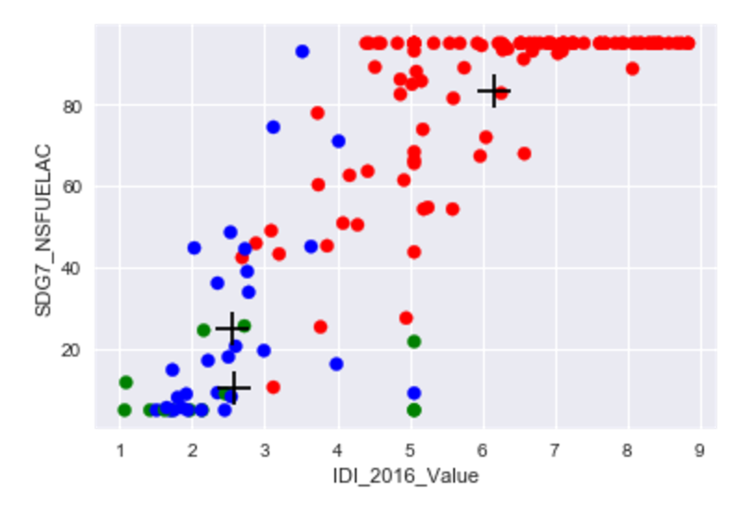
Data: Clusters visualization

Slide 13
Results: Cluster Analysis
Clustering K-means
Run clustering algorithm
Methods tests: K-means, DBSCAN
Use Silhouette Coefficient to determine number of clusters
Clustering DBSCAN
Compare silhouette scores of different clustering algorithms to determine the preferred model
Silhouette scores
Compare silhouette scores of different clustering algorithms to determine the preferred model
Cluster based on best silhouette coefficients
Analysis of Results
Merge back with data to test correlation (gdp, regions?)
What is the clustering telling me about the data?

Slide 14
Conclusion: Takeaways
What had the most impact on your work?
Isolating certain variables using Lasso and Ridge
Clustering to find similarities among countries
What can you confirm? What can you suggest? What is still to be determined?
- Health-related issues (maternal mortality, neonatal mortality, etc.) are more correlated with ICT development

Slide 15
Next Steps: Further Explorations
What should this project do moving forward?
Test more models
Try different, potentially more relevant, features
What would be the next two or three things you want to try? What impact might they have?
Try correlation of clusters with other indicative data e.g., regions, income
What might your conclusions enable others to do?
- Focus on health-related issues as an area to tailor ICT solutions
- Refine metrics for sustainable development

Slide 16
Acknowledgements
Thanks!!!

Slide 17
Citations
Links to reference material and data

Slide 18
Github
Links to github

