Slide 1
Biodiversity in National Parks
Rochelle Vermaak
2025

Slide 2
Project Overview
Goal: Analyze biodiversity in US national parks
Data: species_info.csv & observations.csv

Slide 3
Key Questions
- Which species are at risk?
- Which categories are most protected?
- Which parks report the most endangered species?

Slide 4
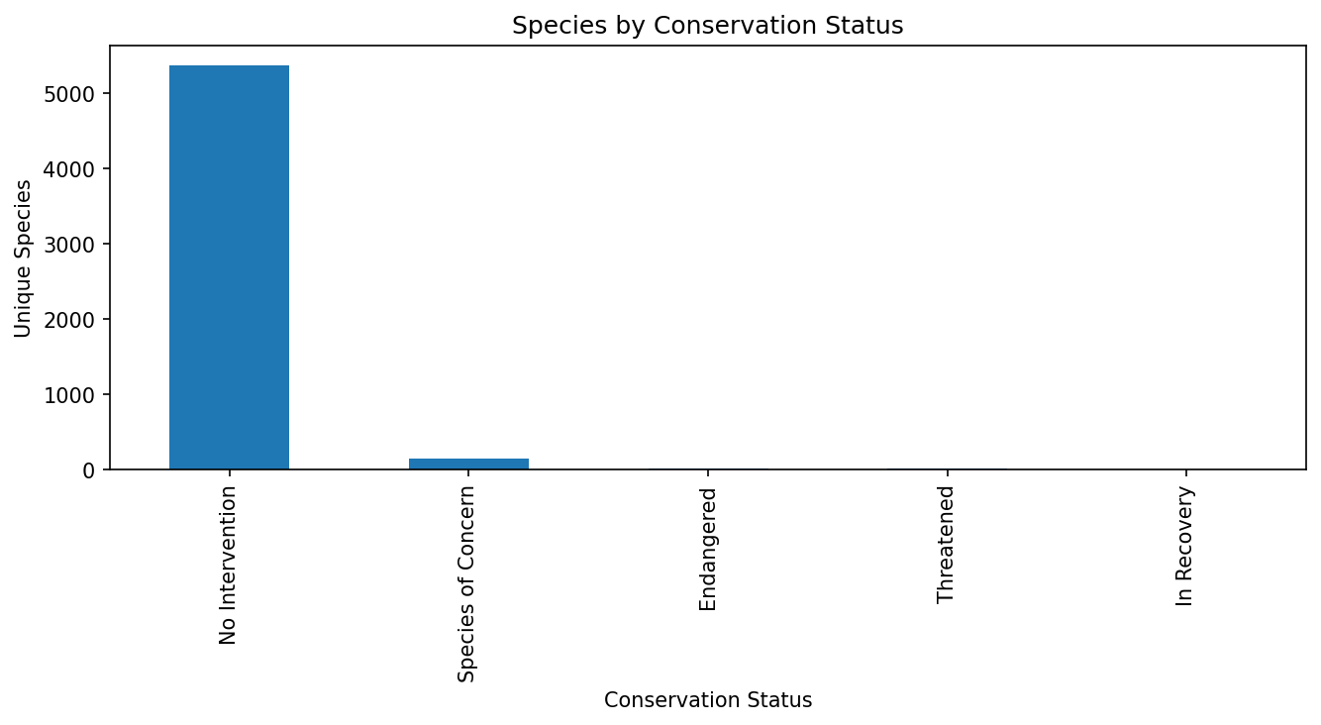
Species by Conservation Status

Slide 5
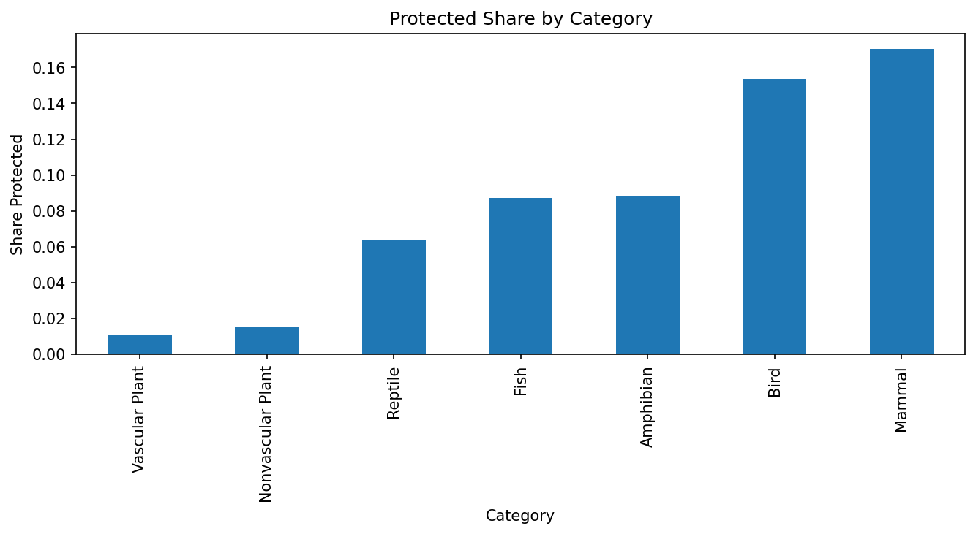
Protected Share by Category

Slide 6
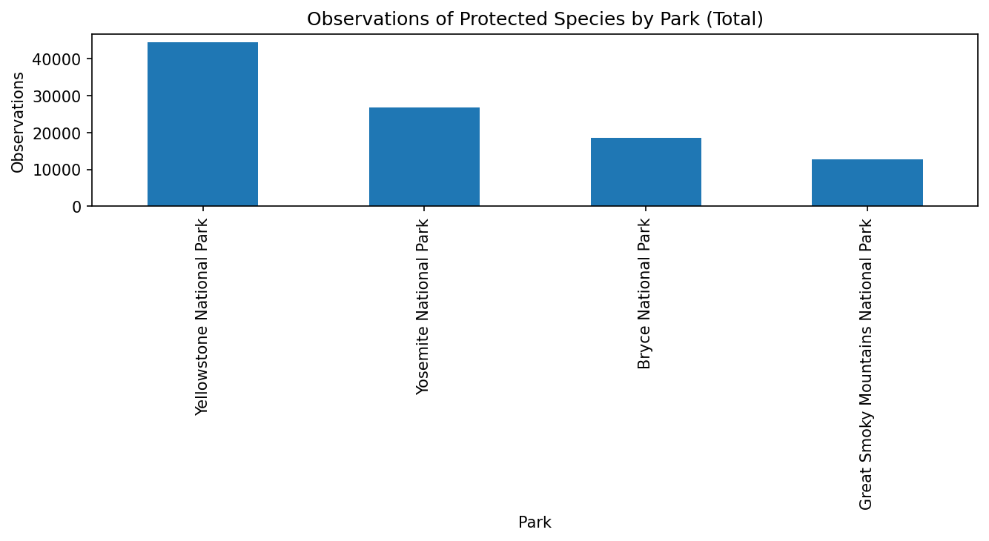
Protected Observations by Park

Slide 7
Key Insights
- Most species are 'No Intervention', but many are protected
- Mammals & birds have higher protection rates
- Yosemite & Great Smoky show the highest protected sightings

Slide 8
Conclusions & Next Steps
- Some categories remain vulnerable
- Next: hypothesis testing, track trends over time, expand dataset

Slide 9
Thank You
GitHub: https://github.com/rochellea6464-sys/biodiversity-national-parks
Author: Rochelle Vermaak

