Slide 1

Assessing the Potential Opportunities of User-Provided Connectivity Roch Guérin Washington University in St. Louis
Workshop on Information & Communication Systems and their Application to Vertical Sectors
Montevideo, Uruguay, March 16-18, 2015

Slide 2
Acknowledgments
This talk is based on joint work with M. H. Afrasiabi (Ph.D. student at Penn) and was funded by NSF grant CNS-0915982
All errors and/or lack of clarity are, however, my own doing
More details can be found at
[1] M. H. Afrasiabi and R. Guérin, “Exploring User-Provided Connectivity.” To appear in ACM Transactions on Networking, November 2014 (full-length version available at http://openscholarship.wustl.edu/cse_research/157/)
[2] M. H. Afrasiabi and R. Guérin, “Pricing Strategies for User-Provided Connectivity Services.” Proc. IEEE INFOCOM 2012 mini-conference, Orlando, FL, March 2012.
[3] M. H. Afrasiabi and R. Guérin, “Exploring User-Provided Connectivity - A Simple Model.” Proc. ICQT'11 Workshop, Paris, France, October 2011.

Slide 3
Premises
The rise of the sharing economy
Car sharing, e.g., Uber, Lyft, RelayRides, Zipcar, car2go, etc.
Home sharing, e.g., Airbnb, HomeAway, VRBO, Wimdu, 9flats, etc.
Connectivity sharing: FON, AnyFi, airfy, (KeyWifi), Comcast XFINITY WiFi sharing, etc.
The user as the infrastructure
Organic growth
Lower costs
But when and how does it work or be made to work?

Slide 4

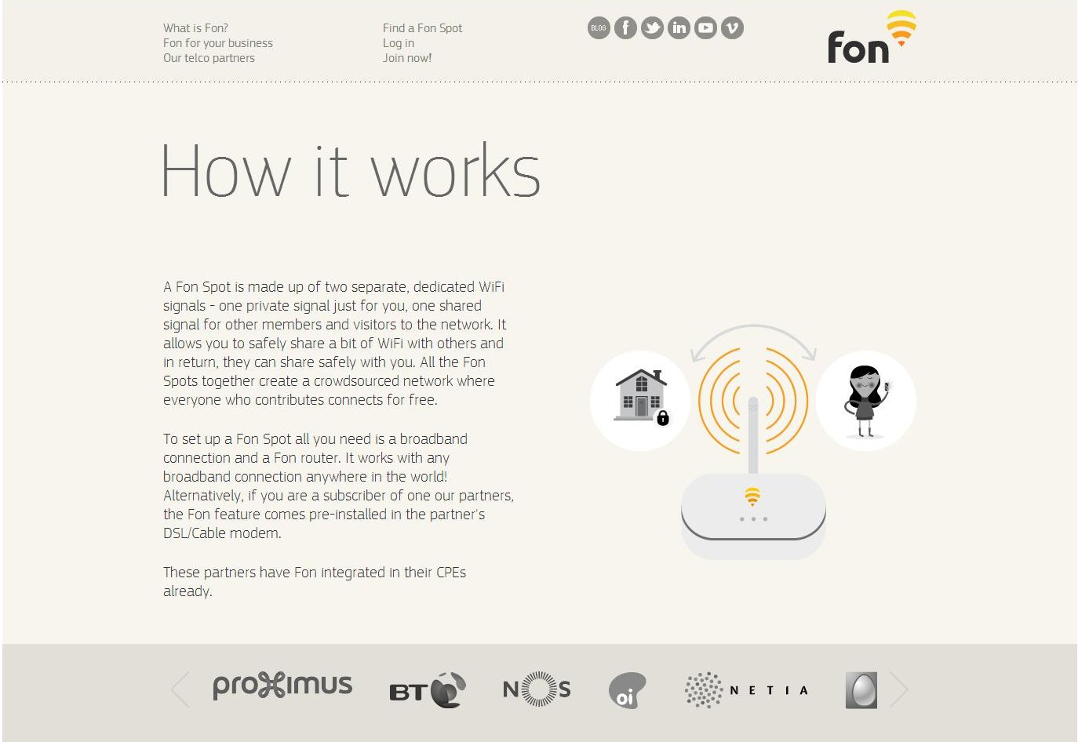
The FON Model (Over 14 Millions Users)
FON users trade ability to access other users’ WiFi hotspots for reciprocation (i.e., allowing other FON users to access their own WiFi hotspot)
Alternative options are also possible, e.g., provide access in exchange for compensation but without reciprocation rights

Slide 5
Framing the Investigation
Key features behind a “user as the network” system
The network value depends on adoption
More users means broader coverage
But, with more users, having to share (whether at home or on the road) becomes more likely
It also depends on how often users need access to and can access shared resources
FON’s main benefit is while “roaming”
FON is only useful if you can find a FON spot
Finally, it depends on cost, pricing, and possible “compensation” (for sharing)

Slide 6
Methodology
Develop and analyze a “stylized” analytical model
Simplifying assumptions for analytical tractability
Explore solutions’ structure
Extract insight and guidelines
Validation through numerical evaluation and simulations
Relaxation of simplifying assumptions
Do major outcomes still (qualitatively) hold?

Slide 7
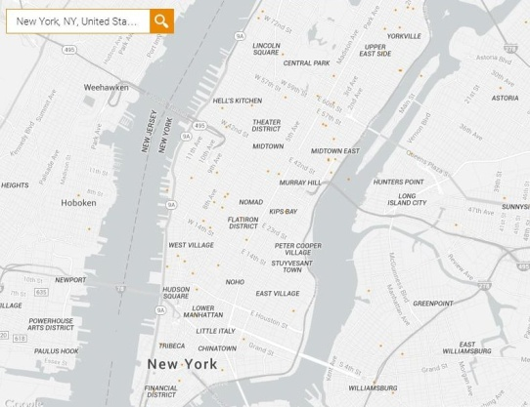
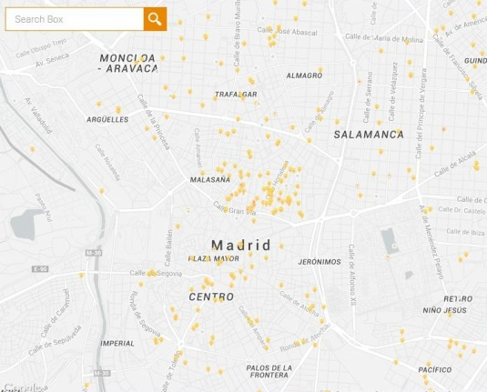
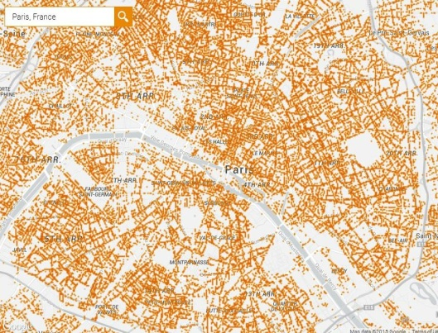
High-Level Model Definition
Consider a service offered to a (very) large population of heterogeneous users
Users evaluate the service and adopt (purchase), only if they derive positive value from it
Value is measured through a utility function incorporating different parameters that characterize the service and its users
As mentioned, a key aspect of a FON-like service is that its value changes with its adoption (because of positive and negative externalities)
Notes:
Model is based on individual user decisions to generate aggregate behavior rather than directly characterize aggregate behaviors, e.g., based on diffusion equation.

Slide 8
Specifying The Model
Users’ heterogeneity is in their roaming propensity θ, θ ∈[0,1]
The main feature of a FON-like service is connectivity while away from home
Utility of user with roaming value θ given a set of adopters Θ:
U(Θ,θ) = F(θ,κ(Θ)) + G(m(Θ)) − p(Θ,θ)
F(.,.): value of connectivity (at home and while roaming)
κ(Θ): service coverage given Θ
G(.): (negative) impact of roaming traffic, and positive impact of possible compensation
m(Θ): volume of roaming traffic generated by Θ adopters
p(Θ, θ): service price for user θ, given Θ
User θ adopts iff U(Θ,θ) > 0

Slide 9
Making Things Tractable (To Facilitate Analytical Insight)
Linear value functions and uniform distributions
Value is proportional to frequency of connectivity
θ is uniformly distributed in [0,1]
Users are uniformly distributed over service area
Service coverage κ equals adoption level x
Roaming patterns are uniform over service area
Roaming traffic m is evenly distributed across adopters
Each user contributes one unit of traffic
Utility is then of the form
U(Θ,θ) = (1 – θ)γ + θrx(Θ) – cm(Θ) – p(Θ,θ)
γ is value of home connectivity, r is value of roaming connectivity, and c is impact of roaming traffic (minus any compensation) – We assume c < r
at home
roaming
finding connectivity

Slide 10
Questions of Interest
When can the service succeed and generate substantial value?
Maximum total welfare?
When are maximum welfare and maximum adoption congruent?
What pricing strategies?
Pricing controls
Users adoption
Provider’s ability to extract welfare from users
Whether welfare or profit is maximized, or both
Complexity of implementation (how much information)
Notes:
Mention theory of clubs that involve positive and negative externalities and for which optimal adoption is typically at some intermediate value

Slide 11
A Two-Prong Investigation
Characterizing system welfare
How useful is the service and for whom?
Exploring pricing strategies and their impact
A benchmark: Discriminatory pricing
Four practical pricing strategies with different levels of implementation complexity

Slide 12
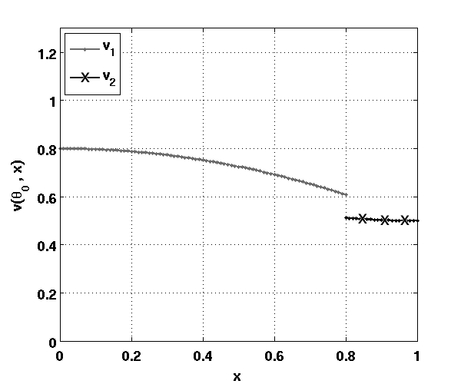
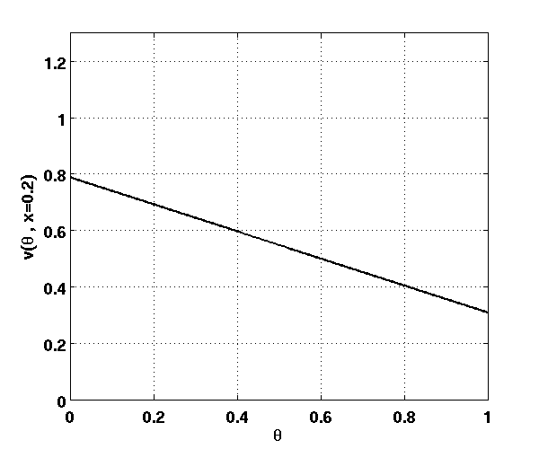
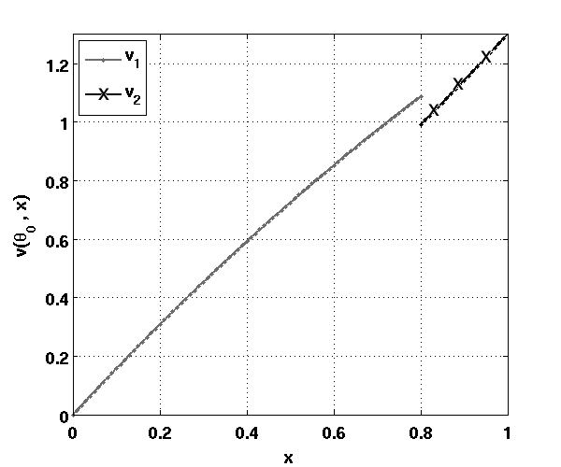
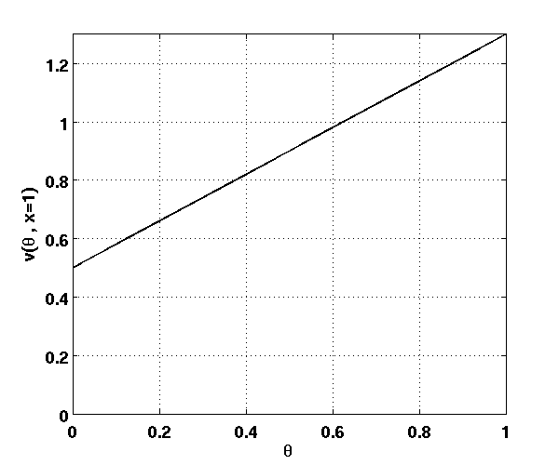
Where Is The Value in UPC?
Value of user θ: (1 – θ)γ + θrx – cm(Θ) – e, e = cost
Different users see different changes in the value they contribute as adoption varies
Low θ users see decreases in utility as x increases
High θ users see increases in utility as x increases
Individual value
Overall value
θ = 0 user
x = 0.2
θ = 1 user
x = 1

Slide 13
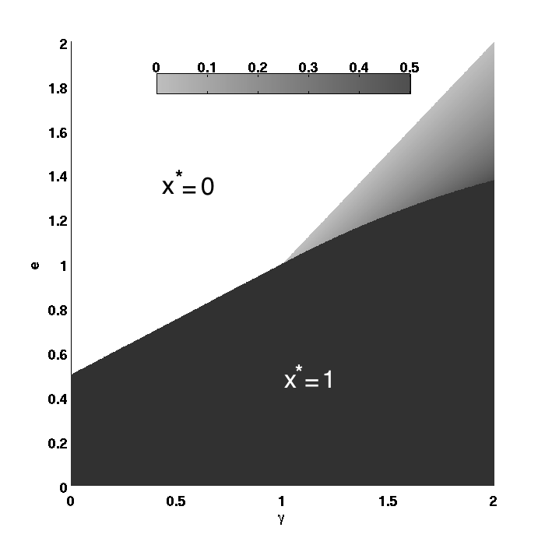
Maximizing Welfare
Value of user θ: (1 – θ)γ + θrx – cm(Θ) – e, e = cost
Two main welfare regimes
γ ≤ (r – c), welfare is maximized at full or zero adoption depending on service cost, e
γ > (r – c), intermediate regime can emerge
Intuition: When home connectivity value is
low relative to the net value of roaming connectivity, service cost is the main factor
high relative to the net value of roaming connectivity, limiting adoption can be preferable when service cost is high
1.
2.
Service cost (e)
e = (γ + r – c)/2
Value of home connectivity (γ)
(r – c = 1)
Notes:
Reminder of difference with standard results from theory of clubs

Slide 14
From Welfare to Profit
Provider seeks control on converting welfare into profit
Pricing is the tool that realizes this goal
Users’ heterogeneity implies pricing heterogeneity
Pricing also affects adoption (service value varies)
Discriminatory pricing as an impractical benchmark
Each user’s price set to “value + cost – ε”, ε > 0
p(Θ,θ) = [(1 – θ)γ + θrx – cm(Θ) – e] + e – ε
Realizes full adoption (all users have positive utility ε > 0)
Can arbitrarily adjust transfer of welfare between users and provider
Note: Setting p(Θ,θ) = e, also results in a provider’s profit of 0, but does so very differently (more on this later)
Notes:
Note: Maximizing user welfare

Slide 15
Pricing Strategies
We investigate four (practical) pricing policies that offer different trade-offs between efficiency and complexity
Usage based pricing, p_{h} per unit of traffic from home and p_{r} per unit of traffic while roaming
Hybrid pricing, fixed price p_{h} for home connectivity, and p_{r} per unit of traffic while roaming
Fixed price p for home and roaming connectivity (FON model)
Pricing options: Users choose the best of two alternatives
Fixed price p_{h} for home connectivity and free roaming
Fixed price p_{h} for home connectivity, p_{r} per unit of traffic while roaming, and compensation of b per unit of roaming traffic using their home access

Slide 16
Usage-Based Pricing
Mimics discriminatory pricing (based on roaming profile, θ)
p(u_{h},u_{r}) = p_{h} . u_{h} + p_{r} . u_{r} – a, (a is allowance, and u_{h} and u_{r} are home and roaming usages, respectively)
p_{θ} = p_{h}(1 – θ) + p_{r}θx(Θ) – a
U(Θ,θ) = γ(1 – θ) + rθx(Θ) – cm(Θ) – p_{h}(1 – θ) – p_{r}θx(Θ) + a
Set p_{h} = γ and p_{r} = r, ⇒ U(Θ,θ) = a – cm(Θ), ∀ θ, i.e., for all users
Full adoption, i.e., x([0,1]) = 1, (hence, maximum welfare) is readily realized by setting a > cm([0,1]) (= c/2 for uniform roaming traffic)
All users have the same positive utility
Allowance, a, is a “control knob” for arbitrarily shifting welfare from users to provider (from 0 to max value)
Notes:
Mention it ignores other utility factors that account for users’ psychological preferences for fixed prices. It is possible to account for such effects, but at the cost of additional complexity in the models.

Slide 17
Usage-Based Pricing Summary
A highly effective though complex policy
Can simultaneously maximize welfare and profit
Can be “tuned” to arbitrarily shift welfare from users to provider
Note: Maximizing welfare may require subsidies
p_{θ} = γ(1 – θ) + rθ – a = γ – a + θ(r – γ)
p_{θ} < 0 ⇔ θ < (a – γ)/(r – γ)
Sedentary users must be enticed to stay when value of home connectivity, γ, is low compared to allowance, a

Slide 18
Hybrid Pricing
Fixed-price, p_{h}, at home, and usage-based roaming pricing, p_{r}
p(u_{r}) = p_{h} + p_{r} . u_{r}, = p_{h} + p_{r}θx(Θ)
U(Θ,θ) = γ(1 – θ) + rθx(Θ) – cm(Θ) – p_{h} – p_{r}θx(Θ)
= (γ – cm(Θ) – p_{h} ) + θ(rx(Θ) – γ – p_{r}x(Θ))
= (γ – c/2 – p_{h} ) + θ(r – γ – p_{r}), at full adoption, x = 1
Full adoption is unique equilibrium iff
θ = 0 user has positive utility, i.e., p_{h} < γ – c/2
θ = 1 user has positive utility, i.e., r – c/2 > p_{r} + p_{h}
And either γ < c, or when γ ≥ c, a more complex condition that upper-bounds p_{h} based on a decreasing function of p_{r}
The latter can prevent recouping all welfare as profit
Notes:
To recoup all welfare as profit, you need p_{h} = γ – c/2 + ε and p_{r} = r – γ + ε . All users have utility of ε at full adoption. However, when γ ≥ c, the initial “utility margin,” c/2 at low adoption is lower, and utility initially decreases faster than it increases, for a net overall decrease. This can result in an intermediate adoption point with negative utility.

Slide 19
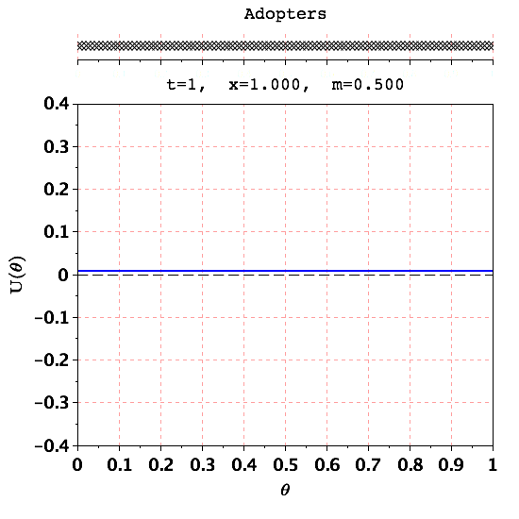
Max Profit vs. Max Welfare
Welfare = profit ⇒ p_{h} = γ – c/2 – ε and p_{r} = r – γ – ε, ε > 0, ε ≈ 0
r = 1.6, c = 0.8, γ = 1 (>0.8), p_{h} = 0.59, p_{r} = 0.6
As adoption increases, positive and negative externalities compete to change users’ utility. When γ ≥ c, the relative utility margin of early adopters (low θ) is lower, and a “cross-over” becomes possible

Slide 20
Fixed Price Policy (FON-Like)
Structurally, a fixed price cannot maximize profit and/or welfare
Unable to capture different users’ utility
Unable to afford subsidies when needed
But it has the benefit of simplicity
Two main questions
Price effect on ability to maximize welfare
Tension between profit and welfare maximization

Slide 21
Fixed Price Policy Properties
U(Θ,θ) = γ(1 – θ) + rθx(Θ) – cm(Θ) – p
U([0,1],θ) = γ – c/2 – p + θ(r – γ)
Maximizing welfare calls for a low enough price
p < min {γ – c/2, γ – γ²/(4r – 2c)}
Positive utility for θ = 0 user at full adoption, and additional condition to avoid “cross-over” as adoption increases
However, simultaneously maximizing welfare and profit conflicts unless negative impact of roaming traffic, c, is small

Slide 22
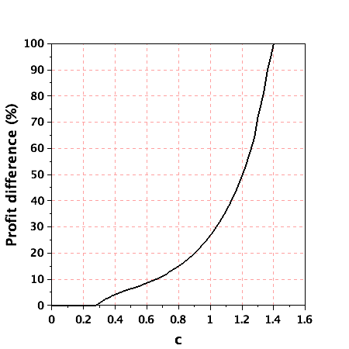
The “Cost” of Welfare Maximization
Targeting maximum service adoption can result in a substantial drop in profit
Controlling the negative impact of roaming traffic is key to mitigating this
% drop in profit from welfare maximization
c

Slide 23
Giving Users Pricing Options
Motivation: Instead of subsidies, users that roam infrequently are offered compensation, but they have to pay when roaming
Pay p plus pay p_{r} when roaming, but get compensated b per unit of roaming traffic your home WiFi carries; or
Pay p and roam for free
Seeks to combine the best of fixed-price and hybrid policies
However, giving users the option to choose between policies adds significant complexity to the analysis
Adoption regions can become disconnected

Slide 24
Adoption Progression Under a Two-Price Policy
r = 1.6, c = 0.8, γ = 0.2
p = 0.371, p_{r} = 0.08, b = 0.5

Slide 25
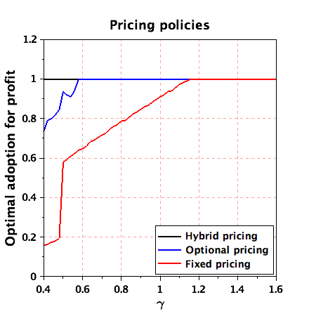
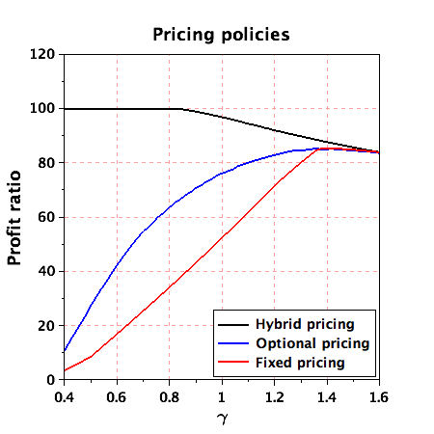
Hybrid vs. Fixed vs. Optional Pricing
Adoption under maximum profit
Max profit/Max welfare (%)
Of note: Optimizing profit under the hybrid policy still maximizes welfare (though the profit needs not be equal to the maximum possible profit)
Optional pricing policy offers and intermediate solution between hybrid and fixed-price policies
It achieves maximum adoption in most scenarios,
It improves profit over the fixed-prince policy, though it still lags behind the hybrid policy

Slide 26
Summary
Unless the value of home connectivity is high relative to the net value of roaming connectivity, the value of UPC grows with its user-base
A usage-based pricing scheme offers the most flexibility in maximizing value and in allocating it between users and provider, but it has a high implementation cost
A hybrid scheme offers a possible trade-off between efficiency and cost
Main deficiency, somewhat surprisingly, arises when impact of roaming traffic is small
It can be addressed through the use of “introductory pricing”
A fixed-price scheme (FON) has the benefit of simplicity, but can quickly limit adoption in favor of higher profits
Impact of roaming traffic needs to be tightly controlled
Two-price option can improve on the fixed-price policy at the cost of some additional complexity
The findings hold under various relaxations of the simplifying assumptions used to facilitate analytical tractability

