Slide 1
US Accidents 2019 – Technical Presentation
Date: 07/30/2020
Presenter: Rochini Paidisetty

Slide 2
Analyse US accidents data of 2019 to provide Recommendations based on the insights generated and build a model to predict the severity of accidents given the weather conditions as input.
!
To understand if there are any patterns or any specific location or weather specific conditions leading to the accidents.
Problem 1
Identify any patterns or outstanding observations to provide recommendations.
!
To generate a model that can take the weather conditions and predict the severity of an accident.
Problem 3
Generate a model to predict the severity of an accident.

Slide 3
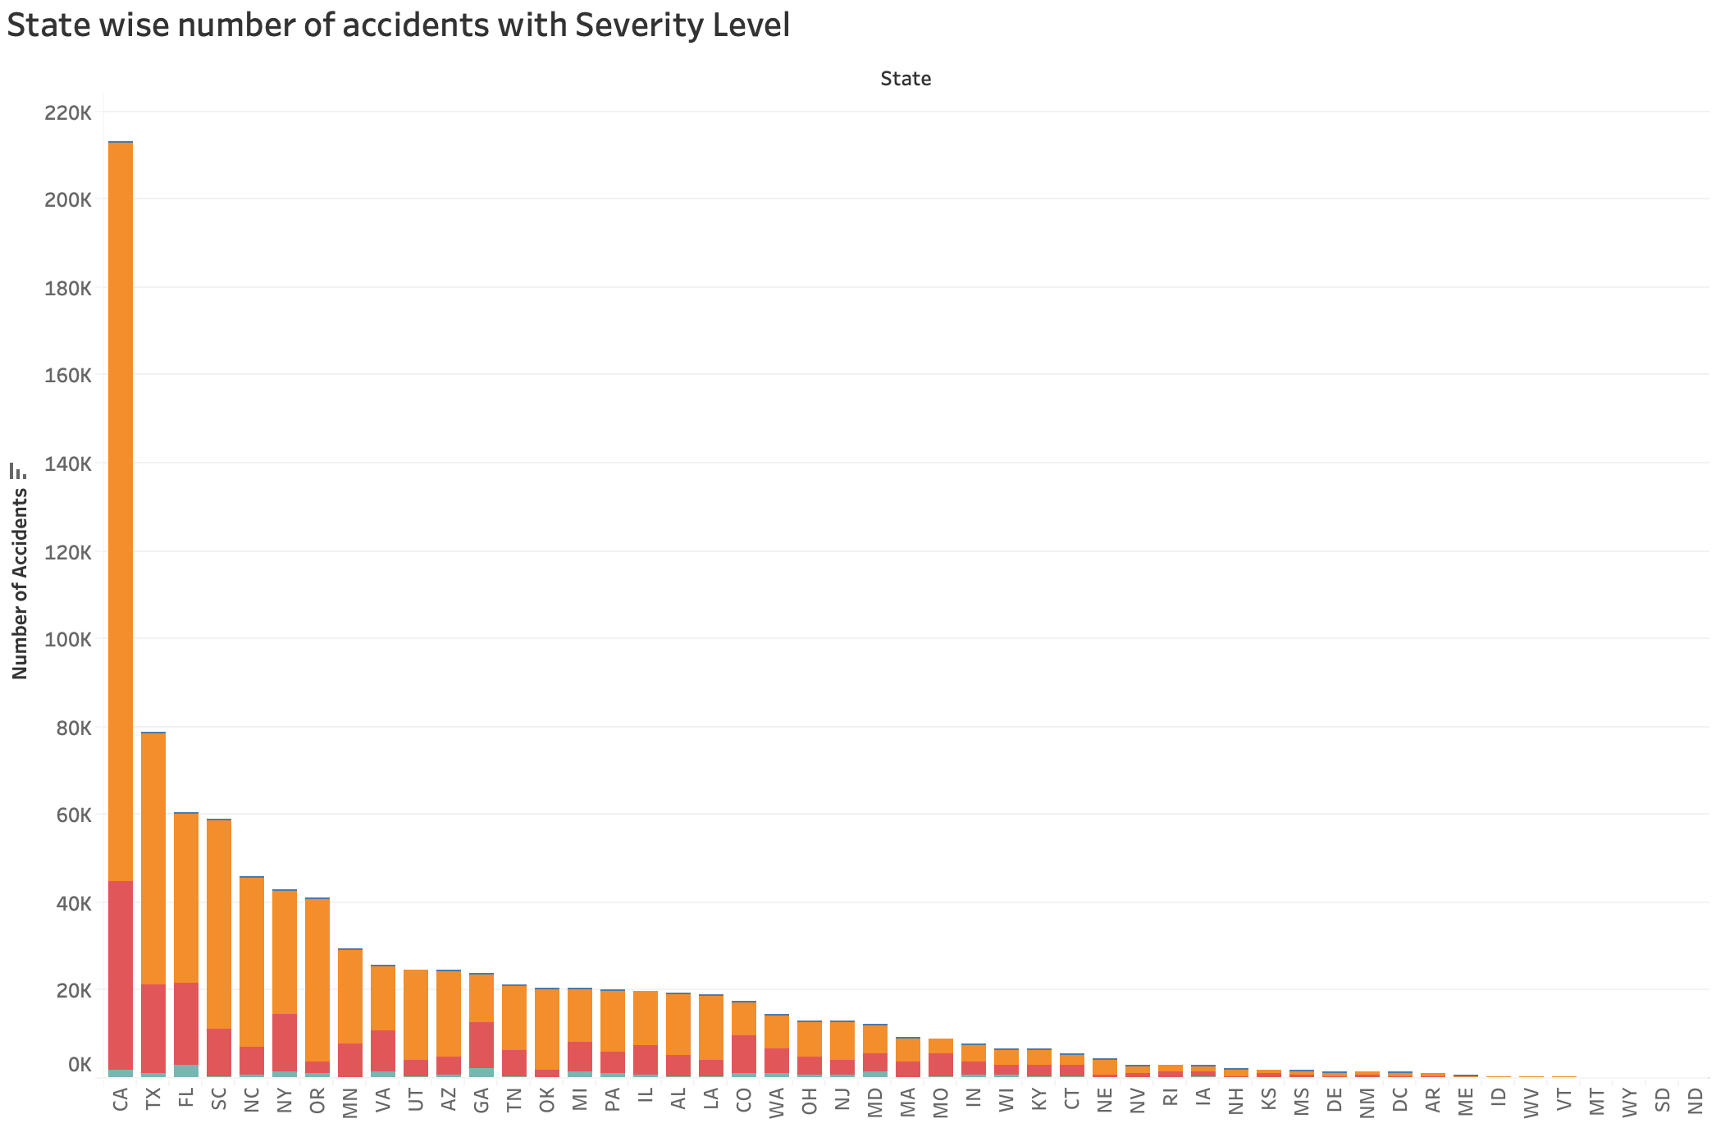
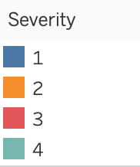
California is a state with highest number of accidents of 213,307 in USA.
CA with highest number of accidents of 213,307
Key Insights
1. The number of accidents in California are more than double the number of accidents of the next highest state, Texas.
Source: US Accidents Data set from Kaggle

Slide 4
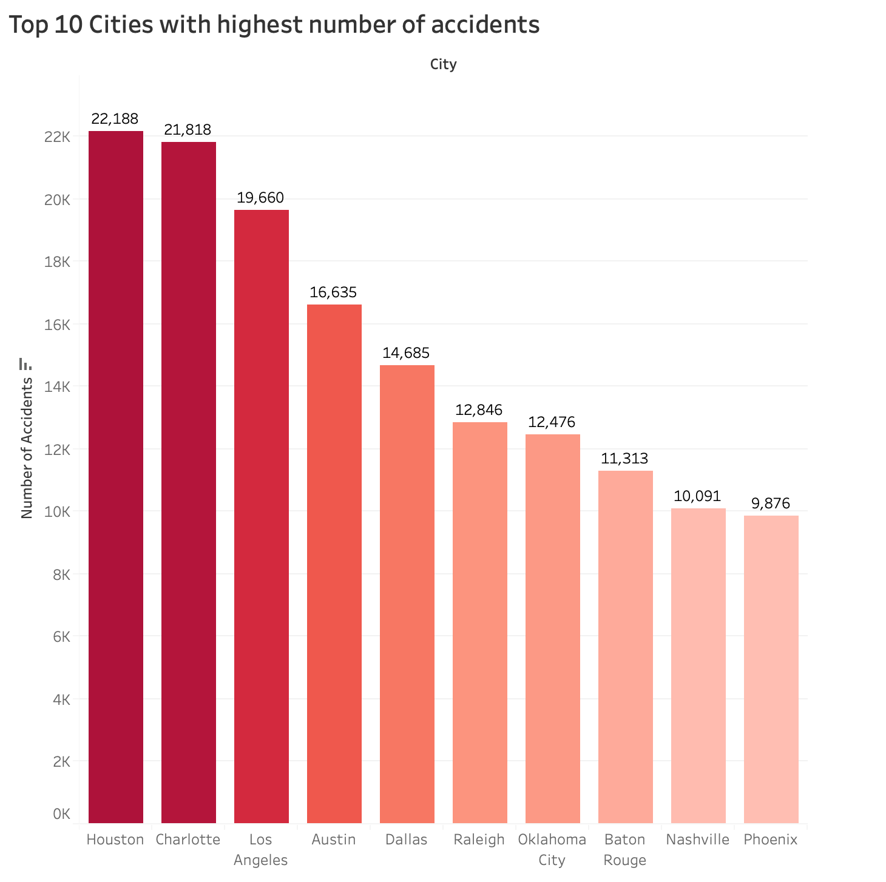
Three cities from the top five Cities with highest number of accidents are from the state Texas.
Key Insights
Houston is the city with highest number of Accidents of 22,188.
More Vehicle speed monitors to be installed on the roads to check for the obedience of the Speed limits.
Traffic tickets issuance / traffic rules should be made more stringent to inculcate careful drive for individuals.

Slide 5
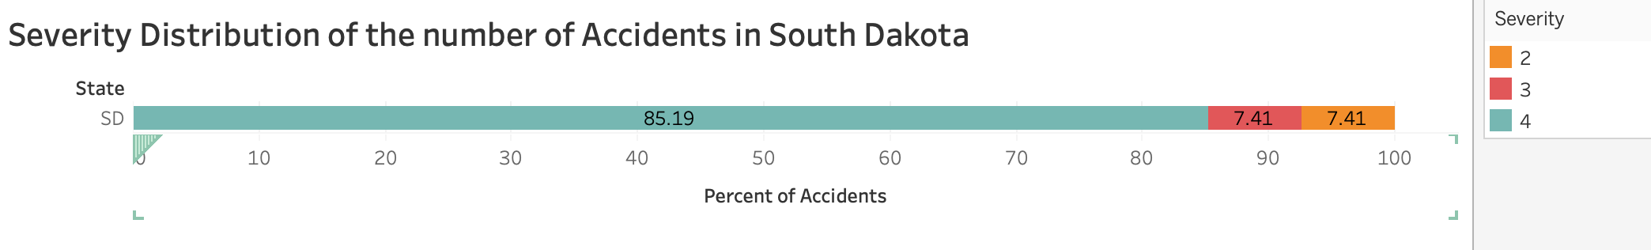
85% of the accidents in South Dakota are of Severity - 4
Key Insights
1. Traffic Department of South Dakota needs to prioritize and look for better ways to clear the accident cite to reduce the impact on the traffic.

Slide 6
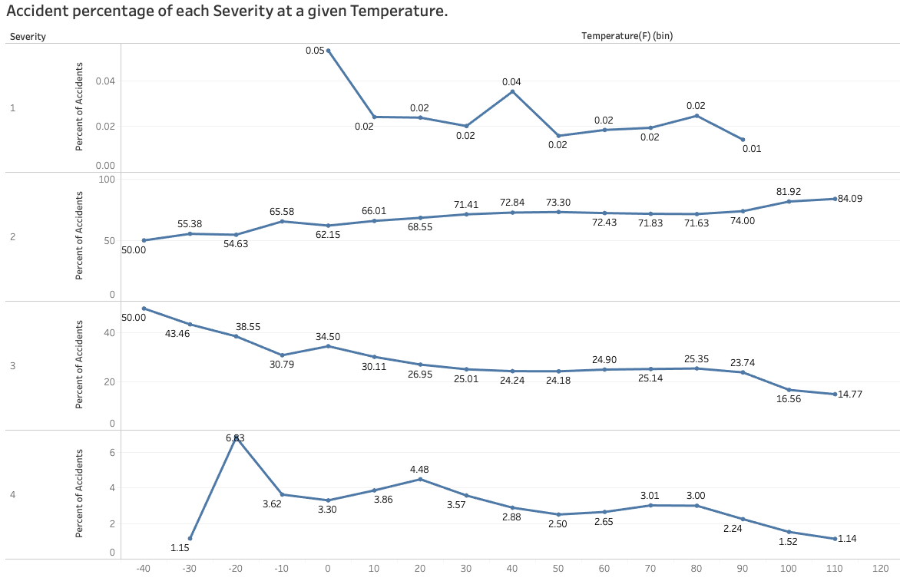
As the Temperature increases, there is slight decrease in the Severity of the accidents.

Slide 7
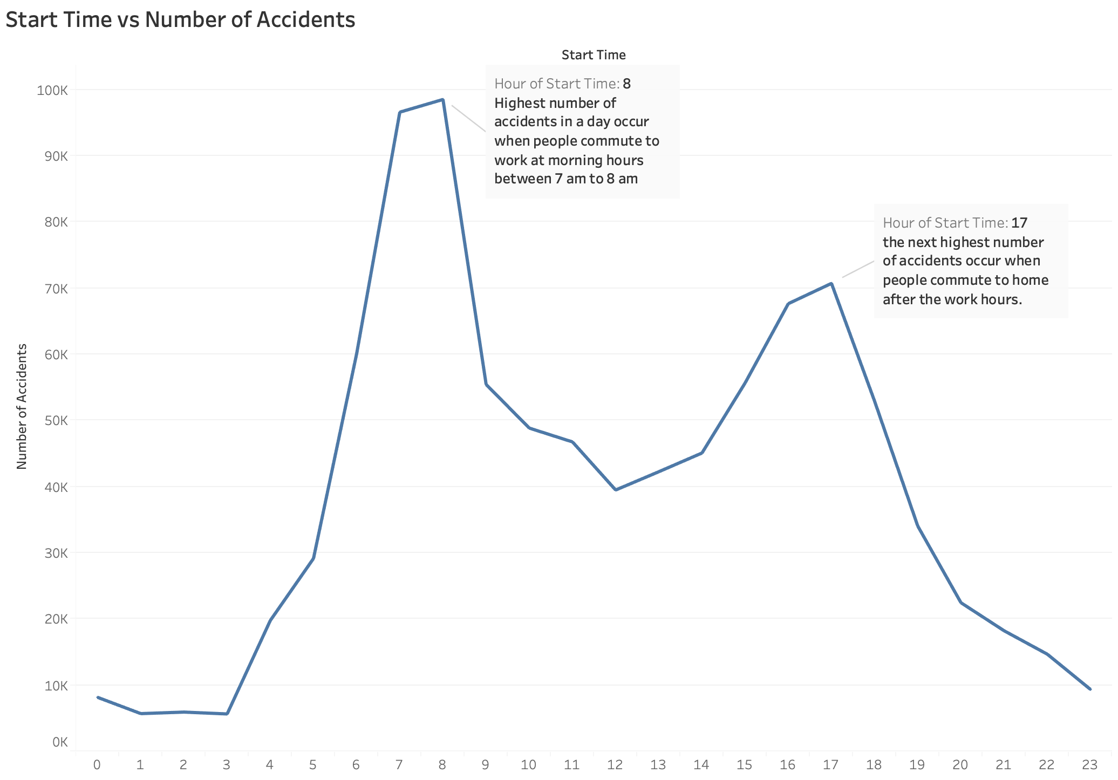
Highest number of accidents in a day occurred during the start and end timings of office hours.

Slide 8
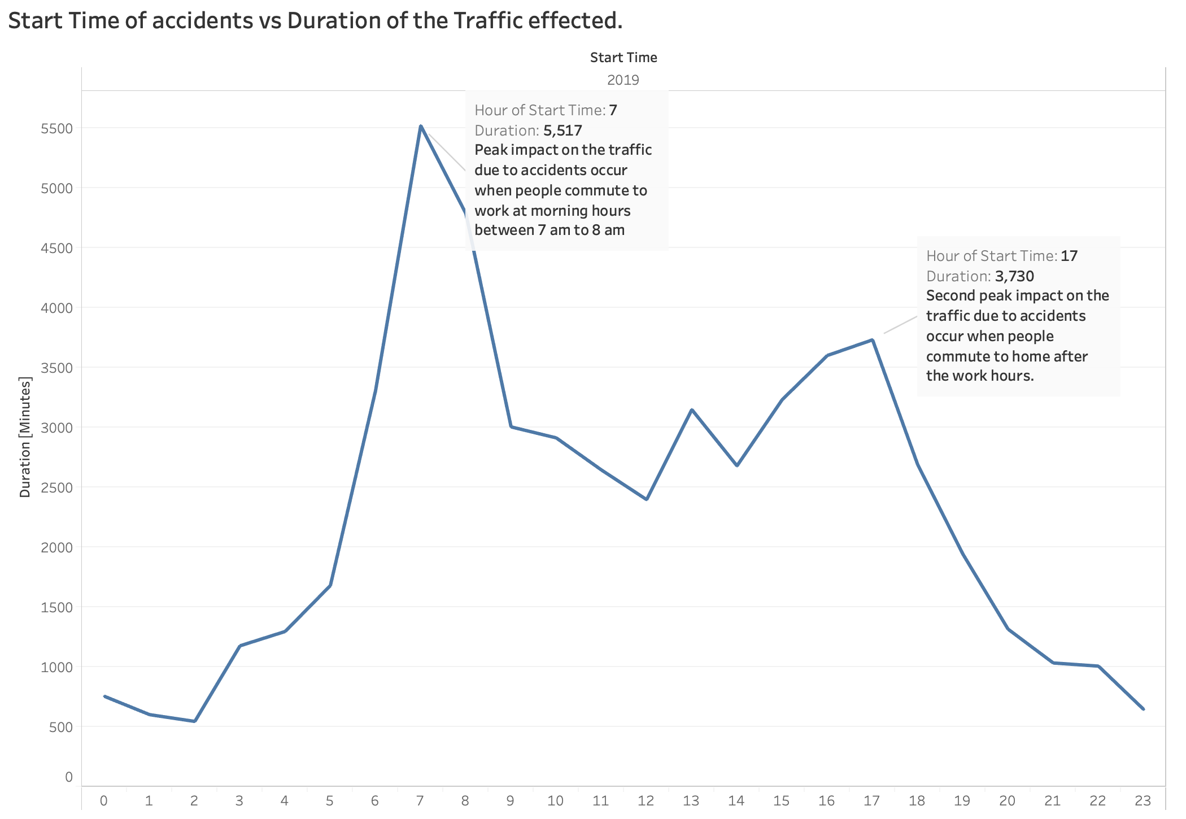
The longest effect of accidents on traffic in a day are at the start and end timings of the office hours

Slide 9
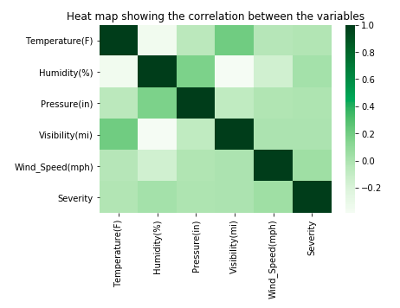
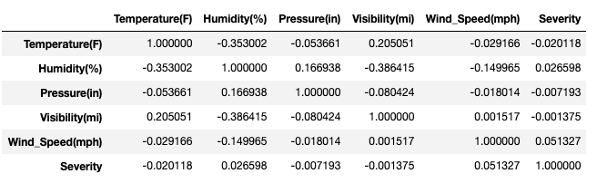
The correlation between each independent variable with the target variable Severity is very low.

Slide 10
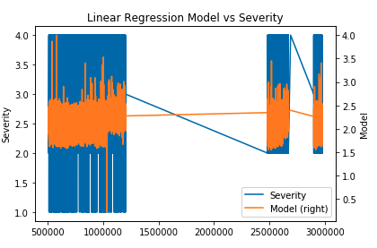
A Linear Regression Model is generated to predict the severity of the accidents with the weather conditions as independent variables
Key Insights
1. Though individual independent variable has a very low correlation with the target variable, all the independent variable together make a best fit model to predict the severity of an accident.

Slide 11
Recommendations:
More Vehicle speed monitors to be installed on the roads of California and Texas to check for the obedience of the Speed limits.
Traffic tickets issuance / traffic rules should be made more stringent in California and Texas to inculcate careful drive for individuals.
Traffic Department of South Dakota needs to prioritize and look for better ways to clear the accident cite to reduce the impact on the traffic.
A predictive model is generated to predict the Severity of an accidents given the weather conditions.
This model be used by the traffic team to predict the severity of an accident occurred and act in accordance with it.

