Slide 1
HTML TUTORIAL WEBSITE
Prepared By:
Rochisha Jaiswal
Date: 10-3-2019

Slide 2
Presentation Overview
Objective
Navigation Bars
Buttons
Code Snippet
CSS
Feedback form
Resources Used
Thank You

Slide 3
OBJECTIVE:
In this project I have created a HTML tutorial on form controls.
Implementation of css, bootstrap has been done. This project was highly helpful in increasing my knowledge about HTML, Bootstrap and CSS.
Today all of us prefer studying online as it gives us more flexibility i.e flexible schedule and environment. The advantage of online learning is that there is a support team which guides us throught the learning.
Also, one of the main benefits of online learning is that it lowers the cost as one just needs an internet connection and a personal computer and can learn anything he or she wants. Students will save time, energy ans expenses.
It promotes active and independent learning. As we have access to the internet 24*7, students can train themselves anytime and anywhere

Slide 4
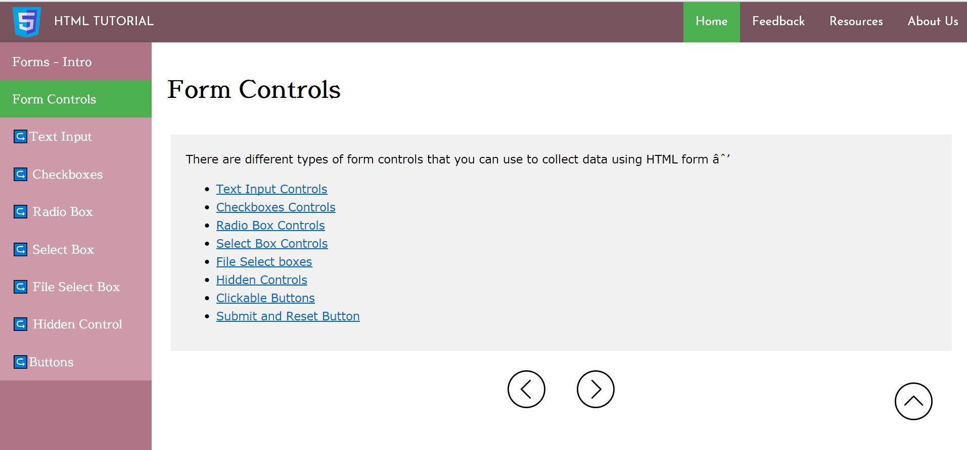
There are two nav-bars i.e., horizontal nav-bar and vertical nav-bar and a target window where the contents are displayed.

Slide 5
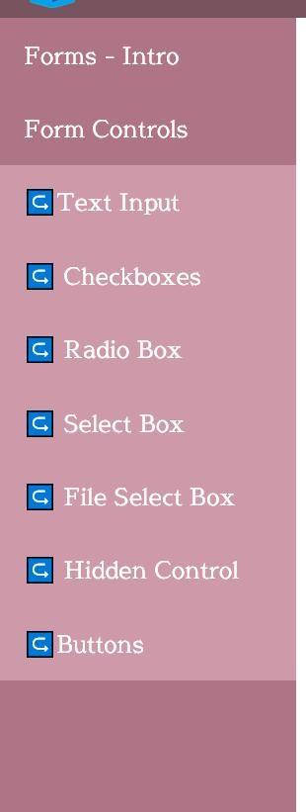
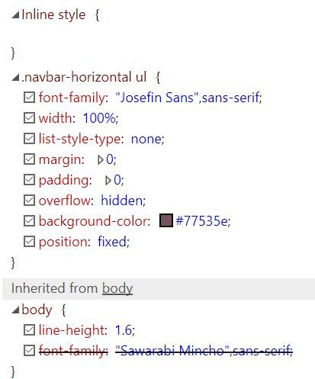
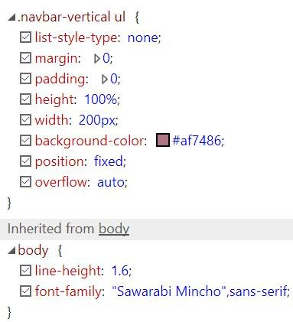
The navigation bars are present in all the pages.
Horizontal nav-bar:
Vertical nav-bar:

Slide 6



The buttons used to scroll the page up and to go to the previous and next page.Those are actually images which works as buttons.
Next button:
Previous button:
Top button:

Slide 7
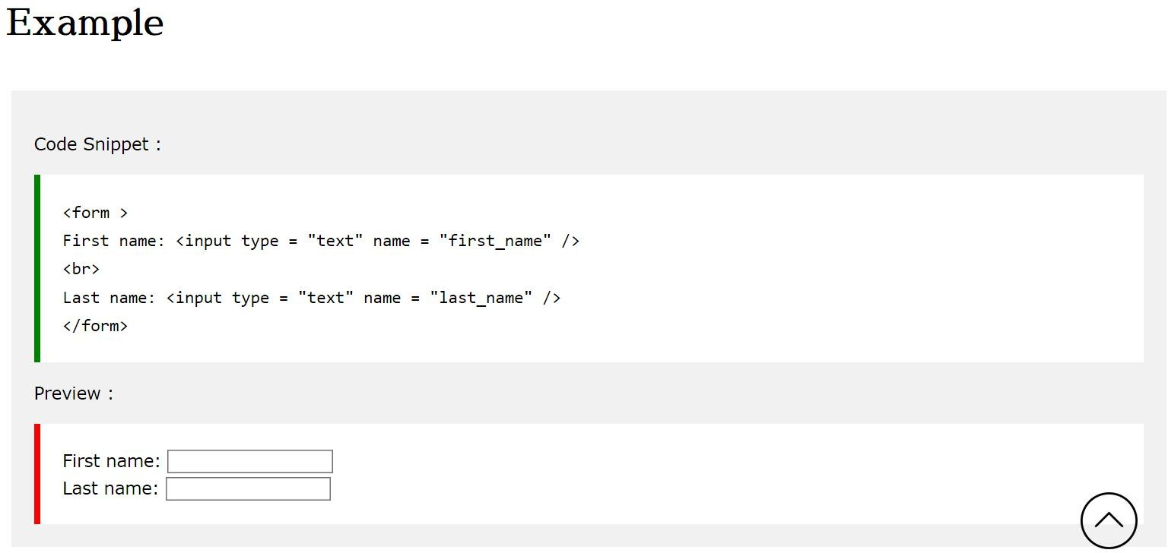
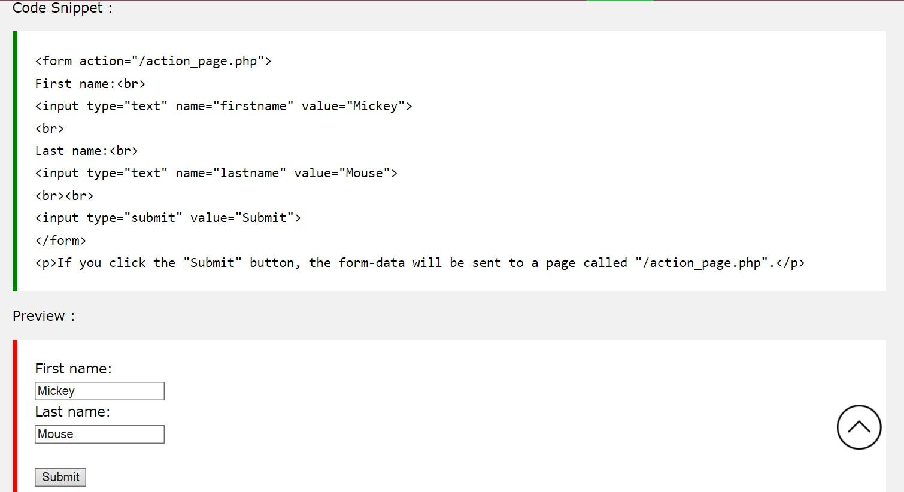
This is the Code snippet, Preview and the tables of each page.

Slide 8
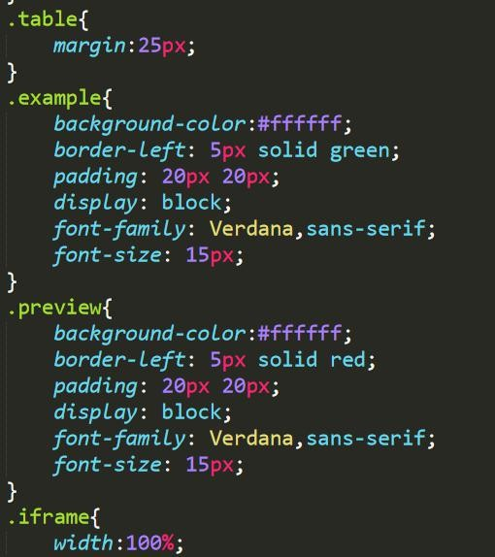
The css part of example, preview and table.

Slide 9
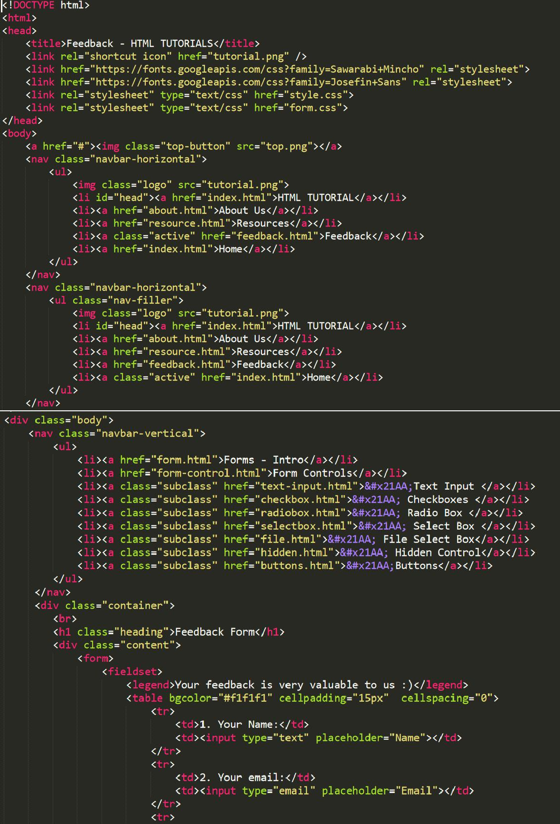
The feedback page is designed using the form tag in html. The data provided by the client was forwarded to the server using the path specified in the action attribute.

Slide 10
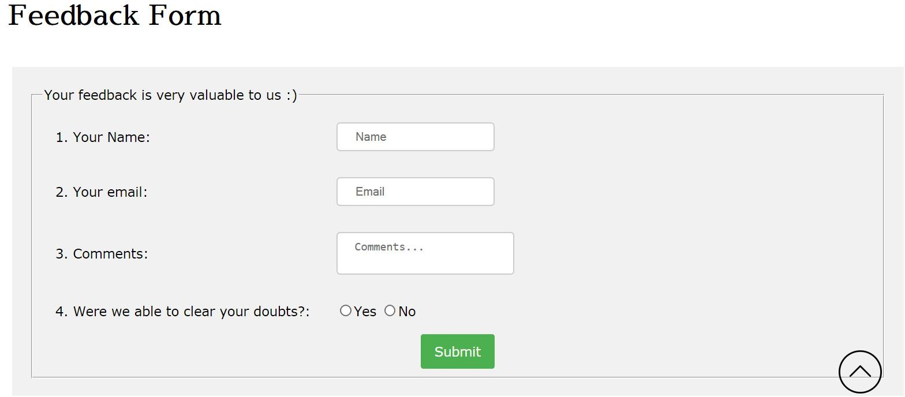
This is the feedback form where the user can give his reviews.

Slide 11
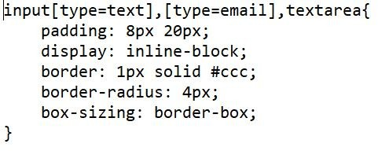
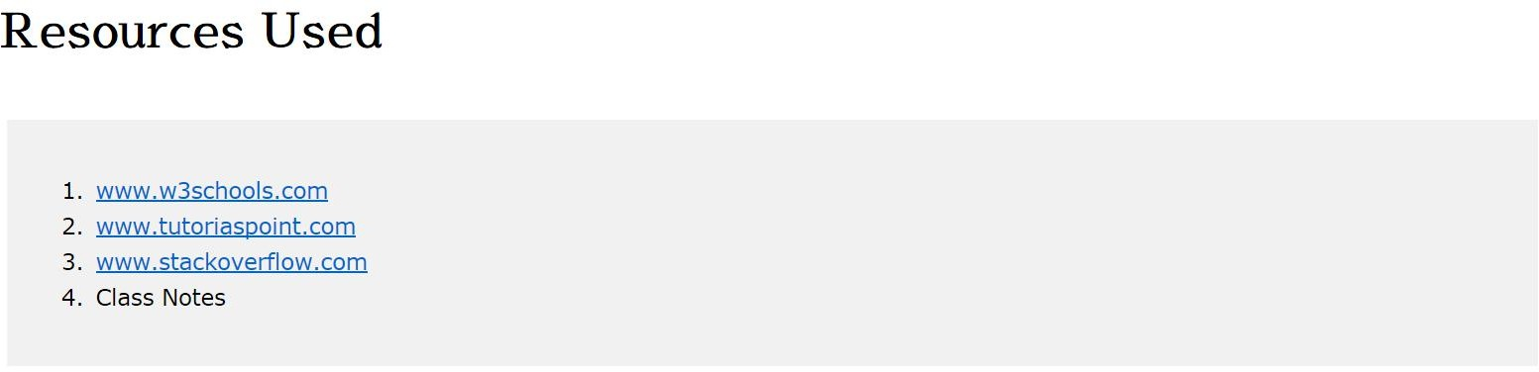
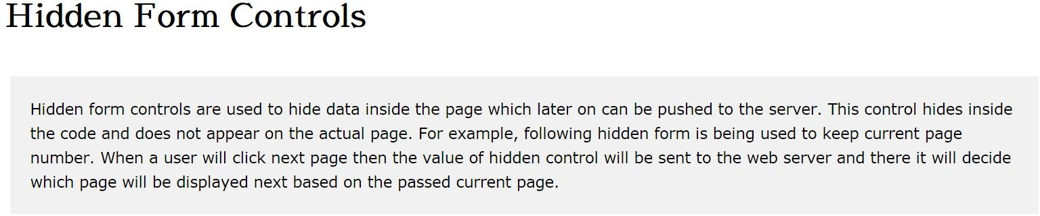
Css is used to make the website more colorful and attractive.The document content of Css is separated from that of Html.
Contents:

Slide 12
Thank You

